Slide 1
Preventing Radicalization
in
Aarhus
Mayor Jacob Bundsgaard
1
Notes:
1

Slide 2
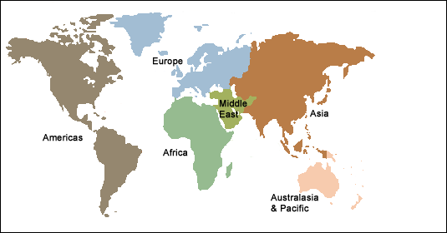
FRAMEWORK

Slide 3
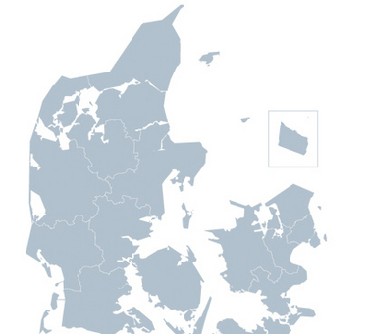
FRAMEWORK
Population Aarhus Municipality: 330,000
The City of Aarhus is the
2nd largest city in Denmark.
Largest disadvantaged
area in Denmark is
located in Aarhus.
AARHUS
COPENHAGEN

Slide 4
PREVENTING VIOLENT EXTREMISM
POLICING
Surveillance, prosecution – Intelligence Service
Investigation, prosecution – the enforcing police departments
PREVENTING
3. Prevention and early intervention – multi-agency collaboration with city authorities, police and neighborhood representatives.

Slide 5
CRIME PREVENTION

Slide 6
EARLY PREVENTION AND COMMUNITY WORK
Protective factors
Inclusion in society/community
Purpose and meaning in life
Identity
Care and resilience
Positive group dynamics
Life skills
In general /
Self-sufficient
Specifically /
In need of help
Workshop to raise
awareness
Individually /
Risk factors
Push
Exclusion
Poor living conditions
Personal or social crisis
Frustration, intolerance
Recruitment
Isolation
Pull
Respect
Acceptance
Purpose and meaning in life
Identity
Mentors
Presentation to raise
awareness
Intervention
Surveys and
risk assessment
Seminars
for the general public and for professionals
EXIT
Infohouse
Parent networks
Contingency for Syrian volunteers

Slide 7
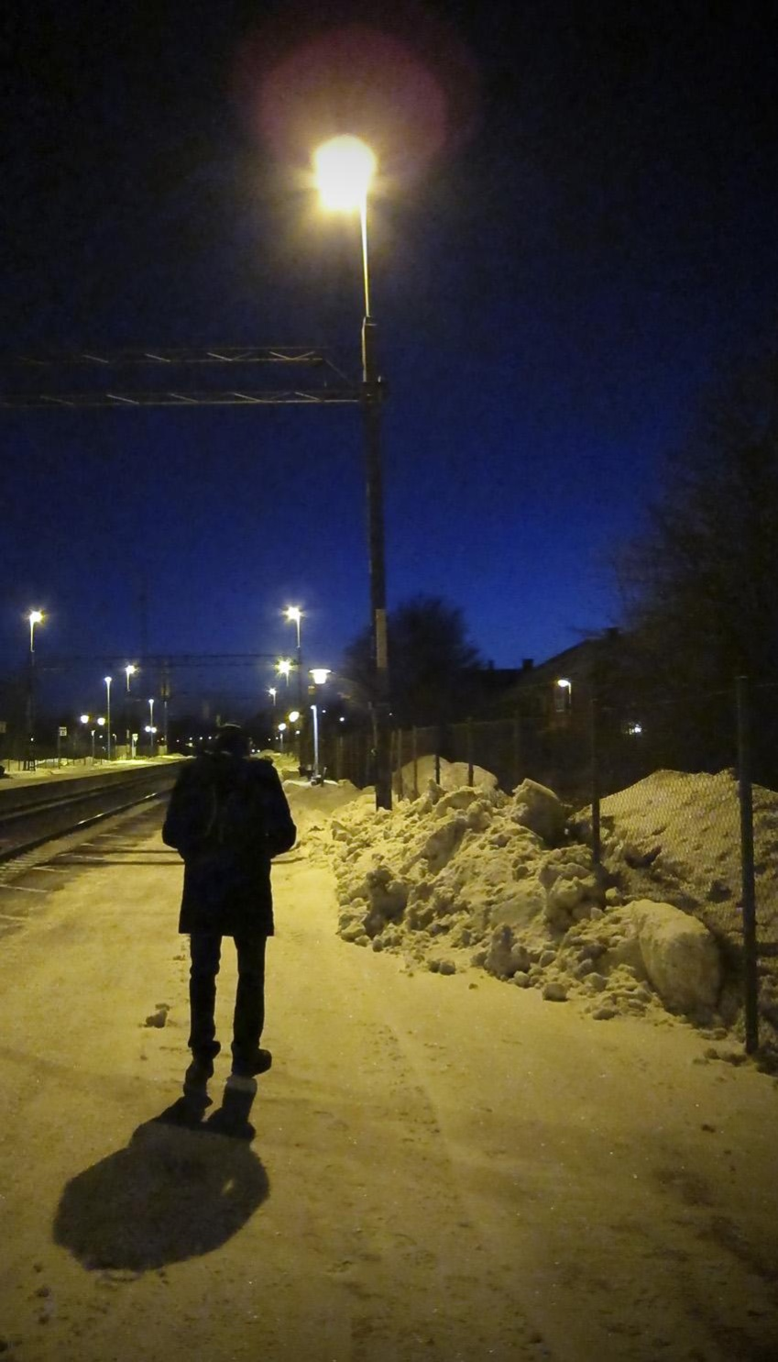
SEARCHING FOR MEANING

Slide 8
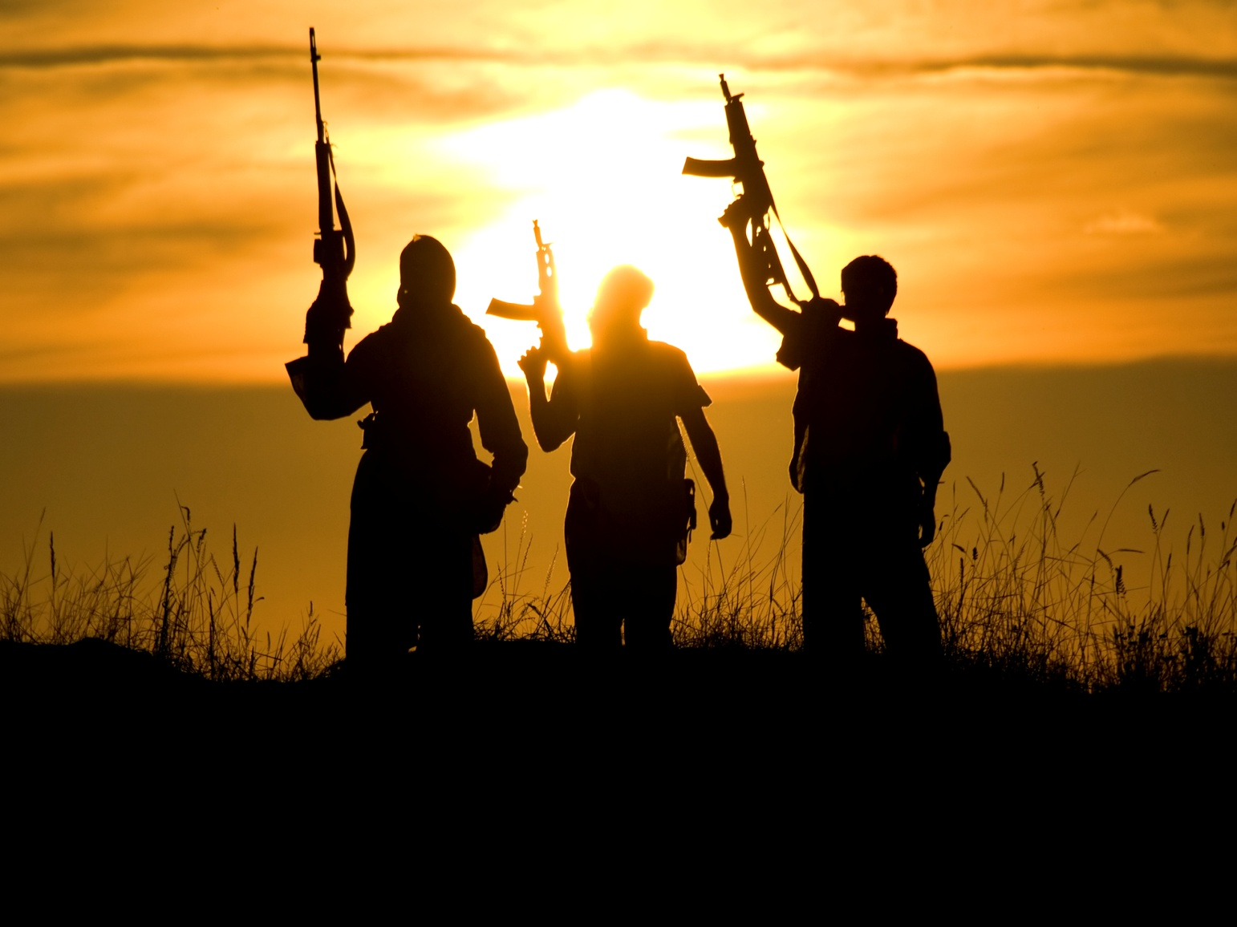

Slide 9
EXPERIENCE SO FAR

Slide 10
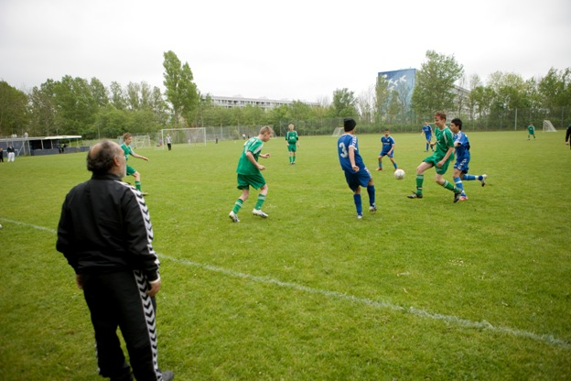
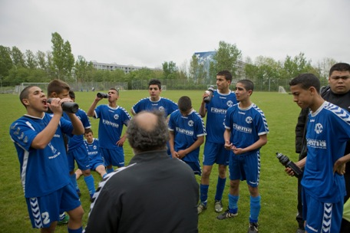
A MEANINGFUL LIFE

