Slide 1
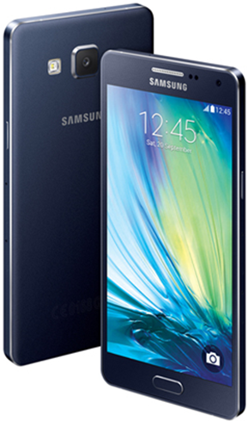
BT Mobile Launch Portfolio
 |  |  | All Rounders |  |  |  |  |  | Premium
 |  |  | Samsung Galaxy A3 (2016) | iPhone 5S 16GB | Sony M4 Aqua | Samsung Galaxy A5 | iPhone SE 16GB |  | iPhone SE 64GB | Samsung Galaxy S6 | Sony X | Samsung Galaxy S7 | Samsung Galaxy S7 Edge | iPhone 6 |  | iPhone 6 Plus |  | iPhone 6S |  |  | iPhone 6S Plus
 |  |  |  |  |  |  |  |  |  |  |  |  |  | 16GB | 64GB | 16GB | 64GB | 16GB | 64GB | 128GB | 16GB | 64GB | 128GB
Plan 1 | 400 mins Unl SMS 500MB |  | £20 per month / £25 non-BT |  |  |  |  |  | £31 per month / £36 non-BT
 |  |  | Free | Free | £35 upfront | £50 upfront | £140 upfront |  | £30 upfront | Free | £100 upfront | £100 upfront | £210 upfront | £50 upfront | £110 upfront | £110 upfront | £250 upfront | £150 upfront | £250 upfront | £350 upfront | £230 upfront | £350 upfront | £430 upfront
Plan 2 | 1,000 mins Unl SMS 2GB |  | £25 per month / £30 non-BT |  |  |  |  |  | £36 per month / £41 non-BT
 |  |  | £25 upfront | Free | £10 upfront | £25 upfront | £50 |  | Free | Free | £50 upfront | £50 upfront | £160 upfront | £9 upfront | £80 upfront | £80 upfront | £150 upfront | £100 upfront | £150 upfront | £260 upfront | £230 upfront | £250 upfront | £385 upfront
Plan 3 | Unl mins Unl SMS 15GB |  | £35 per month / £40 non-BT |  |  |  |  |  | £46 per month / £51 non-BT
 |  |  | £25 upfront | Free | Free | Free | £50 |  | Free | Free | Free | £10 upfront | £110 upfront | £9 upfront | £40 upfront | £40 upfront | £100 upfront | £50 upfront | £100 upfront | £210 upfront | £100 upfront | £210 upfront | £250 upfront
Launch Special Offers:
iPhone 6
16GB
Samsung
A3
Samsung
S6
Stunning iPhone 6. Incredible deal.
Save £15 for the first 3 months
Half price for first 6 months
Half price for first 3 months.

