Slide 1
Stockholm Economy Q4 2016 March 2017

Slide 2
Stockholm Economy Q4 2016
Positive figures for Stockholm During the fourth quarter 2016 Stockholm’s economic growth continued. Aggregated gross pay data show positive growth figures both for Stockholm County and the City of Stockholm compared to the same quarter 2015. In total 6 724 new companies were registered in Stockholm County during the fourth quarter of 2016, whereof the City of Stockholm accounted for 4 001. This represents a minor increases for both the county and the city compared to the fourth quarter 2015.
During the last quarter the number of persons employed increased as did the number of listed positions. The largest percentage increase of listed positions were in the information and communication sector followed by the construction sector. The number of people given notice however increased rapidly in both Stockholm county and in the city. The unemployment rate continued to decrease both in Stockholm County and the City of Stockholm compared to the same quarter in 2015. The last four quarters the number of residents has increased by 37 600 in Stockholm County, of which the City of Stockholm accounted for 12 100, representing a 1,7 % increase for the county and 1,3 % for the city.
The number of housing projects increased in both the county and the City of Stockholm in relation to the same quarter last year. In total, construction of 19 400 apartments were started in Stockholm County during the last four quarters, whereof about 7 500 in the City of Stockholm.
Olle Zetterberg
CEO Stockholm Business Region
About the report
The report is published each quarter by Stockholm Business Region.
The report includes Stockholm County and the City of Stockholm.
Statistics used is collected from Statistics Sweden, The Labour Exchange and The Swedish Companies Registration Office.
The report can be downloaded from:
http://www.stockholmbusinessregion.se/en/facts--figures/#facts-about-business
The Stockholm Region is defined as Stockholm County, Uppsala County, Södermanland County, Östergötland County, Örebro County, Västmanland County, Gävleborg County and Dalarna County. Individual county reports for the above mentioned can be found in Swedish here: http://www.stockholmbusinessalliance.se/konjunkturrapporter/
Questions can be addressed to Stefan Frid at Invest Stockholm. Publisher: Olle Zetterberg.

Slide 3
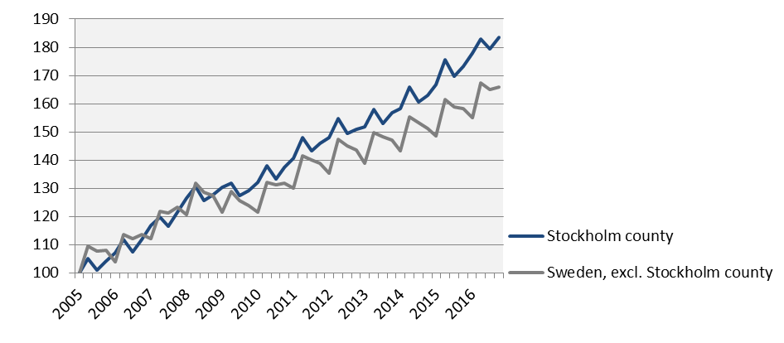
Economic growth, private sector Index 100 = 2005 Q1
 | 2016 Q4 | Change (%) since,
 | Billion cr. | 2005 Q1 | 2010 Q1 | 2015 Q4
Sweden | 304,9 | 71,4 | 37,4 | 5,2
Stockholm Region | 156,3 | 77,1 | 37,9 | 5,5
Stockholm county | 101,5 | 83,6 | 39,0 | 6,0
City of Stockholm | 66,0 | n.d. | 40,0 | 5,2
Sweden, excl. Stockholm county | 203,4 | 65,8 | 36,6 | 4,8
Source: Statistics Sweden

Slide 4
Economic growth, 2016 Q4
 | Stockholm county |  |  |  |  | City of Stockholm
 |  | Growth (%) since, |  |  |  |  | Growth (%) since,
 | Billion cr. | 2009 Q1 | 2010 Q1 | 2015 Q4 |  | Billion cr. | 2009 Q1 | 2010 Q1 | 2015 Q4
Total | 123,6 | 39,5 | 37,7 | 5,9 |  | 76,7 | 40,1 | 38,0 | 5,3
Agriculture, forestry & fishing | 0,2 | 56,3 | 38,0 | -0,7 |  | 0,0 | 127,7 | 49,4 | -1,2
Manufacturing, mining, quarrying & utilities | 8,8 | 7,5 | 11,6 | 3,3 |  | 4,2 | 11,6 | 11,9 | 2,0
Energy & Environment | 1,1 | 42,4 | 40,6 | 3,7 |  | 0,5 | -12,6 | -1,9 | 0,7
Construction | 7,8 | 75,5 | 70,0 | 7,1 |  | 3,8 | 96,9 | 114,2 | 8,3
Trade | 15,9 | 33,6 | 27,8 | 4,6 |  | 9,0 | 38,5 | 30,3 | 3,9
Transport | 5,4 | 24,8 | 20,6 | 3,8 |  | 2,4 | 23,7 | 17,0 | 1,6
Accommodation & food services | 3,6 | 95,1 | 81,4 | 5,4 |  | 2,6 | 94,2 | 82,5 | 5,9
Information & communication | 12,3 | 31,4 | 35,9 | 9,1 |  | 9,8 | 32,6 | 37,6 | 5,5
Financial & insurance | 8,2 | 2,0 | 4,1 | 4,5 |  | 6,4 | -2,1 | 0,0 | 3,1
Real Estate | 2,3 | 66,1 | 60,5 | 4,3 |  | 1,6 | 62,1 | 58,6 | 4,8
Business services | 20,5 | 62,5 | 62,0 | 8,0 |  | 16,1 | 62,1 | 62,0 | 7,4
Public administration | 0,1 | 47,5 | 33,5 | 6,6 |  | 0,1 | 29,9 | 22,1 | 0,3
Education | 3,0 | 71,4 | 62,8 | 8,2 |  | 1,7 | 74,1 | 66,5 | 8,1
Health | 7,8 | 81,7 | 62,8 | 5,7 |  | 4,5 | 78,2 | 56,8 | 5,1
Personal & cultural services | 4,2 | 54,2 | 47,4 | 4,3 |  | 3,1 | 51,7 | 44,3 | 4,7
Unspecified | 0,3 | 46,1 | 73,6 | 0,9 |  | 0,1 | 54,2 | 22,6 | -1,1
Private sector | 101,5 | 40,9 | 39,0 | 6,0 |  | 66,0 | 41,6 | 40,0 | 5,2
State | 8,6 | 37,6 | 34,2 | 3,2 |  | 6,0 | 32,9 | 28,0 | 3,8
Municipal | 10,3 | 32,8 | 31,0 | 8,3 |  | 3,9 | 29,6 | 26,8 | 8,7
County council | 3,3 | 24,8 | 31,6 | 5,2 |  | 0,9 | 32,3 | 20,4 | 5,5
Public sector | 22,2 | 33,3 | 32,3 | 5,8 |  | 10,7 | 31,6 | 26,9 | 5,6
Source: Statistics Sweden

Slide 5
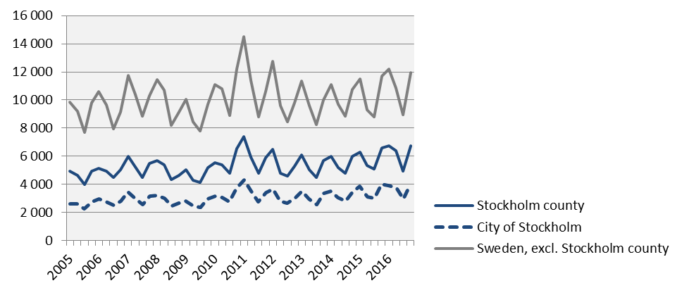
The number of newly registred businesses
 | 2016 Q4 |  | Yearly change*
 | Number | Ch., % | Number | Ch., %
Sweden | 18 691 | 2,2 | 68 793 | 6,4
Stockholm Region | 9 816 | 1,2 | 36 411 | 6,2
Stockholm county | 6 724 | 2,0 | 24 808 | 6,5
City of Stockholm | 4 001 | 0,1 | 14 666 | 5,0
Sweden, excl. Stockholm county | 11 967 | 2,3 | 43 985 | 6,4
*Last four quarters
Source: The Swedish Companies Registration Office.

Slide 6
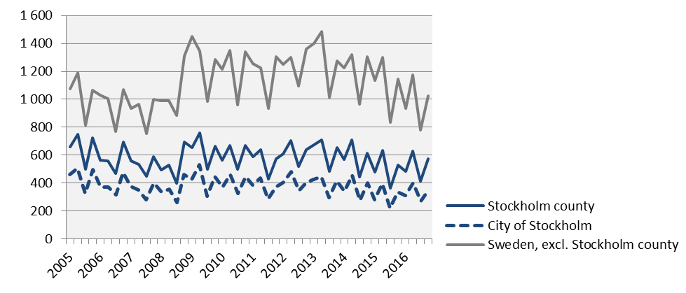
Company bankruptcies
 | 2016 Q4 |  | Yearly change*
 | Number | Ch., % | Number | Ch., %
Sweden | 1 596 | -4,8 | 6 019 | -6,3
Stockholm Region | 844 | 3,9 | 3 090 | -2,4
Stockholm county | 573 | 8,1 | 2 103 | 4,8
City of Stockholm | 350 | 3,2 | 1 336 | 7,5
Sweden, excl. Stockholm county | 1 023 | -10,7 | 3 916 | -11,4
*Last four quarters
Source: Statistics Sweden

Slide 7
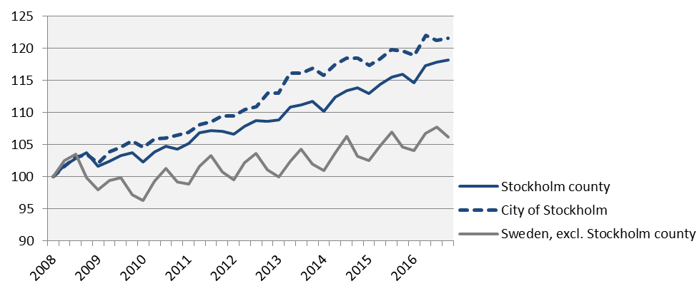
Employment Index 100 = 2008 Q1
 | Number | Growth | Growth (%) since,
 | 2016 Q4 | Yearly ch.* | 2008 Q1 | 2010 Q1 | 2015 Q4
Sweden | 4 920 900 | 73 600 | 8,9 | 11,5 | 1,5
Stockholm Region | 2 253 700 | 33 500 | 11,8 | 12,5 | 1,5
Stockholm county | 1 209 800 | 21 800 | 18,1 | 15,5 | 1,8
City of Stockholm | 529 300 | 9 000 | 21,6 | 16,3 | 1,7
Sweden, excl. Stockholm county | 3 711 100 | 51 800 | 6,1 | 10,3 | 1,4
*Last four quarters
Source: Statistics Sweden

Slide 8
The number of employed people in Stockholm County
 | Number | Growth | Growth (%) since,
 | 2016 Q4 | Yearly ch.* | 2008 Q1 | 2010 Q1 | 2015 Q4
Total | 1 209 800 | 21 800 | 18,1 | 15,5 | 1,8
Agriculture, forestry & fishing | n.d. | n.d. | n.d. | n.d. | n.d.
Manufacturing, mining, quarrying & utilities | 59 200 | -200 | 1,7 | 1,4 | -0,3
Manufacturing of workshop products | 27 400 | -1 700 | -4,2 | -8,7 | -5,8
Construction | 69 000 | 4 400 | 15,0 | 21,5 | 6,8
Trade | 139 800 | -2 400 | 4,0 | 9,9 | -1,7
Transport | 59 900 | 2 500 | 12,8 | 9,9 | 4,4
Accommodation & food services | 49 600 | 1 900 | 38,5 | 33,7 | 4,0
Information & communication | 96 600 | 8 500 | 26,4 | 22,0 | 9,6
Arts, entertainment, recreation & other services | 71 000 | 1 100 | 13,6 | 10,9 | 1,6
Financial & insurance | 306 100 | 2 400 | 27,0 | 19,1 | 0,8
Public administration | 79 900 | 2 200 | 23,1 | 11,7 | 2,8
Education | 125 200 | -1 700 | 19,2 | 13,5 | -1,3
Health | 145 400 | 6 800 | 17,2 | 18,4 | 4,9
Unspecified | n.d. | n.d. | n.d. | n.d. | n.d.
Employed in Sweden | 1 206 100 | 23 500 | 18,2 | 15,6 | 2,0
Employed abroad | 3 600 | -1 800 | 5,9 | -2,7 | -33,3
Source: Statistics Sweden
*Last four quarters

Slide 9
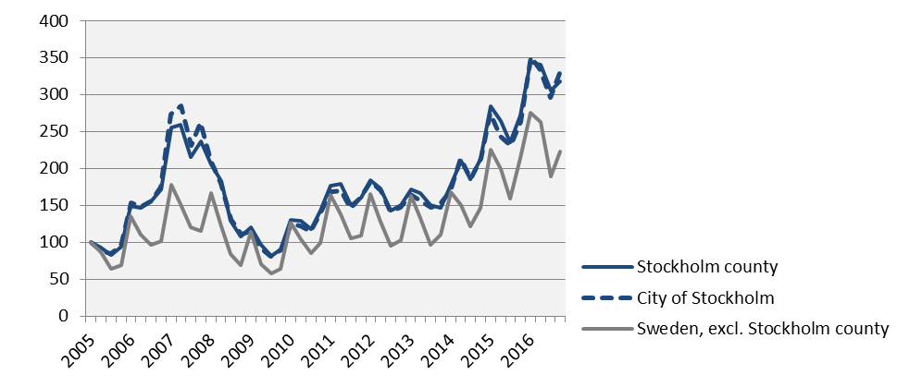
Number of recently listed positions Index 100 = 2005 Q1
 | 2016 Q4 |  | Yearly growth*
 | Number | Ch., % | Number | Ch., %
Sweden | 308 239 | 7,9 | 1 299 710 | 20,6
Stockholm Region | 153 659 | 12,4 | 636 583 | 21,3
Stockholm county | 96 398 | 17,3 | 396 662 | 23,9
City of Stockholm | 67 103 | 25,8 | 265 545 | 29,6
Sweden, excl. Stockholm county | 211 841 | 4,1 | 903 048 | 19,2
*Last four quarters
Source: The Labor Exchange

Slide 10
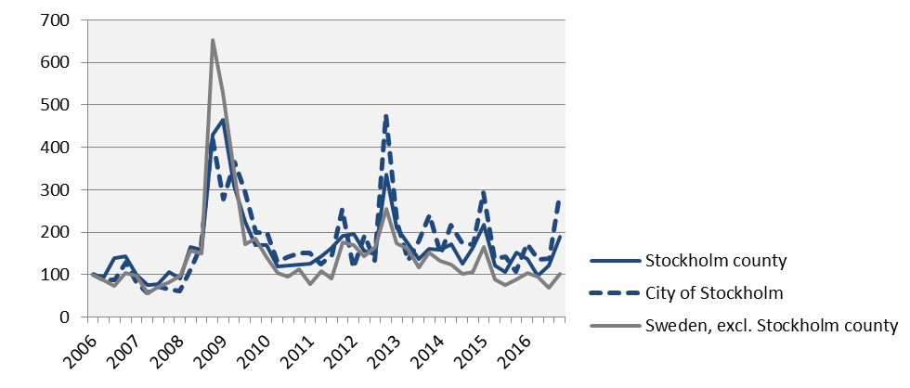
The number of people given notice Index 100 = 2006 Q1
 | 2016 Q4 |  | Yearly change*
 | Number | Ch., % | Number | Ch., %
Sweden | 11 454 | 18,2 | 38 587 | -10,6
Stockholm Region | 5 961 | 18,4 | 18 796 | -13,2
Stockholm county | 3 829 | 23,8 | 11 006 | -8,9
City of Stockholm | 2 532 | 166,2 | 6 473 | 7,7
Sweden, excl. Stockholm county | 7 625 | 15,5 | 27 581 | -11,2
*Last four quarters
Source: The Labor Exchange

Slide 11
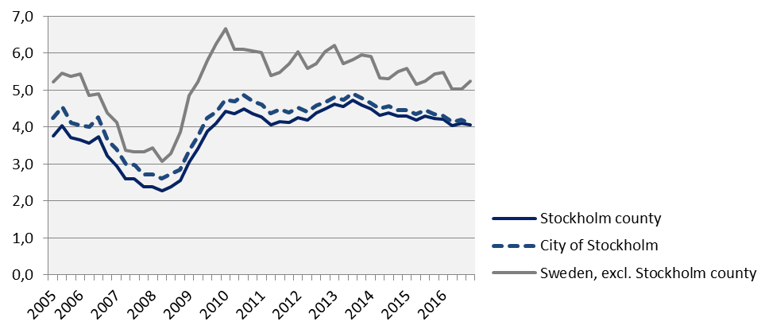
Unemployment in relation to the population (%), 15-74 years
 | Number | Yearly | Unemployed out of population, 15-74 years
 | 2016 Q4 | change* | 2010 Q1 | 2015 Q4 | 2016 Q4
Sweden | 366 390 | -9 662 | 6,2 | 5,2 | 5,0
Stockholm Region | 160 099 | -3 557 | 5,7 | 5,0 | 4,8
Stockholm county | 68 760 | -1 987 | 4,4 | 4,2 | 4,1
City of Stockholm | 29 426 | -1 442 | 4,7 | 4,4 | 4,1
Sweden, excl. Stockholm county | 297 629 | -7 676 | 6,7 | 5,4 | 5,2
*Last four quarters
Source: The Labor Exchange and Statistics Sweden

Slide 12
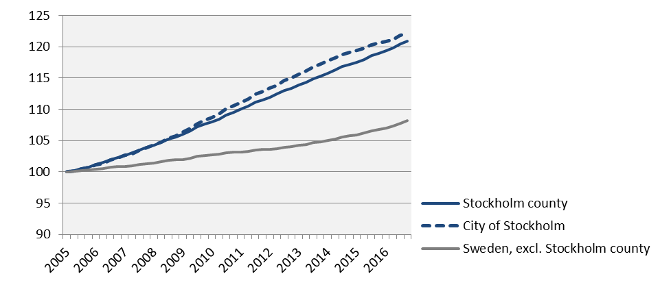
Population Index 100 = 2005 Q1
 | 2016 Q4 | Yearly ch.* | Growth (%) since,
 | (in thousands) |  | 2005 Q1 | 2010 Q1 | 2015 Q4
Sweden | 9 995,2 | 144,1 | 10,9 | 6,8 | 1,5
Stockholm Region | 4 502,3 | 69,2 | 14,2 | 8,8 | 1,6
Stockholm county | 2 269,1 | 37,6 | 20,9 | 12,0 | 1,7
City of Stockholm | 935,6 | 12,1 | 22,1 | 12,4 | 1,3
Sweden, excl. Stockholm county | 7 726,1 | 106,5 | 8,2 | 5,4 | 1,4
*Development last four quarters
Source: Statistics Sweden

Slide 13
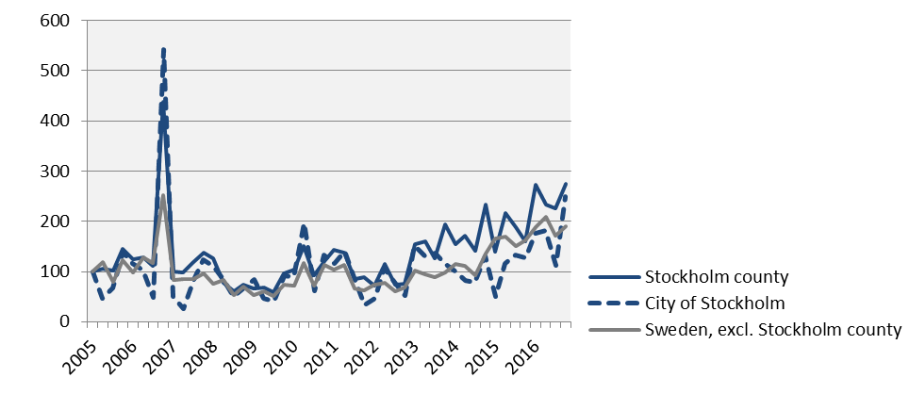
Number of housing projects started Index 100 = 2005 Q1
 | 2016 Q4 |  | Yearly change*
 | Number | Ch., % | Number | Ch., %
Sweden | 19 153 | 29,7 | 74 490 | 23,0
Stockholm Region | 7 724 | 25,0 | 31 872 | 21,4
Stockholm county | 5 303 | 71,6 | 19 417 | 43,0
City of Stockholm | 2 599 | 96,7 | 7 502 | 68,3
Sweden, excl. Stockholm county | 13 850 | 18,6 | 55 073 | 17,2
*Last four quarters
Source: Statistics Sweden

Slide 14
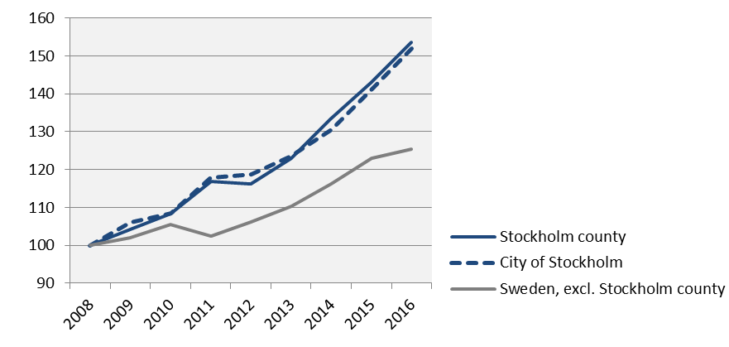
Commercial Accommodations Index 100 = 2008 Q4 (Q4, 2008 - 2016)
 | 2016 Q4 | Yearly ch.* | Growth (%) since,
 | (in thousands) |  | 2008 Q4 | 2010 Q4 | 2015 Q4
Sweden | 10 124 | 61 862 | 33,0 | 25,2 | 3,7
Stockholm Region | 4 898 | 25 630 | 30,4 | 23,7 | 3,4
Stockholm county | 3 129 | 13 506 | 53,6 | 41,8 | 7,4
City of Stockholm | 2 145 | 9 080 | 52,0 | 40,1 | 7,7
Sweden, excl. Stockholm county | 6 995 | 48 356 | 25,5 | 19,0 | 2,1
*Development last four quarters
Source: Statistics Sweden and Swedish Agency for Economic and Regional Growth

Slide 15
Stockholm Business Region Stockholm Business Region is responsible for developing and promoting Stockholm as a business and tourist destination under the brand Stockholm - The Capital of Scandinavia. The aim is to make Stockholm the leading sustainable growth region in Europe. Stockholm Business Region is owned by the city of Stockholm and has two subsidiaries Invest Stockholm and Visit Stockholm. For questions: Contact Stefan Frid, Invest Stockholm. Publisher: Olle Zetterberg, CEO Stockholm Business Region Stockholm Business Region P.O. Box 16282 SE-103 25 Stockholm, Sweden Phone + 46 8 508 280 00 www.visitstockholm.com www.investstockholm.com www.stockholmbusinessregion.se

