Slide 1
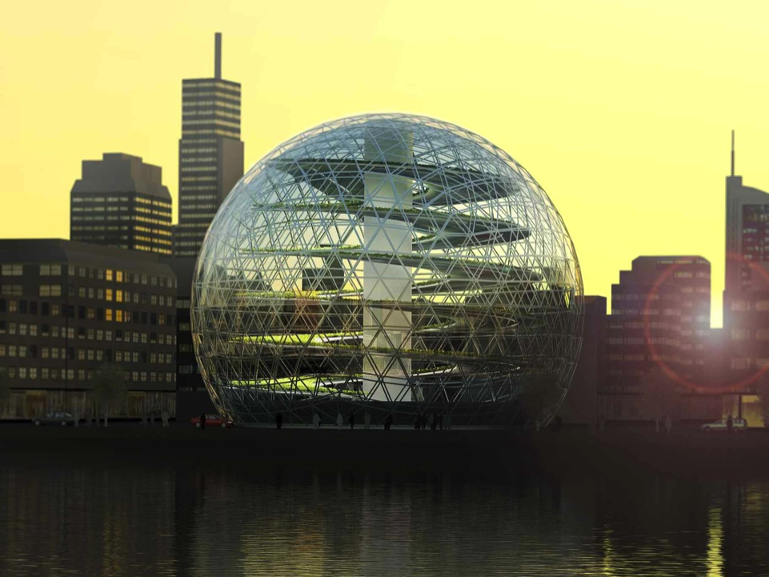

BUSINESS AS USUAL IS OVER
Stockholm • Onondaga Nation • New York • New Delhi

Slide 2
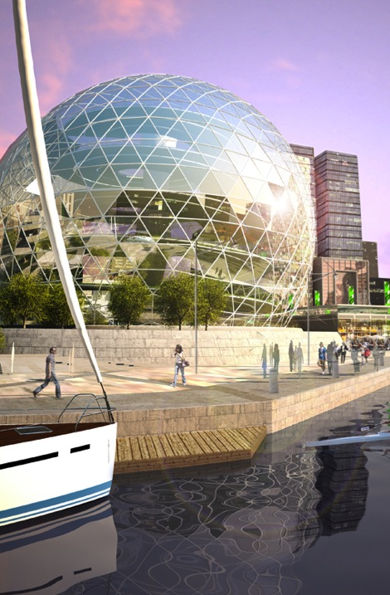


The Vertical Greenhouse
A complete solution within Urban Agriculture
Available in sizes from 36 diameter to 142 diameter
Producing and selling organic food inside cities
LEED-certified. Latest cleantech solutions secures energy efficiency and recycling of water and waste

Slide 3
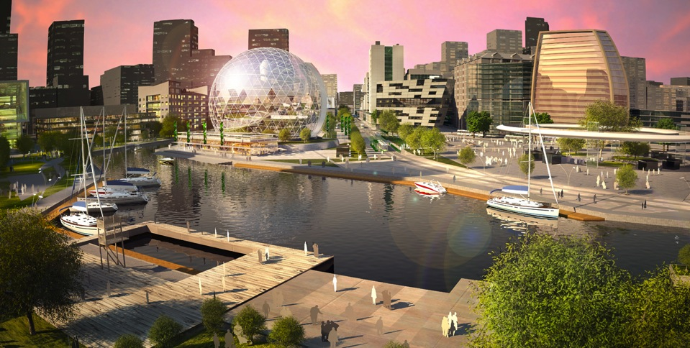
Advantages
Sustainability landmark
Locally grown, organic food
Food security in a world with sharply rising food prices
Decreased CO₂-emissions by up to 100 000 ton/year by cutting transportation and consuming CO₂ in the greenhouse
Lower costs by cutting middle hands, selling directly to the consumer
Better land use. 3-10 more crops per square meter
Profitable solution. Payback period of 3-5 years.
Increases the price of surrounding properties

Slide 4
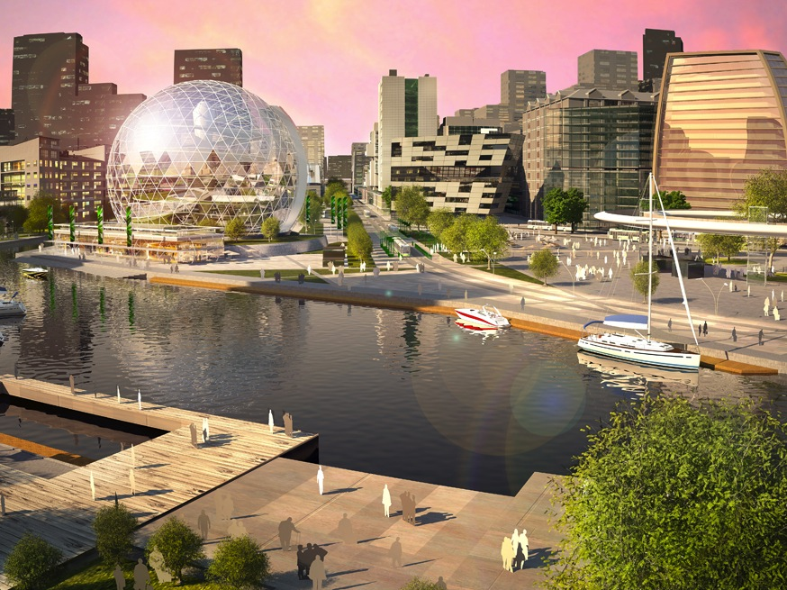
Business Case Vertical Greenhouse Singapore (36 meter)
Industrializing the agriculture
Like in any industry it takes a higher initial investment to reach the lower operating costs that the automatic solution brings
Investments: | Enginering | 6 MSEK
 | Construction | 40 MSEK
 | Land | 10 MSEK
Total: |  | 56 MSEK
Real cost of capital: |  | 12%
Pay-back time: |  | 4.8 years
NPV: | 2011-2051 | 36 MSEK
IRR: | 2011-2051 | 20.8%
Additional revenue sources:
Emission rights (CER/VER)
Selling the name of the greenhouse to a corporation
Rental
Commission from local farmers selling their organic food on the marketplace
Commission from suppliers testing their solutions
Visitors

Slide 5
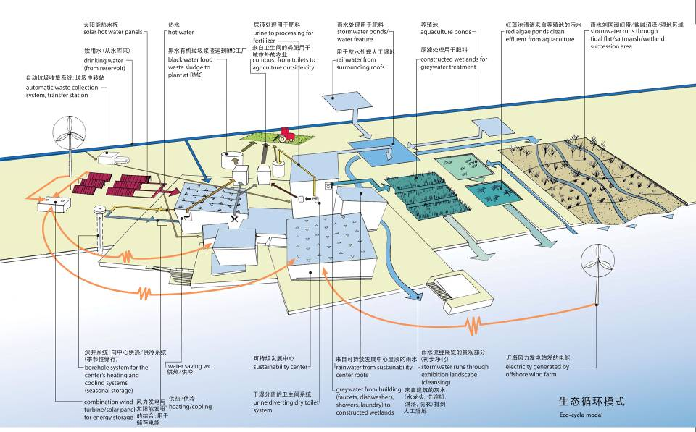

Integrated into the existing utility infrastructure of the city
Every city produces large amounts of surplus heat, creates carbon dioxide spillage and waste.
Instead of getting rid of it we can put it to good use. Creating food out of waste and at the same time decreasing energy costs and emissions

Slide 6
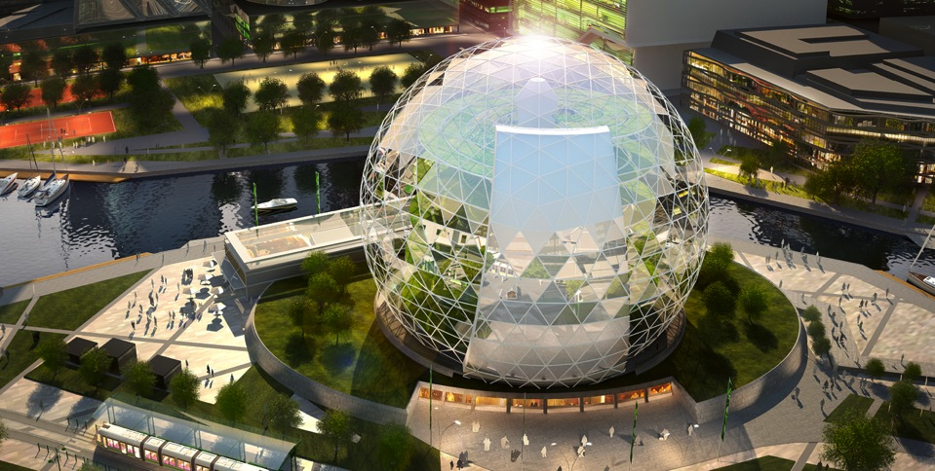
Creating a sustainability center in the city
Selling the organic food produced by the greenhouse
Cooperating with local farmers, offering a complete organic market place
Restaurants, cafés and deli shops
Recreation- and health center
Information about environmental initiatives in the city and its progress
Educational center

Slide 7
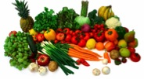





Success story from Linköping
Values: R&D, Attraction, Environment, Store → Growth!
Surplus heat from gas purifying plant provide for several hectares greenhouse. Peak heating and backup from district heating
Carbon dioxide spillage from gas purification can be directed to the green house.
Biogas production plant delivers nutrients
Organic waste from greenhouse to bio gas production
Besides locally produced food the system generates other values
H₂O
Light
Electricity
Locally
Produced
food
Nitrogen
Phosphorus
Potassium
CO₂
Heating
Organic
waste
Biogas
Power & heating
Nitrogen
Phosphorus
Potassium
Heating
Vehicle gas
Electricity

Slide 8
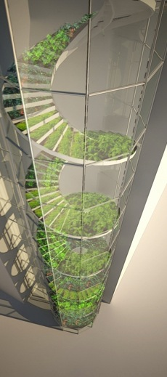
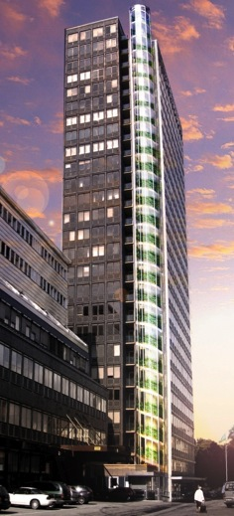
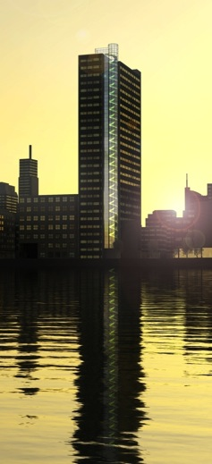
Available in different designs…
…in order to (retro)fit existing buildings

Slide 9
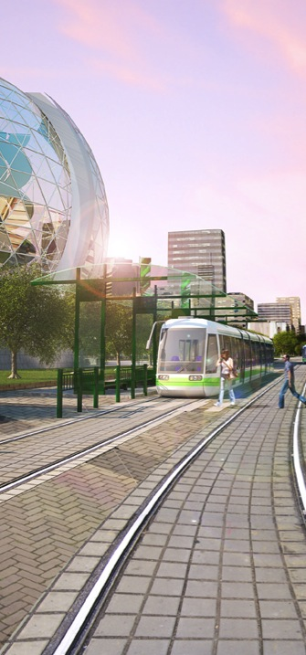
About Plantagon
Global Brand leader within Urban Agriculture
Ongoing projects in Sweden, Singapore and India
Partner with SWECO, international consulting company within sustainable engineering and design. 5300 employees and projects in more than 100 countries
Selected partner to SymbioCity. Initiative of the Swedish Government and Swedish Industry
Strong Advisory Board lead by Mats Hellström, Former Minister of Foreign Trade, European and Nordic Affairs and Agriculture
Awards & recognitions:
  Selected to the Swedish Pavilion during World Expo Shanghai
  Globe Forum Innovation Idol 2009
  Globe Award Nominee 2010 & 2011
  Katerva Challenge Nominee 2010
  Swedish American Green Alliance 2010
  Red Herring Europe Top 100 Winner
  House of Sweden, Washington DC 2011

