Slide 1
How Money Can Change the State of the World? How Can it Not?
Julia Vol,
Worldwatch Institute Europe Manager

Slide 2
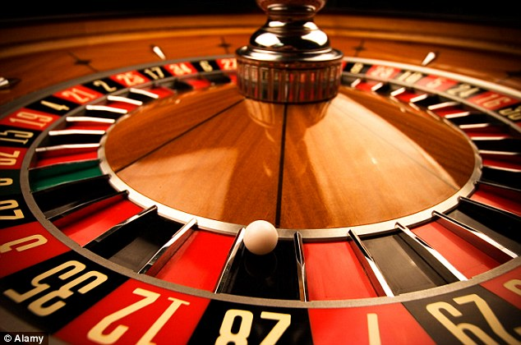
"We need a system that goes beyond the casino economy” Tim Jackson, 2015

Slide 3
Linear economic model – High Risk while missing on Great Opportunities
Growing Risks
Missed opportunities
Growth in population, world’s middle-class and demand for manufactured goods vs. resource scarcity
80% of waste from consumer goods ends up in incineration, landfills or waste water (Ellen MacArthur F. 2014)
Climate change, environmental
degradation, pollution, water
contamination – will cost €28
trillion by 2050 (UN, 2015).
Every day we are losing the equivalent
of $3-4 billion worth of materials (McKinsey, 2014).
Climate refugees, social injustice,
armed conflicts - Can we put a price
of social impacts of our current system?
Shifting towards circular economic model
will add €1tn to the global economy
by 2025 and create 100,000 new
jobs over the next 5 years (McKinsey, 2015)

Slide 4
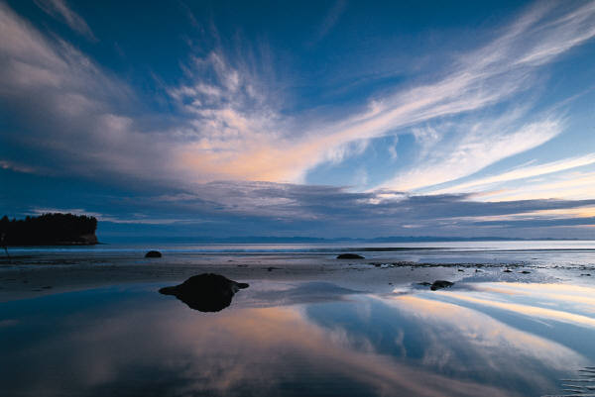
Imagining an alternative reality and a different economic future is the real challenge

Slide 5
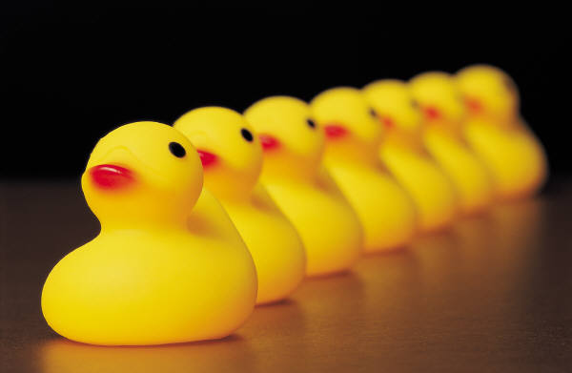
The good news is that we don’t really have a choice
The current economic system doesn’t serve our needs anymore
Growing body of evidence that
transition makes economic sense
The frontrunners wait for no one,
setting new rules of the game

Slide 6
What is the role of financial institutions
– enablers or barriers for change?
Building financial capacity for transformation is still one of the main barriers for transition towards more sustainable and circular economy. How can we convince the financial sector that this is the way to go?
How can we engage the financial sector in helping us address old problems with innovative solutions?

Slide 7
Contact:
Worldwatch Institute Europe
www.worldwatch-europe.org
Julia Vol
E: jvol@worldwatch-europe.org

