Slide 1
Content Marketing
Presentation at Procomm Day 2011, Helsinki by @jonobean,
Notes:
LOVELY TO BE IN FINLAND – I WAS INVOLVED IN THE EARLY DEVELOPMENT OF ONLINE PR TOOLS OVER 10 YEARS AGO AND WE ALWAYS LOOKED TOWARDS THE FINNISH MARKET FOR THEIR INSIGHT INTO THE EARLY ADOPTION OF TECHNOLOGY AS COMMUNICATORS
WHO ARE FROM AGENCIES
WHO ARE FROM COMPANIES
WHO WOULD CLASSIFY THEMSELVES AS MARKETERS
WHO WOULD CLASSIFY

Slide 2
Why does content do
It drives decision making

Slide 3
Where is THE OPPORTUNITY
Where Content is working

Slide 4
Owned , Paid and Earned
Notes:
ANYONE HERE FROM EDELMAN / PILGRIM

Slide 5
MOVING FOM BRAND TO SOCIAL CONTENT

Slide 6
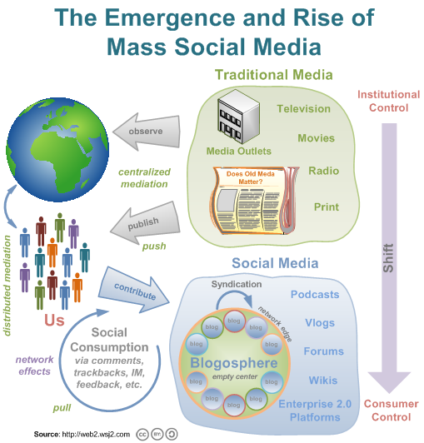
a
To understand content marketing we need to understand the new model of consumption.
We are now dealing with educated buyers
Word of Mouth
has become
Word of Mouse

Slide 7
Journalism + Marketing = Content marketing
Stakeholder engagement best achieved by
Publishing NOT Marketing
Along with the products you offer, one of your core products is information.
Notes:
Alternative bild

Slide 8
How are companies using Content marketing
Notes:
There are 20 types here
Companies over 1000 employees 9 tactics
- Companies less than 10 employees average of 6

Slide 9
The Platforms & The Challenges

Slide 10
Spend Levels - Creation & Distribution
Notes:
Average 380 USD
Opportunity here for Agencies to take money for both creation and distribution
Opportunity for in house communicator to take money from marketing

Slide 11
What is my Content strategy?
Some useful questions to start with:
How is my content being generated?
Who is generating my content?
Am I using multiple formats?
Am I making my content accessible?
Am I making my content easy to view?
Am I making my content easy to use and share?
?

Slide 12
What is my engagement strategy?
The 3 I’s of engagement:
INTERACTION
The action a person takes whilst present at those touch points
INTIMACY
The affection a person holds for a brand
INFLUENCE
The likelihood a person is to advocate on behalf of a brand

Slide 13
Where is content found in my organisation?

Slide 14
Who’s job is it to produce content
Who is your CEO?
Chief Editorial Officer
Who is your Chief Conversation Officer?
Do you have one or many?
Where does content come from?
Look internally - Clients Services, R&D, Engineering, Sales, Production etc

Slide 15
Crowdsourcing & Curating content

Slide 16
The OLD WORLD – THE COMMUNICATOR AS the Teacher

Slide 17
THE NEW WORLD – all in the playground - Who’s in Your Gang
Notes:
YOU CONTENT IS ONLY AS STRONG / USEUL AS THE PEOPLE THAT SURROUND IT
WHAT ARE YOU DOING TO CREATE AND ENGAGE WITH YOU GANG
CONTENT ECONOMY / LINK ECONOMY / NETWORK ECONOMY – JEFF JARVIS

Slide 18
Through your Mynewsdesk newsroom - In 1o minutes you CAN
Push content to your existing contacts / influencers (Email)
Draw new contacts / influencers through effective SEO
Update your own newsroom on you website with our hosted newsroom
Publish to your own wordpress blogg
Publish and reach your 600m + Facebook users
Publish and reach 200m + Twitter users
Publish video and reach 490m + Youtube users
Publish presentations and reach 50m + Slideshare users
Publish photo’s and reach your portion of the 50m + Flickr users

Slide 19
How Mynewsdesk helps your content marketing

Slide 20
Jonathan Bean
@jonobean
Jonathan.bean@mynewsdesk.com
Skype: mynewsdeskjpb

