Slide 1
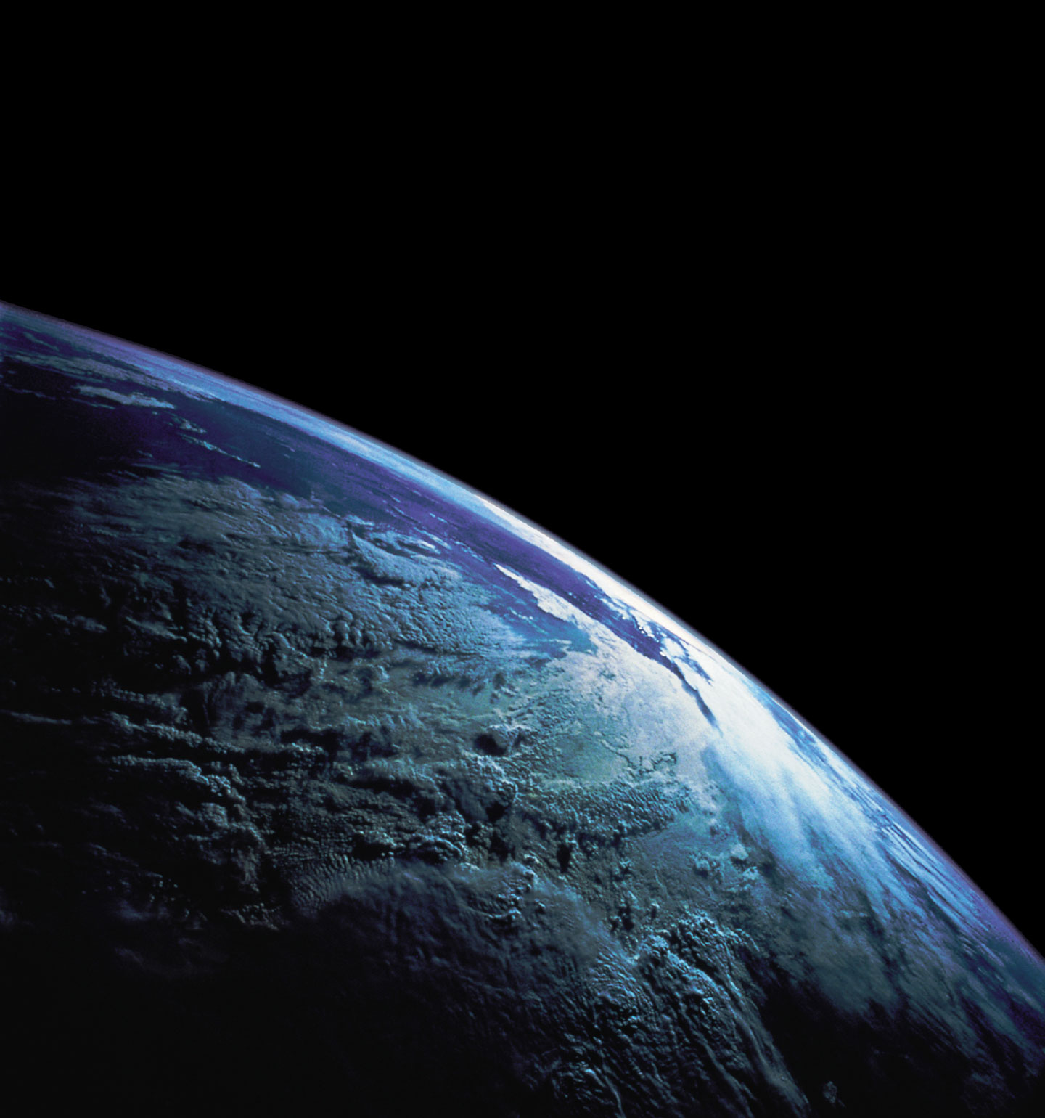

Slide 2
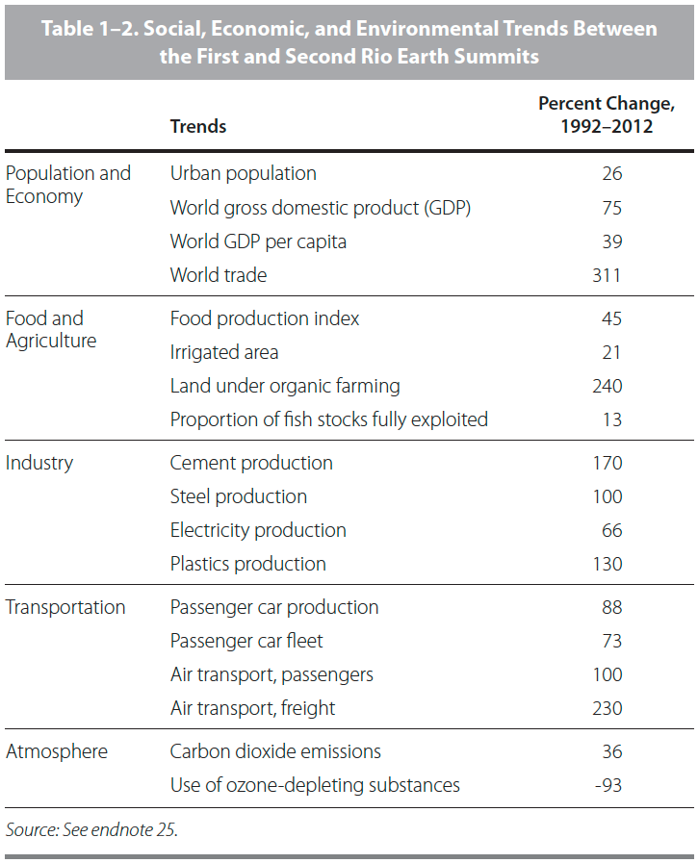

Slide 3
Stranded assets
Losses of agricultural resources
Risks to ocean resilience
Arctic “ownership” and its implications
Emerging zoonoses
Climate-driven migration
+
Energy, credit, and the end of growth
Prospects for a no-growth economy

Slide 4
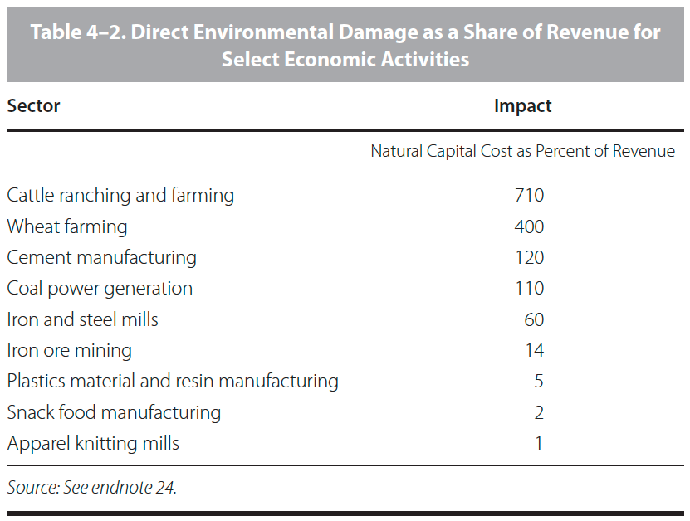

Slide 5
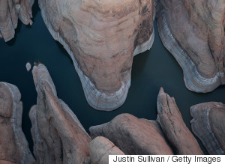
Lake Powell reservoir, March 2015

Slide 6
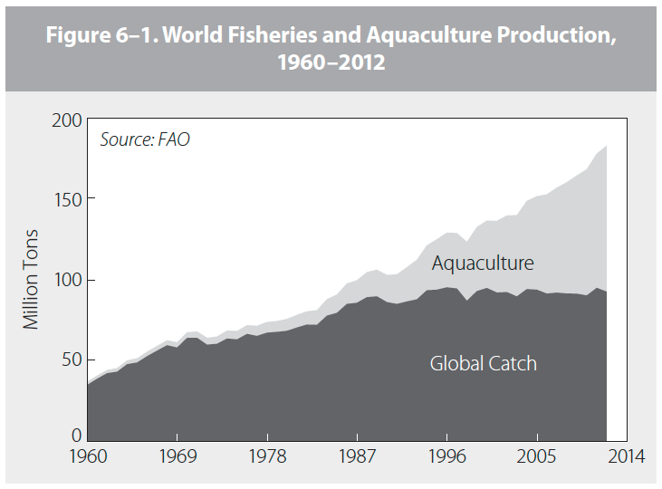

Slide 7
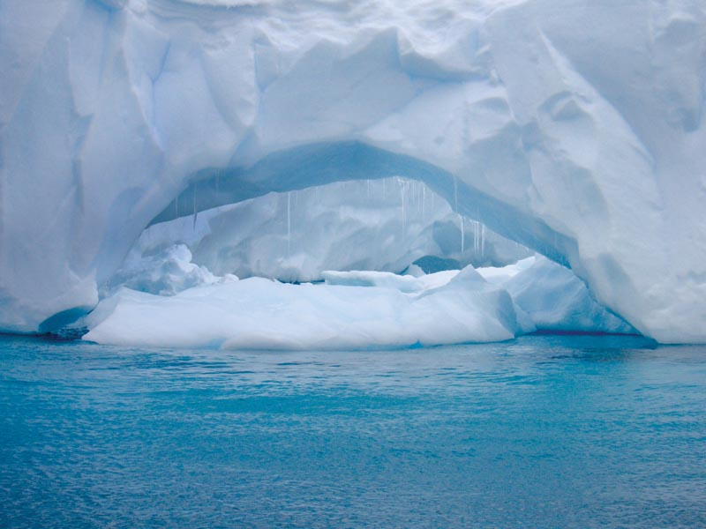
Wikimedia Commons

Slide 8
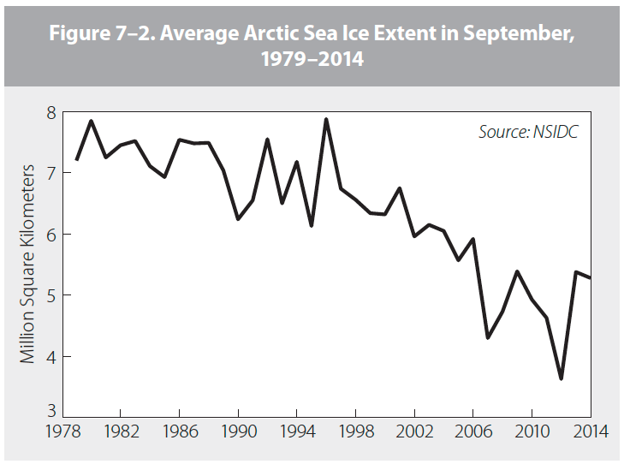

Slide 10
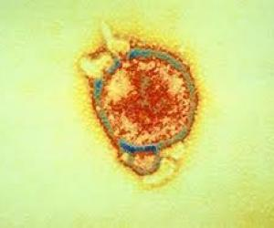
SARS virus
SARS virus
Nipah virus

Slide 11
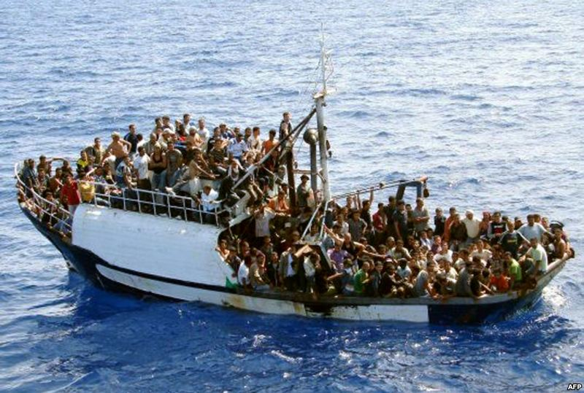
echrblog.blogspot.com

Slide 12
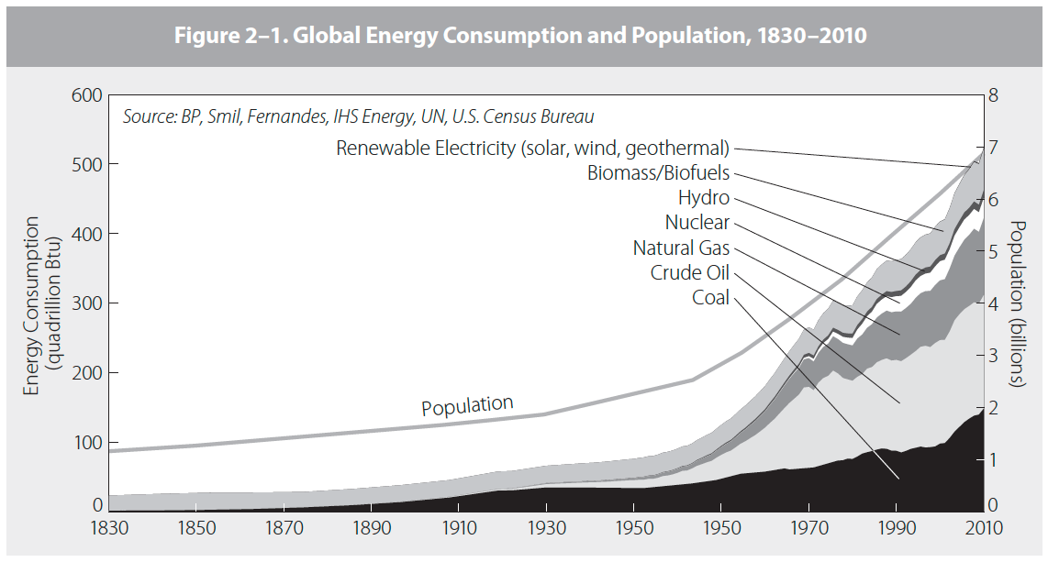

Slide 13
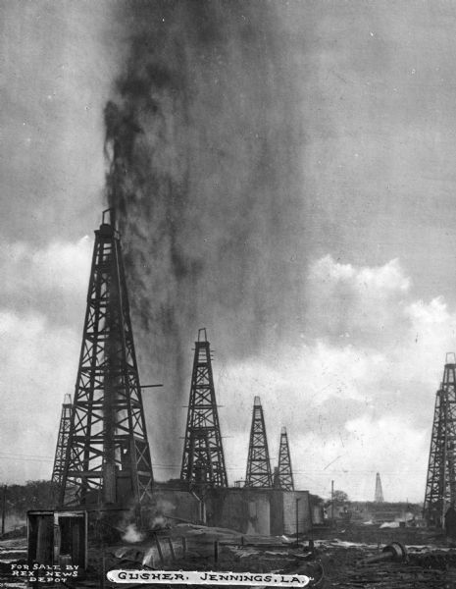

Slide 14
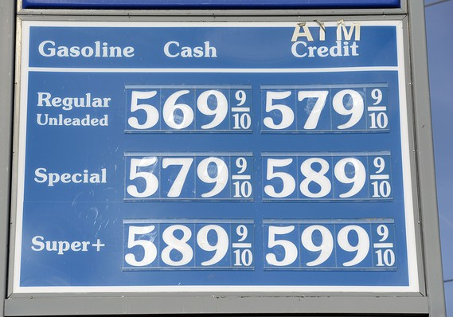
Marketwatch.com

Slide 15
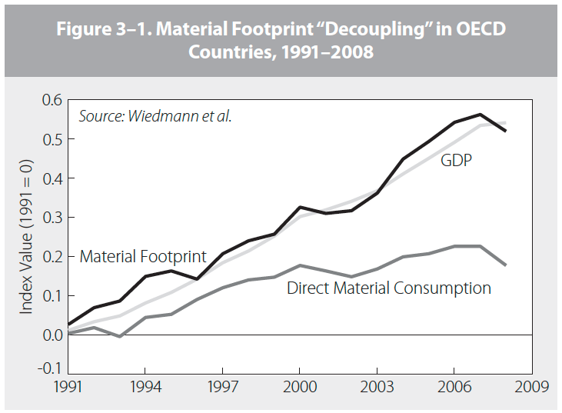

Slide 16
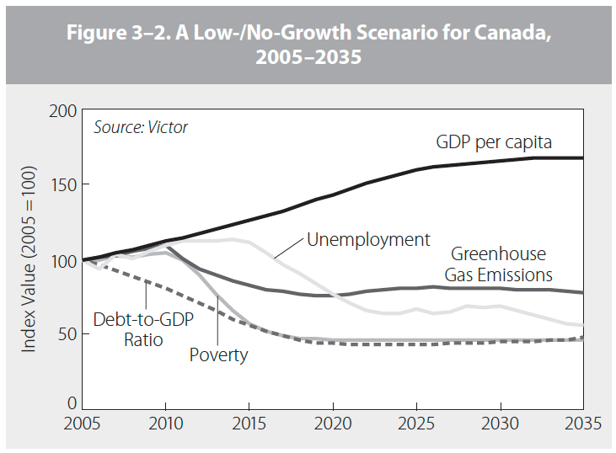

Slide 18
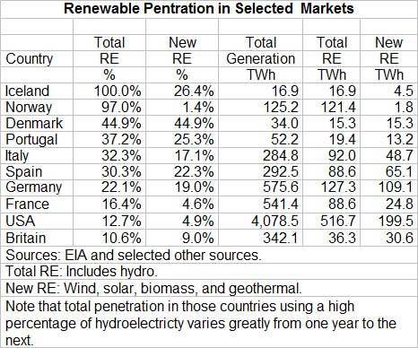
Paul Gipe, Penetration of Renewable Energy
in Selected Markets

