Slide 1
Notes:
Today we will discuss what makes a great newsroom and show you examples of companies that, in general, have gotten it right – though there is always room for improvement.
Theme song to The Good the Bad the Ugly, by Ennio Morricone: http://open.spotify.com/track/1JSIWsJfxOji0FrxFcxdCK

Slide 2
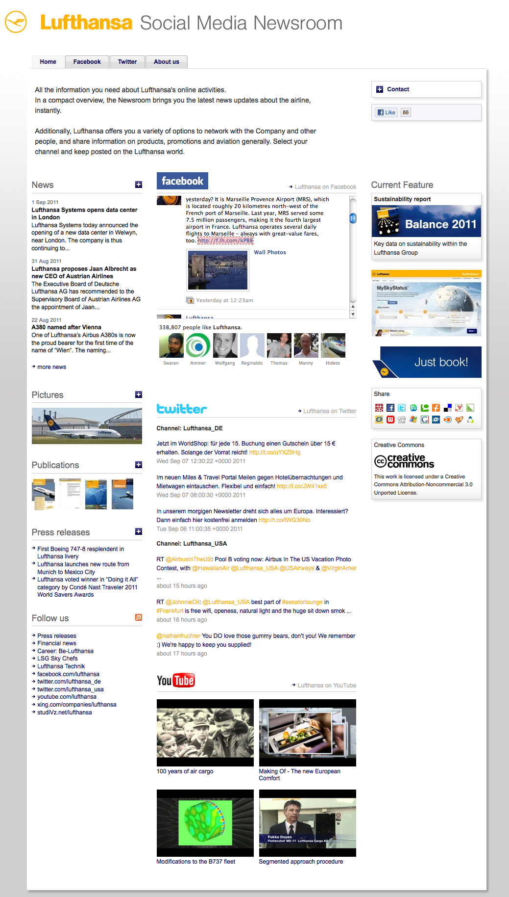
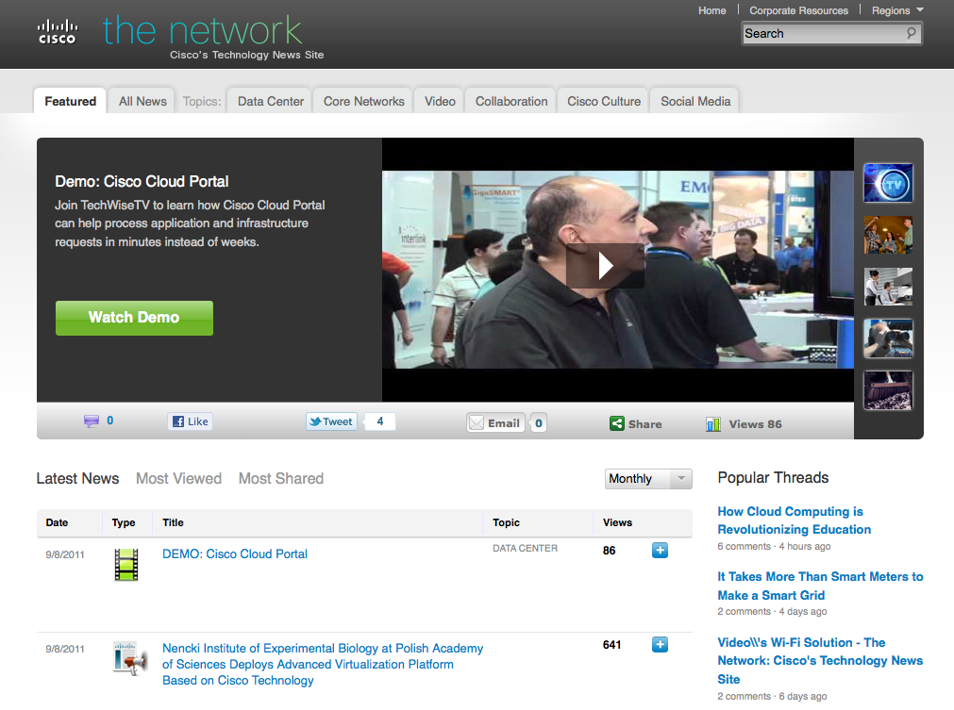
The Social Media Newsroom
What is it?
Notes:
Online Newsroom Definition: A website that contains information about a corporation or organization.
Social Media Newsroom Definition: A company resource, set up to increase the functionality and usability of the traditional online newsroom.
Social media newsrooms are intended to encourage dialogue and information sharing.
All newsrooms should give the visitor (your influencers, bloggers, journalists, competitors, partners, employees) access to news, public relations announcements, images, audio, video and other multimedia files. Social media newsrooms allow visitors to interact and share on other networks, and allow the company to engage directly with this audience on their own terms.
EXAMPLES
http://newsroom.cisco.com/
Cisco is a great BEST PRACTICE to highlight. The audience should see what Cisco has done and really examine their newsroom.
http://newsroom.lufthansa.com/
Another great example
http://campaign.mynewsdesk.com/newsroom/fi/

Slide 3
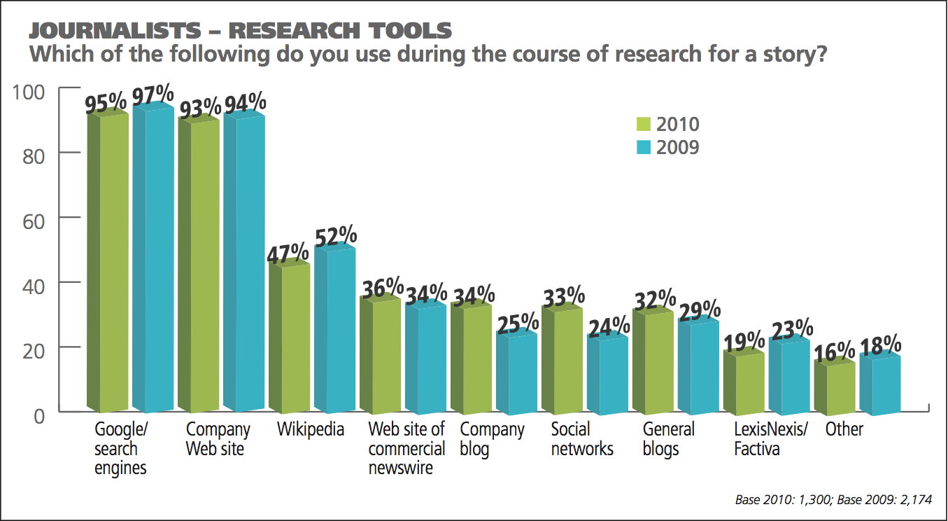
The Social Media Newsroom
Why do you need it?
Notes:
It’s expected of you! 93% of journalists and other stakeholders use a company website as a research tool in their work. These same visitors assume that a company website has an online newsroom.
According to studies (example TEKGroup), 97% use a company’s website, as well as their online newsroom. 75% of them use it once a week or more!
Reasons to have a newsroom online?
Journalists,bloggers, and any other relevant influencer expect a company to have an online newsroom. They visit online newsrooms often to find company information relevant to them. This counts for both large and small-to-medium sized company online newsrooms
- Centralized location and 24-hour access of press materials, as well as control and delivery of corporate message
- Social media interaction: a social media newsroom allows you to engage your audience on many different networks at the same time, while they can take in various conversations across the web simultaneously.
SEO – all material is published and ”lives” online, allowing relevant stakeholders to find your information more easily
- Statistics! – once your press material is published online, its spread and visibiility (and its shareability) can be measured. You can then see who visited you, how they found you, what press release was most popular, and what time is best suited for publishing.

Slide 4
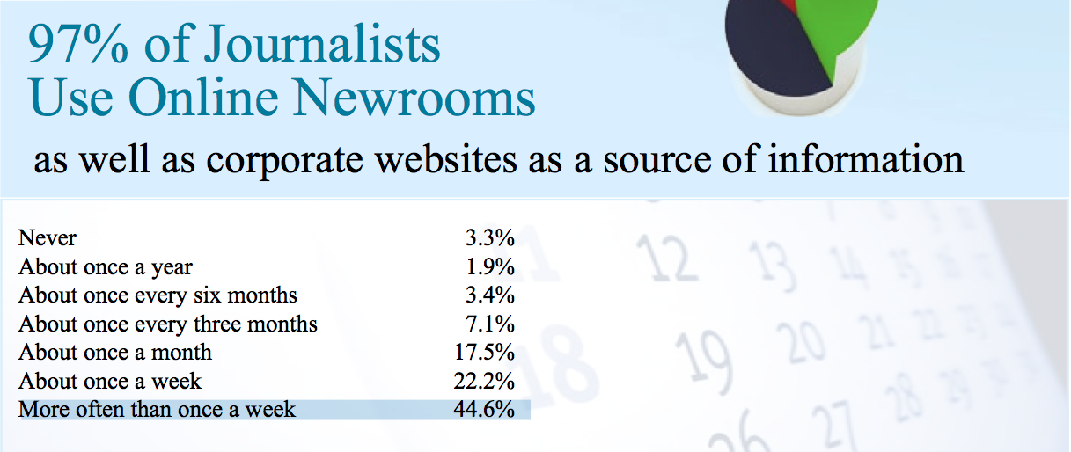
What Do Your Visitors Think?
What do journalist really want from your newsroom?
Notes:
Journalists and other visitors to your website are not that happy about your newsrooms though: “More than 57% of journalists generally agree that it’s difficult to find press materials that address their interests. What’s more, almost 42% of respondents generally agree that it’s difficult even to find organizations’ online newsrooms.” (TEKGroup)
What do your visitors, your audience of influencers, want from your newsroom?
Your material should be archived properly for easy access and browsing. Ex: http://www.nestle.com/Media/PressReleases/Pages/2011.aspx
Make sure they can search through the archive too and filter the material they need. This means that you should keep in mind how you write headlines for news releases, how you tag each piece of press material, and how you link to each piece from external sites (and vice versa). SEO is one of the first steps to being found by your influencers.
They want to know who to contact and want to find their contact details easily.
Make sure that you have a solid and extensive image library, fully searchable, well organized, with different types of shots from formal high-resolution glossy shots to informal snapshots of your employees or crowd-sourced pics. Consider using Flickr to complement your image library!
Let’s take a closer look into what will take your social media newsroom to the next level!

Slide 5
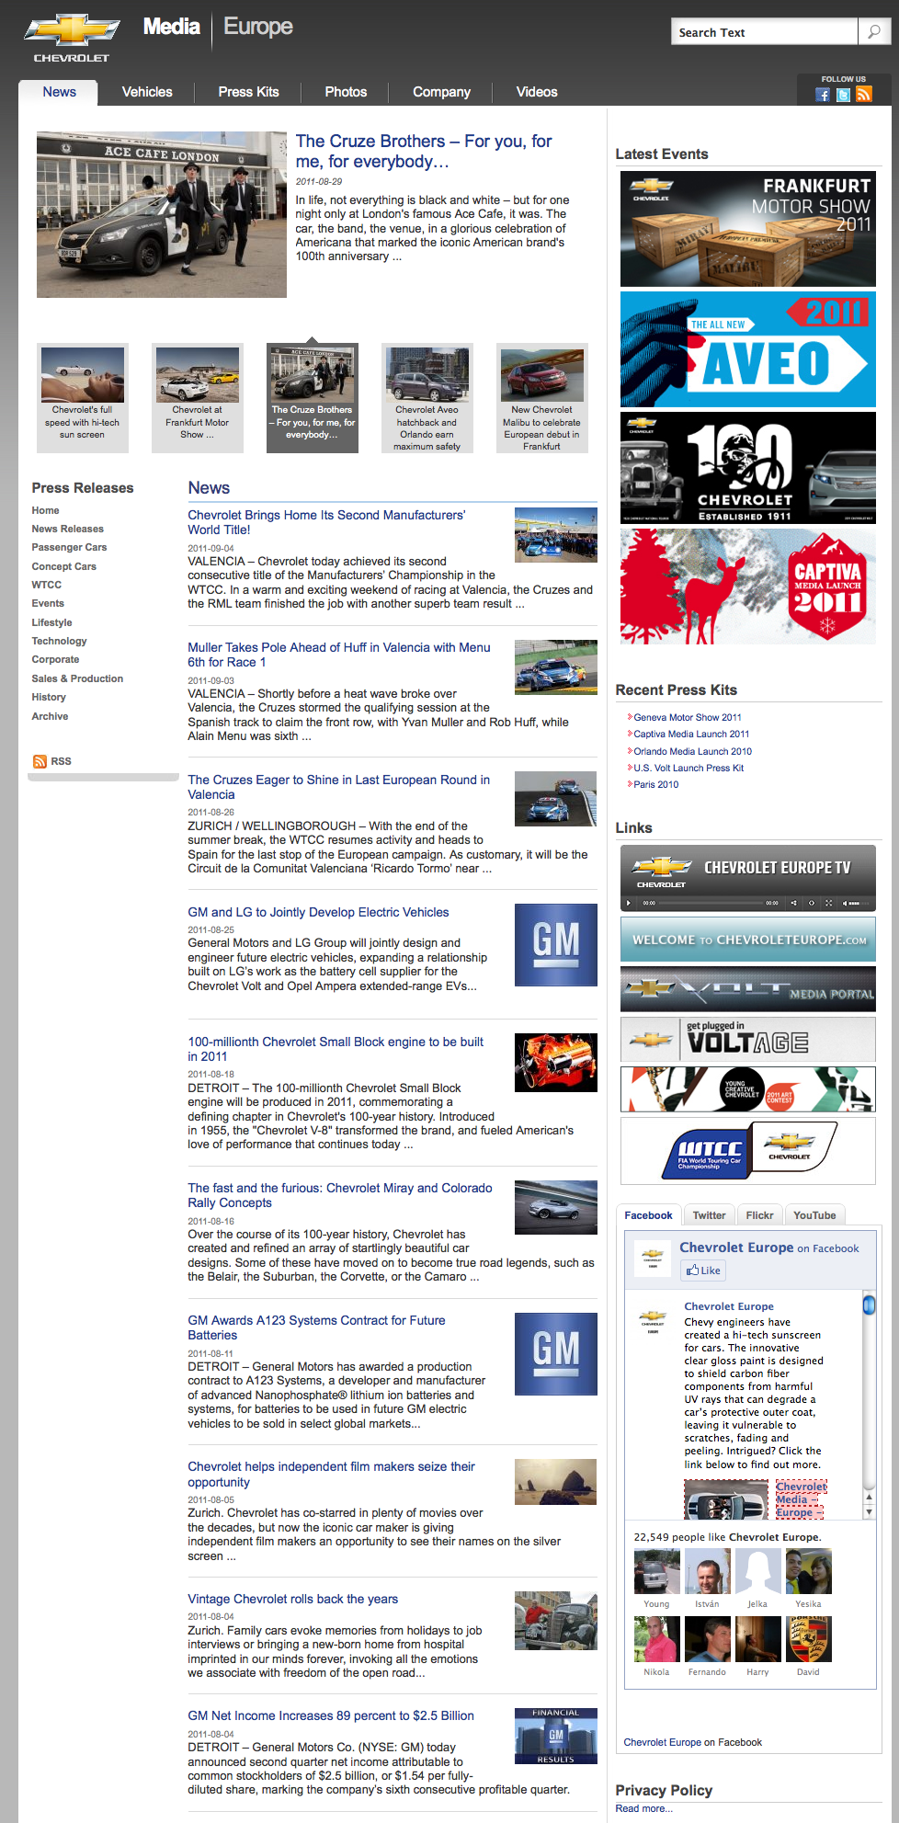
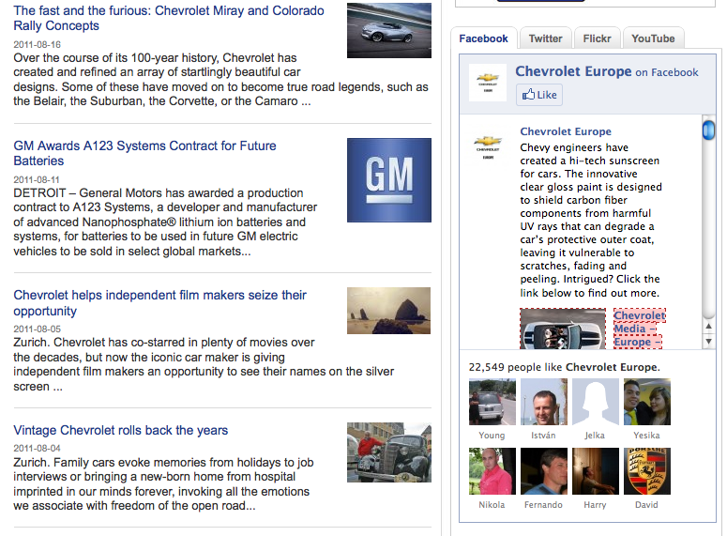
Great Examples
Socialize
Notes:
Allow visitors to your newsroom to get a quick overview of all the social networks your company manages.
At a glance, your visitors should know what is being said about you on Twitter, which videos you are featuring on YouTube, or what your latest blog entries are about.
Moreover, they should be encouraged to follow your company on platforms like your Facebook Page or your Twitter account.
Your newsroom is the central point of conversations on different media between you and your influencers.
Example: http://media.chevroleteurope.com/media/intl/en/chevrolet/news.html

Slide 6
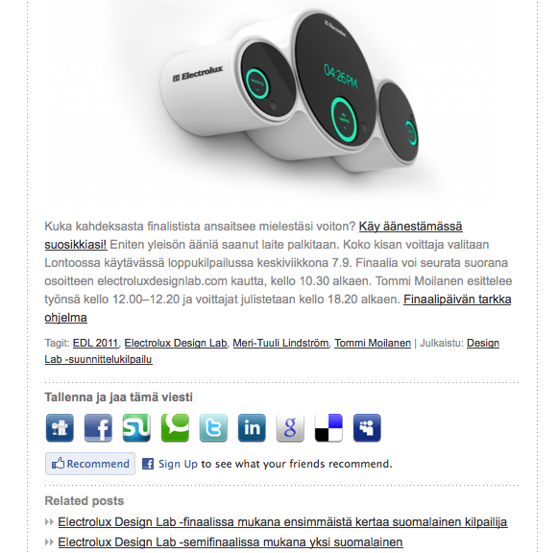
Great Examples
Share
Notes:
Sharing is caring. The main purpose of an online newsroom is to make it easier for your audience to share the press material with others.
Share buttons are essential as these allow material to spread through social media or attract traffic to the newsroom itself.
In fact, any press material you publish in your newsroom, should be uploaded to and shared with your own social networks instantly, like Flickr or YouTube uploads.
Example: http://newsroom.electrolux.com/fi/2011/09/07/ravintolayrittaja-meri-tuuli-lindstrom-ihastui-electrolux-design-lab-finalistien-toihin/

Slide 7
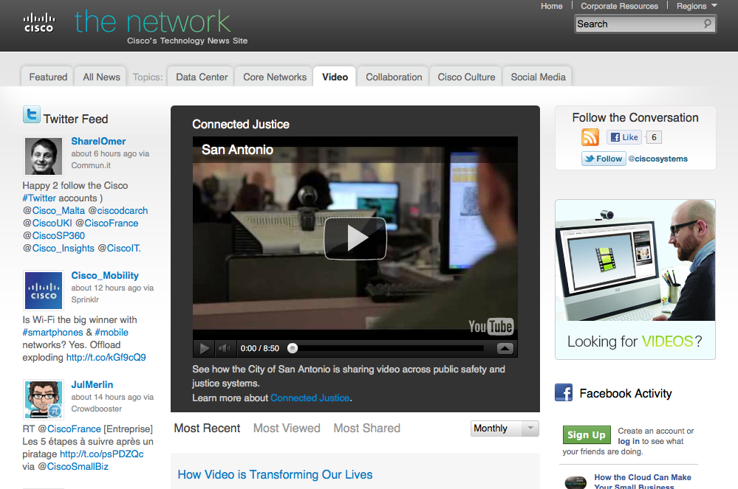
Great Examples
Visualize
Notes:
Goes without saying – high-resolution images and videos are a must, as they convey your message clearly and concisely, and are easily shared through social media. If your news or story can be enhanced by video or images, there is no excuse for not doing it!
Tag all videos and images properly, in order to optimize them for search engines!
Example: http://newsroom.cisco.com/video
Cisco is a great BEST PRACTICE to highlight. The audience should see what Cisco has done and really examine their newsroom.

Slide 8
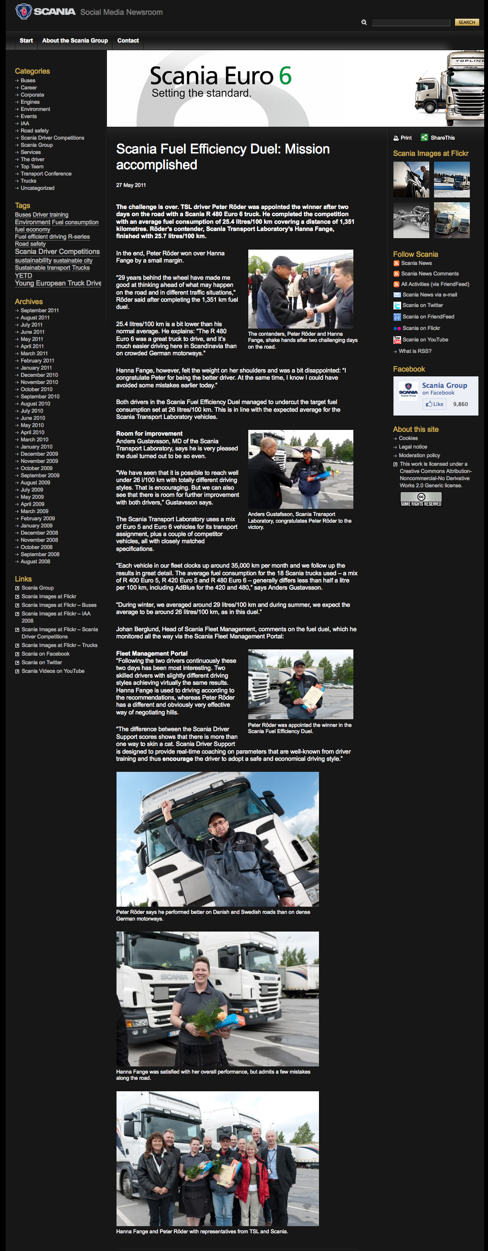
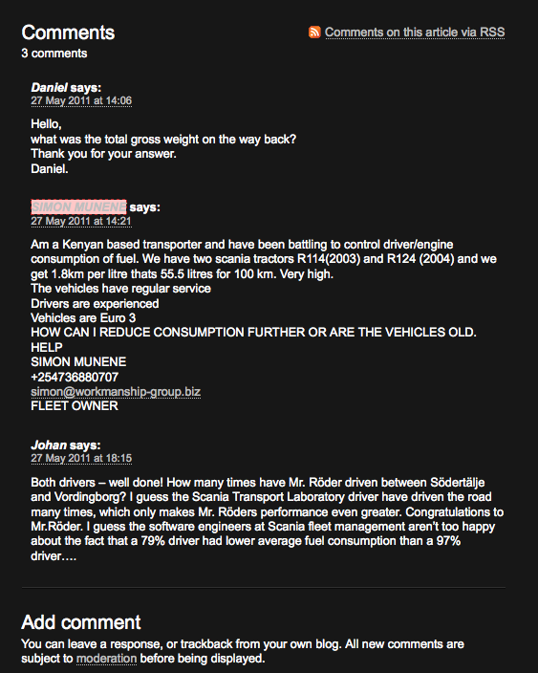
Great Examples
Open up!
Notes:
This is usually a touchy subject, and marked with a bit of controversy, but we encourage newsrooms to open a comments section for each piece of press material uploaded, especially news releases or articles.
Even if you get negative comments, a comments field allows you to interact with your visitors directly in your newsroom, developing a story further and sharing it publicly and instantly. The best ambassador you can get is a disappointed customer that you turned into a happy one, publicly!
Example: http://www.scanianewsroom.com/2011/05/27/scania-fuel-efficiency-duel-mission-accomplished/#comments
Fault: Scania never replies to the comments written by the visitors (which are made up of external audiences as well as their own employees from literally around the world)

Slide 9
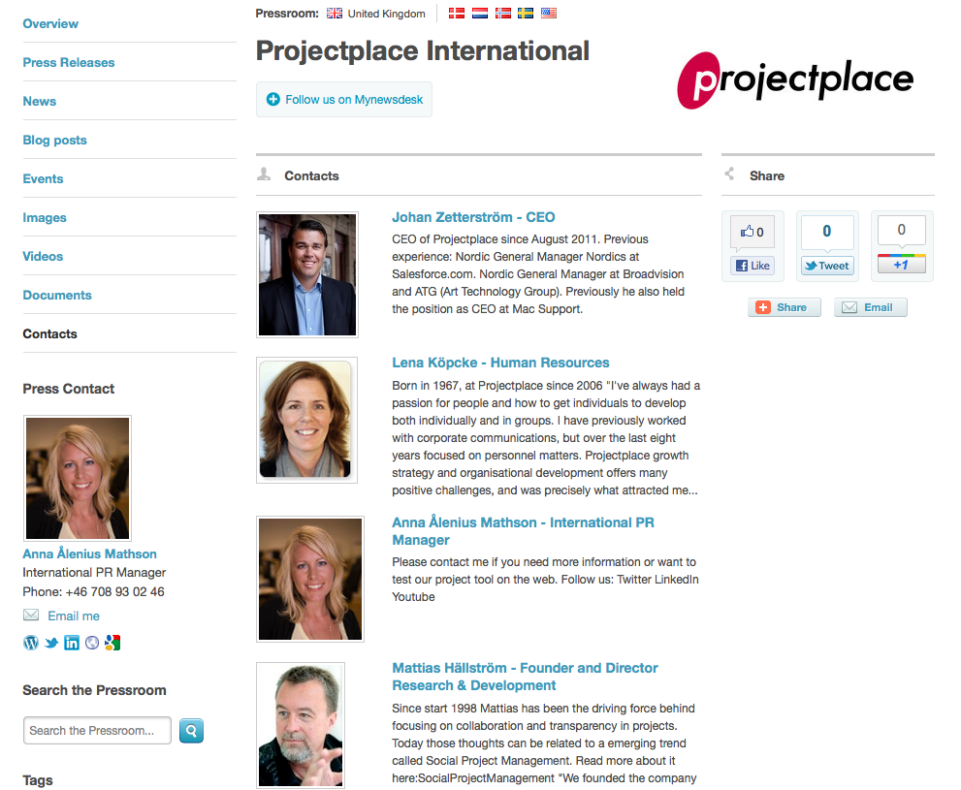
Great Examples
Personalize
Notes:
Give your brand or company a face. Or maybe even 30 faces. The traditional pressroom might only feature one or two contact persons for a journalist to reach (usually the PR Manager and the CEO). But perhaps they are not the right people to contact for a particular story.
Turn the contact pages to personal online business cards for the individuals that make up your company, that are an important part of what makes your brand what it is. Display portraits, add short personal bios, link to Twitter, LinkedIn, or Facebook accouts, and describe the roles within the company for each person you choose to highlight.
Examples: http://newsroom.sebgroup.com/en/Pages/Our-Experts/
http://www.mynewsdesk.com/uk/pressroom/projectplace_international/contact_person/list
Faults of examples above: not personal enough, especially SEB is a bit staged. But definitely step in right direction!

Slide 10
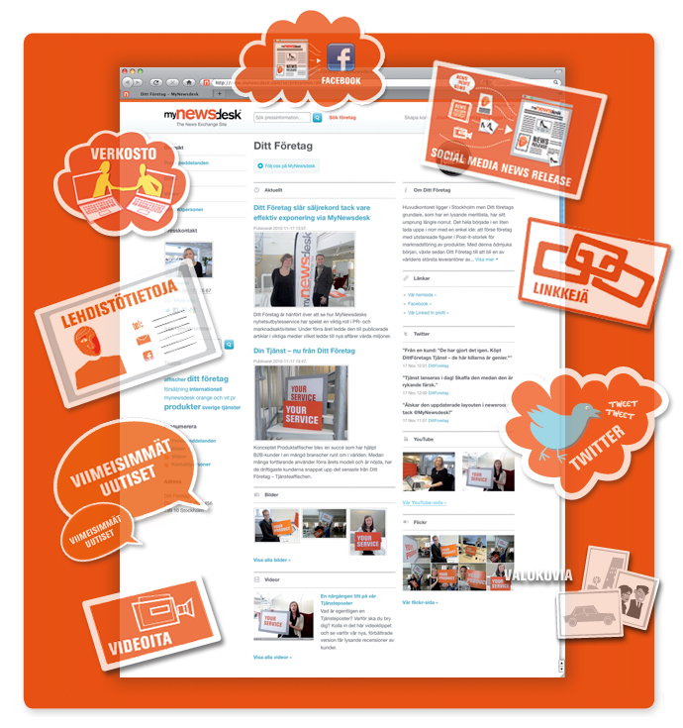
Further Reading
http://bit.ly/journo1
http://bit.ly/journo2
http://bit.ly/whitepaper-smnr
http://bit.ly/smnr-fi
Notes:
For further reading, remember to check out our blog: blog.mynewsdesk.com and specifically this article (journo1): http://blog.mynewsdesk.com/2011/08/15/what-journalists-really-want-from-an-online-news-room/
Then also read PR2.0, our founder, Kristofer Björkman’s blog. And specifially this article (journo2): http://pr20.wordpress.com/2011/03/09/journalists-loves-your-homepage-but-not-your-newsroom/
Please share the whitepaper on social media newsrooms and mention PR Insights: http://insight.mynewsdesk.com/pdf/WHITEPAPER_SMNR.pdf
And direct them towards the campaign site about social media newsrooms: http://campaign.mynewsdesk.com/newsroom/fi/

