Slide 1
THE ART OF
STYLING CLASSICS
Notes:
Our Styling category is set to grow with two new great innovations.

Slide 2
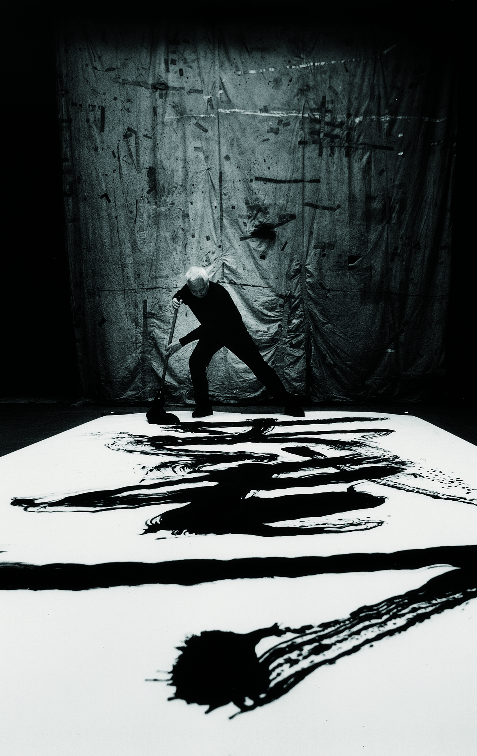
DURING HIS MAKE-UP ARTIST CAREER
MR SHU UEMURA HAS BEEN THE EPITOME OF TEXTURE
PASSIONATELY AND INSISTENTLY, MR SHU UEMURA CHALLENGED HIMSELF TO EXPLOIT THE INFINITE POSSIBILITES WHEN COMBINING VERSATILE TEXTURES AND VARIED EFFECTS
TODAY, THIS EXPLORATION OF TEXTURE IS TAKEN FURTHER, TO OFFER AN INSPIRATIONAL, TREND-LEAD CATALOGUE, ADOPTED BY PROFESSIONNALS AND RENOWNED WORLDWIDE
Notes:
Drawing upon Mr. Shu Uemura’s love and passion for textures we take inspiration from this for our two new and upcoming launches we have within our styling category.

Slide 3
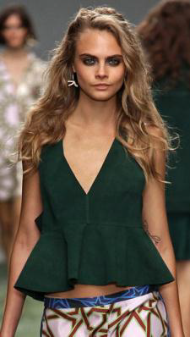
On trend FOR 2014 runway
The wave effect.
s/s 2014 pucci
s/s 2014 Topshop unique
s/s 2014 Marc jacobs
Notes:
One of the biggest trends we saw on the catwalk was that of the “textured waves” from the likes of Marc Jacobs and Emilio Pucci.

Slide 4
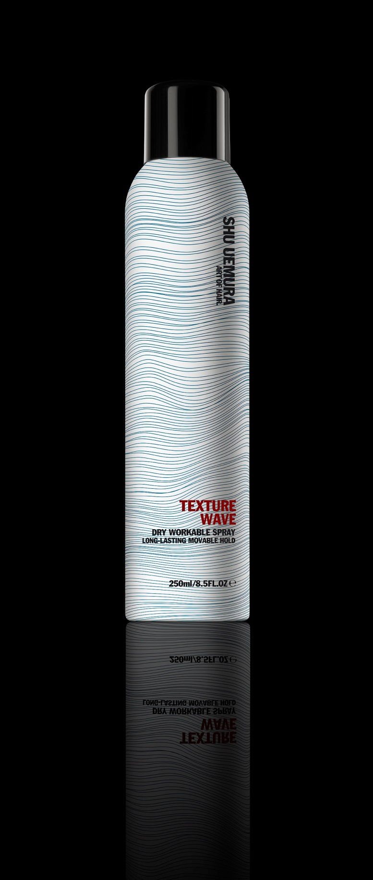
TEXTURE WAVE.
DRY WORKABLE SPRAY
LONG-LASTING MOVEABLE HOLD
THE STRENGTH OF A TEXTURIZING MINERAL POWDER WITH THE SOFTNESS OF COTTON FOR LONG-LASTING HOLD
AND A FULLER TOUCH
IDEAL FOR TEXTURIZED UNDONE LOOKS OR SUBTLE
NATURAL WAVES TO THE MOST DESIGNED
MOVEMENTS WITH A NO SHINE FINISH
BUILDABLE GRIP. FULLER TOUCH. MOVEABLE TEXTURE
PRIS: 360kr
Notes:
Taking inspiration from this, we are launching “Texture Wave”, which is a dry workable spray with long lasting moveable hold.
It has the strength of a texturizing mineral powder for long-lasting hold and fuller looks, and allows you to:
Build Grip
Create a fuller look
Create moveable texture
EFFORTLESS, LIVED-IN LOOKS
TEXTURE WAVE is the answer to natural looking styling, to texture not only shape. Whether it is to add a natural bend to free flowing hair, transform spiral ringlets to ruffled waves or to undo an updo, TEXTURE WAVE personalizes styles with effortless, lived-in looks.

Slide 5
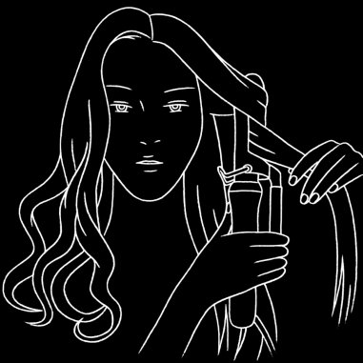
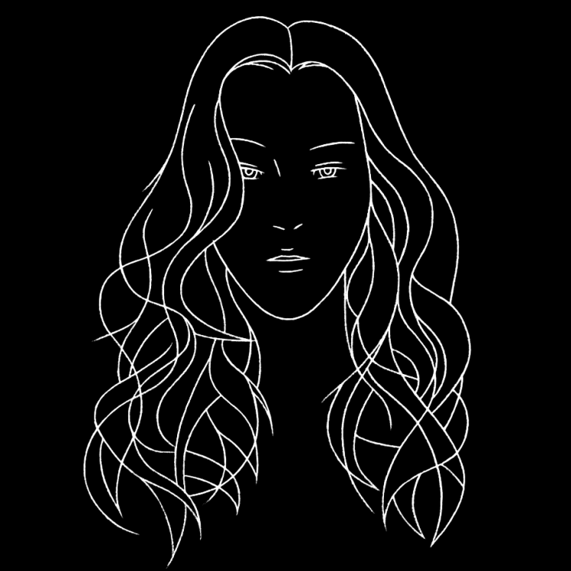
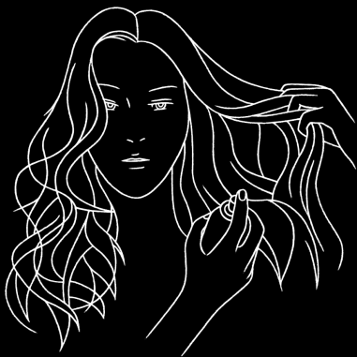
GET The windy wave LOOK.
TEXTURE WAVE
DRY WORKABLE SPRAY. LONG LASTING MOVEABLE HOLD
Step 1
Step 2
STEP 1. FORM CURLS USING A WIDE-BARREL CURLING IRON, WORKING SECTIONS OF 5CM INTERCHANGING DIRECTIONS, INWARDS AND OUTWARDS
STEP 2. UNDO CURLS USING FINGERS. LIFT LENGTHS AND
APPLY TEXTURE WAVE WHILE TOUSLING LAYERS TO GET AN EvEN TEXTURIZATION

Slide 6
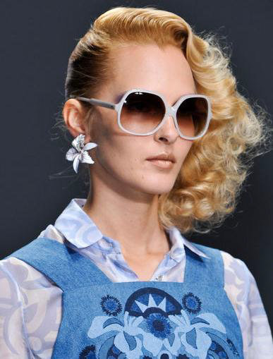
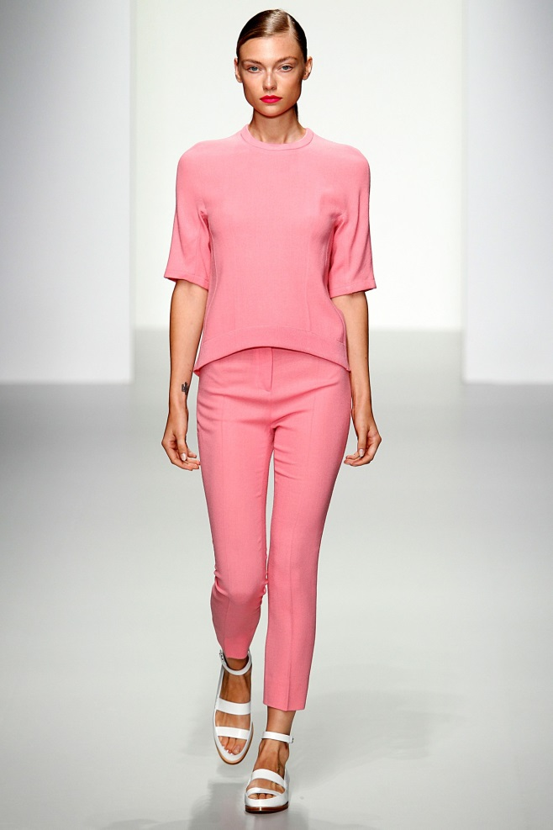
On trend FOR 2014 runway
The SLEEK CONTROL effect.
s/s 2014 gucci
s/s 2014 Holly fulton
s/s 2014 Antonio Berardi
Notes:
Another key trend seen on the catwalk was the Sleek Control and Shine from Gucci and Holly Fulton.

Slide 7
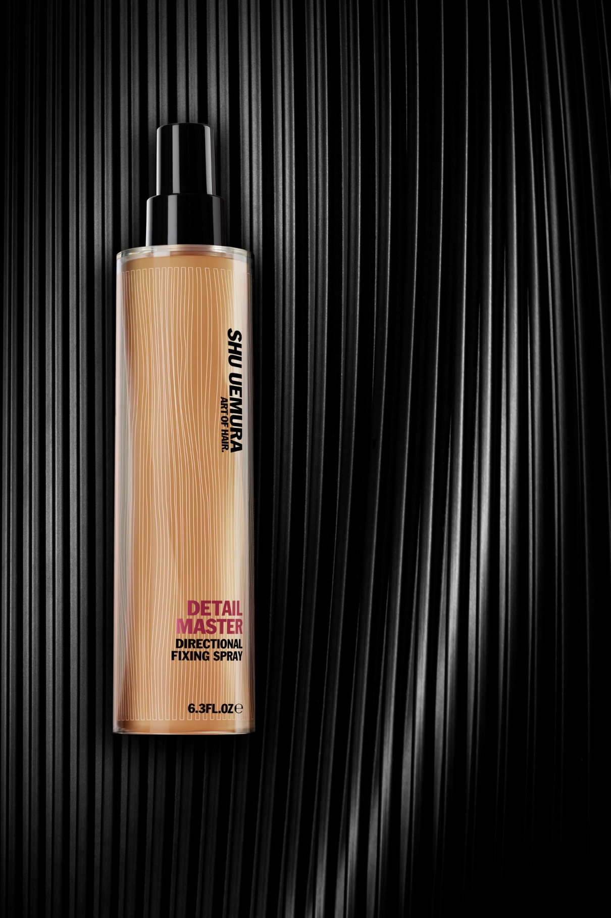
DETAIL MASTER.
DIRECTIONAL FIXING SPRAY
HIGH HOLD, SLEEK SHINE
SECURE ANY STYLE WITH FOCUSED HOLD
& DETAILED CONTROL
THE INDISPENSABLE TOOL FOR THE EVERYDAY HAIR ARTIST
WORKABLE HIGH HOLD. SLEEK CONTROL. HIGH SHINE
Pris: 360kr
Notes:
To embrace this trend we will be launching Detail Master, directional fixing spray for high hold and sleek shine.
This product offers workable high hold, amazing sleek control and super high shine.
DETAIL MASTER is a styling station staple, applied precisely for zone-focused hold. It goes on wet allowing workability – this permits the Hair Artist to set details in place, and once dry these details are captured all day with high hold and a sleek shine finish.

Slide 8
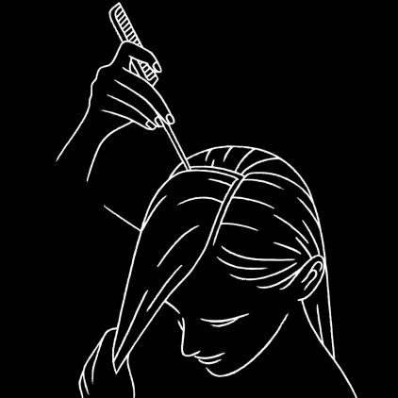
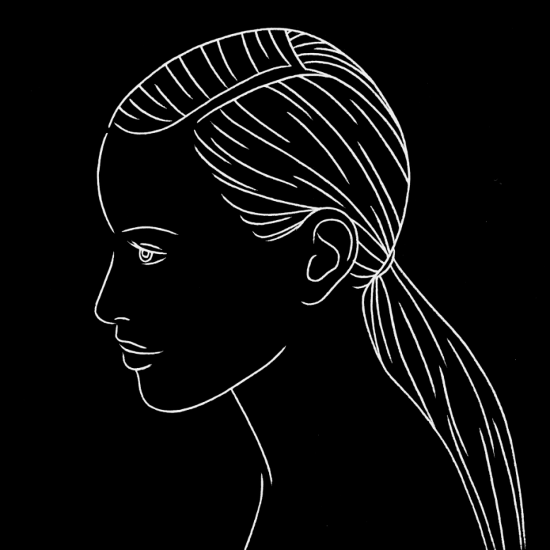
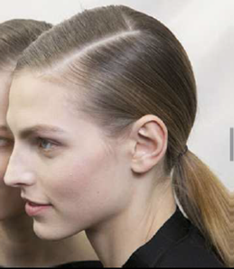
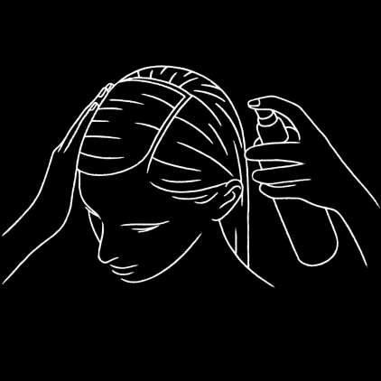
GET The dandy pony LOOK.
DETAIL MASTER
DIRECTIONAL FIXING SPraY. HIGH HOLD, SLEEK SHINE
Step 1
Artistic money makers
Step 2
STEP 1. PART HAIR TO FORM AN “L” SHAPE, STARTING ABOVE THE MIDDLE OF THE EYEBROW
STEP 2. SMOOTH SECTIONS WITH THE PALM OF THE HAND AND FIX WITH DETAIL MASTER. GATHER HAIR IN A LOW PONYTAIL WHILE MAINTAINING THE “L” PART

Slide 9
FÖR VIDARE PRESSINFORMATION:
MONICA JONSSON, PR MANAGER
MONICA.JONSSON@LOREAL.COM, 0765-366086
HÖGUPPLÖSTA BILDER:
LÄNK

