Slide 1
Marketing CONTENT IN TODAY´S COMMUNICATIONS LANDSCAPE

Slide 2

Agenda
Changing Times
Search Engine Optimisation versus Social Media Optimisation
Brand PR
Content and Consumption
Content Targeting and
Engagement
What has changed and
what do we need to focus on

Slide 3
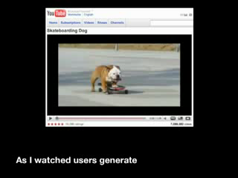
Times ARE CHANGING…
…SO ARE OUR JOBS

Slide 4
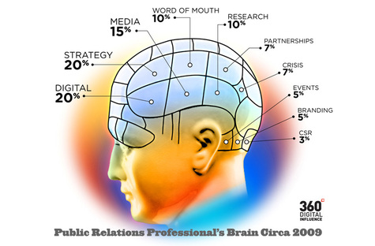
The Brain of a Communicator in 2010
Notes:
Expand your Target Publics
Opportunity is far greater but we are all in a fight for attention
THINK BEYOND YOUR MEDIA TARGET GROUPS

Slide 5

Start thinking community notigeography
As media and content consumption
is being liberated from geography –
so should media and content supply.
Everybody is now local
Everybody is now a stakeholder
New technology, new participation,
new models
Tactics are where geography and
language come into play, but it should
not be a starting point for strategy.

Slide 6


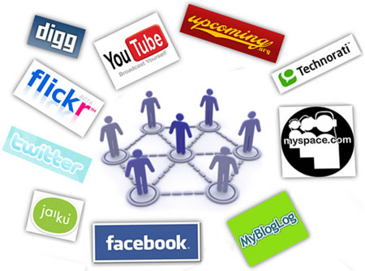
Seo Vs. SMO – what’s the difference?
So we are all doing Search Engine Optimisation (SEO)?
How many of us are doing and synching Social Media Optimisation (SMO)?

Slide 7
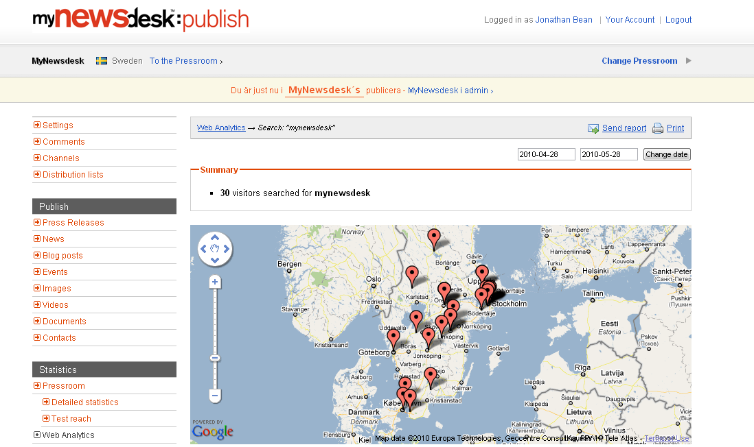
The Who, What and Where of Stakeholder Search
?
Do you know?
WHO is searching?
WHAT they search for?
WHERE they are located?
Too often the answer to all the above questions is no!
Notes:
In regdars to stakeholder

Slide 8

BRAND PR
The classic branding questions for all organisations to answer
What are we all about ?
What are we best at ?
How do we convert that promise to the consumer?
Unlike traditional branding channels, brand PR is based on content which tells a story

Slide 9
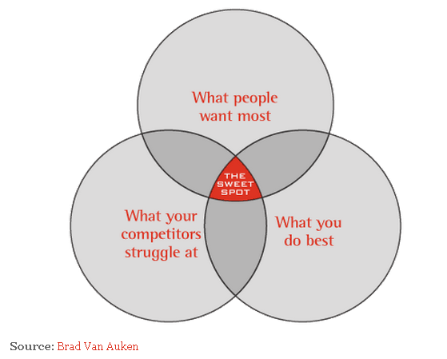
The Brand PR ”Sweet Spot”
All Brand PR messaging must attempt to hit the sweet spot with your storytelling!!!

Slide 10
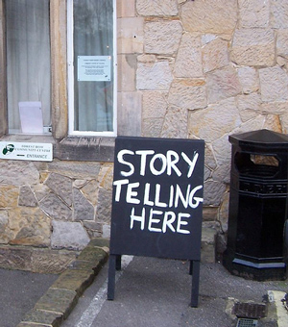
Why does content matter?
It tells your story
It answers peoples questions
It inspires and entertains
It motivates and educates
It manages expectations
It brings your brand to life
It builds OR breaks trust
It drives decision making!

Slide 11
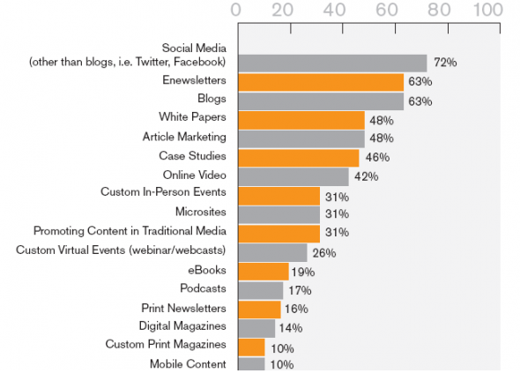
What Content products do you currently use?
How many of these tools are you currently responsible for?
Source

Slide 12
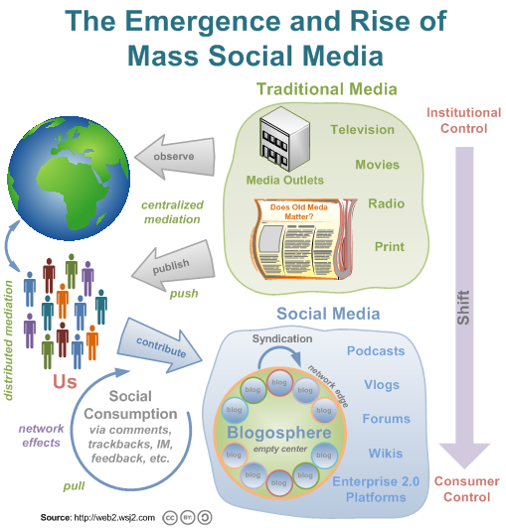
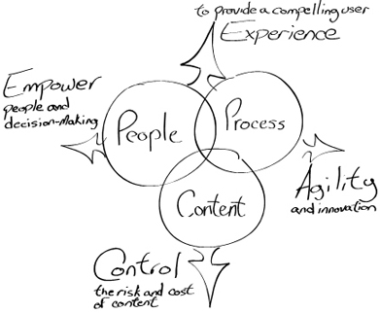
To understand content marketing we need to understand the new model of consumption.

Slide 13
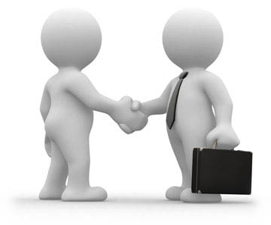
Purchasing has changed
The old model of buying
  Talk to an organisations sales representative
  Talk to a distributor or reseller
  Read product literature
  See and act on an advert in relevant media

Slide 14
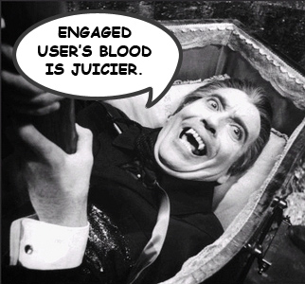
The world of Educated buyers
In today’s world we base our purchasing decisions on:
Google searches
Direct engagement with company websites
Online portals and websites
Listening and acting on the opinions of
likeminded individuals online (in our social
networks, influential bloggers we follow)
The highly sought after WORD OF MOUTH
has become WORD OF MOUSE.

Slide 15
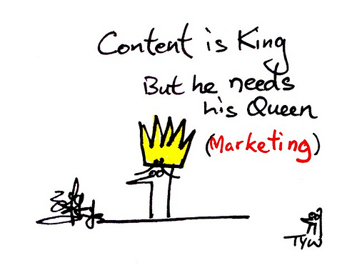

Journalism + Marketing
= Content marketing
Stakeholder engagement best achieved by Publishing NOT Marketing - successful organisations that are winning the battle of information realise this…
…along with the products they offer, one of their core products is information.
Notes:
Alternative bild

Slide 16
What is my Content strategy?
Some useful questions to start with:
  How is my content being generated?
  Who is generating my content?
  Am I using multiple formats?
  Am I making my content accessible?
  Am I making my content easy to view?
  Am I making my content easy to use and share?
?

Slide 17
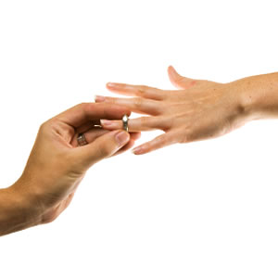
What is my engagement strategy?
The 3 I’s of engagement:
INTERACTION
The action a person takes whilst present at those touch points
INTIMACY
The affection a person holds for a brand
INFLUENCE
The likelihood a person is to advocate on behalf of a brand
I

Slide 18

The key question for communicators over the next few years…
Do we want to stop being
Cinderella at the Marketing ball?
As content marketing becomes
more important do we want
to gain a larger share of our
companies or clients’ marketing
spend?
…if so:
Start shaping and targeting
our messaging and content like the marketers!

Slide 19
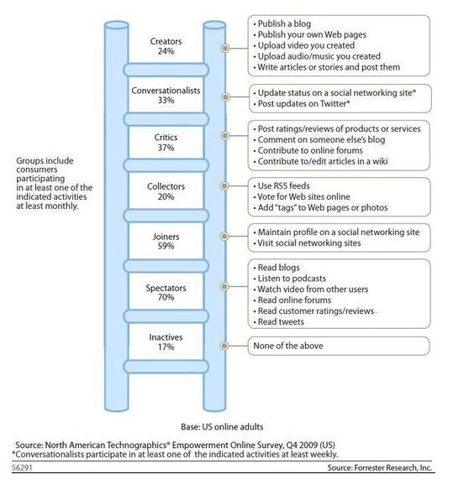
Notes:
Who is my content engaging with?

Slide 20
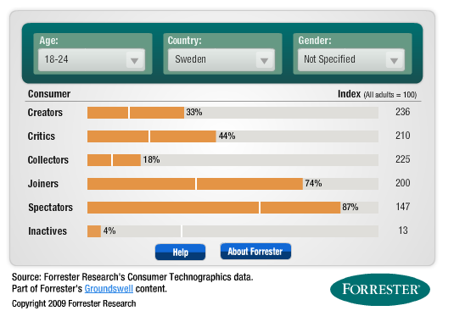
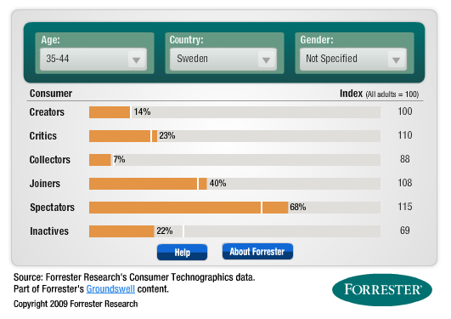
Swedish Content Consumers
AGED 18 – 24 vs. aged 35 - 44

Slide 21

3 Key content creation tips
1,2,3
Stop creating, writing and publishing
content for your CEO
Start creating, writing and publishing content
for your customer audience
Remember - content is personal ☺

Slide 22
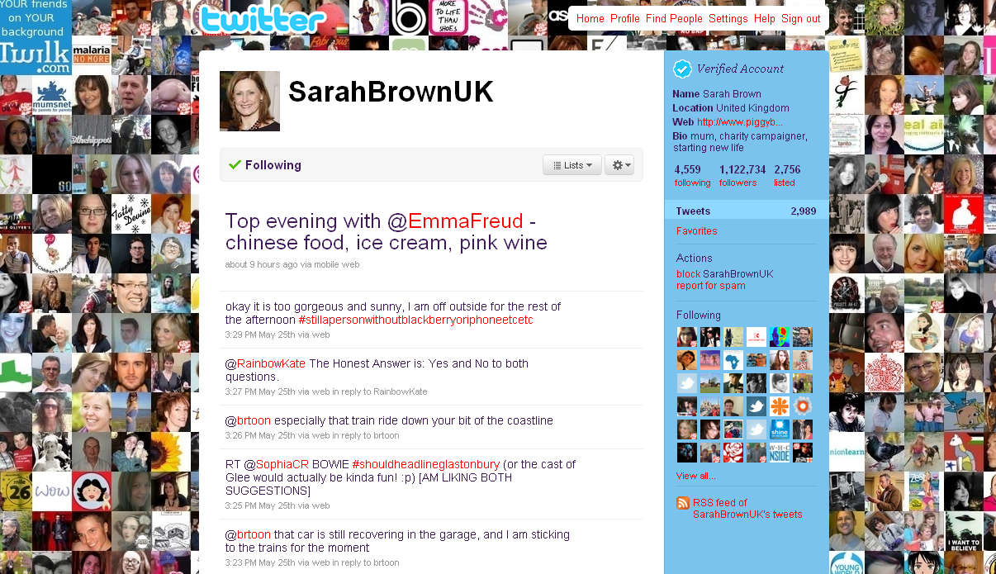
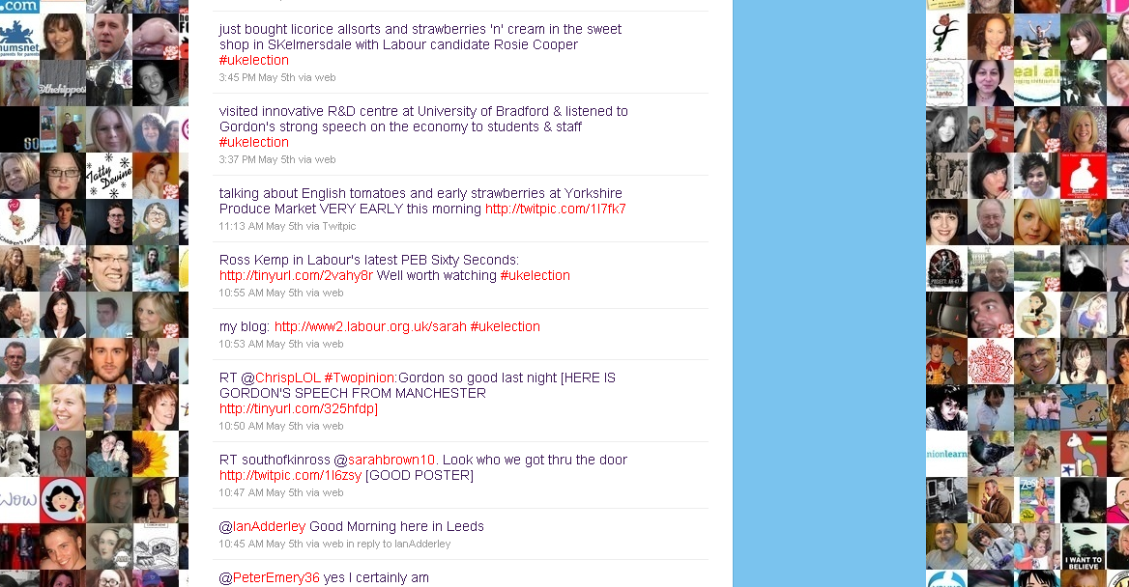
Most followed person on twitter in uk general election

Slide 23
Who’s job is it to produce content?
Who is your CEO?
Chief Editorial Officer
Who is your Chief Conversation Officer?
Do you have one or many?
Where does content come from?
Look internally - Clients Services, R&D, Engineering, Sales, Production etc
Identify and engage with your internal storytellers. They will provide your Social Media Optimisation
?

Slide 24
COMMUNICATION IS AND always has been a two way process
x
Today’s modern communicator needs to let go of news management and control…
…and start thinking and engaging in news and reputation conversation

Slide 25
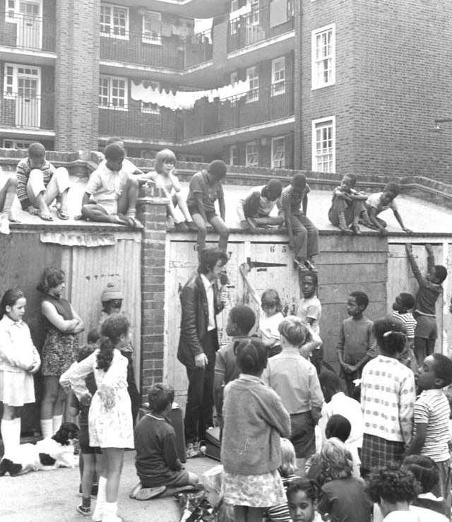
SO WHAT HAS CHANGED?
Opportunity… Speed… Reach… Content Platforms…
What has not changed?
The fundementals of good public relations
…A good story is still a good story
…Good writing is still good writing
…A headline (or 140 character elevator pitch) is
still what catches attention
…Good relationship building is still what secures coverage
Notes:
Cowley Estate off Brixton Road. Showing Children being entertained at a storytelling session at the Cowley Estate, off Brixton Road. These sessions were organised by Lambeth Libraries.
The estate was built by London County Council in the 1930s.

Slide 26
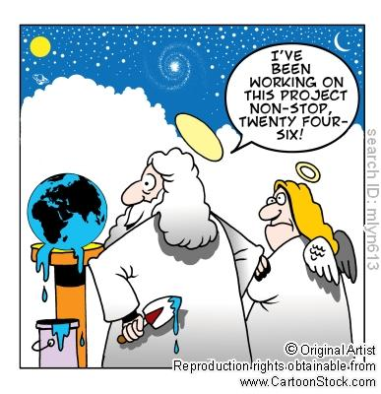
A Final Piece of Advice…
Stop thinking about all the new
content PLATFORMS…
…Continue thinking about creating
innovative and engaging CONTENT!

Slide 27
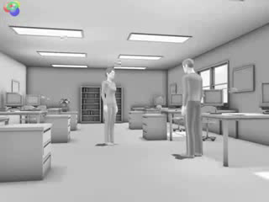
But beware of these people!
…I see and hear many of these people walking the streets of London, New York and Stockholm!

Slide 28


Where to find me!!!
Jonathan Bean
Chief Operating Officer
Jonathan.bean@mynewsdesk.com
@jonobean
www.linkedin.com/in/jonathanpbean

