Slide 3
1994
Jönköping University Foundation (JU) was founded on 1 July 1994.

Slide 4
1994
Antal registrerade studenter
1994: 4447
2019: 12598
Jönköping University Foundation (JU) was founded on 1 July 1994.
Personal (årsarbeten)
1994: 234
2019: 742
Internationella studenter
1994: 70
2019: 2134
Partneruniversitet
1994: 3
2019: ca 350
2019
Invånarantal i kommunen
1994: 113 557
2019: 139 735

Slide 5
ANNIVERSARY EXHEBITION
UNIVERSITY LIBRARY | Starts Monday, October 7th
HISTORY LECTURES
UNIVERSITY LIBRARY | Thursday, October 10th 10.30 – 12.00
JU LIVE
JU AULAN | Thursday, October 10th 14.00 – 17.00
INAUGURAL LECTURES
JU AULAN | Friday, October 11th 08.00 – 13.00
ACADEMIC CEREMONY
SPIRA AND CAMPUS ARENA: | Saturday, October 12th 16:00

Slide 6
HISTORY LECTURES
UNIVERSITY LIBRARY | Thursday, October 10th 10.30 – 12.00
Nerrolyn Ramstrand
School of Health and Welfare.
Jörgen Birgersson
School of Engineering.
Leif Melin
Jönköping International Business School.
Stefan Engberg
School of Education and Communication.

Slide 7
JU LIVE
JU AULAN | Thursday, October 10th 14.00 – 17.00
Taking the brain for a walk – how science is helping amputees think less and move more
Narrolyn Ramstrand, Associate Professor of Prosthetics and Orthotics and Saffran Möller, PhD, from the School of Health and Welfare
TO BE ANNOUNCED
You’re living your best life, thanks to metal castings...
Salem Seifeddine, Professor of Materials and Manufacturing from the School of Engineering
PANEL DISCUSSION
From babies to business start-ups – the rise of entrepreneurship among Swedish mothers
Lucia Naldi, professor of Business Administration, and Magdalena Markowska, Assistant Professor in Business Administration, from Jönköping International Business School
Johan Wester, moderator
Entertainment as education
Tobias Samuelsson, Professor of Social Sciences from the School of Education and Communication

Slide 8
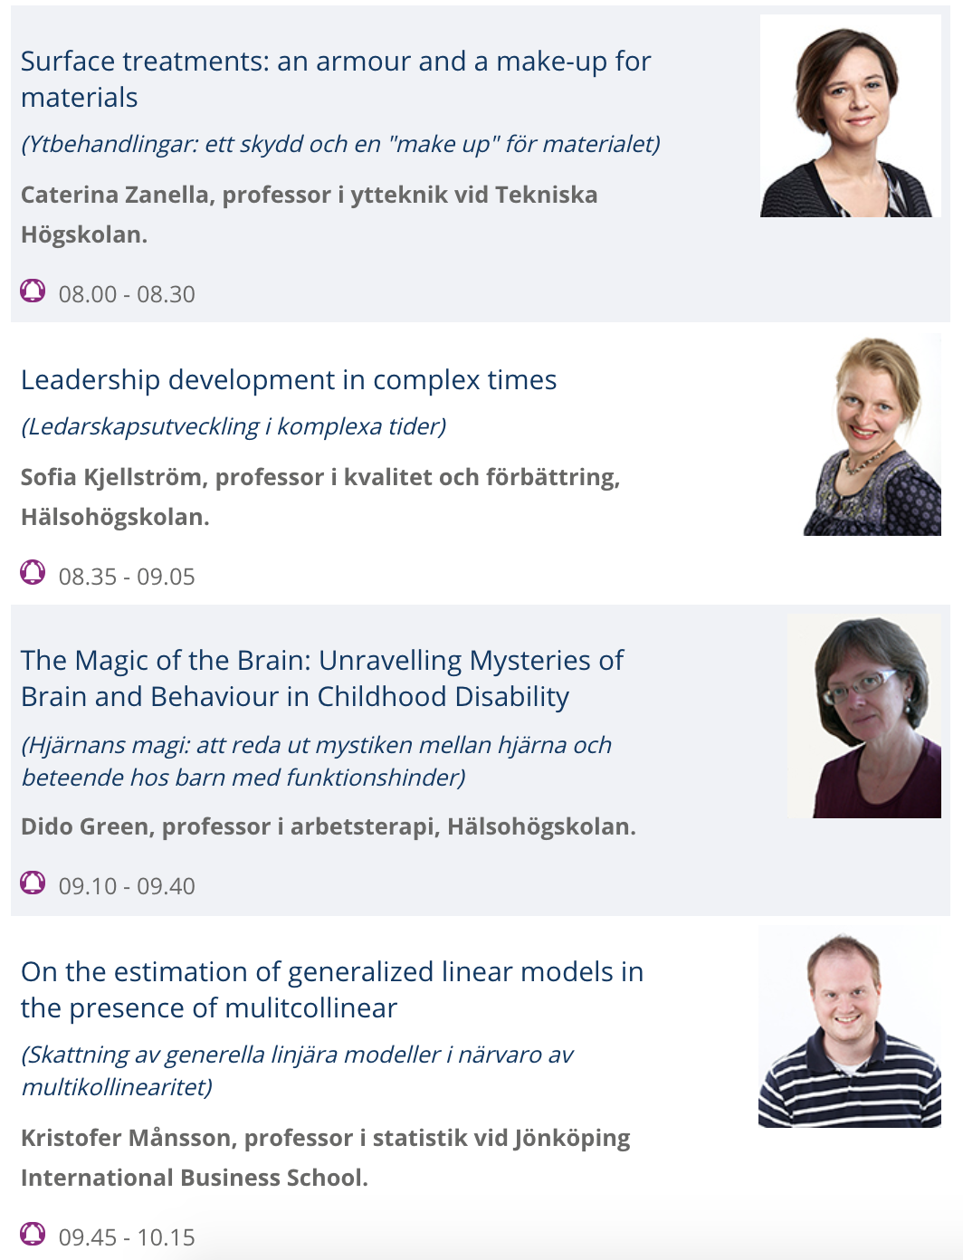
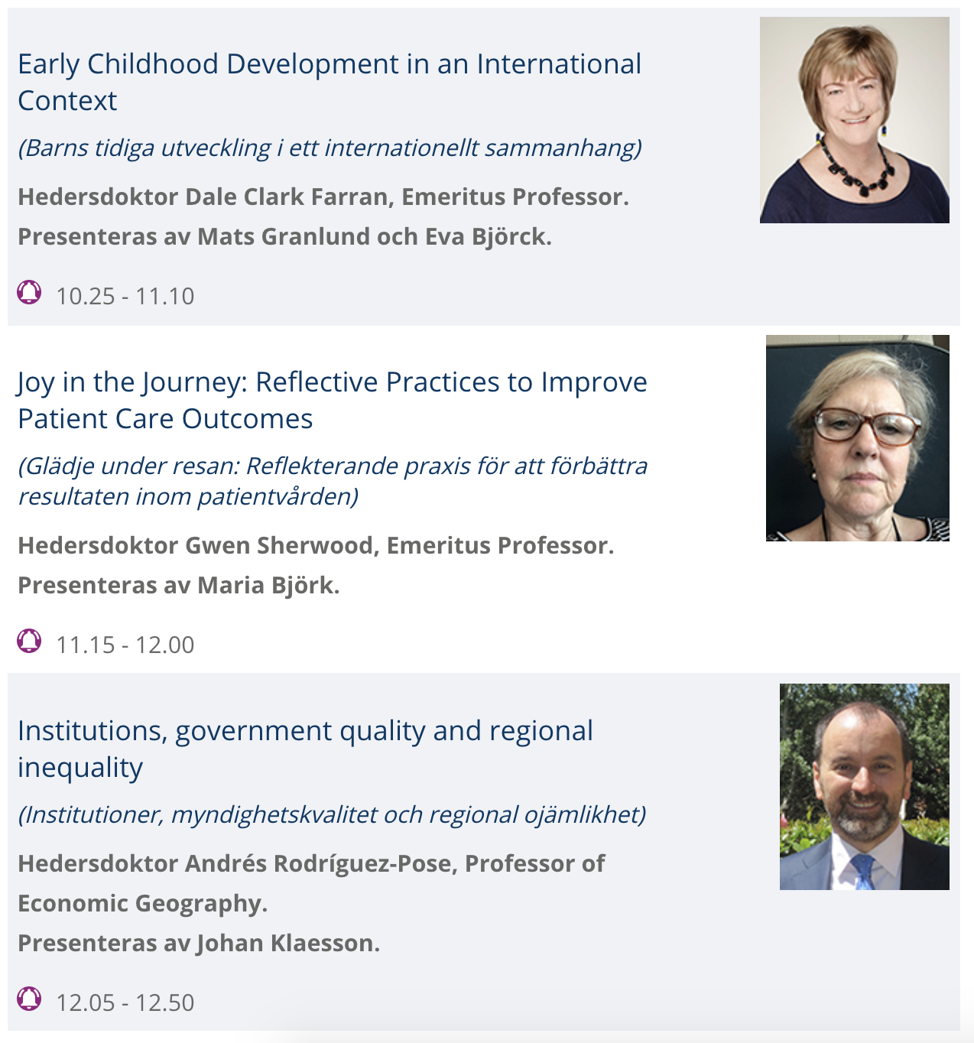
INAGURAL LECTURES
JU AULAN | Friday, October 11th 08.00 – 13.00
Charlotta Mellander, moderator

Slide 9
ACADEMIC CEREMONY
SPIRA | Saturday, October 12th 16.00 – 18.00

Slide 10
ACADEMIC CEREMONY
SPIRA | Saturday, October 12th 16.00 – 18.00
Kontaktperson: Ingegerd Skrealid, +46 (0)36 10 18 30, ingegerd.skrealid@ju.se

