Slide 1
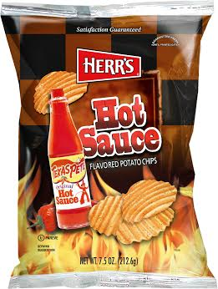
Texas Pete Potato Chips
Herr’s Hot Sauce Potato Chips
Art.nr: 11007
EAN: 072600076082
Storlek: 12x213g

