Slide 1
Stockholm Economy Q2 2017 September 2017

Slide 2
Stockholm Economy 2017 Q2
Mostly positive figures for Stockholm
The Stockholm economy continues to develop strongly which is shown by most indicators.
Aggregated gross pay data showed positive growth figures both for Stockholm County and the City of Stockholm compared to the same quarter in 2016. Information and communication, business services, trade and construction where the driving forces behind this development. Even though the number of company bankruptcies increases and newly registered businesses decreases, the sector strengthens by eight times more companies being started than the number of company bankruptcies. The labour market in Stockholm continued its strong development. During the last four quarters the number of persons employed increased by 30 600. Further the number of persons given notice decreased in both the county and the city. However both the number of people unemployed and the unemployment rate increased compared to the same quarter in 2016. The number of listed positions decreased in Stockholm and also in the rest of the country. The number of residents in the county and the city increased by 39 500 and 14 200 respectively during the last four quarters, representing increases by 1,8 percent and 1,5 percent. The number of housing projects started increased in both the county and the city in comparison to the same quarter last year. During the last four quarters construction increased in Stockholm County, while decreasing slightly in the City of Stockholm.
Olle Zetterberg
CEO Stockholm Business Region
About the report
The report is published each quarter by Stockholm Business Region.
The report includes Stockholm County and the City of Stockholm.
Statistics used is collected from Statistics Sweden, The Labour Exchange and The Swedish Companies Registration Office.
The report can be downloaded from:
http://www.stockholmbusinessregion.se/en/facts--figures/#facts-about-business
The Stockholm Region is defined as Stockholm County, Uppsala County, Södermanland County, Östergötland County, Örebro County, Västmanland County, Gävleborg County and Dalarna County. Individual county reports for the above mentioned can be found in Swedish here: http://www.stockholmbusinessalliance.se/konjunkturrapporter/
Questions can be addressed to Stefan Frid at Invest Stockholm. Publisher: Olle Zetterberg.

Slide 3
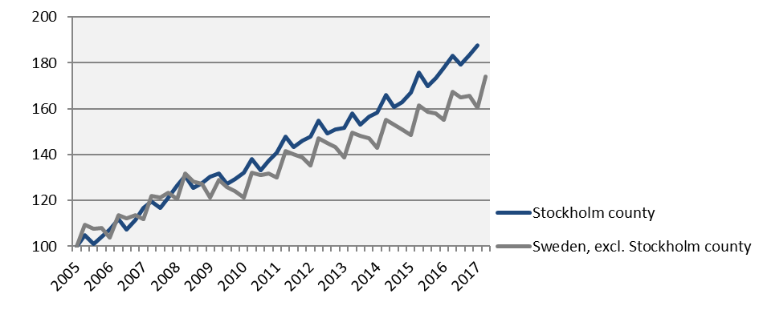
Economic growth, private sector Index 100 = 2005 Q1
 | 2017 Q2 | Change (%) since,
 | Billion SEK | 2005 Q1 | 2010 Q1 | 2016 Q2
Sweden | 321,7 | 80,8 | 44,9 | 5,0
The Stockholm Region | 165,5 | 87,6 | 46,1 | 5,8
Stockholm county | 108,2 | 95,8 | 48,2 | 7,0
City of Stockholm | 70,0 | i.u. | 48,4 | 5,6
Sweden, excl. Stockholm county | 213,5 | 74,0 | 43,4 | 4,0
Source: Statistics Sweden

Slide 4
Economic growth, 2017 Q2
 | Stockholm county |  |  |  |  | City of Stockholm
 |  | Growth (%) since, |  |  |  |  | Growth (%) since,
 | Billion SEK | 2009 Q1 | 2010 Q1 | 2016 Q2 |  | Billion SEK | 2009 Q1 | 2010 Q1 | 2016 Q2
Total | 131,2 | 48,1 | 46,2 | 6,6 |  | 81,2 | 48,2 | 46,0 | 5,6
Agriculture, forestry & fishing | 0,2 | 61,7 | 42,7 | -1,9 |  | 0,0 | 101,2 | 32,1 | -2,7
Manufacturing, mining, quarrying & utilities | 8,1 | -0,3 | 3,5 | -12,9 |  | 3,0 | -19,8 | -19,6 | -31,7
Energy & Environment | 1,2 | 55,0 | 53,1 | 6,4 |  | 0,5 | -4,8 | 6,9 | 3,5
Construction | 8,4 | 90,7 | 84,8 | 9,8 |  | 4,2 | 118,5 | 137,7 | 9,7
Trade | 16,8 | 41,7 | 35,5 | 5,1 |  | 9,4 | 44,4 | 35,9 | 3,8
Transport | 5,6 | 29,6 | 25,2 | 4,8 |  | 2,5 | 27,2 | 20,3 | 3,7
Accommodation & food services | 3,8 | 101,6 | 87,4 | 5,7 |  | 2,7 | 102,2 | 90,0 | 6,9
Information & communication | 14,8 | 58,8 | 64,2 | 22,2 |  | 12,3 | 67,1 | 73,4 | 22,8
Financial & insurance | 9,4 | 17,0 | 19,3 | 2,8 |  | 7,4 | 13,2 | 15,6 | 2,2
Real Estate | 2,5 | 83,6 | 77,3 | 7,1 |  | 1,8 | 81,6 | 77,7 | 8,2
Business services | 21,7 | 71,7 | 71,2 | 12,5 |  | 16,4 | 64,8 | 64,7 | 7,6
Public administration | 0,1 | 38,3 | 25,2 | -1,0 |  | 0,1 | 29,5 | 21,7 | -0,4
Education | 3,0 | 74,6 | 65,9 | 7,5 |  | 1,8 | 78,5 | 70,7 | 8,5
Health | 8,1 | 87,1 | 67,6 | 4,2 |  | 4,6 | 81,5 | 59,7 | 2,0
Personal & cultural services | 4,1 | 53,0 | 46,3 | 3,7 |  | 3,2 | 53,0 | 45,6 | 4,8
Unspecified | 0,2 | -8,3 | 8,9 | -5,9 |  | 0,1 | 56,6 | 24,6 | -20,1
Private sector | 108,2 | 50,2 | 48,2 | 7,0 |  | 70,0 | 50,1 | 48,4 | 5,6
State | 8,9 | 43,0 | 39,4 | 4,6 |  | 6,3 | 38,6 | 33,5 | 5,7
Municipal | 10,8 | 40,0 | 38,0 | 5,8 |  | 4,1 | 36,9 | 33,9 | 6,5
County council | 3,3 | 25,4 | 32,2 | 2,9 |  | 0,9 | 33,3 | 21,2 | 3,1
Public sector | 23,1 | 38,8 | 37,7 | 4,9 |  | 11,2 | 37,6 | 32,6 | 5,8
Source: Statistics Sweden

Slide 5
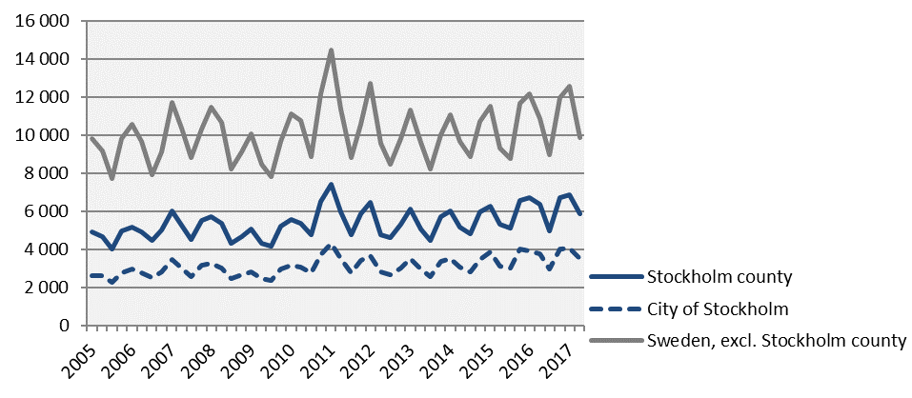
The number of newly registered businesses
 | 2017 Q2 |  | Yearly change*
 | Number | Ch., % | Number | Ch., %
Sweden | 15 770 | -8,5 | 67 829 | -0,8
The Stockholm Region | 8 530 | -7,5 | 35 977 | -1,1
Stockholm county | 5 884 | -7,7 | 24 426 | -1,6
City of Stockholm | 3 525 | -6,3 | 14 541 | -1,1
Sweden, excl. Stockholm county | 9 886 | -8,9 | 43 403 | -0,3
*Last four quarters
Source: The Swedish Companies Registration Office.

Slide 6
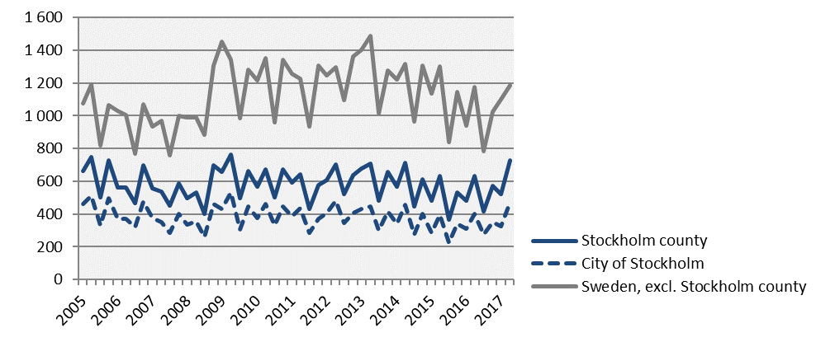
Company bankruptcies
 | 2017 Q2 |  | Yearly change*
 | Number | Ch., % | Number | Ch., %
Sweden | 1 913 | 6,0 | 6 327 | 3,7
The Stockholm Region | 1 060 | 15,0 | 3 348 | 10,5
Stockholm county | 726 | 15,1 | 2 234 | 11,2
City of Stockholm | 471 | 17,5 | 1 421 | 11,5
Sweden, excl. Stockholm county | 1 187 | 1,1 | 4 093 | 0,0
*Last four quarters
Source: Statistics Sweden

Slide 7
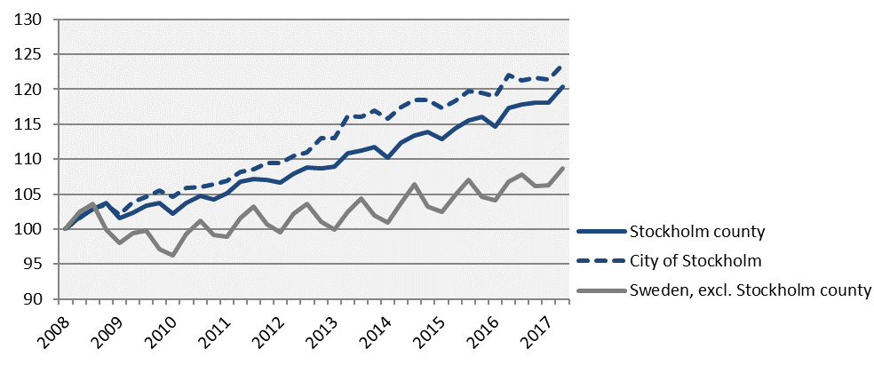
Employment Index 100 = 2008 Q1
 | Number | Growth | Growth (%) since,
 | 2017 Q2 | Yearly ch.* | 2008 Q1 | 2010 Q1 | 2016 Q2
Sweden | 5 033 900 | 99 400 | 11,4 | 14,1 | 2,0
The Stockholm Region | 2 301 100 | 38 400 | 14,1 | 14,8 | 1,7
Stockholm county | 1 232 000 | 30 600 | 20,3 | 17,6 | 2,5
City of Stockholm | 537 900 | 6 700 | 23,6 | 18,1 | 1,3
Sweden, excl. Stockholm county | 3 801 900 | 68 800 | 8,7 | 13,0 | 1,8
*Last four quarters
Source: Statistics Sweden

Slide 8
The number of employed people in Stockholm County
 | Number | Growth | Growth (%) since,
 | 2017 Q2 | Yearly ch.* | 2008 Q1 | 2010 Q1 | 2016 Q2
Total | 1 232 000 | 30 600 | 20,3 | 17,6 | 2,5
Agriculture, forestry & fishing | 3 400 | -400 | 6,3 | 6,3 | -10,5
Manufacturing, mining, quarrying & utilities | 60 500 | 2 100 | 4,0 | 3,6 | 3,6
Manufacturing of workshop products | 28 100 | -700 | -1,7 | -6,3 | -2,4
Construction | 69 400 | 300 | 15,7 | 22,2 | 0,4
Trade | 143 600 | 1 000 | 6,8 | 12,9 | 0,7
Transport | 57 300 | 1 700 | 7,9 | 5,1 | 3,1
Accommodation & food services | 51 500 | 3 600 | 43,9 | 38,8 | 7,5
Information & communication | 98 800 | 7 600 | 29,3 | 24,7 | 8,3
Arts, entertainment, recreation & other services | 73 800 | 1 600 | 18,1 | 15,3 | 2,2
Financial & insurance | 303 300 | 4 500 | 25,8 | 18,0 | 1,5
Public administration | 86 100 | 3 500 | 32,7 | 20,4 | 4,2
Education | 129 500 | 2 900 | 23,3 | 17,4 | 2,3
Health | 150 200 | 4 000 | 21,0 | 22,3 | 2,7
Unspecified | n.d. | n.d. | n.d. | n.d. | n.d.
Employed in Sweden | 1 228 600 | 31 100 | 20,4 | 17,7 | 2,6
Employed abroad | 3 400 | -500 | 0,0 | -8,1 | -12,8
Source: Statistics Sweden
*Last four quarters

Slide 9
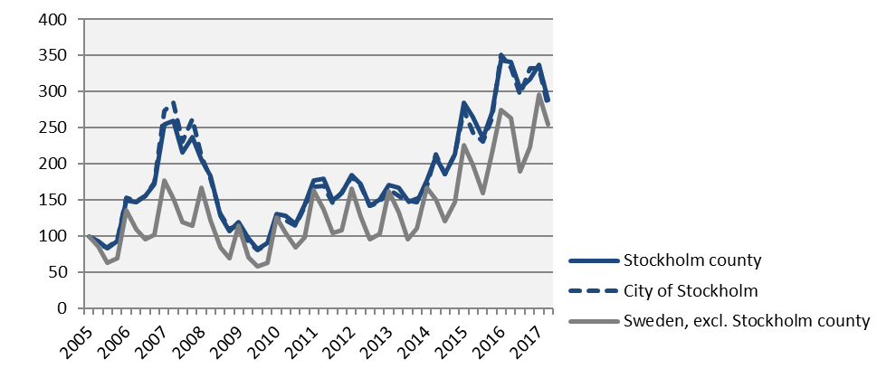
Number of recently listed positions Index 100 = 2005 Q1
 | 2017 Q2 |  | Yearly growth*
 | Number | Ch., % | Number | Ch., %
Sweden | 328 852 | -6,9 | 1 293 336 | 5,4
The Stockholm Region | 148 125 | -11,7 | 622 102 | 5,2
Stockholm county | 87 503 | -15,4 | 378 655 | 4,8
City of Stockholm | 56 565 | -16,1 | 250 914 | 5,1
Sweden, excl. Stockholm county | 241 349 | -3,4 | 914 681 | 5,6
*Last four quarters
Source: The Labor Exchange

Slide 10
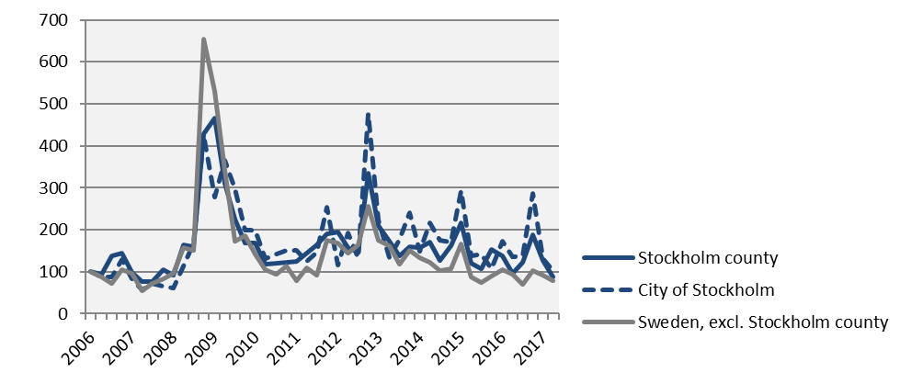
The number of people given notice Index 100 = 2006 Q1
 | 2017 Q2 |  | Yearly change*
 | Number | Ch., % | Number | Ch., %
Sweden | 7 701 | -14,2 | 36 127 | -2,1
The Stockholm Region | 3 170 | -15,6 | 17 390 | -1,8
Stockholm county | 1 781 | -8,7 | 10 613 | 6,4
City of Stockholm | 897 | -25,1 | 5 797 | 17,6
Sweden, excl. Stockholm county | 5 920 | -15,7 | 25 514 | -5,3
*Last four quarters
Source: The Labor Exchange

Slide 11
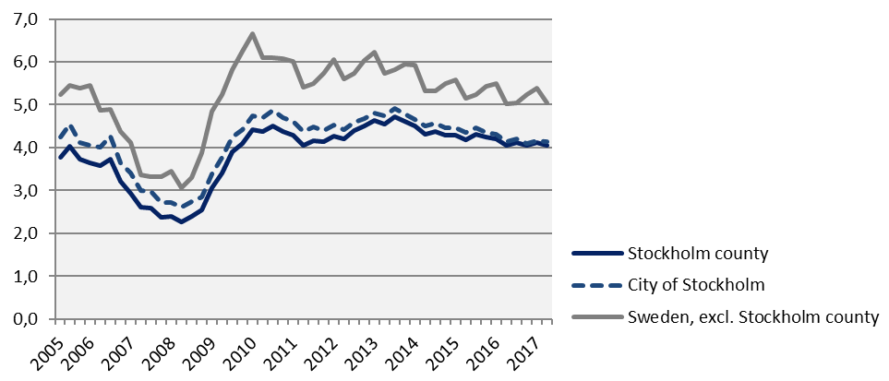
Unemployment in relation to the population (%), 15-74 years
 | Number | Yearly | Unemployed out of population, 15-74 years
 | 2017 Q2 | change* | 2010 Q1 | 2016 Q2 | 2017 Q2
Sweden | 356 444 | 4 698 | 6,2 | 4,8 | 4,8
The Stockholm Region | 157 579 | 2 516 | 5,7 | 4,7 | 4,7
Stockholm county | 69 407 | 1 326 | 4,4 | 4,0 | 4,1
City of Stockholm | 29 874 | 380 | 4,7 | 4,1 | 4,1
Sweden, excl. Stockholm county | 287 037 | 3 373 | 6,7 | 5,0 | 5,0
*Last four quarters
Source: The Labor Exchange and Statistics Sweden

Slide 12
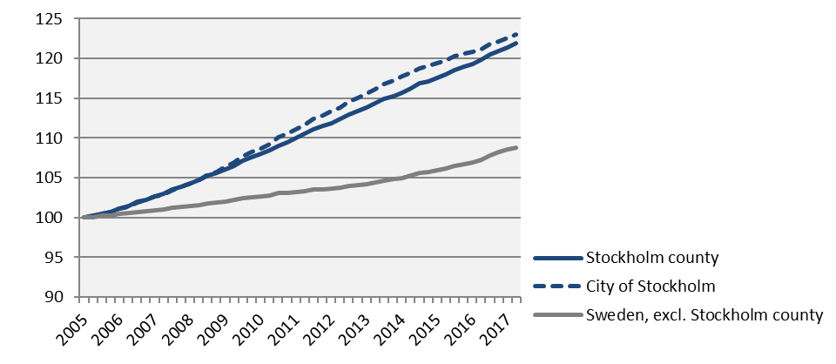
Population Index 100 = 2005 Q1
 | 2017 Q2 | Yearly ch.* | Growth (%) since,
 | (in thousands) |  | 2005 Q1 | 2010 Q1 | 2016 Q2
Sweden | 10 053,1 | 146,7 | 11,5 | 7,5 | 1,5
The Stockholm Region | 4 533,6 | 72,0 | 15,0 | 9,5 | 1,6
Stockholm county | 2 288,0 | 39,5 | 21,9 | 12,9 | 1,8
City of Stockholm | 942,4 | 14,2 | 23,0 | 13,2 | 1,5
Sweden, excl. Stockholm county | 7 765,1 | 107,3 | 8,8 | 6,0 | 1,4
*Last four quarters
Source: Statistics Sweden

Slide 13
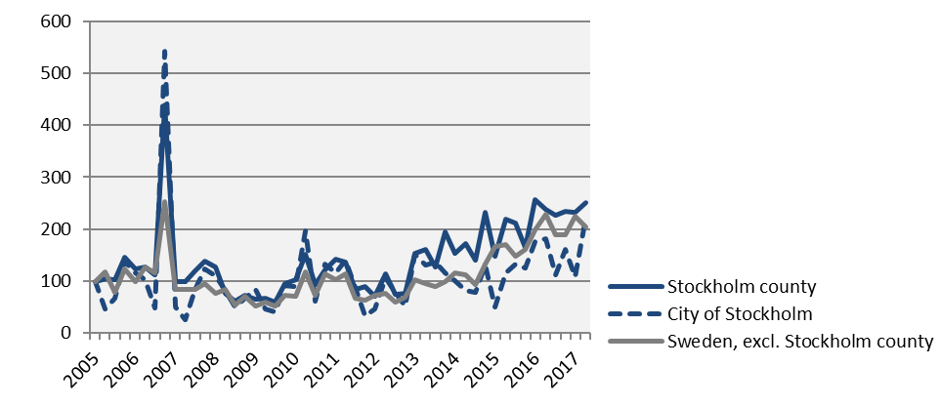
Number of housing projects started Index 100 = 2005 Q1
 | 2017 Q2 |  | Yearly change*
 | Number | Ch., % | Number | Ch., %
Sweden | 19 667 | -7,2 | 76 810 | 9,5
The Stockholm Region | 8 932 | 4,9 | 32 344 | 8,5
Stockholm county | 4 859 | 5,6 | 18 249 | 8,5
City of Stockholm | 2 336 | 23,6 | 6 312 | -2,0
Sweden, excl. Stockholm county | 14 808 | -10,8 | 58 561 | 9,8
*Last four quarters
Source: Statistics Sweden

Slide 14
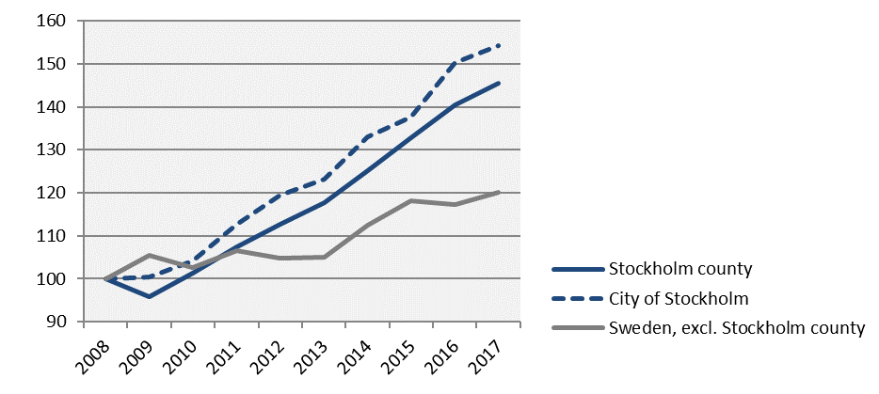
Commercial Accommodations Index 100 = 2008 Q2 (Q2, 2008 - 2017)
 | 2017 Q2 | Yearly ch.* | Growth (%) since,
 | (in thousands) |  | 2008 Q2 | 2010 Q2 | 2016 Q2
Sweden | 15 049 | 62 487 | 25,3 | 22,5 | 2,6
The Stockholm Region | 6 276 | 26 041 | 29,1 | 25,6 | 3,0
Stockholm county | 3 617 | 13 784 | 45,4 | 43,5 | 3,5
City of Stockholm | 2 441 | 9 285 | 54,2 | 48,2 | 2,6
Sweden, excl. Stockholm county | 11 432 | 48 703 | 20,1 | 17,1 | 2,4
*Last four quarters
Source: Statistics Sweden and Swedish Agency for Economic and Regional Growth

Slide 15
Stockholm Business Region Stockholm Business Region is responsible for developing and promoting Stockholm as a business and tourist destination under the brand Stockholm - The Capital of Scandinavia. The aim is to make Stockholm the leading sustainable growth region in Europe. Stockholm Business Region is owned by the city of Stockholm and has two subsidiaries Invest Stockholm and Visit Stockholm. For questions: Contact Stefan Frid, Invest Stockholm. Publisher: Olle Zetterberg, CEO Stockholm Business Region Stockholm Business Region P.O. Box 16282 SE-103 25 Stockholm, Sweden Phone + 46 8 508 280 00 www.visitstockholm.com www.investstockholm.com www.stockholmbusinessregion.se

