Slide 1
The Stockholm Economy Stockholm County and City, 2018 Q1 June 20, 2018 Stockholm Business Region

Slide 2
About the report
The report is published each quarter by Stockholm Business Region.
The report includes Stockholm County and the City of Stockholm.
Statistics used is collected from Statistics Sweden, The Swedish Public Employment Service and The Swedish Companies Registration Office.
To show development over time, the change from the corresponding quarter the previous year is mainly used in the report. A rolling 12 month-value is used for some indicators, where the last four quarters are summarized in order to show a more stable development. This metric is then compared to the previous four quarters. Diagrams displaying absolute values have been deseasonalized in order to show the trend over time. The rest of the diagrams use indexed values, showing the percentage change from the starting year with index value 100 (in most cases the corresponding quarter 10 years ago).
The report can be downloaded from:
http://www.stockholmbusinessregion.se/en/facts--figures/#facts-about-business
The Stockholm Region is defined as Stockholm County, Uppsala County, Södermanland County, Östergötland County, Örebro County, Västmanland County, Gävleborg County and Dalarna County.
Individual county reports for the above mentioned can be found in Swedish here: http://www.stockholmbusinessalliance.se/konjunkturrapporter/
Questions can be addressed to Stefan Frid at Invest Stockholm. Publisher: Olle Zetterberg.

Slide 3
The Stockholm Economy 2018 Q1
Signs of cooled off business cycle for Stockholm
The Stockholm economy is still in a boom, but shows signs of coolening off in comparison to 2017. The economy and the population grows, but construction of housing projects has decreased from last year’s strong figures.
Aggregated gross pay data showed positive growth figures both for Stockholm County and the City of Stockholm compared to the same quarter in 2017. Information and communication, and construction where the driving forces behind this development. The number of newly registered businesses decreased as well as the number of company bankruptcies.
The labour market in Stockholm remains strong but with some indicators showing a weaker development. During the last four quarters the number of persons employed increased by 27 900. Employment in healthcare, construction and finance however decreased. The number of persons given notice increased in both the county and the city. The unemployment rate remained unchanged in both the county and the city. The number of listed positions however decreased during the first quarter in Stockholm county and city. The number of residents in the county and the city increased by 37 800 and 12 800 respectively during the last four quarters, representing increases by 1,7 percent and 1,4 percent. The number of housing projects started decreased substantially in both the county and the city in comparison to the same quarter last year. Worth mentioning is however that housing construction has been extraordinarily high during recent years.
Olle Zetterberg
CEO Stockholm Business Region
 | Stockholm county |  |  |  | City of Stockholm
Indicator | Value 2018 Q1 | Change (%) |  |  | Value 2018 Q1 | Change (%)
 |  | -1 year |  |  |  | -1 year
Aggr. gross pay private sector (billion SEK) | 109 | 4,7 | é |  | 72 | 5,7 | é
Newly registered businesses | 6 069 | -11,4 | ê |  | 3 552 | -12,3 | ê
Company bankruptcies | 449 | -13,5 | ê |  | 264 | -19,3 | ê
Employment | 1 236 700 | 2,3 | é |  | 535 600 | 1,3 | é
Recently listed positions | 102 042 | -0,1 | ê |  | 66 162 | -1,7 | ê
No. of people given notice | 2 568 | 0,9 | é |  | 1 399 | 21,3 | é
Unemployment (%) | 4,1 | 0,0 pts.* |  |  | 4,2 | 0,0 pts.*
Population (in thousands) | 2 315,6 | 1,7 | é |  | 952,1 | 1,4 | é
Housing projects started | 2 315 | -49,1 | ê |  | 510 | -54,2 | ê
Commercial accomodations (in thousands) | 2 773 | 3,8 | é |  | 1 852 | 3,7 | é
*Change of unemployment in percentage points, not in percentage.

Slide 4
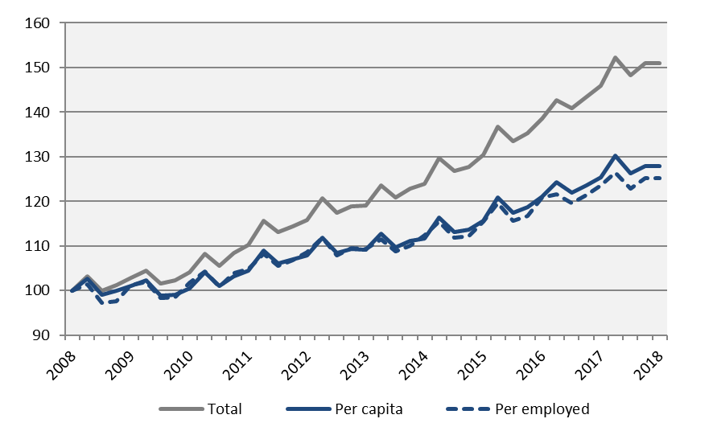
Economic growth
Aggregated gross pay, Stockholm county
Index 100 = 2008 Q1
Aggregated gross pay, total
 | 2018 Q1 | Change -1 year | Change (%)
 | Billion SEK | Billion SEK | -1 year | -5 years
Sweden | 437,4 | 20,4 | 4,9 | 24,4
Stockholm Region | 215,9 | 9,6 | 4,7 | 25,7
Stockholm county | 131,7 | 5,8 | 4,6 | 28,2
City of Stockholm | 82,9 | 4,3 | 5,5 | 29,1
Sweden, excl. Stockholm county | 305,7 | 14,6 | 5,0 | 22,9
Aggregated gross pay per employed
 | 2018 Q1 | Change -1 year | Change (%)
 | Thousand SEK | Thousand SEK | -1 year | -5 years
Sweden | 87,2 | 2,5 | 3,0 | 14,3
Stockholm Region | 93,5 | 1,8 | 1,9 | 14,4
Stockholm county | 106,5 | 2,4 | 2,3 | 15,6
City of Stockholm | 154,7 | 6,2 | 4,2 | 18,6
Sweden, excl. Stockholm county | 80,9 | 2,5 | 3,2 | 13,6
Aggregated gross pay per capita
 | 2018 Q1 | Change -1 year | Change (%)
 | Thousand SEK | Thousand SEK | -1 year | -5 years
Sweden | 43,2 | 1,6 | 3,9 | 17,7
Stockholm Region | 47,3 | 1,6 | 3,5 | 17,9
Stockholm county | 57,0 | 1,8 | 3,2 | 18,6
City of Stockholm | 87,3 | 3,7 | 4,4 | 20,4
Sweden, excl. Stockholm county | 39,1 | 1,6 | 4,1 | 17,0
Source: Statistics Sweden

Slide 5
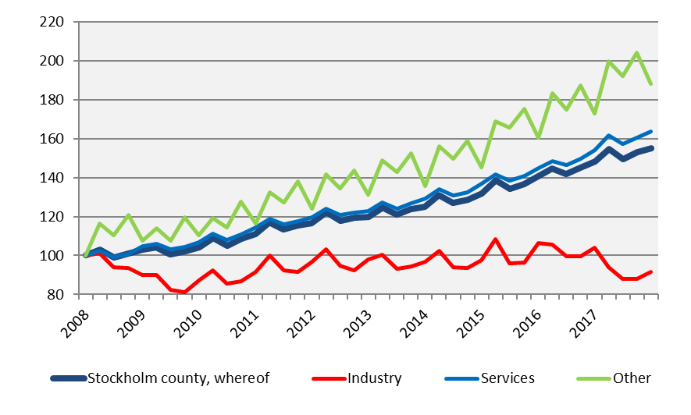
Economic growth by sector
Aggregated gross pay private sector, by industry, Stockholm county
Index 100 = 2008 Q1
 | 2018 Q1 | Change | Change (%)
 | mdkr | -1 year (billion SEK) | -1 year | -5 years
Sweden
Private sector | 316,2 | 15,6 | 5,2 | 24,5
Industry | 64,4 | 3,4 | 5,5 | 7,9
Services | 218,7 | 8,9 | 4,3 | 28,9
Other* | 33,2 | 3,3 | 11,1 | 34,7
Public sector | 121,2 | 4,8 | 4,1 | 24,2
Total | 437,4 | 20,4 | 4,9 | 24,4
The Stockholm Region
Private sector | 164,1 | 7,4 | 4,7 | 26,2
Industry | 25,0 | -0,8 | -3,2 | 1,2
Services | 123,7 | 7,0 | 6,0 | 31,3
Other* | 15,4 | 1,3 | 9,1 | 38,2
Public sector | 51,8 | 2,2 | 4,5 | 24,2
Total | 215,9 | 9,6 | 4,7 | 25,7
Stockholm county
Private sector | 108,5 | 4,9 | 4,7 | 29,5
Industry | 9,1 | -1,3 | -12,1 | -6,9
Services | 91,1 | 5,4 | 6,4 | 33,5
Other* | 8,3 | 0,7 | 8,8 | 43,3
Public sector | 23,2 | 1,0 | 4,3 | 22,4
Total | 131,7 | 5,8 | 4,6 | 28,2
Source: Statistics Sweden
*Other includes, agriculture, forestry and fishing, construction and unspecified sectors

Slide 6
Economic growth, 2018 Q1
 | Stockholm county |  |  |  | City of Stockholm
 |  | Change (%) |  |  |  | Change (%)
 | Billion SEK | -1 year | -5 years |  | Billion SEK | -1 year | -5 years
Agriculture, forestry & fishing | 0,1 | 0,6 | 16,1 |  | 0,0 | 3,4 | 21,5
Manufacturing, mining, quarrying & utilities | 7,9 | -14,4 | -10,6 |  | 3,0 | -30,5 | -29,2
Energy & Environment | 1,2 | 5,7 | 27,6 |  | 0,5 | -1,0 | 26,1
Construction | 7,9 | 8,9 | 45,8 |  | 4,0 | 8,1 | 77,7
Trade | 17,2 | 3,7 | 26,9 |  | 9,8 | 2,4 | 29,0
Transport | 5,6 | 4,1 | 18,2 |  | 2,5 | 3,0 | 22,4
Accommodation & food services | 3,6 | 3,8 | 38,4 |  | 2,6 | 4,2 | 40,4
Information & communication | 15,3 | 17,4 | 46,6 |  | 12,9 | 22,3 | 52,1
Financial & insurance | 10,6 | 5,3 | 29,1 |  | 8,1 | 4,6 | 12,7
Real Estate | 2,3 | 6,8 | 41,7 |  | 1,7 | 6,4 | 44,8
Business services | 21,2 | 4,9 | 38,8 |  | 16,9 | 8,1 | 38,7
Public administration | 0,1 | 6,3 | 7,1 |  | 0,1 | 7,5 | 14,2
Education | 3,1 | 6,4 | 33,2 |  | 1,8 | 7,2 | 34,0
Health | 8,0 | 1,4 | 31,6 |  | 4,6 | 1,8 | 28,0
Personal & cultural services | 4,1 | 6,1 | 25,0 |  | 3,2 | 6,7 | 26,6
Unspecified | 0,2 | 11,1 | -6,1 |  | 0,1 | 16,3 | 6,3
Private sector | 108,5 | 4,7 | 29,5 |  | 71,6 | 5,7 | 30,4
State | 8,9 | 3,5 | 17,9 |  | 6,2 | 3,6 | 15,6
Municipal | 10,9 | 4,8 | 26,9 |  | 4,1 | 5,2 | 30,7
County council | 3,4 | 4,9 | 20,5 |  | 0,9 | 4,7 | 21,9
Public sector | 23,2 | 4,3 | 22,4 |  | 11,2 | 4,3 | 21,3
Total | 131,7 | 4,6 | 28,2 |  | 82,9 | 5,5 | 29,1
Source: Statistics Sweden

Slide 7
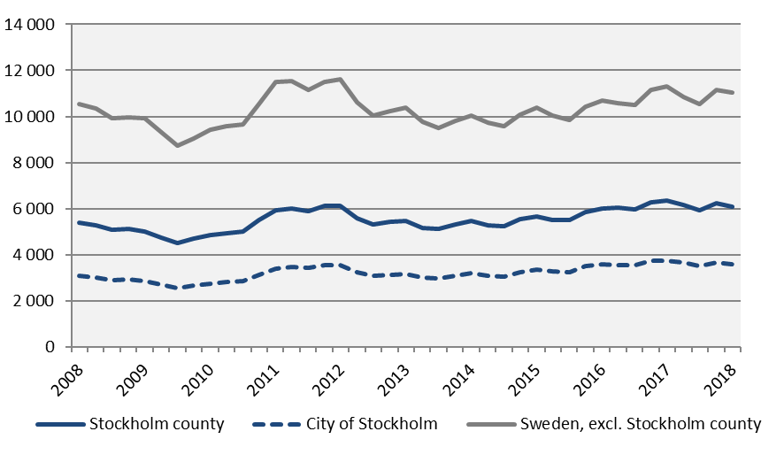
Newly registered businesses
Newly registered businessses
Deseasonalized values (moving average)
 | Number | Change (%) |  | R12*
 | 2018 Q1 | - 1 year | - 5 years | Number | Ch., %
Sweden | 17 421 | -10,3 | -0,1 | 66 105 | -4,6
The Stockholm Region | 9 083 | -11,7 | 0,0 | 34 944 | -4,7
Stockholm county | 6 069 | -11,4 | -0,6 | 23 574 | -5,4
City of Stockholm | 3 552 | -12,3 | 0,5 | 13 802 | -6,6
Sweden, excl. Stockholm county | 11 352 | -9,7 | 0,1 | 42 531 | -4,2
*Last four quarters
Source: The Swedish Companies Registration Office.

Slide 8
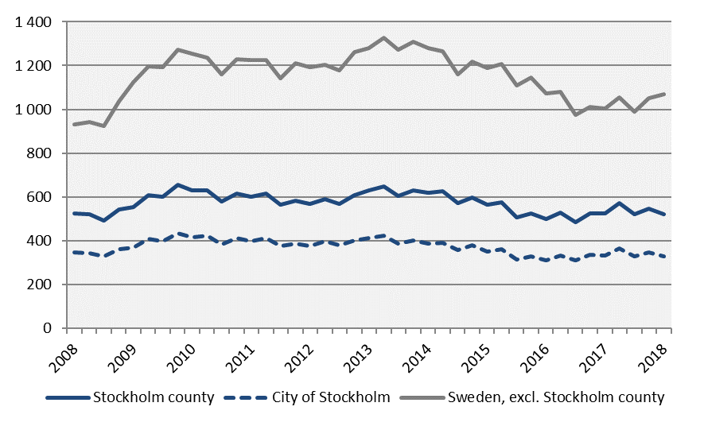
Company bankruptcies
Company bankruptcies
Deseasonalized values (moving average)
 | Number | Change (%) |  | R12*
 | 2018 Q1 | - 1 year | - 5 years | Number | Ch., %
Sweden | 1 561 | -3,6 | -24,8 | 6 335 | 1,9
The Stockholm Region | 744 | -11,1 | -27,4 | 3 221 | 0,3
Stockholm county | 449 | -13,5 | -33,5 | 2 091 | -2,2
City of Stockholm | 264 | -19,3 | -38,5 | 1 320 | -2,3
Sweden, excl. Stockholm county | 1 112 | 1,0 | -20,6 | 4 244 | 4,0
*Last four quarters
Source: Statistics Sweden

Slide 9
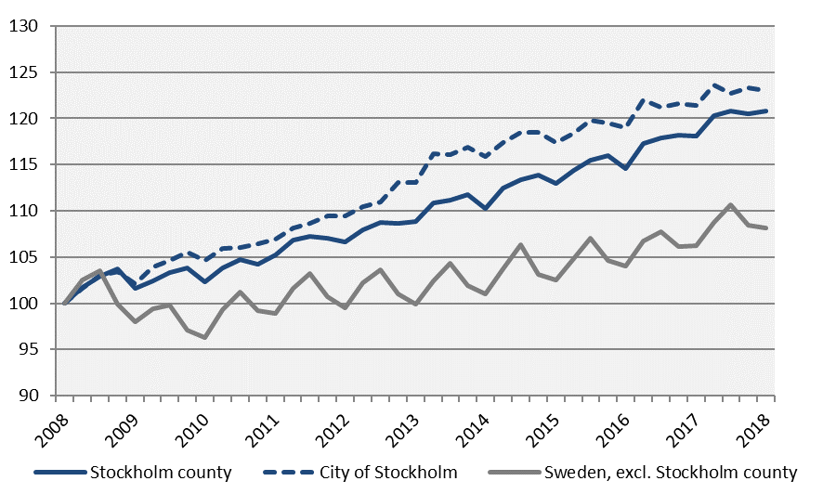
Employment
Employed population
Index 100 = 2008 Q1
 | Number | Change | Change (%)
 | 2018 Q1 | -1 year (number) | - 1 year | - 5 years
Sweden | 5 017 100 | 92 700 | 1,9 | 8,9
Stockholm Region | 2 308 300 | 60 200 | 2,7 | 9,9
Stockholm county | 1 236 700 | 27 900 | 2,3 | 10,9
City of Stockholm | 535 600 | 7 000 | 1,3 | 8,8
Sweden, excl. Stockholm county | 3 780 400 | 64 800 | 1,7 | 8,2
Source: Statistics Sweden

Slide 10
The number of employed people Stockholm County
 | Number | Change | Change (%)
 | 2018 Q1 | -1 year (number) | - 1 year | - 5 years
Total | 1 236 700 | 27 900 | 2,3 | 10,9
Agriculture, forestry & fishing | n.d. | n.d. | n.d. | n.d.
Manufacturing, mining, quarrying & utilities | 68 100 | 9 600 | 16,4 | 17,0
Manufacturing of workshop products | 30 100 | 3 400 | 12,7 | 6,0
Construction | 68 500 | -1 800 | -2,6 | 5,9
Trade | 141 500 | 3 600 | 2,6 | 8,5
Transport | 57 400 | 1 800 | 3,2 | 3,1
Accommodation & food services | 52 000 | 2 200 | 4,4 | 34,0
Information & communication | 108 800 | 14 300 | 15,1 | 20,9
Arts, entertainment, recreation & other services | 76 500 | 1 400 | 1,9 | 14,2
Financial & insurance | 294 900 | -5 900 | -2,0 | 11,6
Public administration | 90 800 | 7 100 | 8,5 | 25,6
Education | 131 200 | 2 600 | 2,0 | 9,3
Health | 139 600 | -6 300 | -4,3 | 0,7
Unspecified | n.d. | n.d. | n.d. | n.d.
Employed in Sweden | 1 232 900 | 28 300 | 2,3 | 11,1
Employed abroad | 3 700 | -400 | -9,8 | -35,1
Source: Statistics Sweden

Slide 11
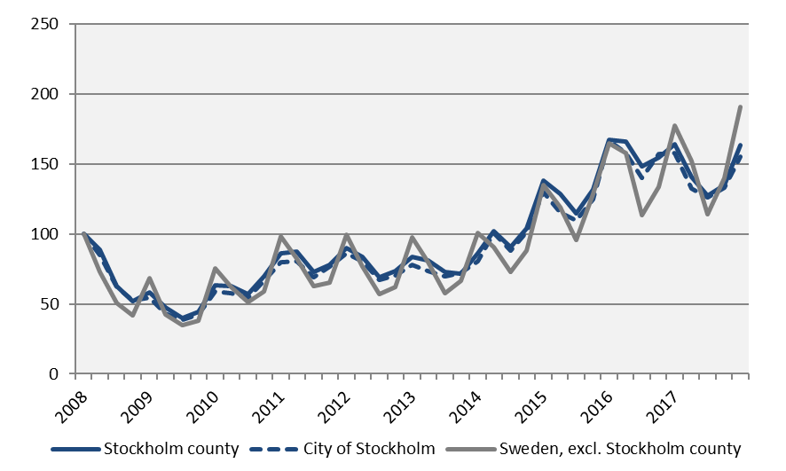
Recently listed positions
Recently listed positions at the Swedish Public Employment Service
Index 100 = 2008 Q1
 | Number | Change (%) |  | R12*
 | 2018 Q1 | - 1 year | - 5 years | Number | Ch., %
Sweden | 404 158 | 5,4 | 96,1 | 1 299 314 | -1,4
The Stockholm Region | 187 437 | 4,1 | 93,4 | 599 407 | -6,6
Stockholm county | 102 042 | -0,1 | 96,2 | 352 955 | -10,5
City of Stockholm | 66 162 | -1,7 | 98,7 | 233 470 | -10,8
Sweden, excl. Stockholm county | 302 116 | 7,4 | 96,0 | 946 359 | 2,5
*Last four quarters
Source: The Swedish Public Employment Service

Slide 12
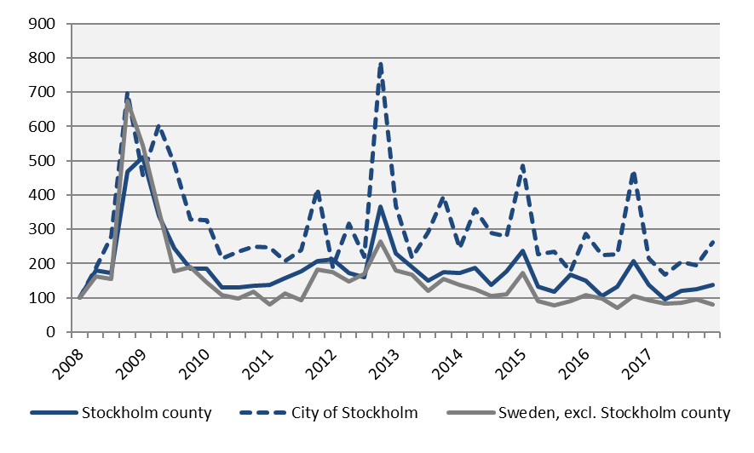
The number of people given notice
The number of people given notice
Index 100 = 2008 Q1
 | Number | Change (%) |  | R12*
 | 2018 Q1 | - 1 year | - 5 years | Number | Ch., %
Sweden | 8 317 | -11,0 | -51,7 | 33 549 | -10,3
The Stockholm Region | 4 178 | -4,5 | -49,5 | 16 099 | -10,4
Stockholm county | 2 568 | 0,9 | -39,6 | 8 871 | -17,7
City of Stockholm | 1 399 | 21,3 | -29,1 | 4 438 | -27,2
Sweden, excl. Stockholm county | 5 749 | -15,5 | -55,6 | 24 678 | -7,3
*Last four quarters
Source: The Swedish Public Employment Service

Slide 13
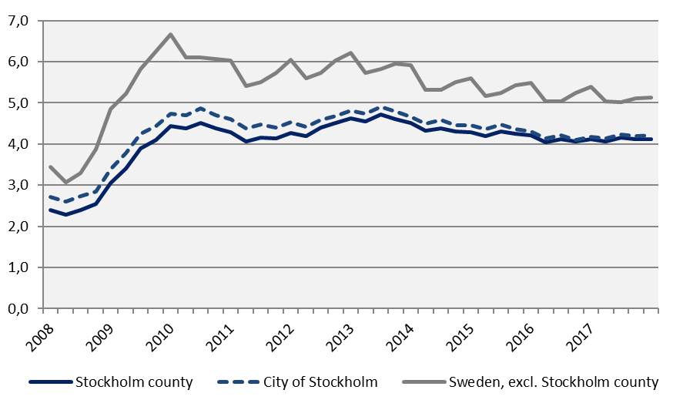
Unemployment
Unemployment in relation to the population (%), 15-74 years
 | Number | Yearly | Unemployed out of population, 15-74 years
 | 2018 Q1 | change* | 2018 Q1 | -1 year | -5 years
Sweden | 365 499 | -11 253 | 4,9 | 5,1 | 5,9
The Stockholm Region | 159 915 | -3 947 | 4,7 | 4,9 | 5,5
Stockholm county | 71 338 | 1 248 | 4,1 | 4,1 | 4,6
City of Stockholm | 30 703 | 625 | 4,2 | 4,2 | 4,8
Sweden, excl. Stockholm county | 294 160 | -12 501 | 5,1 | 5,4 | 6,2
*Last four quarters
Source: The Swedish Public Employment Service and Statistics Sweden

Slide 14
Youth unemployment and long-term unemployment
 | No. of persons | Change | Change (%)
Stockholm county | 2018 Q1 | -1 year (number) | -1 year | -5 years
Total no. of unemployed | 71 338 | 1 248 | 1,8 | -4,4
Open unemployment | 44 453 | 2 146 | 5,1 | -3,4
whereof long-term unemployment | 14 817 | 1 467 | 11,0 | 15,8
whereof youth unemployment | 3 825 | -9 | -0,2 | -35,3
Active labour market programmes | 26 885 | -898 | -3,2 | -6,1
whereof youth in active labour market programmes | 3 102 | -334 | -9,7 | -41,6
City of Stockholm
Total no. of unemployed | 30 703 | 625 | 2,1 | -6,5
Open unemployment | 19 618 | 1 036 | 5,6 | -4,5
whereof long-term unemployment | 6 602 | 891 | 15,6 | 21,6
whereof youth unemployment | 1 542 | 76 | 5,2 | -33,6
Active labour market programmes | 11 085 | -411 | -3,6 | -9,8
whereof youth in active labour market programmes | 1 053 | -46 | -4,2 | -35,9
Source: The Swedish Public Employment Service

Slide 15
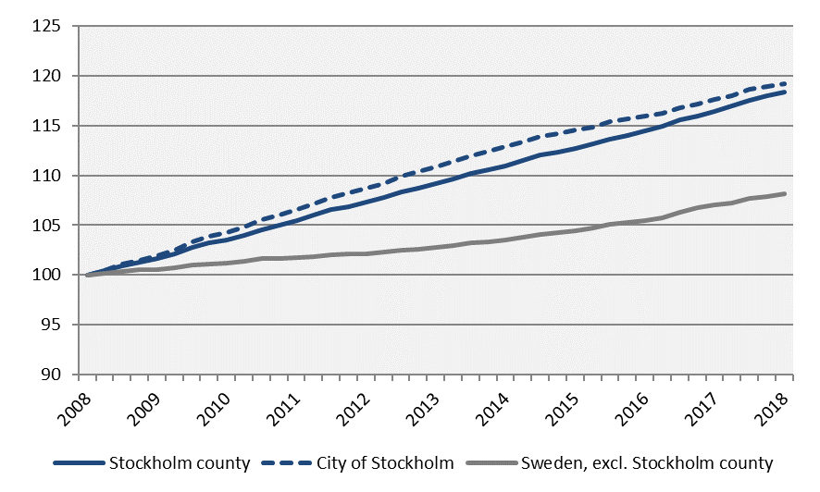
Population
Population growth
Index 100 = 2008 Q1
 | 2018 Q1 | Change -1 year | Change (%)
 | (in thousands) |  | -1 year | -5 years
Sweden | 10 142,7 | 118,8 | 1,2 | 5,9
The Stockholm Region | 4 579,8 | 62,4 | 1,4 | 6,9
Stockholm county | 2 315,6 | 37,8 | 1,7 | 8,4
City of Stockholm | 952,1 | 12,8 | 1,4 | 7,5
Sweden, excl. Stockholm county | 7 827,1 | 81,0 | 1,0 | 5,2
Source: Statistics Sweden

Slide 16
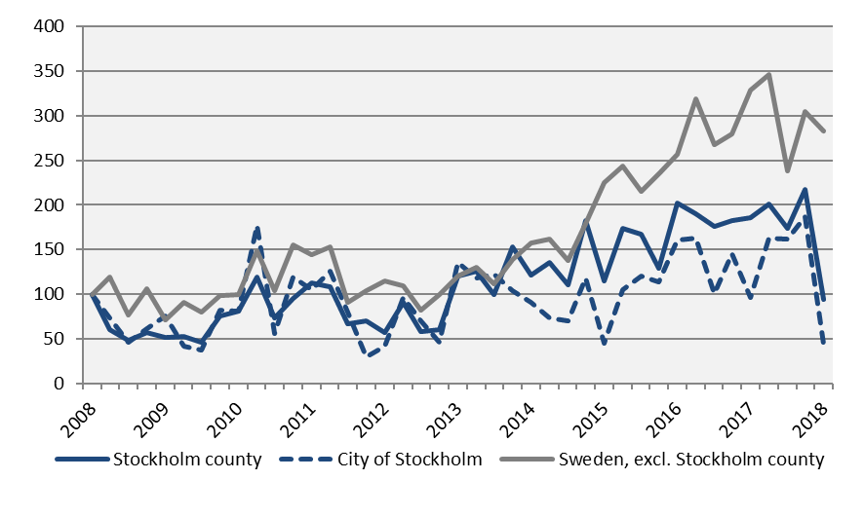
Housing projects started
Number of housing projects started
Index 100 = 2008 Q1
 | Number | Change (%) |  | R12*
 | 2018 Q1 | - 1 year | - 5 years | Number | Ch., %
Sweden | 12 672 | -23,5 | 72,3 | 59 687 | -3,3
The Stockholm Region | 5 610 | -31,2 | 25,7 | 31 060 | -3,0
Stockholm county | 2 315 | -49,1 | -21,3 | 16 795 | -6,6
City of Stockholm | 510 | -54,2 | -67,6 | 6 432 | 9,9
Sweden, excl. Stockholm county | 10 357 | -13,8 | 134,6 | 42 892 | -1,9
*Last four quarters
Source: Statistics Sweden

Slide 17
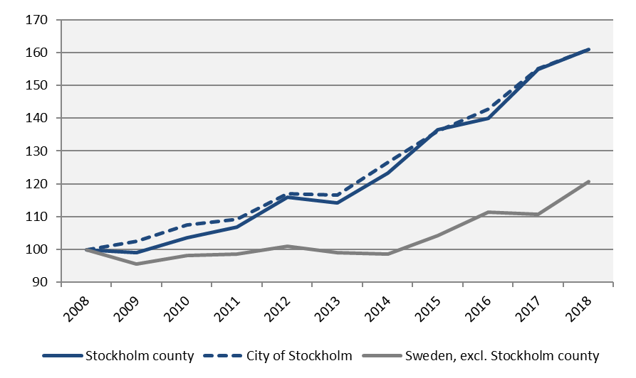
Commercial Accommodations
Commercial accomodations (city: hotels, hostels, cabin villages, county: also include camp sites)
Index 100 = 2008 Q1 (Q1, 2008-2018)
 | 2018 Q1 | Change (%) |  | R12*
 | (thousands) | -1 year | -5 years | (thousands) | Ch., %
Sweden | 12 512 | 7,8 | 25,6 | 64 112 | 3,4
The Stockholm Region | 6 151 | 6,5 | 23,8 | 26 672 | 3,2
Stockholm county | 2 773 | 3,8 | 40,9 | 14 149 | 3,3
City of Stockholm | 1 852 | 3,7 | 38,0 | 9 407 | 2,0
Sweden, excl. Stockholm county | 9 739 | 9,0 | 21,8 | 49 963 | 3,4
*Last four quarters
Source: Statistics Sweden and Swedish Agency for Economic and Regional Growth

Slide 18
Entrepreneurship
The Stockholm county municipalities
 | Newly registered businesses |  | Company bankruptcies
 | Number | Change (%) | Number | Change (%)
 | 2018 Q1 | -1 year | 2018 Q1 | -1 year
Stockholms county | 6 069 | -11,4 | 449 | -13,5
Upplands Väsby | 51 | -44,0 | 9 | 125,0
Vallentuna | 58 | -13,4 | 2 | 0,0
Österåker | 84 | -20,0 | 8 | 33,3
Värmdö | 83 | -15,3 | 10 | 150,0
Järfälla | 137 | 10,5 | 9 | -10,0
Ekerö | 64 | -5,9 | 5 | 150,0
Huddinge | 186 | -11,0 | 18 | 20,0
Botkyrka | 124 | -6,1 | 9 | -18,2
Salem | 18 | -51,4 | 2 | 100,0
Haninge | 133 | -22,7 | 8 | -42,9
Tyresö | 73 | -12,0 | 9 | 0,0
Upplands-Bro | 35 | -16,7 | 6 | 100,0
Nykvarn | 22 | -12,0 | 1 | n.d.
Täby | 166 | -5,1 | 8 | -42,9
Danderyd | 114 | 1,8 | 2 | 0,0
Sollentuna | 132 | -8,3 | 6 | -40,0
Stockholm | 3 552 | -12,3 | 264 | -19,3
Södertälje | 147 | -13,5 | 14 | 0,0
Nacka | 255 | 2,0 | 14 | 7,7
Sundbyberg | 80 | -12,1 | 9 | 80,0
Solna | 179 | -5,8 | 11 | -42,1
Lidingö | 118 | -12,6 | 0 | -100,0
Vaxholm | 33 | 32,0 | 2 | 100,0
Norrtälje | 107 | -13,7 | 12 | 20,0
Sigtuna | 75 | -23,5 | 9 | -18,2
Nynäshamn | 43 | 22,9 | 2 | -66,7

Slide 19
The labour market and population
The Stockholm county municipalities
 | Recently listed positions |  | People given notice |  | Unemployment (no. of persons) |  | Population
 | Number | Change (%) | Number | Change (%) | Number | Change (%) | Number | Change (%)
 | 2018 Q1 | -1 year | 2018 Q1 | -1 year | 2018 Q1 | -1 year | 2018 Q1 | -1 year
Stockholm county | 102 042 | -0,1 | 2 568 | 0,9 | 71 338 | 1,8 | 2 315 612 | 1,7
Upplands Väsby | 1 611 | 7,2 | 90 | 328,6 | 1 433 | 3,9 | 44 788 | 1,6
Vallentuna | 528 | 1,3 | 0 | -100,0 | 454 | 9,7 | 33 274 | 1,1
Österåker | 505 | -17,5 | 10 | n.d. | 740 | 6,3 | 44 261 | 2,0
Värmdö | 813 | 36,4 | 31 | n.d. | 781 | 9,4 | 43 666 | 3,0
Järfälla | 2 220 | -3,0 | 25 | -70,9 | 2 837 | -7,3 | 76 990 | 2,9
Ekerö | 396 | -7,7 | 0 | -100,0 | 368 | 13,7 | 27 938 | 1,8
Huddinge | 2 264 | -12,7 | 33 | -44,1 | 3 723 | 6,9 | 110 335 | 2,3
Botkyrka | 1 419 | -13,4 | 7 | -30,0 | 4 862 | -1,0 | 92 097 | 1,2
Salem | 218 | 36,3 | 0 | -100,0 | 401 | 20,2 | 16 680 | 0,0
Haninge | 2 204 | 4,7 | 0 | -100,0 | 3 084 | -1,4 | 88 431 | 2,6
Tyresö | 929 | 34,1 | 0 | -100,0 | 997 | 8,2 | 47 518 | 0,8
Upplands-Bro | 1 485 | 128,5 | 8 | n.d. | 833 | -0,8 | 28 131 | 4,2
Nykvarn | 287 | 80,5 | 14 | n.d. | 207 | 17,2 | 10 696 | 2,5
Täby | 1 499 | -23,4 | 14 | n.d. | 1 039 | 9,6 | 70 651 | 1,6
Danderyd | 1 088 | 15,0 | 24 | n.d. | 459 | 17,0 | 32 884 | 0,6
Sollentuna | 1 581 | -9,1 | 57 | -3,4 | 1 829 | 4,6 | 71 870 | 1,1
Stockholm | 66 162 | -1,7 | 1 399 | 21,3 | 30 703 | 2,1 | 952 058 | 1,4
Södertälje | 3 478 | 11,3 | 8 | -88,4 | 6 024 | -7,8 | 96 254 | 1,3
Nacka | 2 175 | 3,0 | 49 | -60,2 | 2 338 | 9,1 | 101 697 | 2,0
Sundbyberg | 1 031 | -33,7 | 20 | -78,7 | 1 602 | -5,5 | 49 598 | 2,8
Solna | 4 933 | 3,1 | 354 | 121,3 | 1 918 | 11,7 | 80 035 | 2,4
Lidingö | 916 | 29,0 | 17 | 6,3 | 796 | 11,7 | 47 239 | 0,8
Vaxholm | 219 | -0,5 | 0 | n.d. | 167 | 2,9 | 11 846 | 1,6
Norrtälje | 1 501 | -4,6 | 24 | -14,3 | 1 288 | 6,2 | 61 057 | 2,2
Sigtuna | 2 054 | 26,1 | 60 | 17,6 | 1 640 | 3,9 | 47 481 | 1,9
Nynäshamn | 526 | -7,1 | 8 | n.d. | 816 | 2,8 | 28 137 | 1,1

Slide 20
Stockholm Business Region Stockholm Business Region is responsible for developing and promoting Stockholm as a business and tourist destination under the brand Stockholm - The Capital of Scandinavia. The aim is to make Stockholm the leading sustainable growth region in Europe. Stockholm Business Region is owned by the city of Stockholm and has two subsidiaries, Invest Stockholm and Visit Stockholm. For questions: Contact Stefan Frid, Invest Stockholm. Publisher: Olle Zetterberg, CEO Stockholm Business Region Stockholm Business Region P.O. Box 16282 SE-103 25 Stockholm, Sweden Phone + 46 8 508 280 00 www.visitstockholm.com www.investstockholm.com www.stockholmbusinessregion.se

