Slide 1
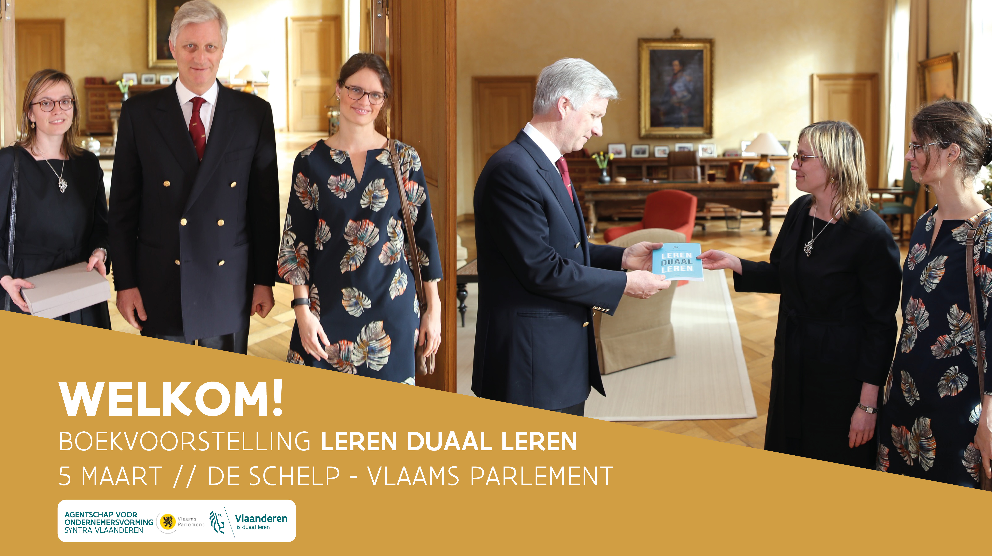


Slide 2



Welkomstwoord
Het belang van duaal leren in een europese context
kasia Jurczak, member of cabinet of commissioner marianne thyssen
- Employment, social affairs, skills and labour mobility
#lerenduaalleren
BOEKVOORSTELLING LEREN DUAAL LEREN // 5 MAART // VLAAMS PARLEMENT

Slide 3
Keynote speech
Lessons learned from finland
karl holm, counsellor of evaluation
Finnish education evaluation centre
#lerenduaalleren
BOEKVOORSTELLING LEREN DUAAL LEREN // 5 MAART // VLAAMS PARLEMENT

Slide 4
Building up the Quality of Education – the Finnish Way
Counsellor of Evaluation Karl Holm
5 March 2018, Brussels
#lerenduaalleren
BOEKVOORSTELLING LEREN DUAAL LEREN // 5 MAART // VLAAMS PARLEMENT

Slide 5
The structure of the presentation
Story of FINEEC
Education and PISA survey
Education and labour market
#lerenduaalleren
BOEKVOORSTELLING LEREN DUAAL LEREN // 5 MAART // VLAAMS PARLEMENT

Slide 6
FINEEC
Independent expert organisation
Responsible for external evaluation at all levels of education in Finland from early childhood to higher education
Support of education providers and higher education
Decision- making is independent of external influence
#lerenduaalleren
BOEKVOORSTELLING LEREN DUAAL LEREN // 5 MAART // VLAAMS PARLEMENT

Slide 7
Strategic focus areas of evaluation activities
Developing learning and competence with evaluation
Functionality and development of the educational system
Foresight and effective evaluation
Supporting education providers in quality management and in strengthening an evaluation cullture
Themes which are central and critical in the society
#lerenduaalleren
BOEKVOORSTELLING LEREN DUAAL LEREN // 5 MAART // VLAAMS PARLEMENT

Slide 8
Examples
  The impact of national budget cuts on educational and cultural rights - early childhood → secondary education + art and adult education
  Peaceful and safe learning environments in schools and educational institutions - early childhood → secondary education
  Integration of immigrants to the educational system - early childhood → adult education
  Entrepreneurship and innovative capacity - vocational → higher education
  Changes in the role of teachers; an evaluation of teacher education and continuing education - early childhood → higher education
#lerenduaalleren
BOEKVOORSTELLING LEREN DUAAL LEREN // 5 MAART // VLAAMS PARLEMENT

Slide 9
Finnish education system
Licentiate & PhD
Master’s
Master’s
Work experience
Bachelor’s
Bachelor’s
Universities
Universities of Applied Sciences
Specialist vocational qualification
General upper secondary
education
Vocational upper secondary education and training
Work
experience
Further
vocational qualification
10th
Age
7 - 15
Basic education
9 years
Work experience
Age 6
Age 0 - 6
Preprimary education
Early childhood education and care
#lerenduaalleren
BOEKVOORSTELLING LEREN DUAAL LEREN // 5 MAART // VLAAMS PARLEMENT

Slide 10
Teachers highly trained
Focus on learning rather than testing
Student guidance
Public funding
Flexible grouping
Non-selective
Education starts at the age of 7
Evaluation, free education, central steering but decentralised local decision, co-operation,
education a priority, trust
#lerenduaalleren
BOEKVOORSTELLING LEREN DUAAL LEREN // 5 MAART // VLAAMS PARLEMENT

Slide 11
Basic arguments
More collaboration, less competition
Prevention is cheaper than repair
School ready for children not children ready for schools
More gender equality and child friendly policies
Enhanced eguity improves quality
#lerenduaalleren
BOEKVOORSTELLING LEREN DUAAL LEREN // 5 MAART // VLAAMS PARLEMENT

Slide 12
PISA survey
PISA is a triennial survey and carried out since 2000 assessing learning outcomes in reading and mathematical and scientific literacy. 2015 the focus was on scientific literacy
Scientific literacy highlights the need to improve student proficiency and skills in using and interpreting science in everyday situations
#lerenduaalleren
BOEKVOORSTELLING LEREN DUAAL LEREN // 5 MAART // VLAAMS PARLEMENT

Slide 13
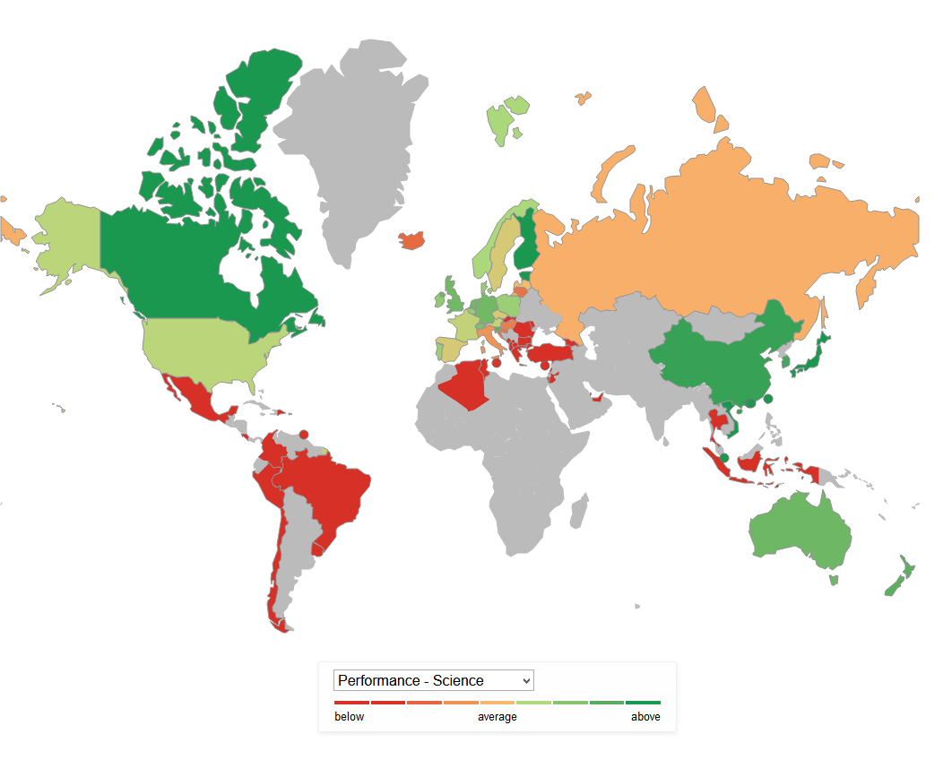
#lerenduaalleren
BOEKVOORSTELLING LEREN DUAAL LEREN // 5 MAART // VLAAMS PARLEMENT

Slide 14
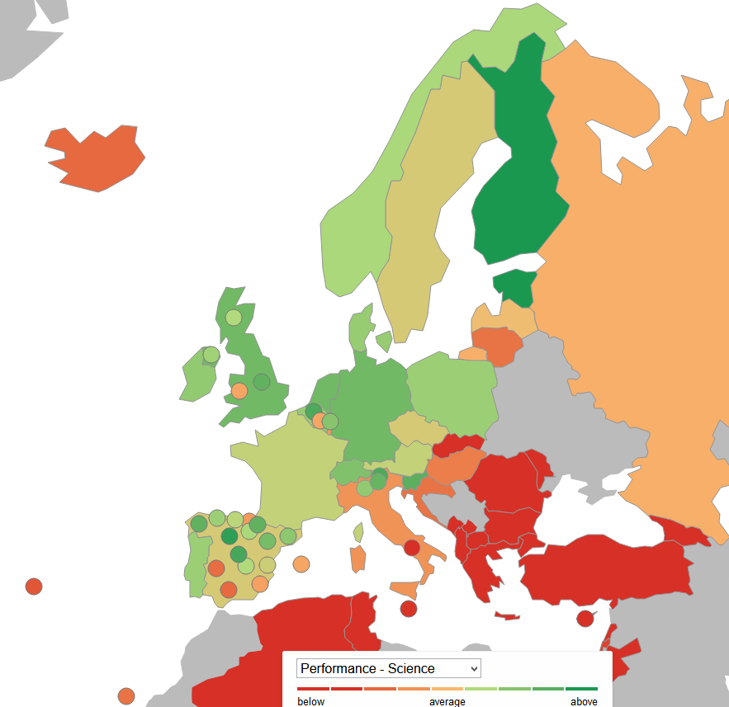
#lerenduaalleren
BOEKVOORSTELLING LEREN DUAAL LEREN // 5 MAART // VLAAMS PARLEMENT

Slide 15
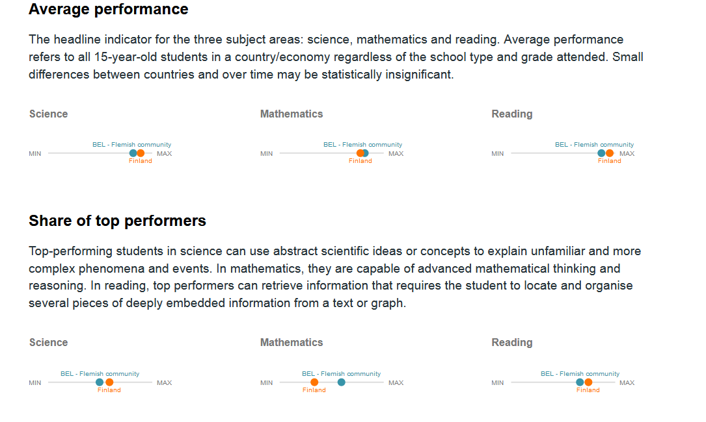
#lerenduaalleren
BOEKVOORSTELLING LEREN DUAAL LEREN // 5 MAART // VLAAMS PARLEMENT

Slide 16
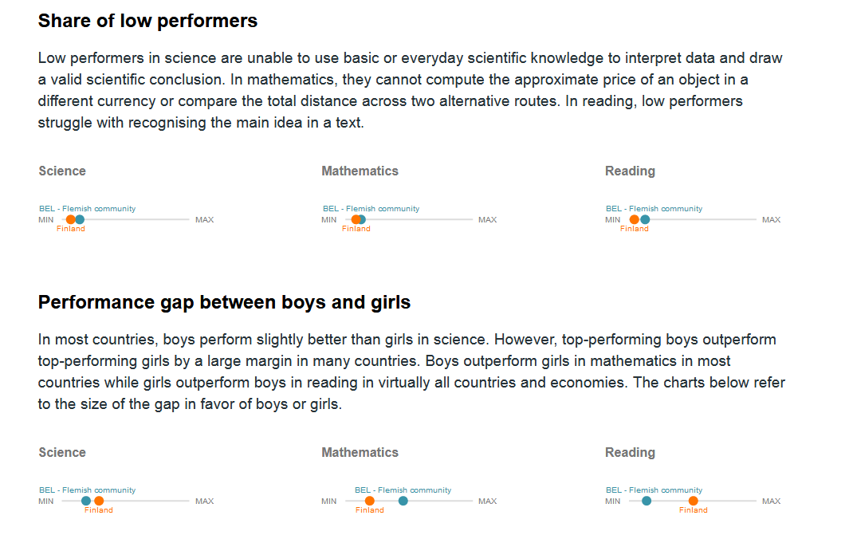
#lerenduaalleren
BOEKVOORSTELLING LEREN DUAAL LEREN // 5 MAART // VLAAMS PARLEMENT

Slide 17
The strategic programme of developing Finnish comprehensive school 2016–18
The head project of the Finnish government
Highlighting f.ex. learning supportive assessment, which is strengthening equity at school.
The equity of students has to be ensured in the terms of manysided, ethically confirmed and equal assessment and feedback. There is available various kind of ways to show one’s knowing and competences.
The pedagogy which bases on the self-guidance of a student is strengthened.
#lerenduaalleren
BOEKVOORSTELLING LEREN DUAAL LEREN // 5 MAART // VLAAMS PARLEMENT

Slide 18
Teacher Education Project
Teacher education in Finland is attractive. Teachers are competent.
Future will be responded by a programme ensureing that the education remains strong and appreciated
Basic questions: What kind of education and competence is needed? How does the change inluence the teacher education? What is the common core of the teachers identity? What do all teachers have in common across different ages, education levels and subjects?
#lerenduaalleren
BOEKVOORSTELLING LEREN DUAAL LEREN // 5 MAART // VLAAMS PARLEMENT

Slide 19
Teacher Education Project – main targets
Teacher’s competence into an entity
Attractive teacher education with well-functioning structures, anticpation and succesful student admissions
Teachers as experts creating new pedagogical innovations – focus on the learners
Strenghtening teachers education through collaboration
Developing educational institution and community with professional management and leadership
Strengthening the research-based teacher education
#lerenduaalleren
BOEKVOORSTELLING LEREN DUAAL LEREN // 5 MAART // VLAAMS PARLEMENT

Slide 20
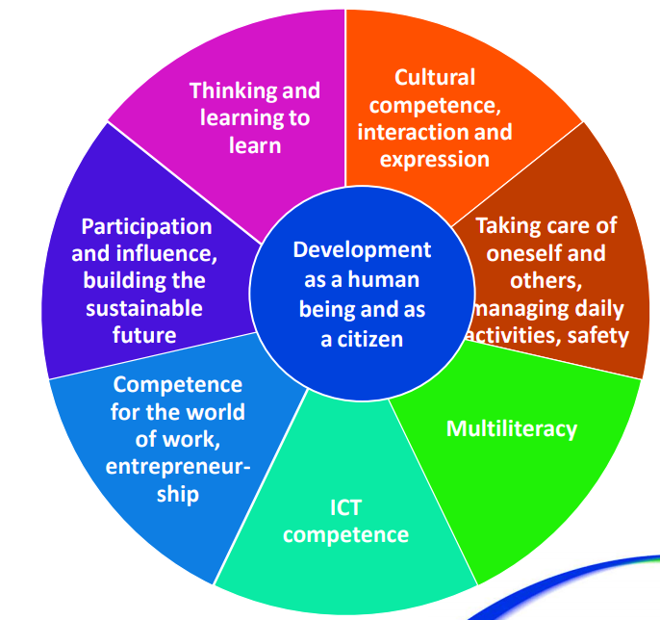
National Goals for Basic Education and Transversal Competences
Transversal learning skills
are included in all school
subjects, based on the 21st century skills
#lerenduaalleren
BOEKVOORSTELLING LEREN DUAAL LEREN // 5 MAART // VLAAMS PARLEMENT
Notes:
Nämä siis laaja-alaisen osaamisne taitoja, jotka läpäisevät kaikki koulutusasteet; tarkemmin enkunkielisessä perusopetuksen opsin perusteissa, jotka mm. Maritalla

Slide 21
Finnish assessment system from the pedagogical point of view ’ASSESSMENT CAKE’
Curricula & administrative instructions
National and international tests in guiding pedagogy
Enhancing tranversal skills
SELF-MONITORING AND CORRECTING; CONNECTIONS AND INTERACTION BETWEEN ALL LEVELS
Continuous, daily assessment
Learning-supporting methods of assessment
Interaction in assessment
Active learner

Slide 22
Soft and hard trail to the top
Finnish system was seen by Koreans: practical, active and utilising different methods. Interaction between a student and a teacher – more time to think, easy atmosphere
Korean system was seen by Finns: enthusiastic, interest of labour, sense of community, ’I’m less than we are’. Focus in the Big Exam
#lerenduaalleren
BOEKVOORSTELLING LEREN DUAAL LEREN // 5 MAART // VLAAMS PARLEMENT

Slide 23
Sustainable school architecture
A new curriculum will lead to school of the future without class rooms
Different age groups are also studying ‘phenomena-based’ together with some themes divided into smaller groups
A large part of the school premises will be for ‘hanging around’
Acoustics is an important part of the new open school space, and for the smaller ones there is ‘rooms of socks’ (the shoes are removed off)
The latest technology is a key part of teaching, personal laptops is a new source of information for teaching
Schooling is critical and reflective
Outdoor facilities are also used for teaching in warm weather
#lerenduaalleren
BOEKVOORSTELLING LEREN DUAAL LEREN // 5 MAART // VLAAMS PARLEMENT

Slide 24
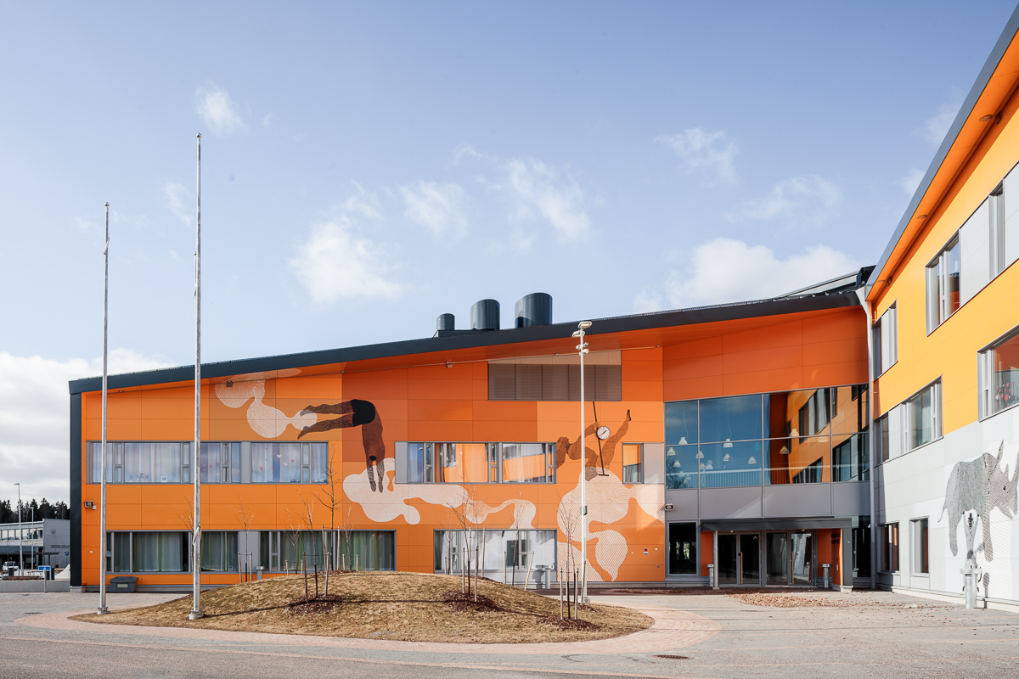
#lerenduaalleren
BOEKVOORSTELLING LEREN DUAAL LEREN // 5 MAART // VLAAMS PARLEMENT

Slide 25
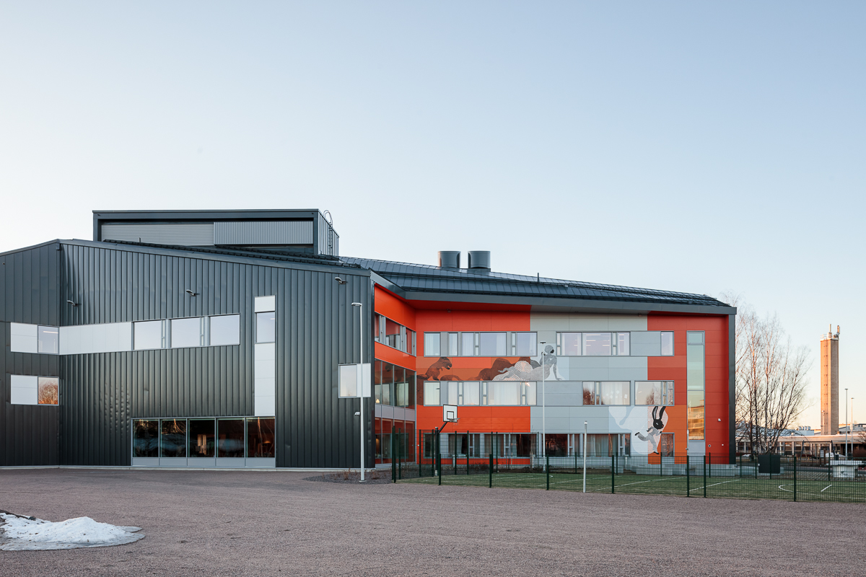
#lerenduaalleren
BOEKVOORSTELLING LEREN DUAAL LEREN // 5 MAART // VLAAMS PARLEMENT

Slide 26
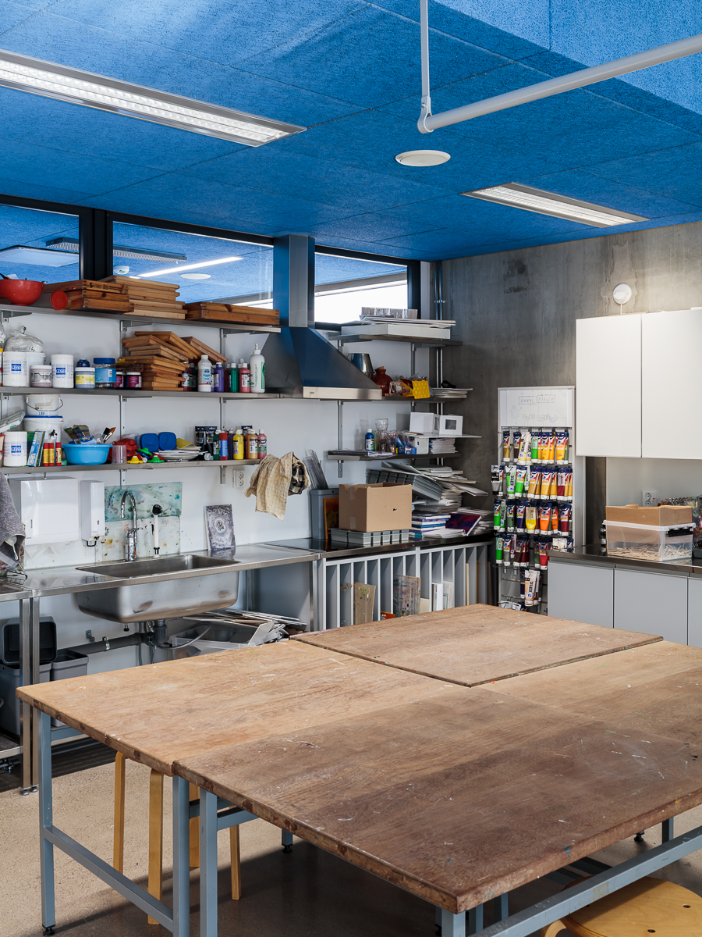
#lerenduaalleren
BOEKVOORSTELLING LEREN DUAAL LEREN // 5 MAART // VLAAMS PARLEMENT

Slide 27
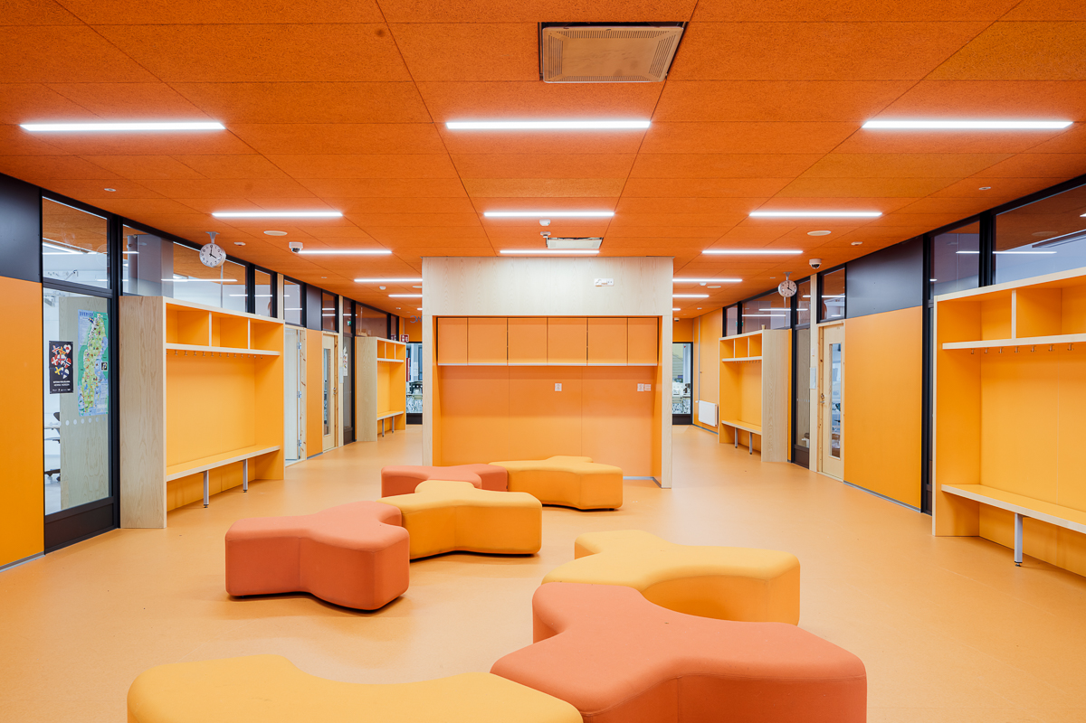
#lerenduaalleren
BOEKVOORSTELLING LEREN DUAAL LEREN // 5 MAART // VLAAMS PARLEMENT

Slide 28
Labour force in Finland
Most of the advertised job vacancies were in the health and social services, commercial and service sectors.
Most unemployment is in the industrial, technical work, art, administrative and office work sectors
#lerenduaalleren
BOEKVOORSTELLING LEREN DUAAL LEREN // 5 MAART // VLAAMS PARLEMENT

Slide 29
Labour force in Flanders
Most jobs – are accounted for by the construction industry and a number of major service sectors: business services, ICT, and social services and healthcare.
The industrial sectors and construction have lost a lot of jobs. Low levels of qualification in particular; employed in the logistics, sales, hospitality, cleaning and transport sectors
#lerenduaalleren
BOEKVOORSTELLING LEREN DUAAL LEREN // 5 MAART // VLAAMS PARLEMENT

Slide 30
Homo Discens – skills of the future
Lifelong Learning as a state of mind
Problem-solving and interaction skills
Ability to understand complex wholes, cultural sensitivities and ethical issue
In depth cooperation between subjects – connection between issues and master large entities
#lerenduaalleren
BOEKVOORSTELLING LEREN DUAAL LEREN // 5 MAART // VLAAMS PARLEMENT

Slide 31
Lifelong Learning
Improving the design of competence development
New types of guidance and coaching work will be developed
Colleges and institutions, in cooperation with working life to develop their working life and LLL modules
Transparency in teaching and open learning materials will be significantly increased
#lerenduaalleren
BOEKVOORSTELLING LEREN DUAAL LEREN // 5 MAART // VLAAMS PARLEMENT

Slide 32
Lifelong Learning…
Open higher education is organized in different ways, more focused and more versatile
Developing an Open Vocational School / Business Model
The recognition of higher education specialization training, ownership in higher education institutions and working life, and policies are supported
To identify and recognize previously acquired skills at all levels of education
Art of the education provision of free adult education is defined on a knowledge-based basis
#lerenduaalleren
BOEKVOORSTELLING LEREN DUAAL LEREN // 5 MAART // VLAAMS PARLEMENT

Slide 33
Promoting impact through the operational culture
Please describe and assess briefly the procedures used by your HEI to promote the impact of the operations.
How does the HEI support the opportunities of students and staff members to participate in new experiments? How does the HEI support the establishment of an experimental operating culture?
How are experiments monitored and utilised in the HEI?
How does the HEI promote the staff’s opportunities for collaboration?
How does the HEI foster lifelong learning in the society?
How do staff members, students and external stakeholders participate in the development of operations which promote an impact?
How does the HEI participate in developing the operations of national and international networks?
#lerenduaalleren
BOEKVOORSTELLING LEREN DUAAL LEREN // 5 MAART // VLAAMS PARLEMENT

Slide 34
Societal impact
The University has a large number of internal and external stakeholders including major financial stakeholders. Education also has a prominent role in the university’s societal impact, which is realised in degree education but also in terms of regional responsibility to develop lifelong learning and the overall competence of the population.
The key issue is not how actively the university engages with stakeholders, but how systematic the quality system is so it can identify stakeholders’ views. The university has defined the key actors and tasks as a form of social interaction and has defined the actors responsible for them although the concept of social interaction was not clearly defined.
Societal interaction relates to functioning in society and in particular in co-operation with external stakeholders. Without societal interaction, societal impact would not be realised.
#lerenduaalleren
BOEKVOORSTELLING LEREN DUAAL LEREN // 5 MAART // VLAAMS PARLEMENT

Slide 35
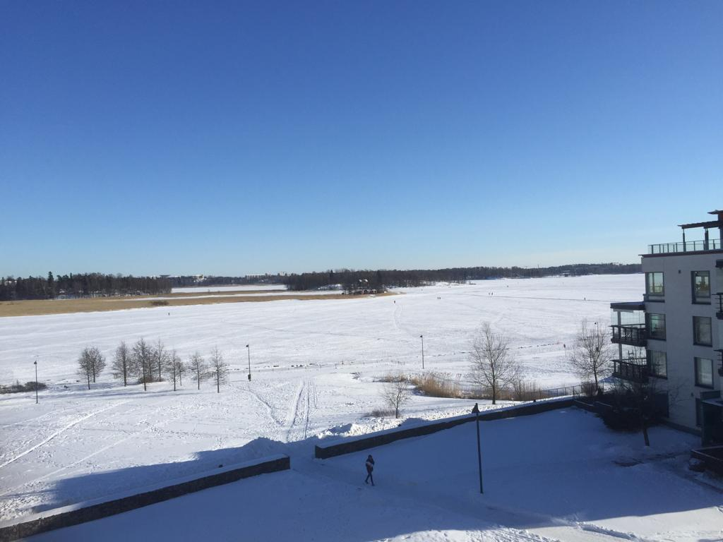
Kiitos, Tack
#lerenduaalleren
BOEKVOORSTELLING LEREN DUAAL LEREN // 5 MAART // VLAAMS PARLEMENT

Slide 36
Leren duaal leren
5 take aways
Vickie Dekocker, Verantwoordelijke innovatie & Secretaris Vlaams partnerschap duaal leren & An Katrien Sodermans, Verantwoordelijke Kenniscentrum
#lerenduaalleren
BOEKVOORSTELLING LEREN DUAAL LEREN // 5 MAART // VLAAMS PARLEMENT

Slide 37

DUAal leren is levenslang
#lerenduaalleren
BOEKVOORSTELLING LEREN DUAAL LEREN // 5 MAART // VLAAMS PARLEMENT

Slide 38

leren is COCREATIE
#lerenduaalleren
BOEKVOORSTELLING LEREN DUAAL LEREN // 5 MAART // VLAAMS PARLEMENT

Slide 39
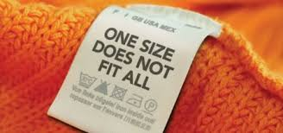
Leren IS GEPERSONALISEERD
#lerenduaalleren
BOEKVOORSTELLING LEREN DUAAL LEREN // 5 MAART // VLAAMS PARLEMENT

Slide 40

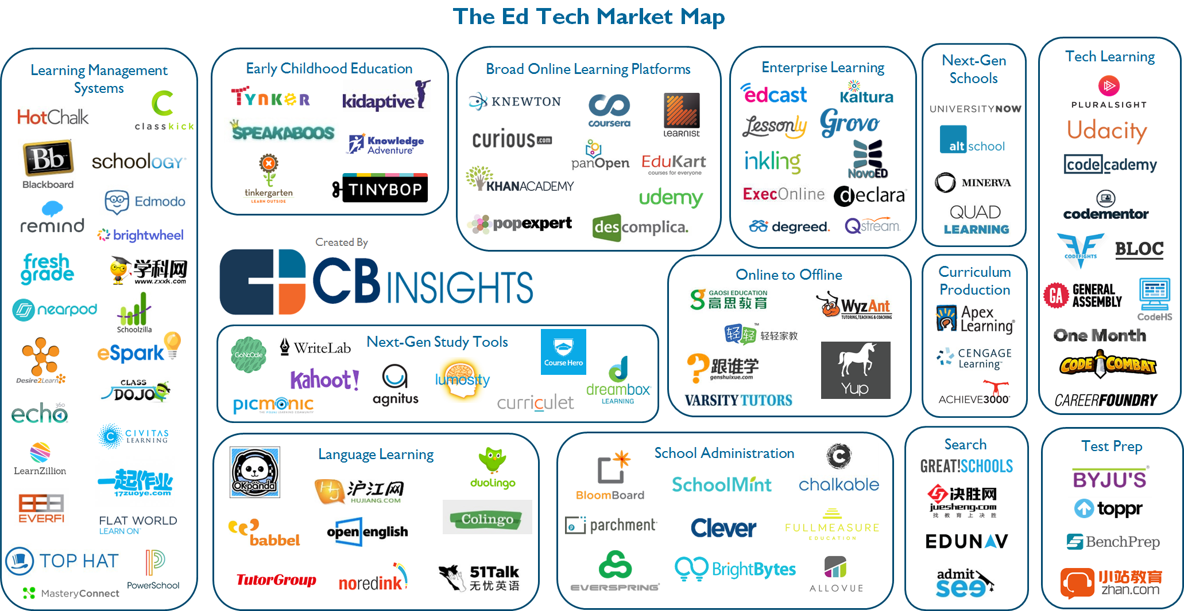
GEPERSONALISEERD IS DIGITAAL
#lerenduaalleren
BOEKVOORSTELLING LEREN DUAAL LEREN // 5 MAART // VLAAMS PARLEMENT

Slide 41

GEPERSONALISEERD VEREIST EEN ANDERE FINANCIERING
#lerenduaalleren
BOEKVOORSTELLING LEREN DUAAL LEREN // 5 MAART // VLAAMS PARLEMENT

Slide 42
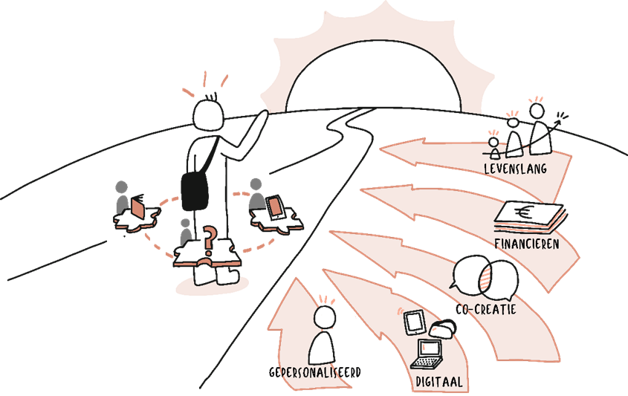

#lerenduaalleren
BOEKVOORSTELLING LEREN DUAAL LEREN // 5 MAART // VLAAMS PARLEMENT

Slide 43
Duaal leren
#futureproof
Bruno tindemans, gedelegeerd bestuurder syntra vlaanderen
#lerenduaalleren
BOEKVOORSTELLING LEREN DUAAL LEREN // 5 MAART // VLAAMS PARLEMENT

Slide 44
slotwoord
Frank baert, voorzitter van het vlaams partnerschap duaal leren
#lerenduaalleren
BOEKVOORSTELLING LEREN DUAAL LEREN // 5 MAART // VLAAMS PARLEMENT

Slide 45
Receptie & netwerkmoment
#lerenduaalleren
BOEKVOORSTELLING LEREN DUAAL LEREN // 5 MAART // VLAAMS PARLEMENT

