Slide 1
WMT Stakeholder Equality Group
Thursday 10 December 2020
1pm to 3pm

Slide 2
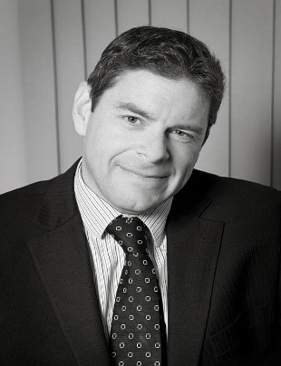
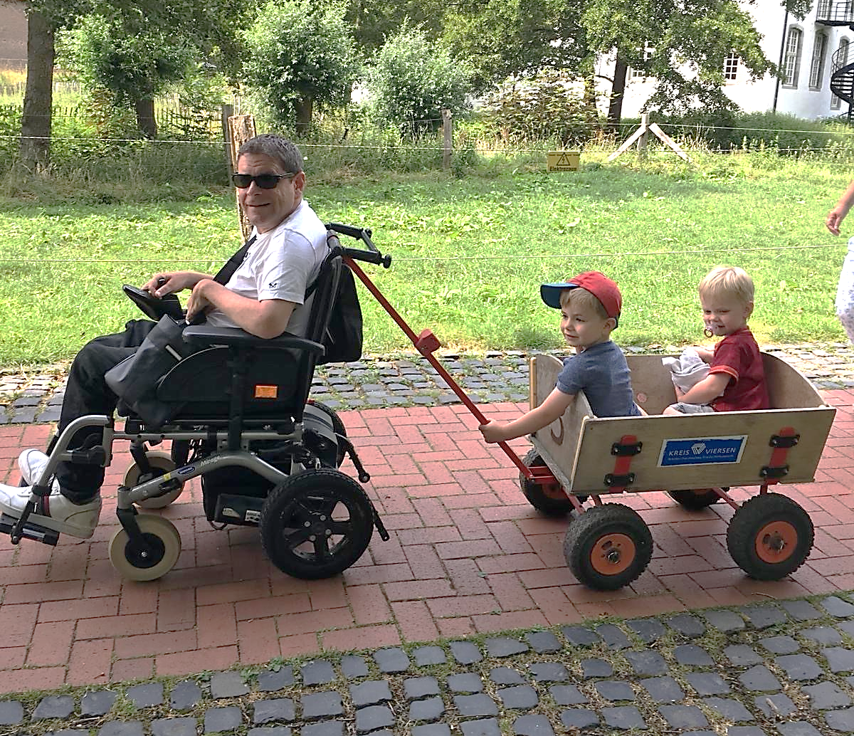
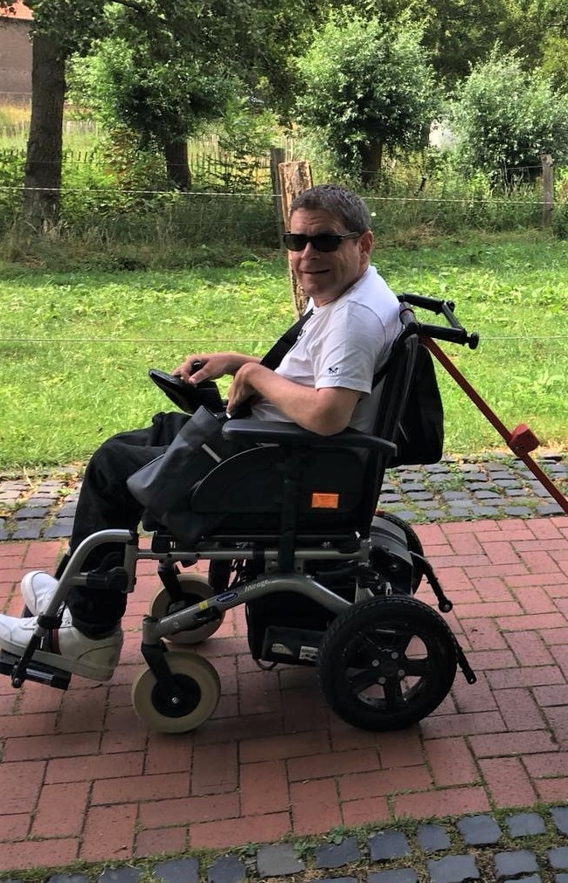
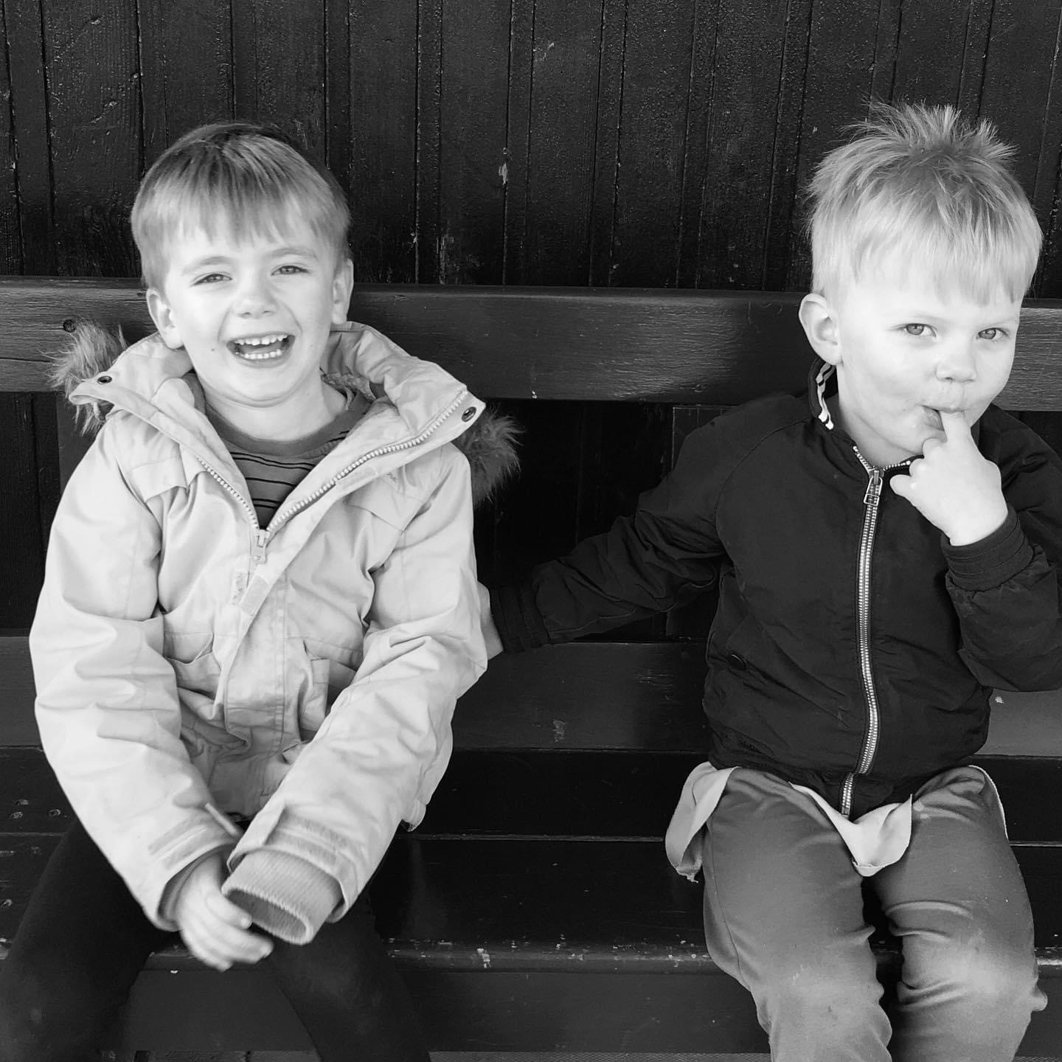

About Nick Goss

Slide 3

Jo Barton
Jo is an Investors in Diversity Advisor.
She will be joining our meeting today to observe and learn more about what we do.

Slide 4
Agenda
Welcome and introduction | Nick Goss | 1 pm | 5 mins
Apologies, Conflicts of interest reminder and inclusive discussion reminder. | Nick Goss | 1.05 | 5 mins
Action Tracker | Rebecca Preece | 1.10 | 5 mins
Wolverhampton lift work | Tom Wadsworth (Network Rail) | 1.15 | 10 mins
News - since we last met | Andrew McGill | 1.25 | 15 mins
Some changes we’re making | Rebecca Preece | 1.40 | 10 mins
BREAK |  | 1.50 | 15 MINS
Minor Works update | Rebecca Preece | 2.05 | 10 mins
Investors in Diversity update | Apeksha Naik | 2.15 | 10 mins
Any other business | Rebecca Preece | 2.25 | 10 mins
Member news | Nick Goss | 2.35 | 15 mins
Sum up and close | Nick Goss | 2.50 | 5 mins

Slide 5

Apologies
Minutes
Are the minutes from the last meeting correct?

Slide 6

Conflicts of interest
Are you involved in any work or projects which means you might not appear independent and objective?

Slide 7

Being inclusive
Meeting etiquette
  Use the chat
  Turn of video and microphone unless speaking
  Raise your hand if you wish to speak
  Any issues – Luke Bodin is on the call

Slide 8

Completed actions from previous meeting
Volunteers for Birmingham New Street wayfinding project.
Please send ideas for minor accessibility works at stations to Accessibility@wmtrains.co.uk and look into minor works ideas given in meeting.
Issues raised by Emily from Coventry Arena station.

Slide 9
Completed actions from previous meeting
Consent required for using Mystery Shopping videos.
Ideas for promo of awareness days and similar inclusion campaigns to be sent to Apeksha Apeksha.Naik@wmtrains.co.uk
Renew travel passes

Slide 10
Outstanding actions
Develop the accessible planter trial with SEG feedback
To discuss with Josh his experience of staff wearing highviz and his recent fall at Wolverhampton station.
Invite Emily to help with Stations as Places documents
Private online forum for SEG member discussion
Agenda item on e-scooter trials

Slide 11
Wolverhampton platform 1
lift renewal
Tom Wadsworth – Network Rail

Slide 12
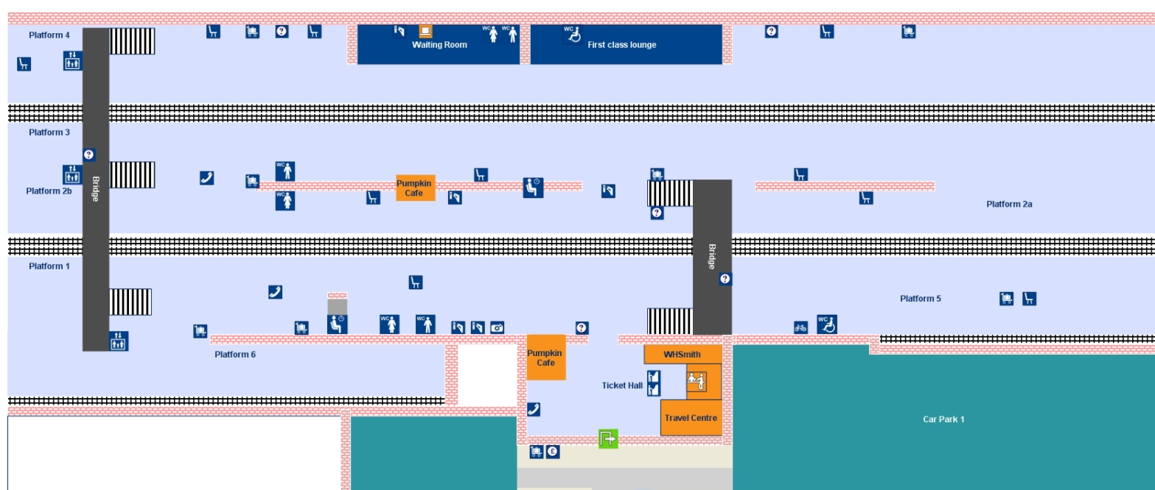
Wolverhampton station plan

Slide 13
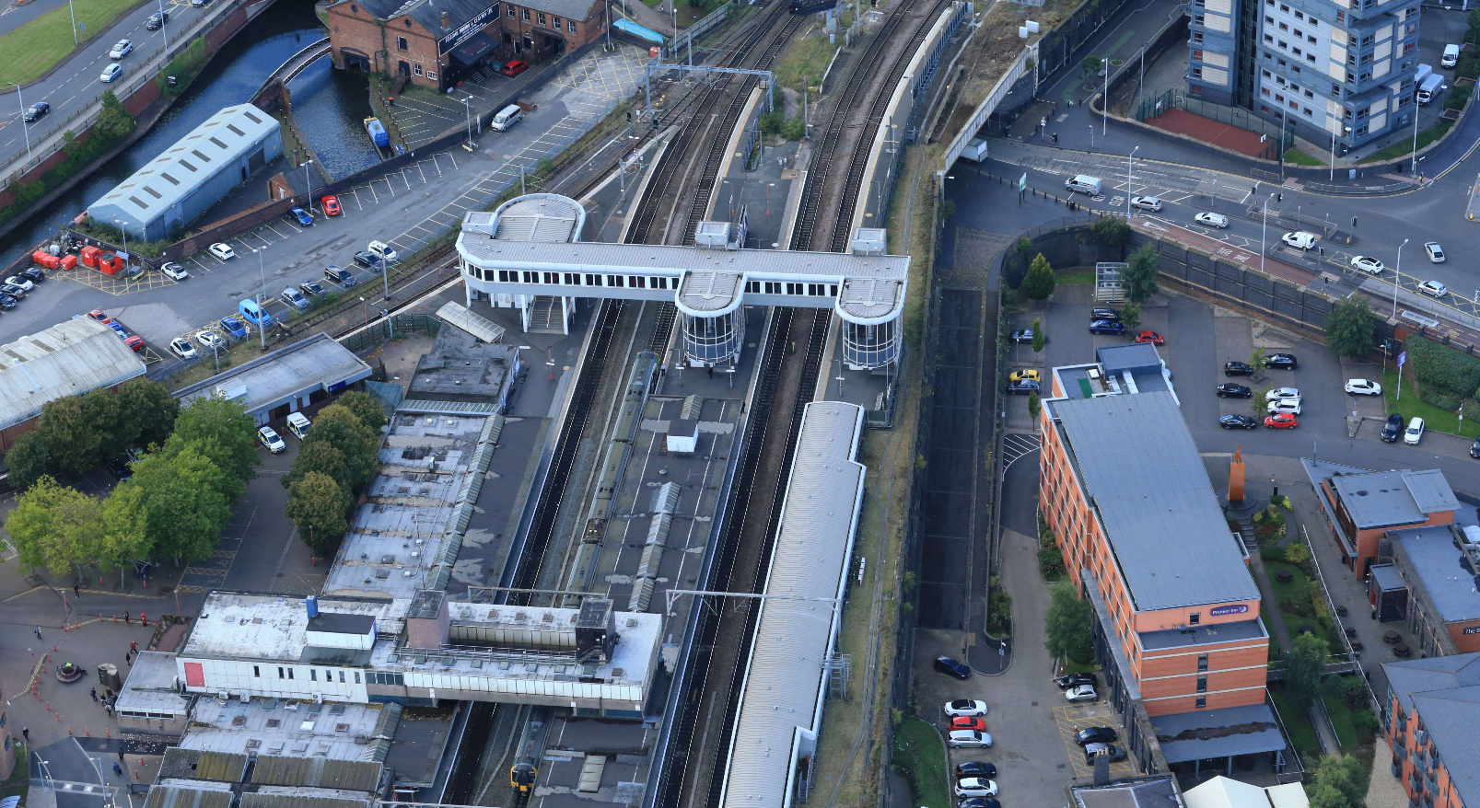

Slide 14
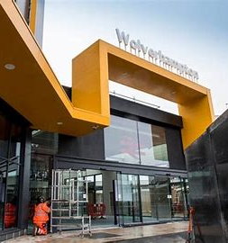
Wolverhampton platform 1
lift renewal
Work will take place from Monday 11 January until Tuesday 20 April 2021 - 14 weeks in total.
Passengers with reduced mobility will be asked to interchange at Birmingham New Street where possible instead of at Wolverhampton.
If this is not possible, passengers will be asked to travel to Smethwick Galton Bridge which has full level access.
Taxis will be provided for passengers to complete their journey.

Slide 15
Wolverhampton platform 1
lift renewal
There will be porters on the station to assist with luggage and ensure that as many passengers as possible can use the stairs.
As a contingency, where passengers do arrive at Wolverhampton on platforms 2, 3 or 4, use of the goods lift at the other end of the platform will enable that passenger to exit the station.
This has not been advertised as this plan remains a contingency and requires a staff member to be inside the lift with the passenger at all times.

Slide 16
Wolverhampton platform 1
lift renewal
There will still be step-free access to and from all other platforms.
There will be significant communications issued on various channels from Monday 14 December
  Local media
  In-station posters
  Across social media accounts.

Slide 17

Since we last met

Slide 18

News Update: Passenger Behaviour
Passenger numbers fell by 90-95% during the first lockdown in March/April.
Numbers had recovered to around 30% of pre-Covid levels when the second lockdown was imposed on Nov 5.

Slide 19
News Update: Passenger Behaviour
Numbers fell to around 15% during the lockdown – not as sharply as the March/April lockdown.
Small increases have been seen in the past few days.
Compliance with face covering rules remains generally high – we are working with BTP across the network

Slide 20
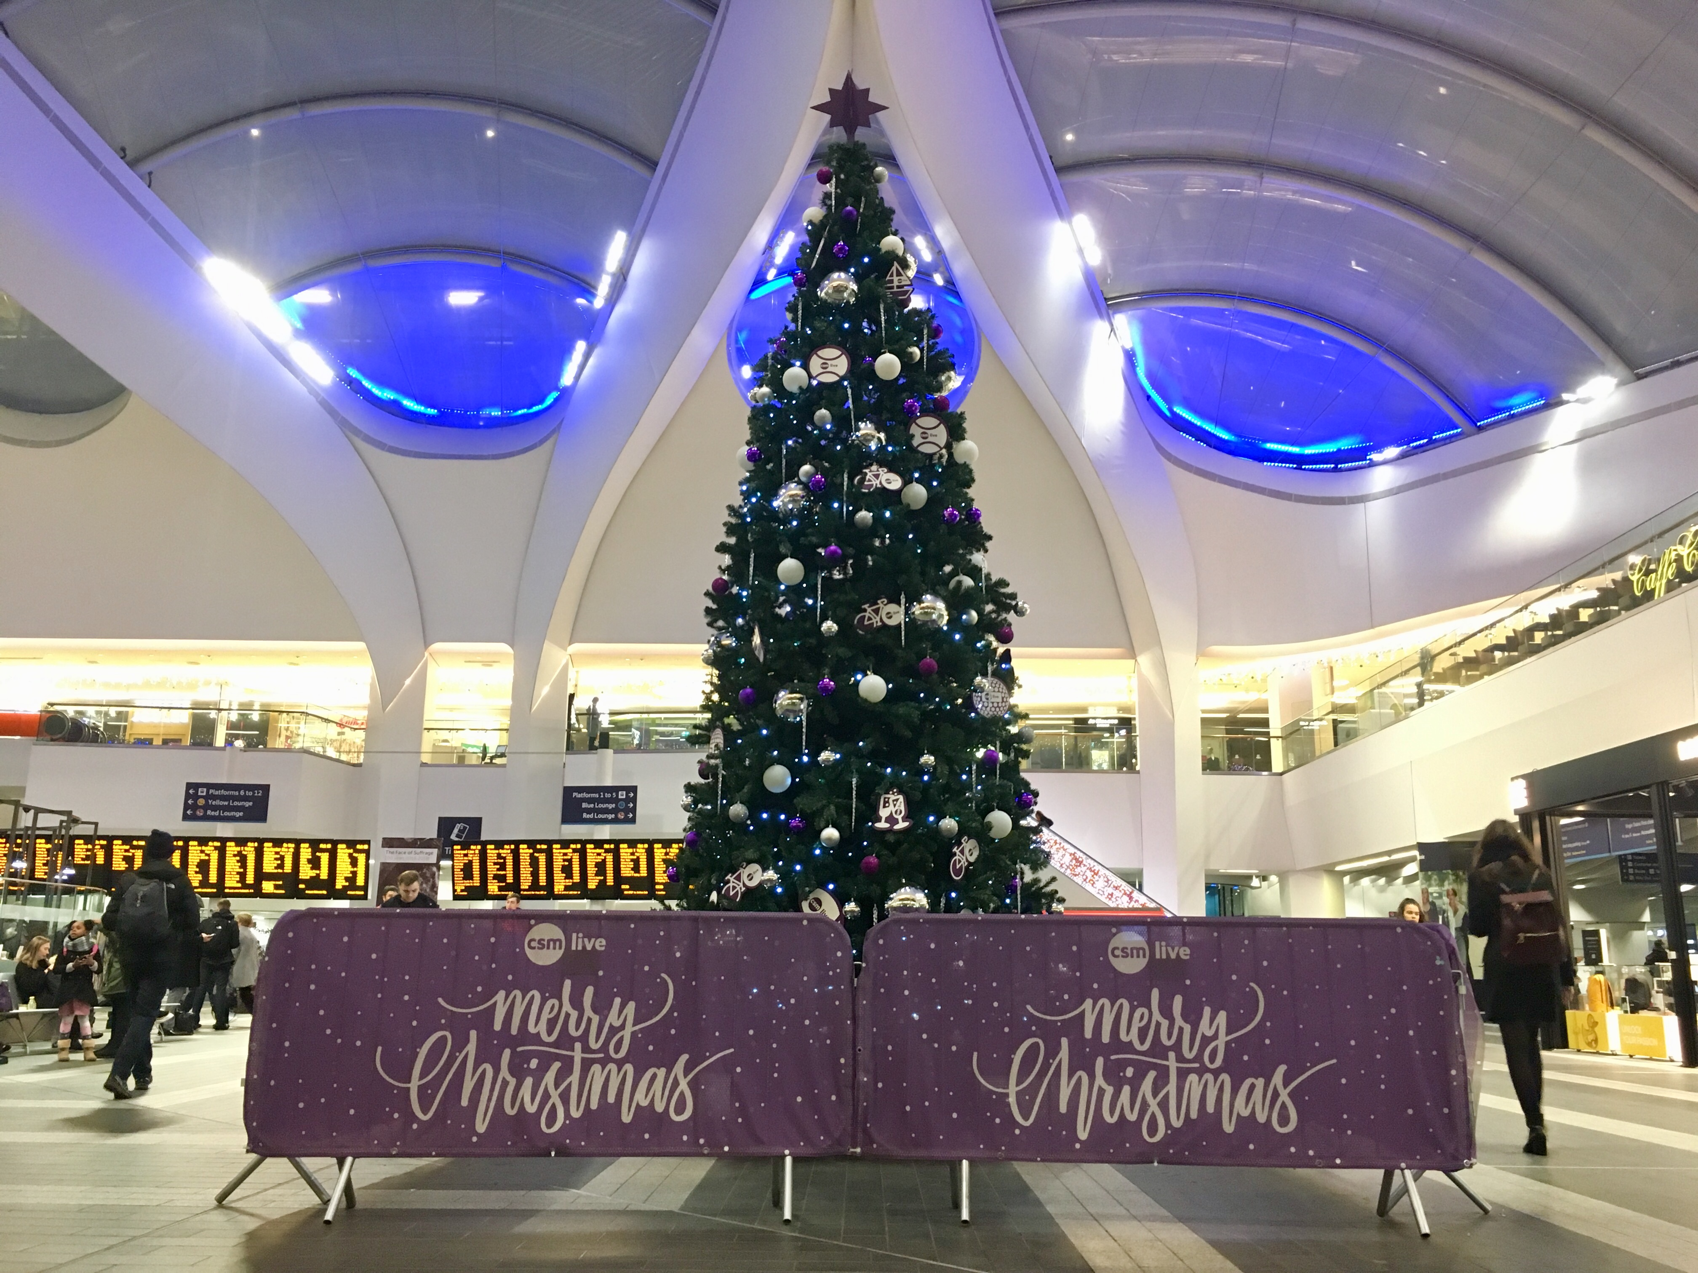
News Update: Christmas Travel
Government announced ‘Christmas Travel Window’ from 23-27 Dec
Monitoring ticket sales and deploying extra staff at key locations
Running longest trains possible in this period

Slide 21
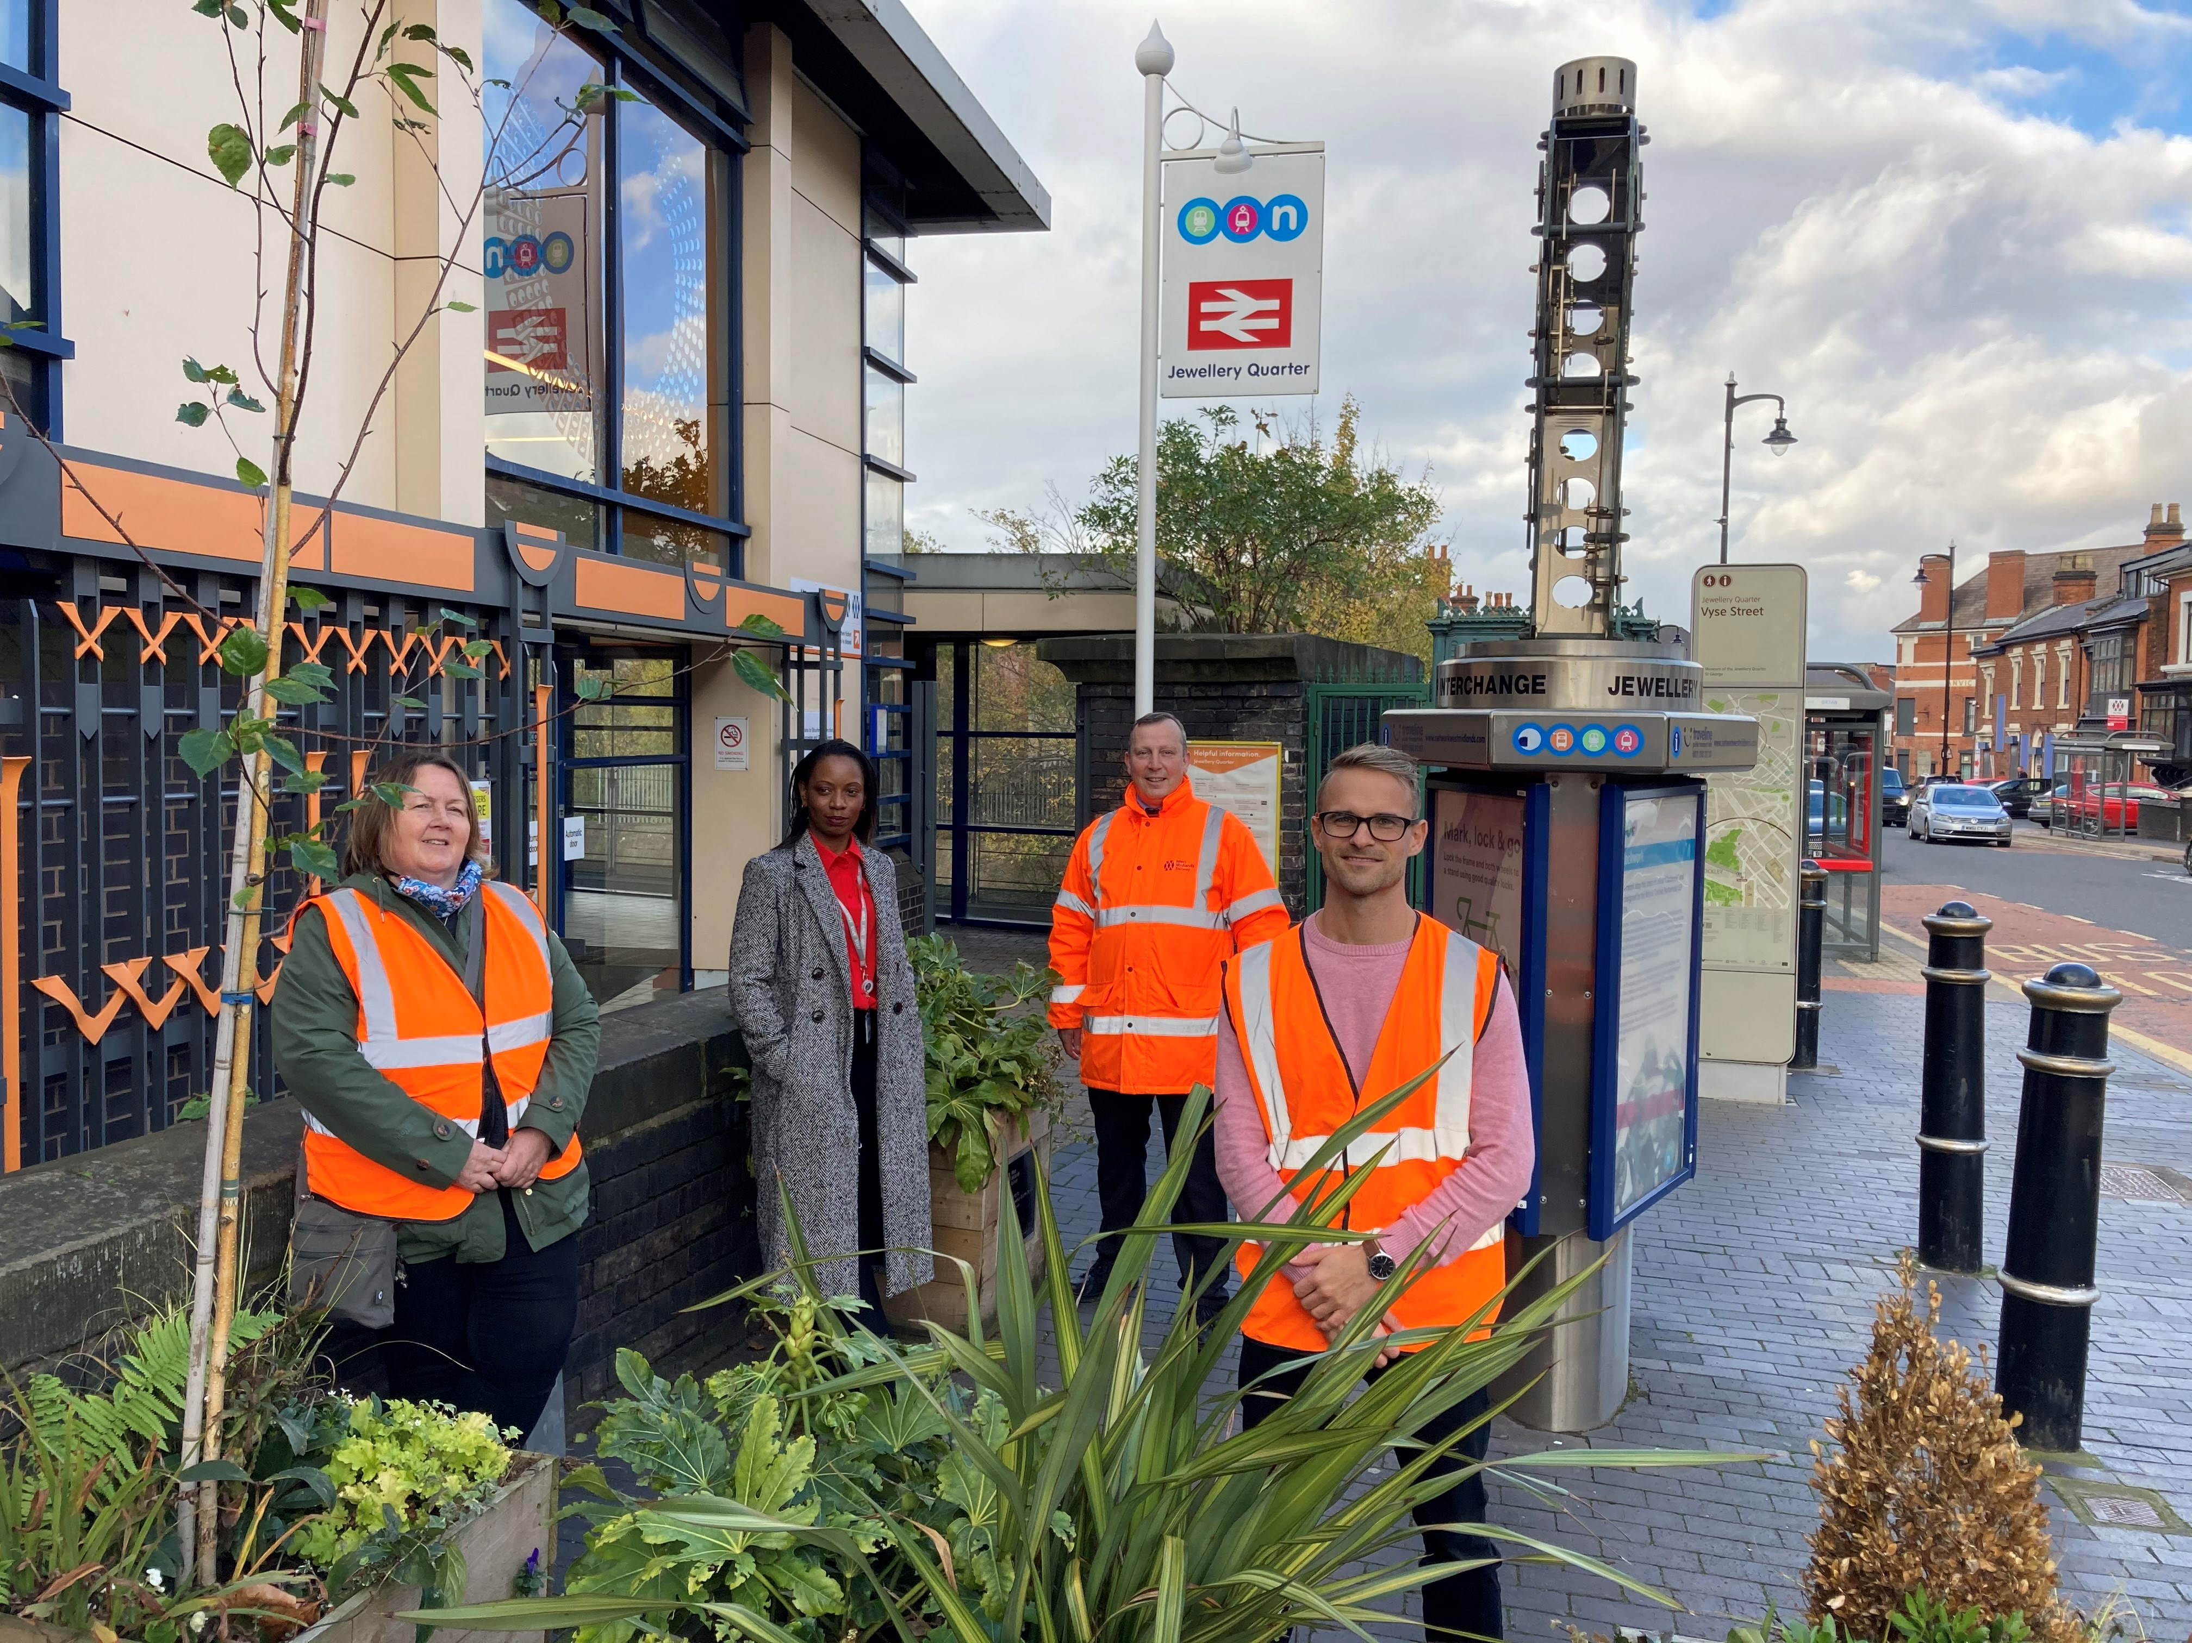
News Update: Community Schemes
Recipients of our £1.7m Customer & Communities Improvement Fund (CCIF) to be announced in Jan
The 2021/22 scheme will launch in February – inviting new applications
Jewellery Quarter CCIF scheme

Slide 22
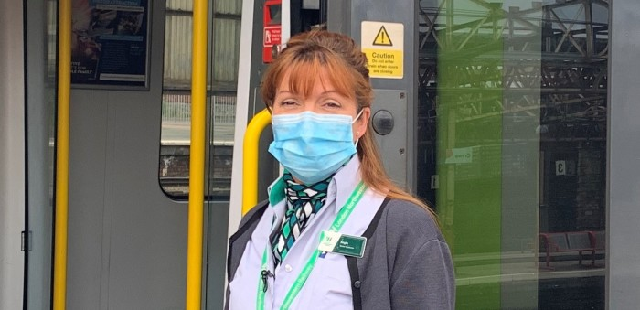
News Update: Where we are today
Passenger numbers currently around 15-20% - expected to climb
Over 90% PPM now routine
We have ‘Covid-proofed’ trains and stations and made trains longer
Now running at around 85% of pre-Covid services
Feeling impact of Covid-19 on our staff

Slide 23
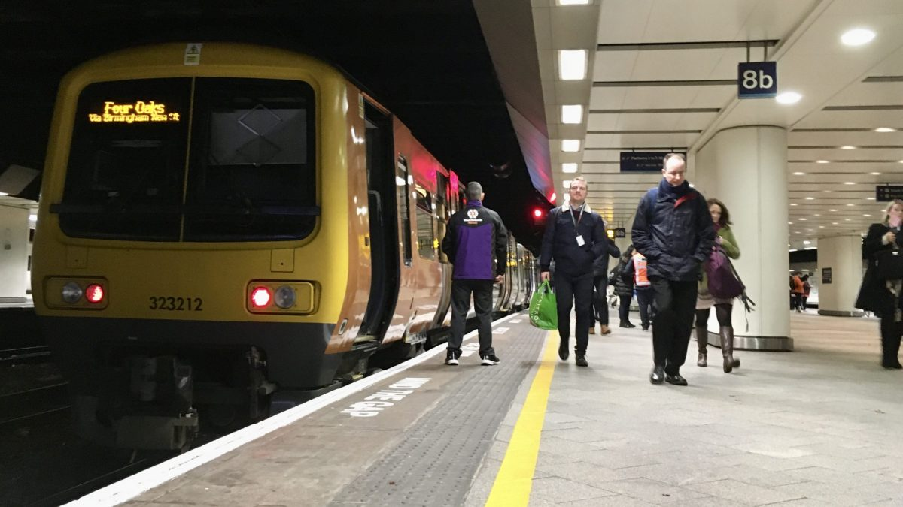
News Update: Looking Forward
Optimistic for a big post- vaccine ‘return to rail’ in 2021
Marketing campaigns in New Year to encourage customers to return
Relaunched our “Whistle Stop Tour” sessions online – first podcast is due to be posted before Xmas

Slide 24
Some changes we’re making

Slide 25
Reduction in passenger assistance booking window
From | Notice required | Where applies
1 January 2021 | 4 hours | WMT services
1 April 2021 | 6 hours | All services
1 April 2022 | 2 hours | All services

Slide 26
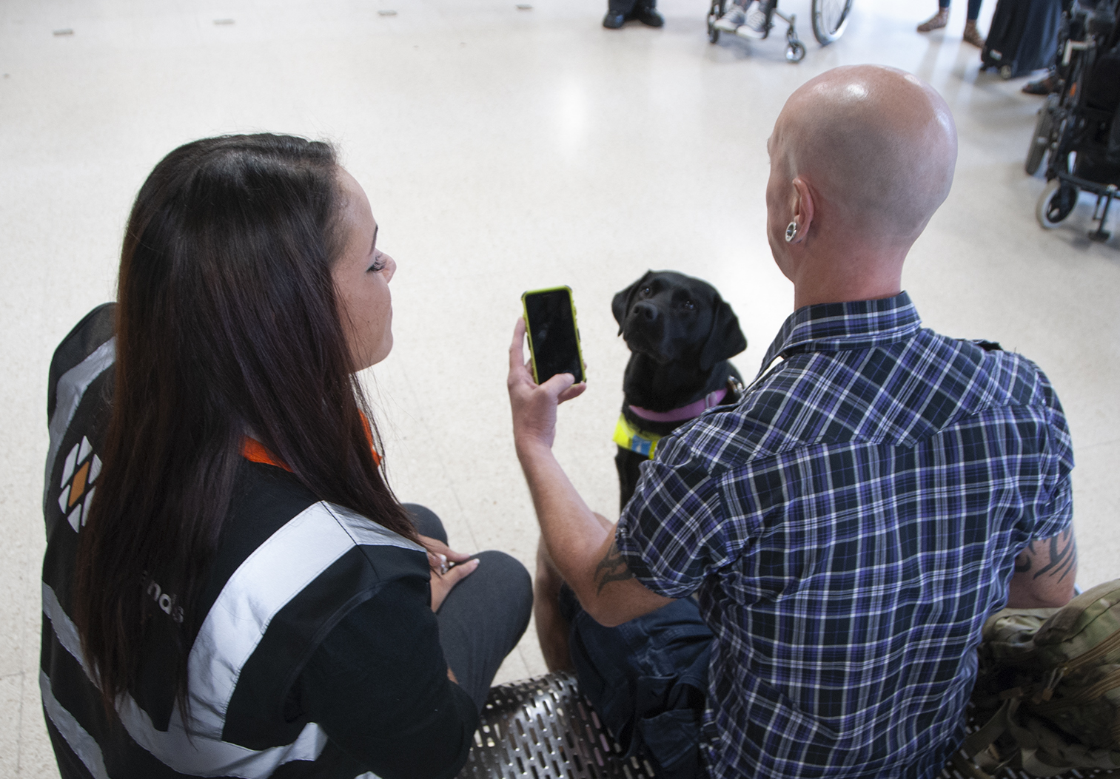
Transreport Passenger Assist apps
TBC
Wider introduction of the passenger app
December 2020
Passenger app trial with small number of participants (ends 17 Dec)
Staff app used by most TOCs (partially or fully)
April 2021

Slide 27
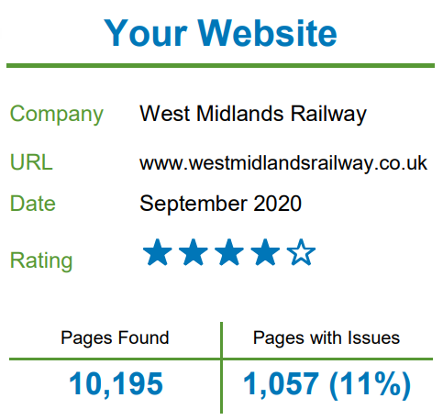
Shaw Trust website audit
Areas for improvement:
  Content – passenger assist service and complaints procedure.
  Colour contrast
  Links in focus for keyboard users
  Missing alternative text
Plan for overall improvements to website and wider marketing planned for 2021.

Slide 28

Publishing assistance figures on our websites
Booked passenger assists
Unbooked passenger assists
Undelivered passenger assists
Will be available on a link from our Accessible Travel pages

Slide 29
Any Questions?

Slide 30
Break
Cameras and microphones will be turned off for 15 minutes

Slide 31
Minor accessibility works update

Slide 32
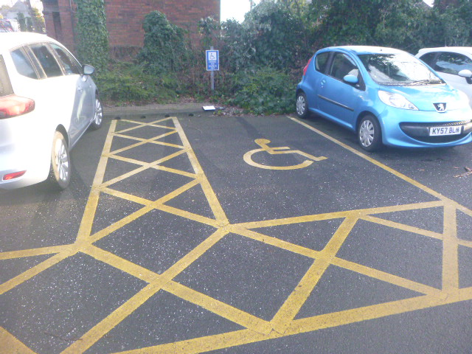
What is the “minor works” scheme?
Must spend £329,000 a year
Station accessibility only
Small scale alterations
Strict list of what it can be spent on

Slide 33
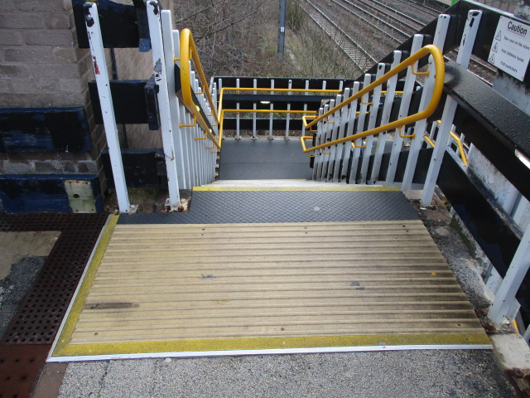
Minor works process – this year
2020 / 2021 works:
Must be completed by March 2021.
List has been sent to this group for questions
Pending no major issues being raised, this list will be endorsed by Sarah Rennie as our former chair.

Slide 34
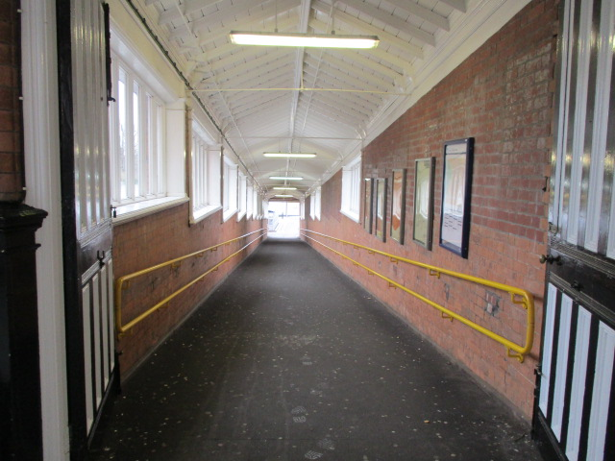
Minor works process – next year
2021 / 2022 works:
Must be completed by March 2022.
Suggestions taken following last meeting.
List has been drawn up.
Final list will require endorsement from this group.

Slide 35
Diversity and inclusion update

Slide 36
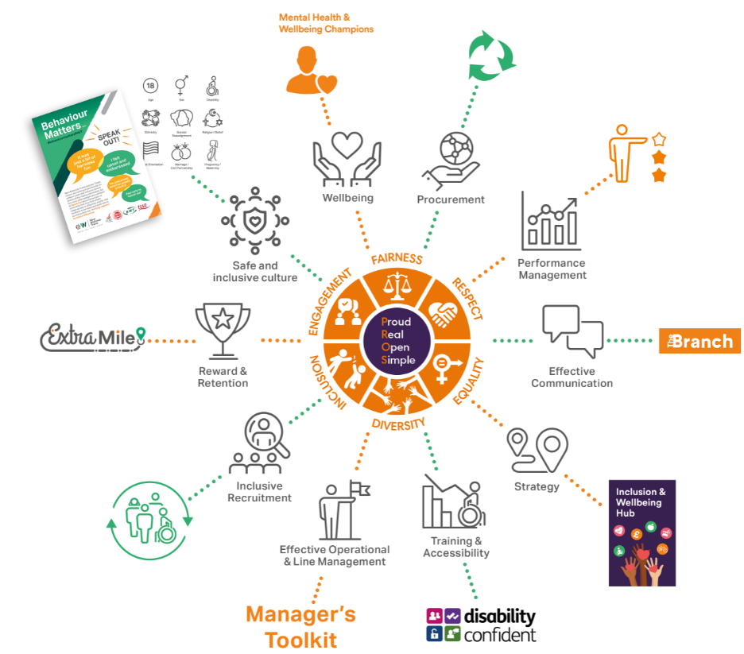
EDI Action Plan – You Matter

Slide 37

Accessibility Matters training
Thank you to everyone who has inputted in developing our new accessibility training.
First module being made available to head office and management shortly.
Delivery to other staff to take place throughout 2021.

Slide 38
Any other business

Slide 39
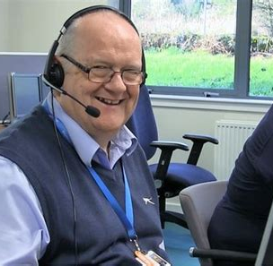
Mystery shopping
Spot check our Passenger Assist booking helpline
Correct information?
Accessible routes?
Complete online survey

Slide 40
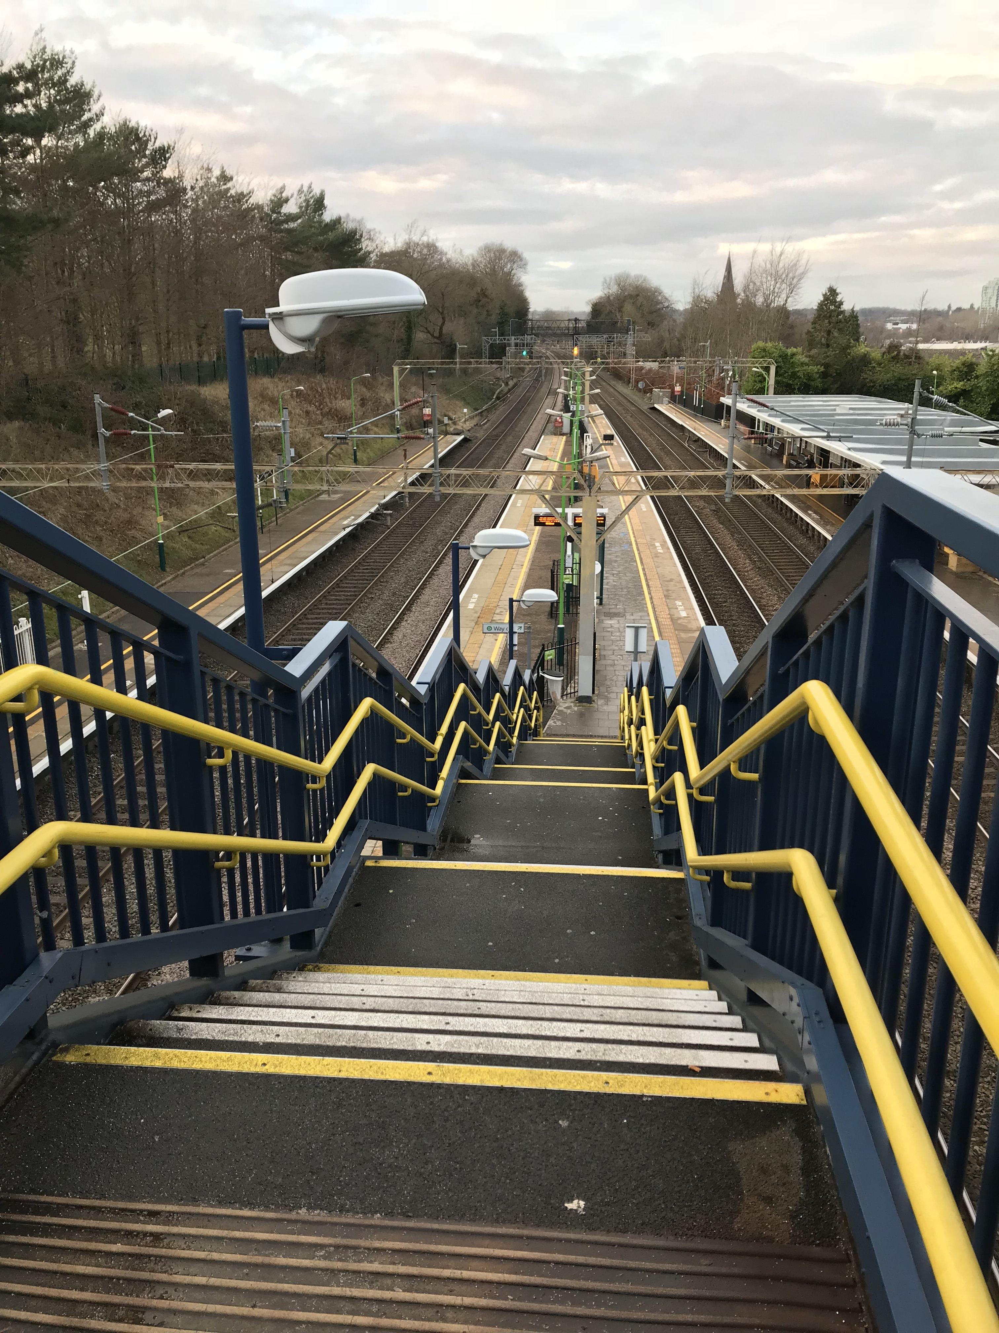
Apsley ‘Access for All’
Network Rail will soon be starting an ‘Access for All’ (AFA) scheme at Apsley.
Step free access to platforms.
Not on the original AFA list
The project is in the early planning stages.

Slide 41
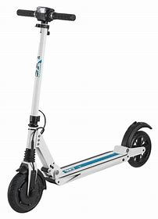
Surveys on e-scooters
Please see our surveys on Audio Vehicle Devices for E-Scooters and a wider Survey for street obstructions.
https://docs.google.com/forms/d/e/1FAIpQLSc4XjA_04yJ9m-c_XojZk0_FYy5gVsA7g40vHXvr5fDJrXY5w/viewform
https://docs.google.com/forms/d/e/1FAIpQLSdC_faazUvYXI0JqCrB4ebBXGA2S0jFfX7gLiEvysXnE1-C-Q/viewform

Slide 42
Members’ news

Slide 43

Future meetings
Thursday 11 February
Online via Zoom
1pm – 3pm
New members
Learning difficulties?
Different backgrounds?

Slide 44
Thank you for joining us
Any questions or feedback please contact:
Rebecca Preece
Rebecca.Preece@wmtrains.co.uk

