Slide 1
Stockholm Economy Q4 2017 March 2018

Slide 2
Stockholm Economy 2017 Q4
Mostly positive figures for Stockholm
The Stockholm economy continues to develop strongly which is shown by most indicators.
Aggregated gross pay data showed positive growth figures both for Stockholm County and the City of Stockholm compared to the same quarter in 2016. Information and communication, and construction where the driving forces behind this development. The number of newly registered businesses decreased somewhat while the number of company bankruptcies decreased in the county but increased somewhat in the City of Stockholm, in comparison to the corresponding quarter of 2016.
The labour market in Stockholm continues its strong development, except for a decreasring number of listed positions and an unchanged unemployment rate. During the last four quarters the number of persons employed increased by 24 400. Further the number of persons given notice decreased substantially in both the county and the city. However, the number of listed positions decreased and at a higher rate than in the rest of the country. The number of residents in the county and the city increased by 39 100 and 14 100 respectively during the last four quarters, representing increases by 1,7 percent and 1,5 percent. The number of housing projects started increased in both the county and the city in comparison to the same quarter last year. During the last four quarters construction increased in both the Stockholm County and the City of Stockholm.
Olle Zetterberg
CEO Stockholm Business Region
About the report
The report is published each quarter by Stockholm Business Region.
The report includes Stockholm County and the City of Stockholm.
Statistics used is collected from Statistics Sweden, The Labour Exchange and The Swedish Companies Registration Office.
The report can be downloaded from:
http://www.stockholmbusinessregion.se/en/facts--figures/#facts-about-business
The Stockholm Region is defined as Stockholm County, Uppsala County, Södermanland County, Östergötland County, Örebro County, Västmanland County, Gävleborg County and Dalarna County. Individual county reports for the above mentioned can be found in Swedish here: http://www.stockholmbusinessalliance.se/konjunkturrapporter/
Questions can be addressed to Stefan Frid at Invest Stockholm. Publisher: Olle Zetterberg.

Slide 3
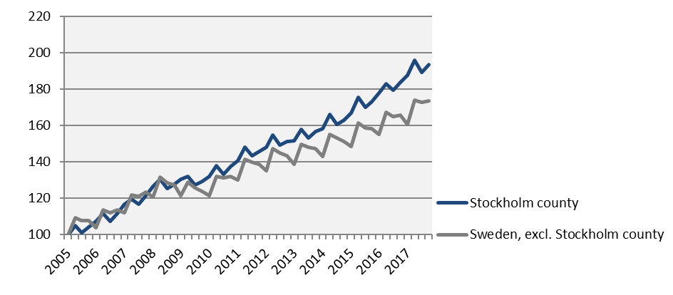
Economic growth, private sector Index 100 = 2005 Q1
 | 2017 Q4 | Change (%) since,
 | Billion SEK | 2005 Q1 | 2010 Q1 | 2016 Q4
Sweden | 319,7 | 79,7 | 44,1 | 4,9
Stockholm Region | 163,8 | 85,7 | 44,6 | 4,8
Stockholm county | 107,0 | 93,7 | 46,6 | 5,5
City of Stockholm | 69,9 | n.d. | 48,3 | 5,9
Sweden, excl. Stockholm county | 212,7 | 73,4 | 42,8 | 4,6
Source: Statistics Sweden

Slide 4
Economic growth, 2017 Q4
 | Stockholm county |  |  |  |  | City of Stockholm
 |  | Growth (%) since, |  |  |  |  | Growth (%) since,
 | Billion SEK | 2009 Q1 | 2010 Q1 | 2016 Q4 |  | Billion SEK | 2009 Q1 | 2010 Q1 | 2016 Q4
Total | 130,1 | 46,8 | 45,0 | 5,3 |  | 81,1 | 48,1 | 45,9 | 5,7
Agriculture, forestry & fishing | 0,2 | 59,3 | 40,7 | 2,0 |  | 0,0 | 118,3 | 43,3 | -4,1
Manufacturing, mining, quarrying & utilities | 7,6 | -6,8 | -3,3 | -13,4 |  | 2,8 | -26,4 | -26,2 | -34,1
Energy & Environment | 1,2 | 47,8 | 46,0 | 3,8 |  | 0,5 | -12,6 | -1,8 | 0,0
Construction | 8,5 | 93,3 | 87,3 | 10,2 |  | 4,2 | 117,1 | 136,2 | 10,2
Trade | 16,4 | 38,4 | 32,4 | 3,6 |  | 9,3 | 42,9 | 34,5 | 3,2
Transport | 5,6 | 29,6 | 25,3 | 3,8 |  | 2,5 | 26,9 | 20,0 | 2,6
Accommodation & food services | 3,8 | 103,9 | 89,6 | 4,5 |  | 2,8 | 105,8 | 93,4 | 6,0
Information & communication | 14,6 | 56,1 | 61,4 | 18,8 |  | 12,2 | 66,1 | 72,4 | 25,2
Financial & insurance | 8,7 | 8,5 | 10,6 | 6,3 |  | 6,9 | 5,1 | 7,4 | 7,4
Real Estate | 2,4 | 76,3 | 70,3 | 6,2 |  | 1,7 | 72,3 | 68,6 | 6,3
Business services | 22,0 | 73,9 | 73,4 | 7,0 |  | 17,2 | 72,8 | 72,7 | 6,6
Public administration | 0,1 | 34,4 | 21,7 | -8,8 |  | 0,1 | 30,0 | 22,1 | 0,1
Education | 3,1 | 80,8 | 71,8 | 5,5 |  | 1,8 | 84,7 | 76,6 | 6,1
Health | 8,1 | 87,7 | 68,2 | 3,3 |  | 4,5 | 80,3 | 58,6 | 1,2
Personal & cultural services | 4,4 | 60,9 | 53,9 | 4,4 |  | 3,3 | 59,9 | 52,1 | 5,4
Unspecified | 0,3 | 25,2 | 48,7 | -14,3 |  | 0,1 | 67,3 | 33,1 | 8,5
Private sector | 107,0 | 48,6 | 46,6 | 5,5 |  | 69,9 | 49,9 | 48,3 | 5,9
State | 9,0 | 44,0 | 40,4 | 4,6 |  | 6,3 | 39,3 | 34,1 | 4,8
Municipal | 10,7 | 38,5 | 36,6 | 4,3 |  | 4,0 | 35,4 | 32,5 | 4,5
County council | 3,4 | 29,6 | 36,6 | 3,9 |  | 0,9 | 37,7 | 25,3 | 4,1
Public sector | 23,1 | 39,2 | 38,0 | 4,4 |  | 11,2 | 37,8 | 32,8 | 4,7
Source: Statistics Sweden

Slide 5
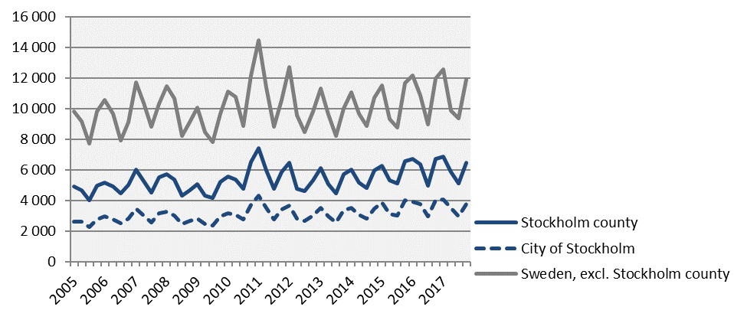
The number of newly registered businesses
 | 2017 Q4 |  | Yearly change*
 | Number | Ch., % | Number | Ch., %
Sweden | 18 410 | -1,5 | 68 113 | -1,0
The Stockholm Region | 9 643 | -1,8 | 36 144 | -0,7
Stockholm county | 6 480 | -3,6 | 24 357 | -1,8
City of Stockholm | 3 758 | -6,1 | 14 301 | -2,5
Sweden, excl. Stockholm county | 11 930 | -0,3 | 43 756 | -0,5
*Last four quarters
Source: The Swedish Companies Registration Office.

Slide 6
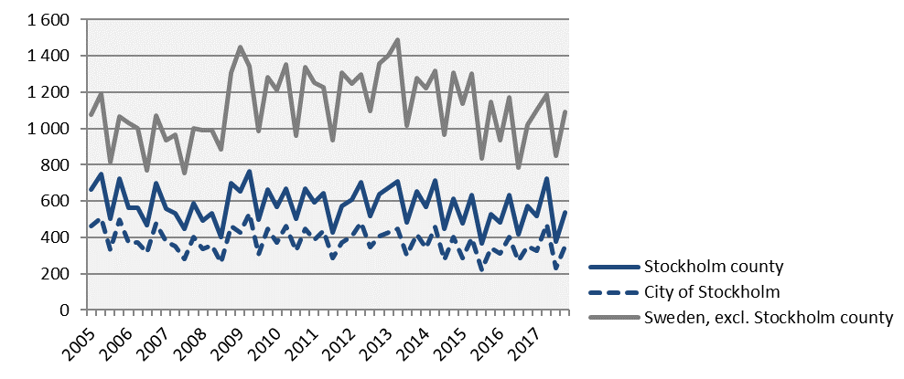
Company bankruptcies
 | 2017 Q4 |  | Yearly change*
 | Number | Ch., % | Number | Ch., %
Sweden | 1 633 | 2,3 | 6 394 | 6,2
The Stockholm Region | 836 | -0,9 | 3 314 | 7,2
Stockholm county | 540 | -5,8 | 2 161 | 2,8
City of Stockholm | 353 | 0,9 | 1 383 | 3,5
Sweden, excl. Stockholm county | 1 093 | 6,8 | 4 233 | 8,1
*Last four quarters
Source: Statistics Sweden

Slide 7
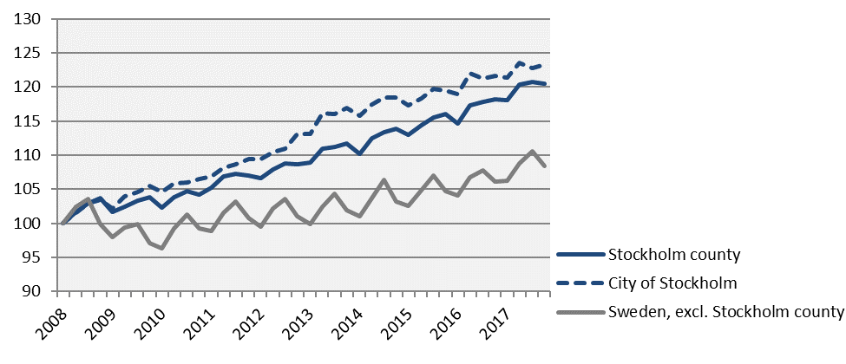
Employment Index 100 = 2008 Q1
 | Number | Growth | Growth (%) since,
 | 2017 Q4 | Yearly ch.* | 2008 Q1 | 2010 Q1 | 2016 Q4
Sweden | 5 025 200 | 104 300 | 11,2 | 13,9 | 2,1
Stockholm Region | 2 308 800 | 55 100 | 14,5 | 15,2 | 2,4
Stockholm county | 1 234 200 | 24 400 | 20,5 | 17,9 | 2,0
City of Stockholm | 536 600 | 7 300 | 23,3 | 17,9 | 1,4
Sweden, excl. Stockholm county | 3 791 000 | 79 900 | 8,4 | 12,6 | 2,2
*Last four quarters
Source: Statistics Sweden

Slide 8
The number of employed people in Stockholm County
 | Number | Growth | Growth (%) since,
 | 2017 Q4 | Yearly ch.* | 2008 Q1 | 2010 Q1 | 2016 Q4
Total | 1 234 200 | 24 400 | 20,5 | 17,9 | 2,0
Agriculture, forestry & fishing | n.d. | n.d. | n.d. | n.d. | n.d.
Manufacturing, mining, quarrying & utilities | 65 500 | 6 300 | 12,5 | 12,2 | 10,6
Manufacturing of workshop products | 29 000 | 1 600 | 1,4 | -3,3 | 5,8
Construction | 66 500 | -2 500 | 10,8 | 17,1 | -3,6
Trade | 150 600 | 10 800 | 12,1 | 18,4 | 7,7
Transport | 55 400 | -4 500 | 4,3 | 1,7 | -7,5
Accommodation & food services | 51 400 | 1 800 | 43,6 | 38,5 | 3,6
Information & communication | 105 900 | 9 300 | 38,6 | 33,7 | 9,6
Arts, entertainment, recreation & other services | 73 700 | 2 700 | 17,9 | 15,2 | 3,8
Financial & insurance | 296 300 | -9 800 | 22,9 | 15,3 | -3,2
Public administration | 93 400 | 13 500 | 43,9 | 30,6 | 16,9
Education | 129 000 | 3 800 | 22,9 | 17,0 | 3,0
Health | 140 400 | -5 000 | 13,1 | 14,3 | -3,4
Unspecified | n.d. | n.d. | n.d. | n.d. | n.d.
Employed in Sweden | 1 230 700 | 24 600 | 20,6 | 17,9 | 2,0
Employed abroad | 3 500 | -100 | 2,9 | -5,4 | -2,8
Source: Statistics Sweden
*Last four quarters

Slide 9
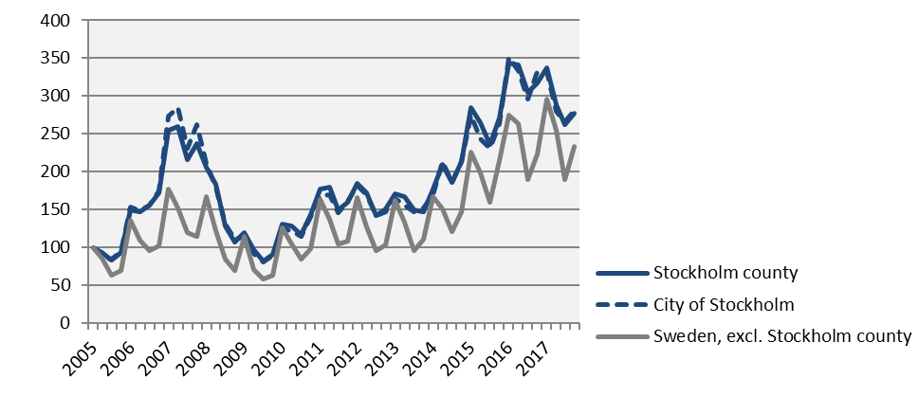
Number of recently listed positions Index 100 = 2005 Q1
 | 2017 Q4 |  | Yearly growth*
 | Number | Ch., % | Number | Ch., %
Sweden | 306 280 | -0,6 | 1 278 760 | -1,6
The Stockholm Region | 139 745 | -9,1 | 591 960 | -7,0
Stockholm county | 84 040 | -12,8 | 353 094 | -11,0
City of Stockholm | 56 847 | -15,3 | 234 630 | -11,6
Sweden, excl. Stockholm county | 222 240 | 4,9 | 925 666 | 2,5
*Last four quarters
Source: The Labor Exchange

Slide 10
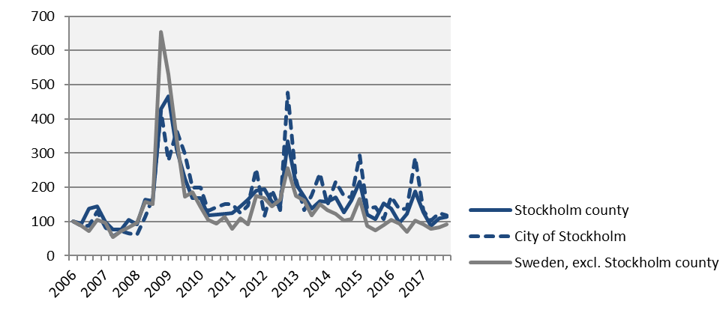
The number of people given notice Index 100 = 2006 Q1
 | 2017 Q4 |  | Yearly change*
 | Number | Ch., % | Number | Ch., %
Sweden | 9 111 | -20,5 | 34 580 | -10,4
The Stockholm Region | 4 145 | -30,5 | 16 297 | -13,3
Stockholm county | 2 306 | -39,8 | 8 849 | -19,6
City of Stockholm | 1 043 | -58,8 | 4 192 | -35,2
Sweden, excl. Stockholm county | 6 805 | -10,8 | 25 731 | -6,7
*Last four quarters
Source: The Labor Exchange

Slide 11
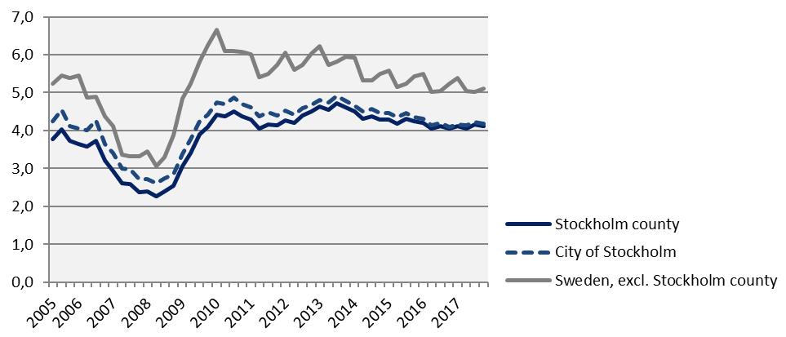
Unemployment in relation to the population (%), 15-74 years
 | Number | Yearly | Unemployed out of population, 15-74 years
 | 2017 Q4 | change* | 2010 Q1 | 2016 Q4 | 2017 Q4
Sweden | 363 041 | -3 348 | 6,2 | 5,0 | 4,9
The Stockholm Region | 159 700 | -400 | 5,7 | 4,8 | 4,7
Stockholm county | 70 697 | 1 936 | 4,4 | 4,1 | 4,1
City of Stockholm | 30 450 | 1 024 | 4,7 | 4,1 | 4,2
Sweden, excl. Stockholm county | 292 345 | -5 285 | 6,7 | 5,2 | 5,1
*Last four quarters
Source: The Labor Exchange and Statistics Sweden

Slide 12
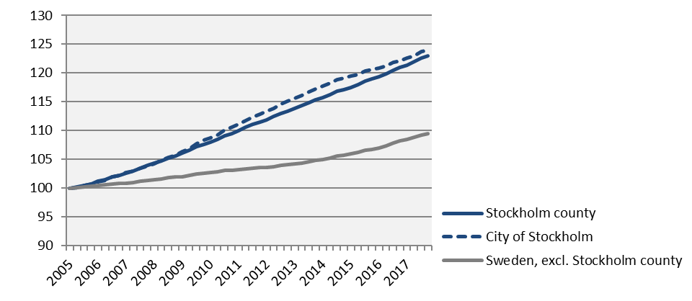
Population Index 100 = 2005 Q1
 | 2017 Q4 | Yearly ch.* | Yearly ch.* | Growth (%) since,
 | (in thousands) |  |  | 2005 Q1 | 2010 Q1 | 2016 Q4
Sweden | 10 120,2 |  | 125,1 | 12,3 | 8,2 | 1,3
The Stockholm Region | 4 567,8 |  | 65,4 | 15,9 | 10,4 | 1,5
Stockholm county | 2 308,1 |  | 39,1 | 23,0 | 13,9 | 1,7
City of Stockholm | 949,8 |  | 14,1 | 24,0 | 14,1 | 1,5
Sweden, excl. Stockholm county | 7 812,1 |  | 86,0 | 9,4 | 6,6 | 1,1
*Last four quarters
Source: Statistics Sweden

Slide 13
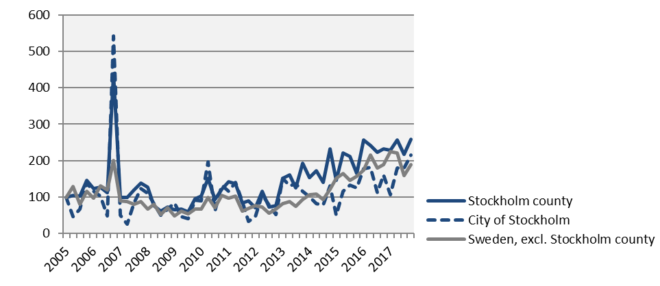
Number of housing projects started Index 100 = 2005 Q1
 | 2017 Q4 |  | Yearly change*
 | Number | Ch., % | Number | Ch., %
Sweden | 15 236 | 3,6 | 61 576 | 3,5
The Stockholm Region | 8 348 | 10,7 | 32 182 | -1,4
Stockholm county | 4 981 | 11,5 | 18 507 | 0,6
City of Stockholm | 2 242 | 33,2 | 7 116 | 7,9
Sweden, excl. Stockholm county | 10 255 | 0,2 | 43 069 | 4,7
*Last four quarters
Source: Statistics Sweden

Slide 14
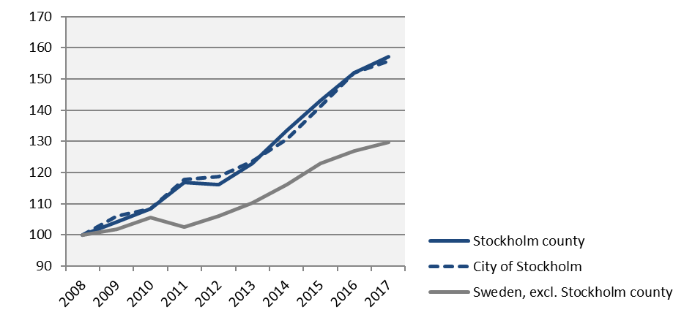
Commercial Accommodations Index 100 = 2008 Q4 (Q4, 2008 - 2017)
 | 2017 Q4 | Yearly ch.* | Growth (%) since,
 | (in thousands) |  | 2008 Q4 | 2010 Q4 | 2016 Q4
Sweden | 10 428 | 63 030 | 37,0 | 29,0 | 2,5
The Stockholm Region | 5 143 | 26 263 | 36,9 | 29,8 | 3,5
Stockholm county | 3 198 | 14 056 | 57,0 | 44,9 | 3,3
City of Stockholm | 2 197 | 9 342 | 55,7 | 43,6 | 2,4
Sweden, excl. Stockholm county | 7 230 | 48 974 | 29,7 | 23,0 | 2,1
*Last four quarters
Source: Statistics Sweden and Swedish Agency for Economic and Regional Growth

Slide 15
Stockholm Business Region Stockholm Business Region is responsible for developing and promoting Stockholm as a business and tourist destination under the brand Stockholm - The Capital of Scandinavia. The aim is to make Stockholm the leading sustainable growth region in Europe. Stockholm Business Region is owned by the city of Stockholm and has two subsidiaries Invest Stockholm and Visit Stockholm. For questions: Contact Stefan Frid, Invest Stockholm. Publisher: Olle Zetterberg, CEO Stockholm Business Region Stockholm Business Region P.O. Box 16282 SE-103 25 Stockholm, Sweden Phone + 46 8 508 280 00 www.visitstockholm.com www.investstockholm.com www.stockholmbusinessregion.se

