Slide 1
DroneGuard™ Series
DroneGuard CS 300, CS 400
and DroneGuard Kit
Above & Beyond
Our DroneGuard series was designed by serious quadcopter pilots for serious quadcopter pilots. A patent-pending design and FormShell™ technology push the limits of flexibility and protection, so you can take your drone whever you want.
The flexible cases are built with Lowepro’s FormShell technology to offer organized protection that’s really easy to transport (walk, hike, car, bike, travel).
The DroneGuard Kit is a patent-pending system of dividers that helps manage all of your gear and goes way beyond the “pick-and-pluck” systems of the competition.
Our unique and highly functional DroneGuard series gives you the perfect, out-of-the-box solutions. Happy flying!

Slide 2
DroneGuard™ Series
DroneGuard CS 300, CS 400
and DroneGuard Kit
Our FormShell technology safeguards your fragile gear via a molded design. Lightweight, yet sturdy composite-shell construction delivers superior impact protection.
Get flexible organization for your quadcopter and drone gear with DroneGuard cases that fit the depth and form factors of top-selling brands. Case designs are built with adjustable dividers and compartments, plus a panel of accessory straps to keep blades, props, mounts, cables and batteries neat and secure.
Super-easy carry. Store your DroneGuard case in the trunk of a car for transport, or garage, closet or workshop for an organized storage option. When you want to take your kit to a great flying and landing location, use the removable backpack straps to hike without a hassle.
Materials: 600D polyester, tactical “fractal camo” in 600D polyester
DroneGuard CS 400 shown on right

Slide 3
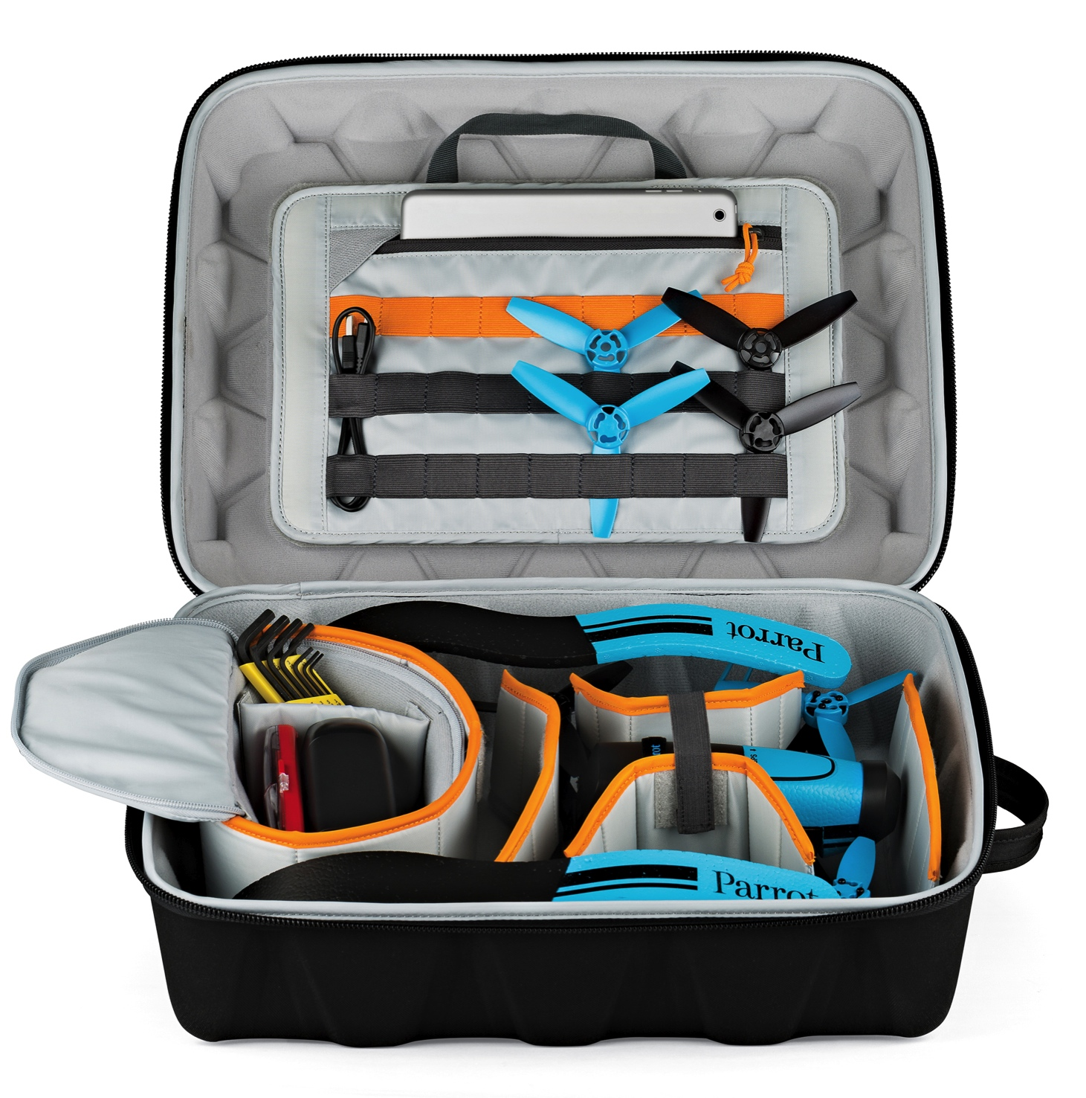
DroneGuard™ CS 300
Parrot Bebop or similar drone, quadcopter or flying camera form factor
RC/transmitter, blades, props, action video camera, batteries, cables, chargers, mounts, etc.
Dedicated storage and organization for drone-related accessories
Moveable accessory box with two padded, adjustable dividers
Exterior Dimensions (WxDxH)
14.0 x 6.9 x 18.2 in.
35.6 x 17.6 x 46.3 cm
Interior Dimensions (WxDxH)
13.8 x 6.0 x 17.4 in.
35 x 15.2 x 44.3 cm
Total Weight
3.3 lbs. | 1.5 kg
Flexible and protective divider system for multiple set-ups
Available Color: Black
Models may vary by locations.

Slide 4
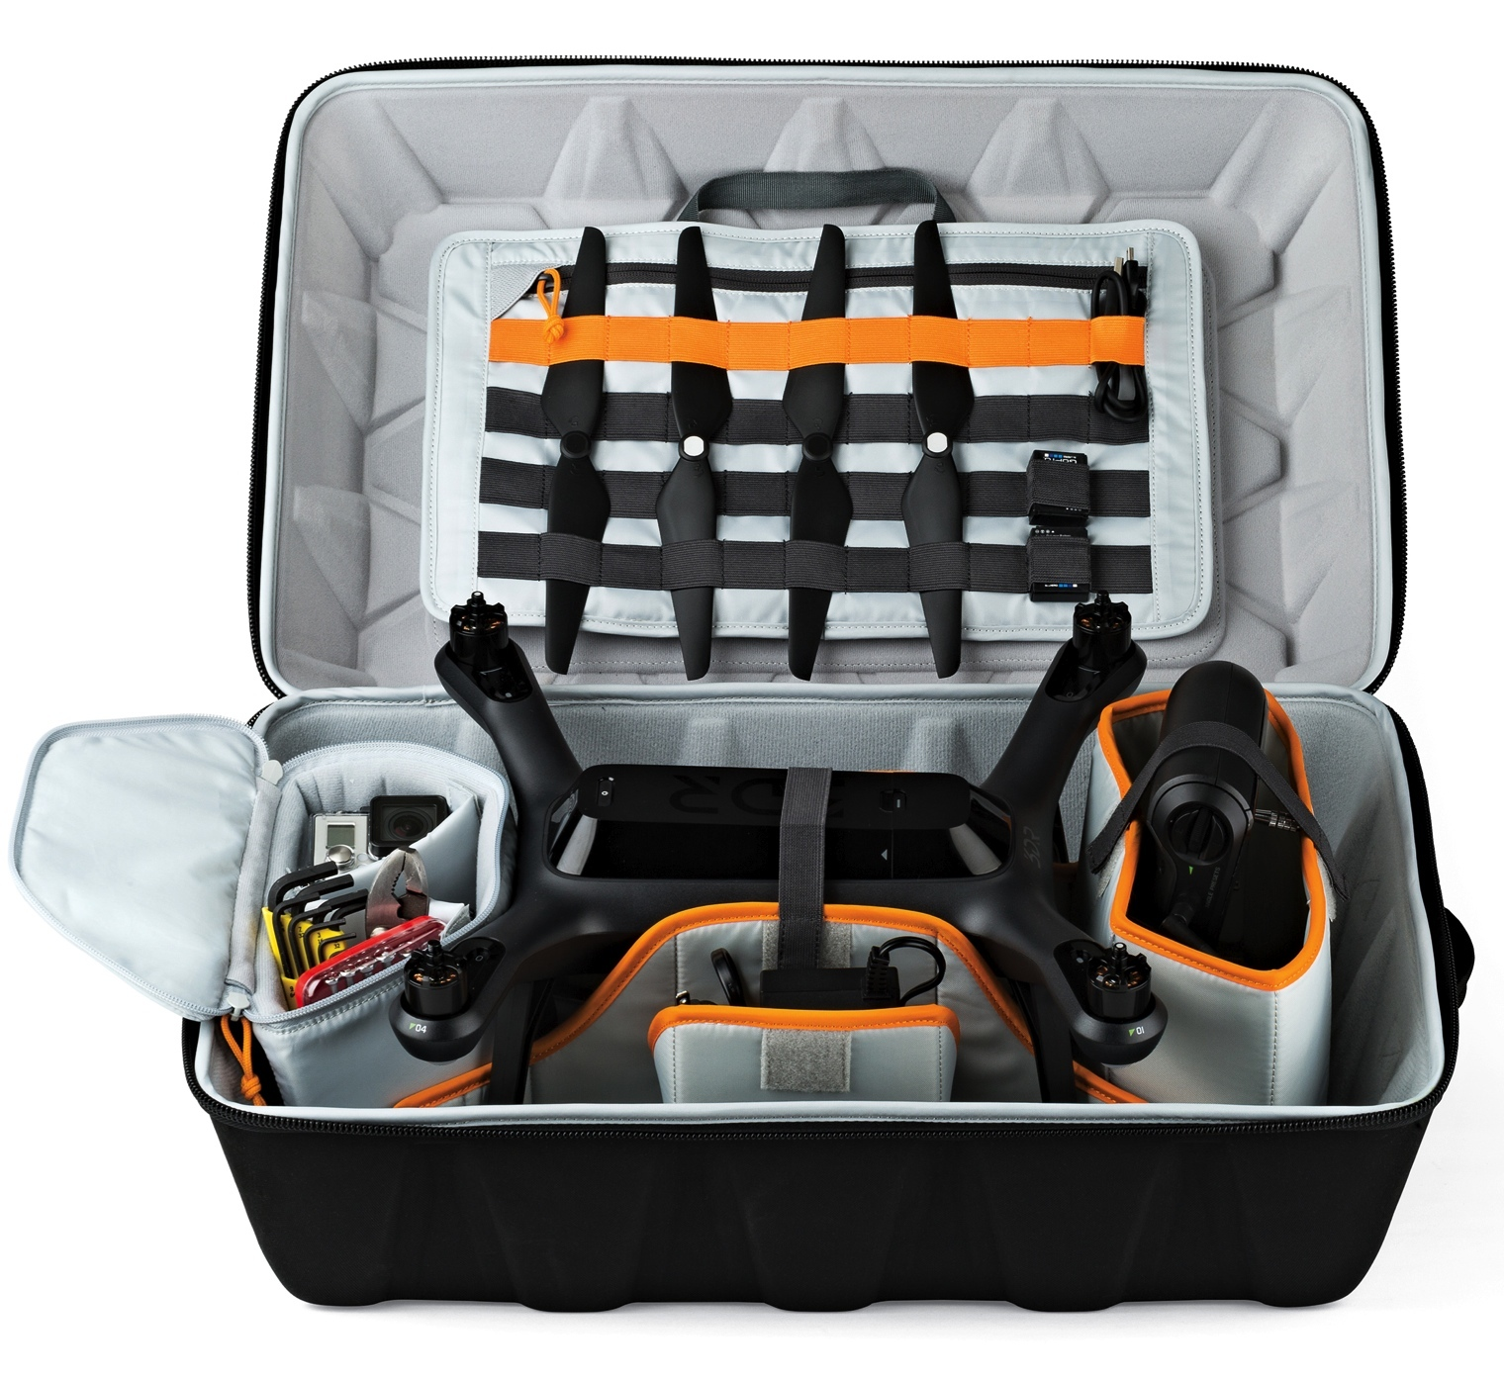
DroneGuard™ CS 400
DJI Phantom 1, 2 or 3, 3DR Solo or similar drone, quadcopter or flying camera form factor
RC/transmitter, blades, props, action video camera, batteries, cables, chargers, mounts, etc.
Dedicated storage and organization for drone-related accessories
Moveable accessory box with two padded, adjustable dividers
Exterior Dimensions (WxDxH)
15.0 x 10.0 x 21.9 in.
38.1 x 25.5 x 55.7 cm
Interior Dimensions (WxDxH)
14.2 x 8.6 x 21.4 in.
36 x 21.8 x 54.4 cm
Total Weight
4.8 lbs. | 2.2 kg
Flexible and protective divider system for multiple set-ups
Available Color: Black
Models may vary by locations.

Slide 5
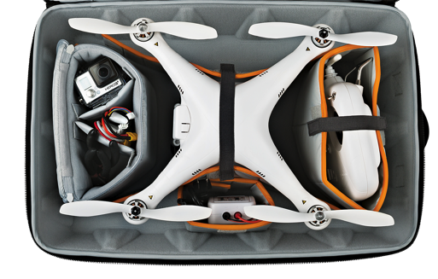
DroneGuard™ Series
DroneGuard CS 300
and CS 400
FormShell™ construction offers superior protection for gear, without adding bulk or weight.
Lightly padded backpad includes removable backpad straps. Use for treks out to flying location, or detach and pack away for less bulk or long-distance travel.
Patent-pending DroneGuard system of organization with flexible dividers and compartments for all large and small accessories.
Easy to customize with removable dividers and compartments. Change your flight plan; change your set-up!

Slide 6
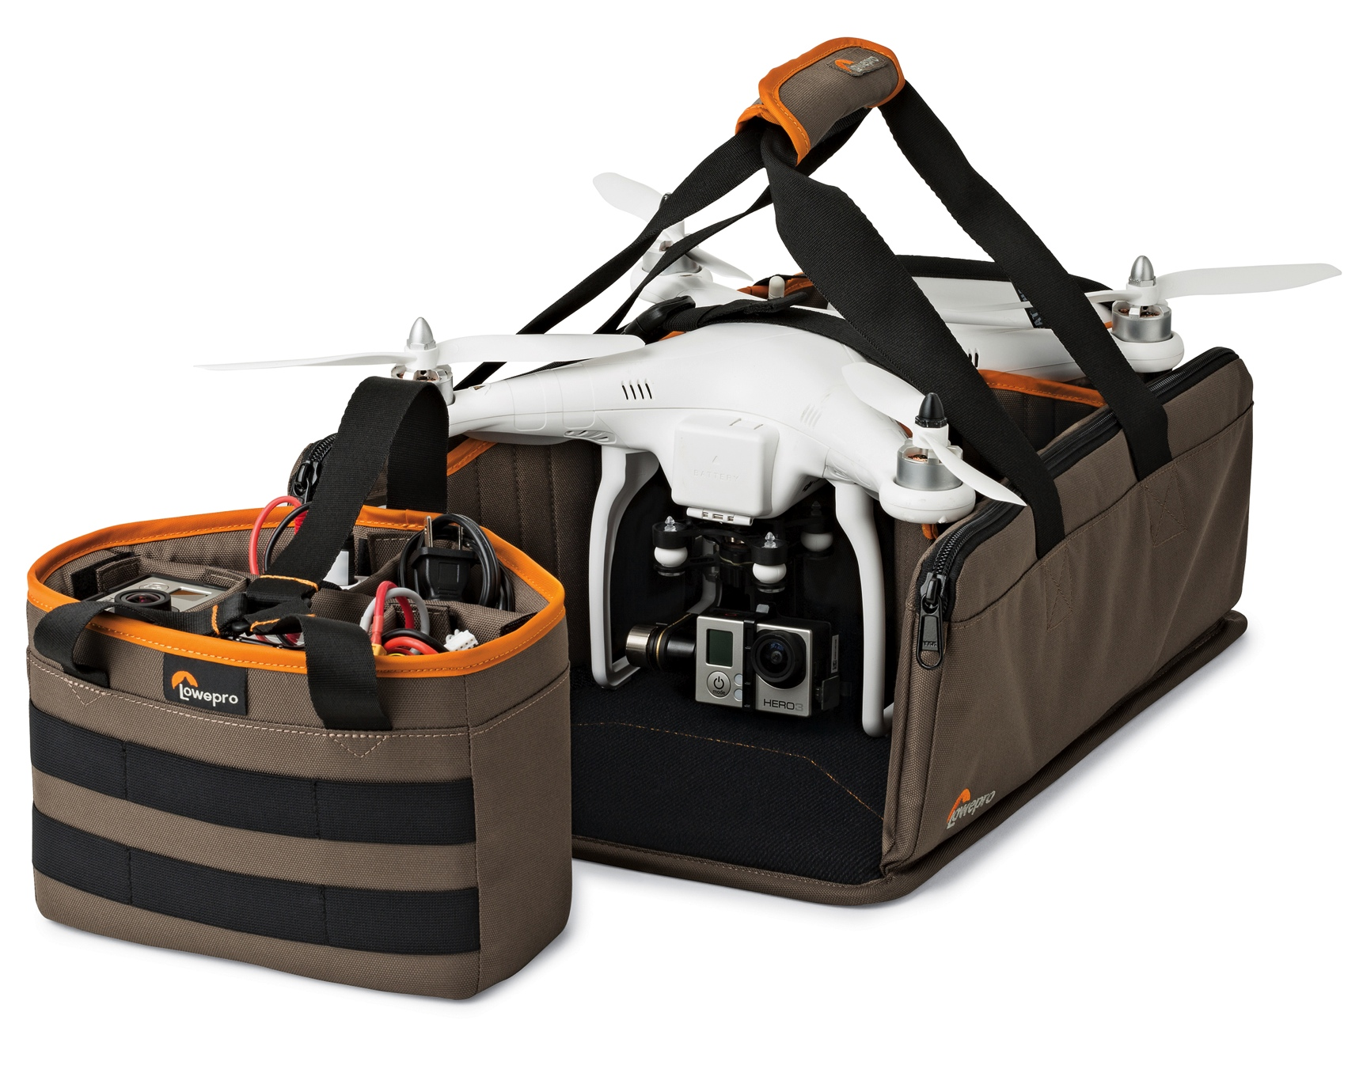
DroneGuard™ Kit
Zippered sidewall pockets keep loose parts and manuals secured and within easy reach
Drone (such as DJI Phantom 1, 2 and 3)
Multiple action video cameras
Multiple props/blades
Multiple batteries, chargers, cables, cords
Transmitter
Tools
Detachable battery box includes 4 padded and removable dividers
Exterior Dimensions (WxDxH)
17.5 x 11.6 x 6.1 in.
44.5 x 29.5 x 15.5 cm
Interior Dimensions (WxDxH)
17.5 x 10.4 x 6.1 in.
44.5 x 26.5 x 15.5 cm
Total Weight
1.5 lbs. | 0.7 kg
Rigid and protective tray with honeycomb interior, plus comfortable carry straps
Available Color: Mica/Black
Models may vary by locations.
Hook/loop attachment system with velex for easy configuration

Slide 7
DroneGuard™ Series
DroneGuard Kit
Built to fit and organize all your drone/quad components, including cameras, transmitters, cords, tools, spare parts, manuals, etc.
Ultra-portable design keeps all equipment safe and within each for storage, transport, set-up and use on location–place it in car or larger bag for travel.
Includes modular components for flexible use and easy customization: Battery Box with 4 dividers and outer loops, Sidewalls with pockets, plus Transmitter Divider.
Kit is built to secure and protect gear with retention straps, elastic loop system, rigid base, padded and adjustable dividers and durable materials that resist moisture and abrasion.

