Slide 1
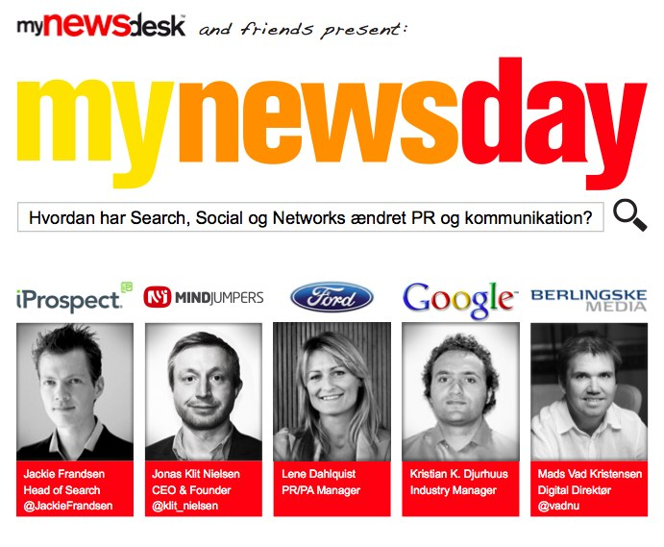

Slide 2

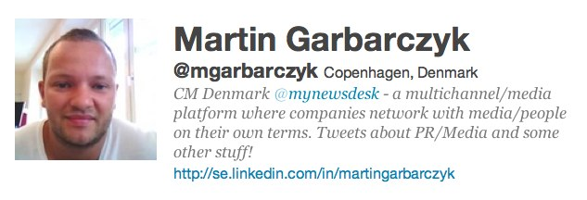
martin.garbarczyk@mynewsdesk.com

Slide 3

Schedule:
09.15 - 09.40 - Almost everyone starts with a Search today – How does Search Engine Optimization (SEO) work?
09.45 - 10.10 - Social PR, what value does it give (ROI)?
10.10 - 10.30 - Coffee Break!
10.30 - 10.55 - How has Ford incorporated Social, Network and Search in our PR work?
11.00 - 11.25 - Digital trends for PR & Marketing?
11.30 - 12.00 - The Journalist’s Reality and how to break through the barriers?
12.00 - 13.00 - Workshops and more inspiration and thoughts from the speakers!

Slide 4
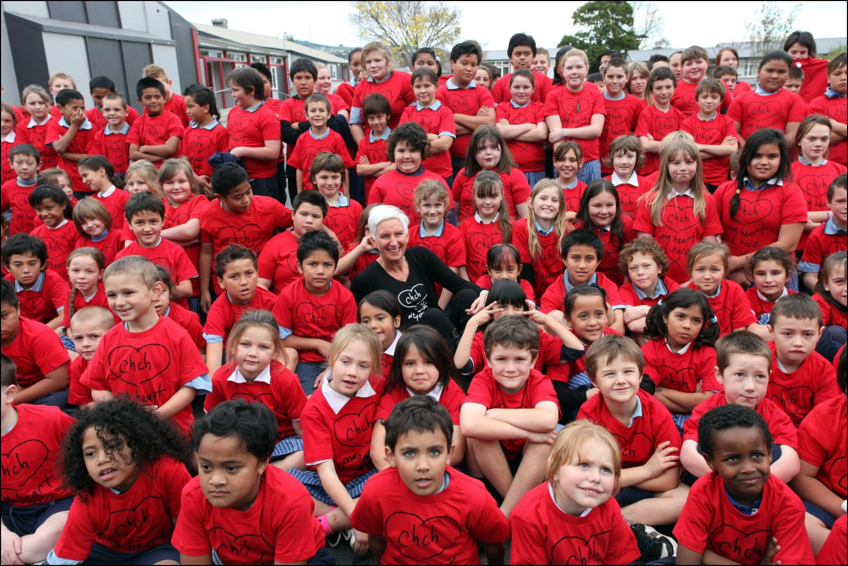
WHAT IS?
AND WHO ARE WE ?

Slide 5
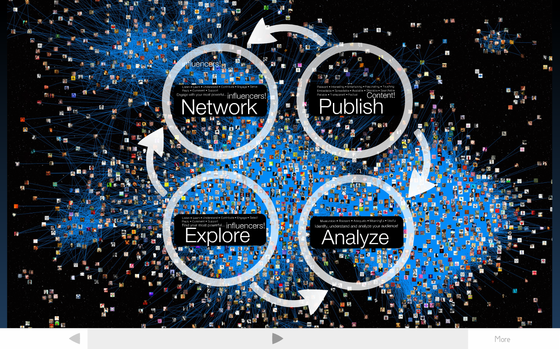

Slide 7
søgemaskineoptimering
Mynewsday
26. oktober 2011

Slide 8

One of the Internet's strengths is its ability to help consumers find the right needle in a digital haystack of data.
Jared Sandberg
Notes:
Og det er lige nøjagtig her søgemaskiner udfylder en væsentlig rolle…..indsamling og organisering af data, så det gøres let tilgængeligt for brugeren

Slide 9

Notes:
75% af al internet aktivitet starter på en søgemaskine (et lille fald fra et par og 80% de sidste par år, men social har ikke taget magten)
75% af alle Google klik er organiske

Slide 10
Al kommunikation leder til søgemaskinerne
Hvilke af følgende punkter har fået dig til at gå ipå en søgemaskine for at få information om en virksomhed, et produkt eller en service?
Notes:
Recommendation is the most important factor - Facebook/twitter (social media) might have an impact here
It is more important to cover up for print ads in search than it is in TV commercials
Print ads are often very “call to action” minded compared to TV commercials

Slide 11
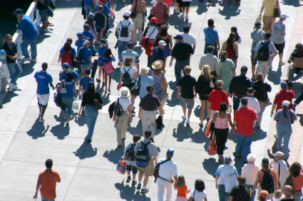
Hvad er search?
Search er pull
Search er 24 timer i døgnet
Search er spørgsmål
Search er jeres svar
Search er verdens største fokusgruppe

Slide 12

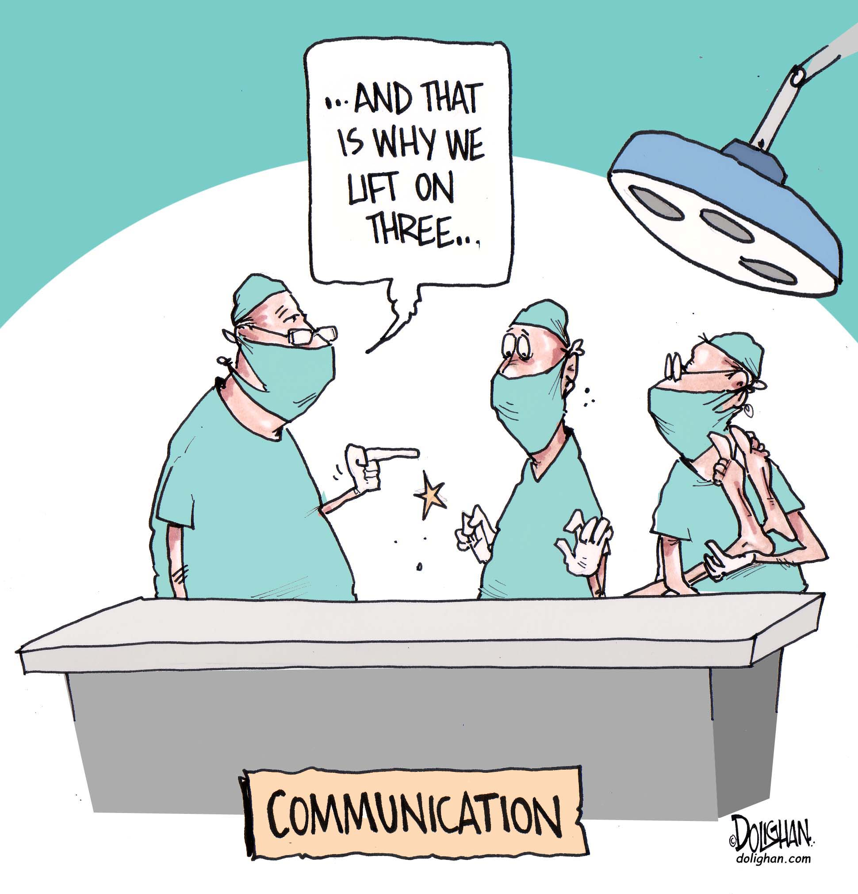

Slide 13
Bedre spørgsmål = bedre svar
Når du søger på en søgemaskine som fx. Google, hvor mange søgeord indtaster du normalt i din søgning ?

Slide 14
Relevans - Tænk på modtageren!
Google Webmaster Guidelines
WEBMASTERE, DER BRUGER DERES ENERGI PÅ AT OVERHOLDE HENSIGTEN I DE GRUNDLÆGGENDE PRINCIPPER, VIL GIVE EN MEGET BEDRE BRUGEROPLEVELSE OG VIL EFTERFØLGENDE OPNÅ EN BEDRE PLACERING END DEM, DER BRUGER DERES TID PÅ AT SØGE EFTER SMUTHULLER, DE KAN UDNYTTE.
UNDGÅ AT BRUGE TRICK, DER HAR TIL HENSIGT AT FORBEDRE PLACERINGEN HOS SØGEMASKINER. EN GOD TOMMELFINGERREGEL ER AT UNDERSØGE, OM DU MED SINDSRO KAN FORKLARE, HVAD DU HAR GJORT, TIL ET WEBSTED, SOM DU KONKURRERER MED. EN ANDEN NYTTIG TEST ER AT SPØRGE: "VIL DETTE HJÆLPE MINE BRUGERE? VILLE JEG GØRE DETTE, HVIS DER IKKE VAR SØGEMASKINER?”

Slide 15
seo
Platform
Links
Indhold

Slide 16
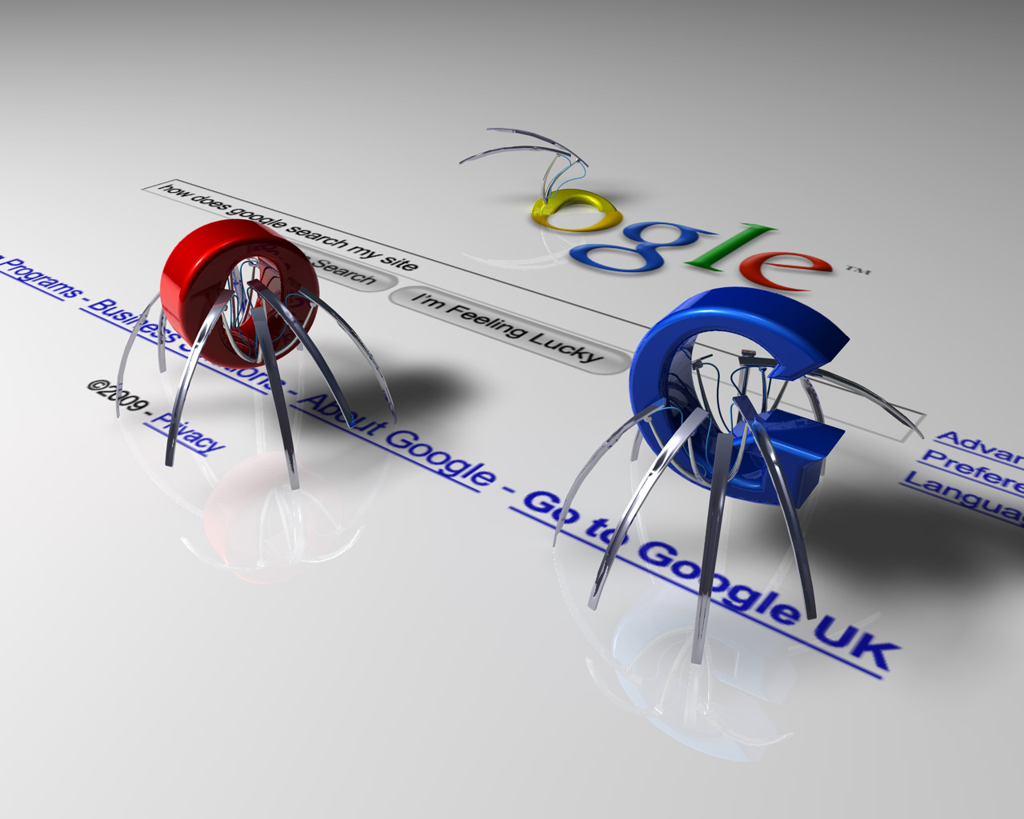
Platform

Slide 17

Indhold

Slide 18

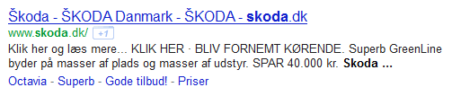

Vil du kommunikere på denne måde i fx avisannoncer?

Slide 19


Relevant kommunikation

Slide 20
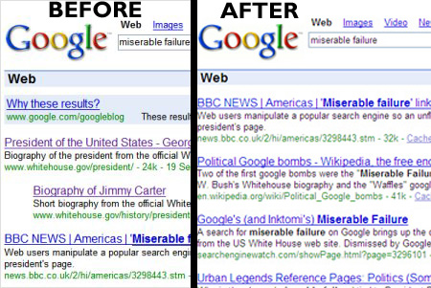
Links er anbefalinger
Links er ekstremt effektive, brug dem ordentligt.
Navngiv links rigtigt - mange links der hedder ”klik her”, ”læs mere” etc.

Slide 21
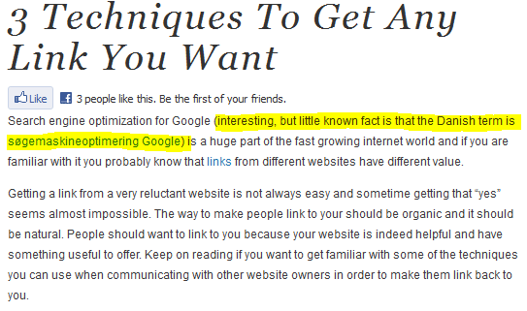
Irrelevante links………….men stadig en anbefaling!

Slide 22
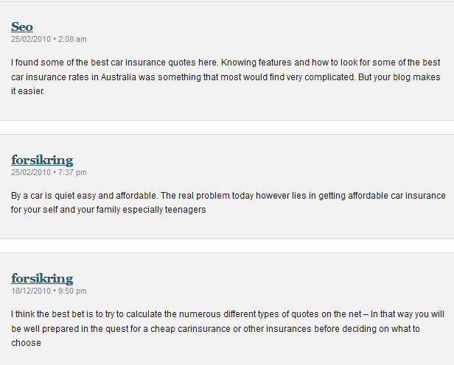
Flere irrelevante links

Slide 23
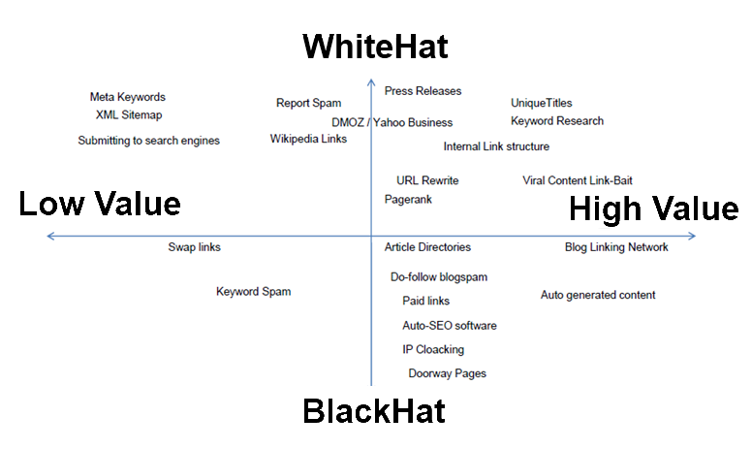
så pas på ………..og tænk altid på modtageren

Slide 24


Slide 25
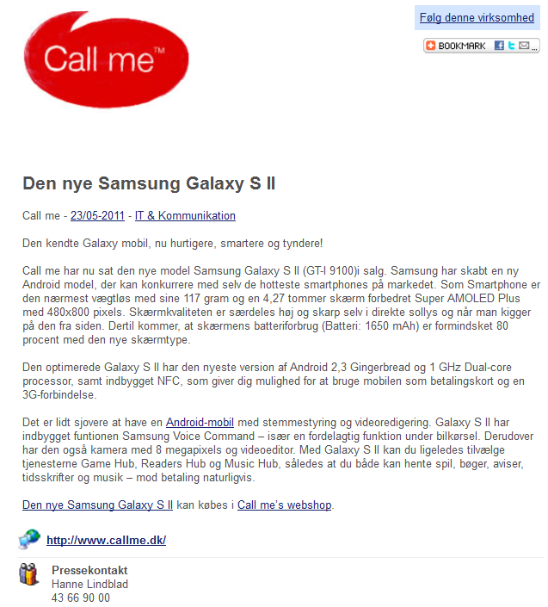

Slide 26
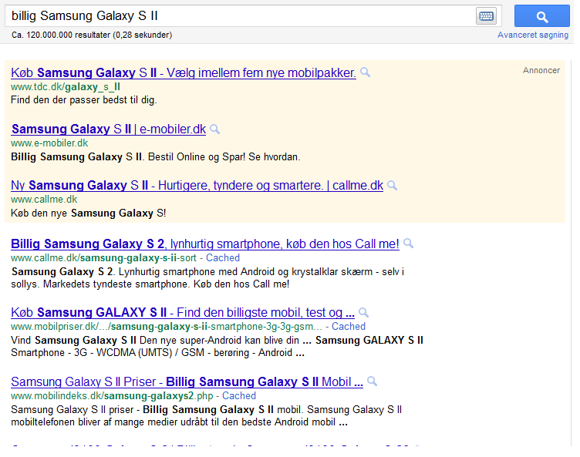

Slide 27
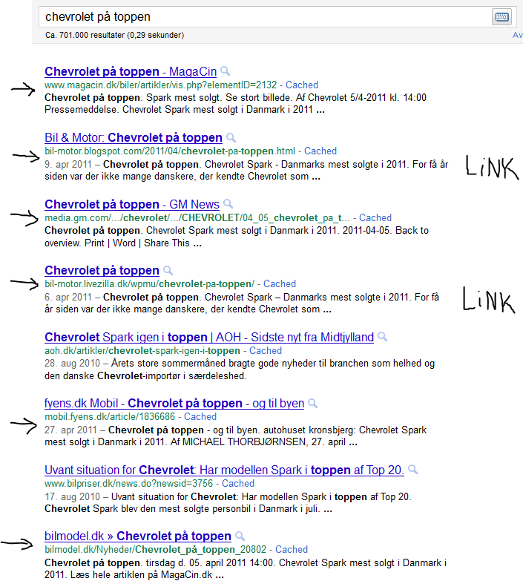

Slide 28
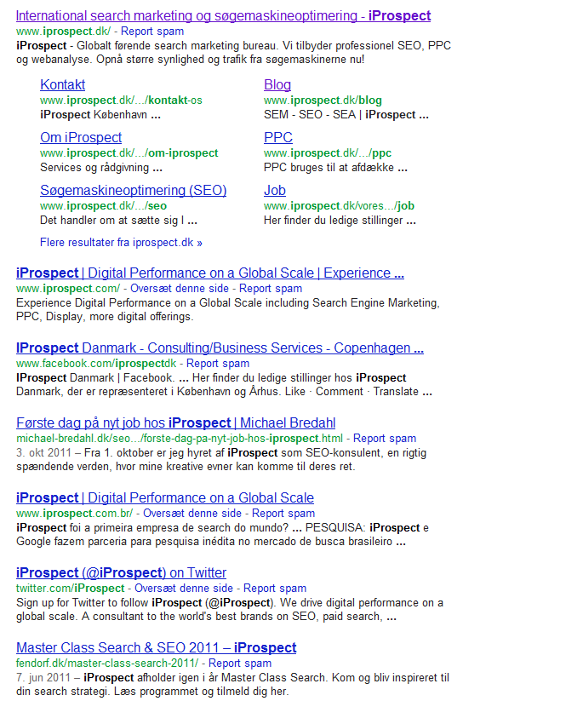

Slide 29
Opsummering
Search er primært kommunikation – tilsat lidt teknik
Søgemaskineoptimering handler overordnet om tre elementer:
  Platform (Kan søgemaskinen læse jeres site?)
  Indhold (Hvad søger brugerne efter og hvad vil I findes på?)
  Links (Er der nogen der anbefaler jeres site?)
Digital PR er et af værktøjerne til succes med søgemaskineoptimering
Search er kæmpestort – så brug det aktivt i jeres kommunikationsstrategi

Slide 30
Tak for opmærksomheden

Slide 31
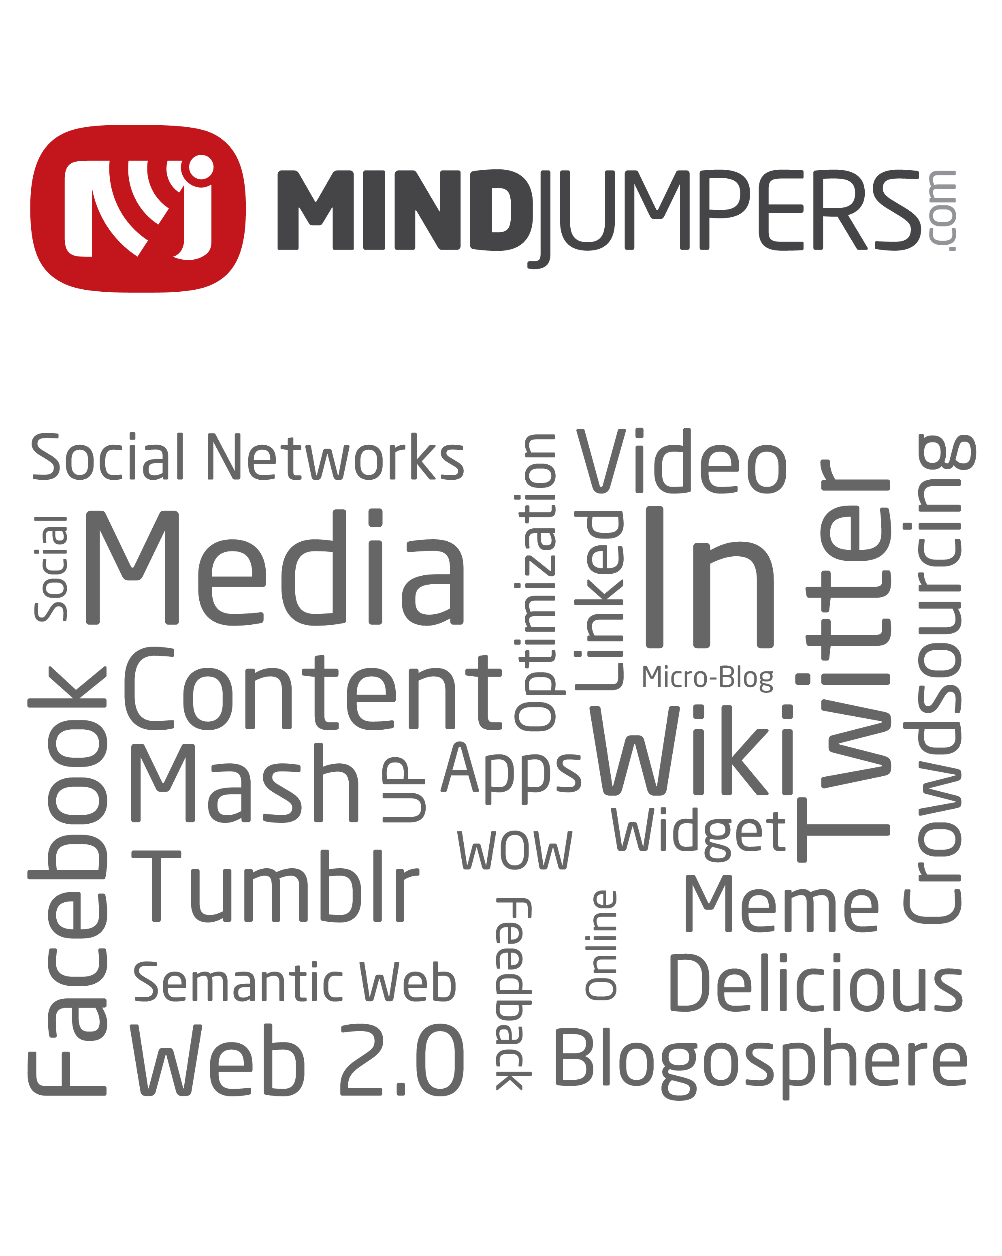
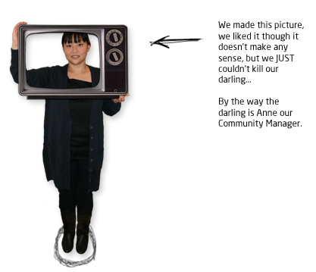
October 2011

Slide 32
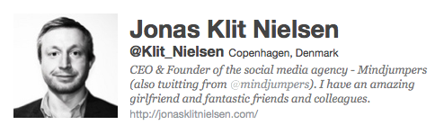
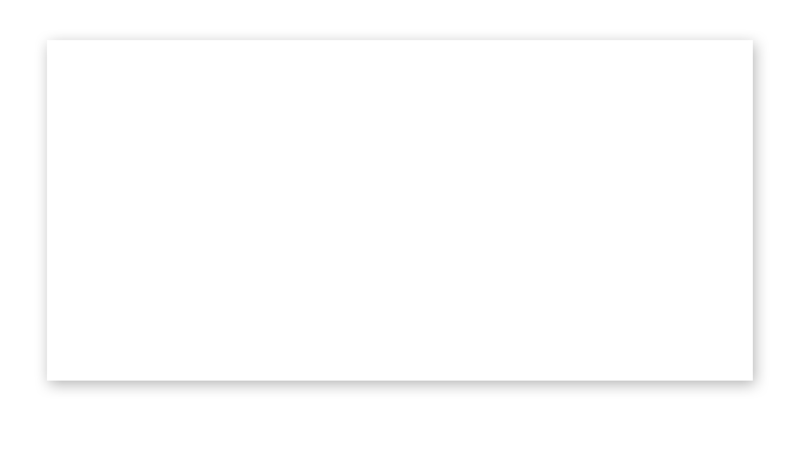
Social PR
ROI

Slide 33
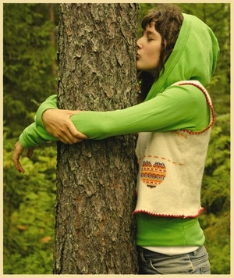

Slide 34
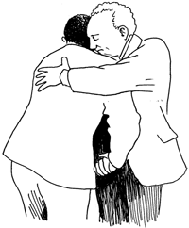
The Death of Traditional PR?

Slide 35
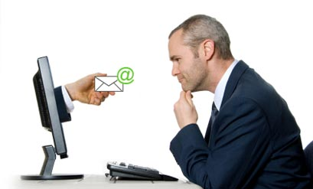
The Death of Email Marketing/PR?

Slide 36
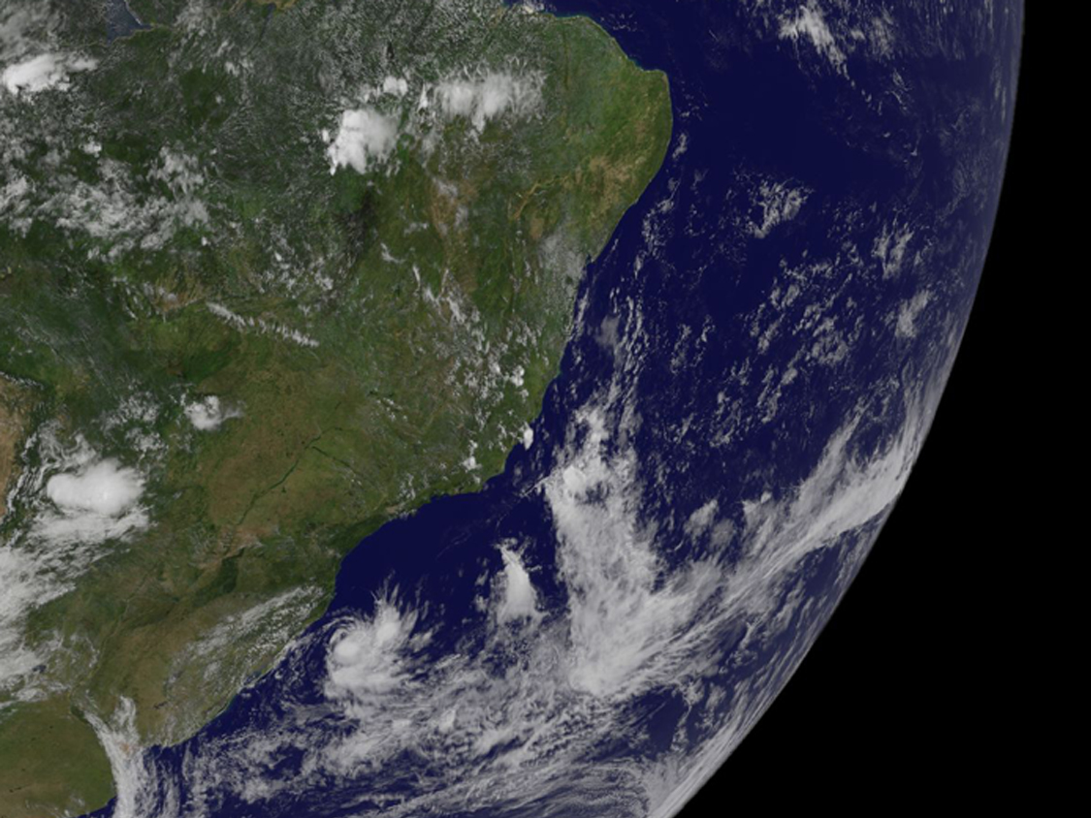
Image by gsfc used with Attribution as directed by Creative Commons http://www.flickr.com/photos/gsfc/4422729133
The World is Changing..

Slide 37
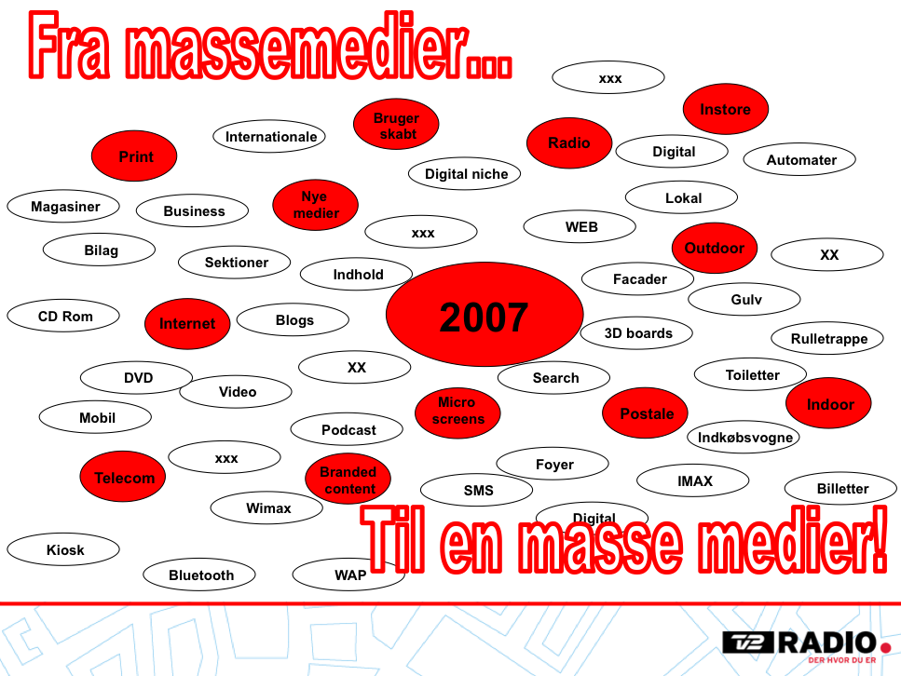
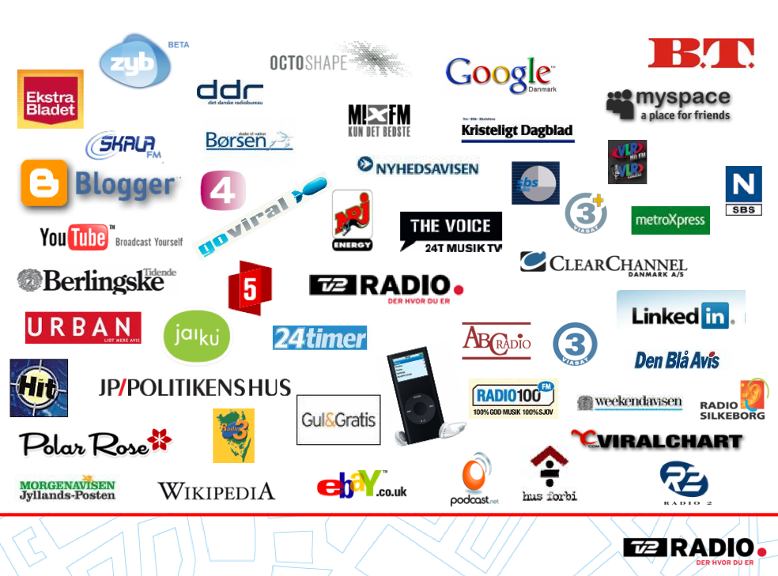
2007

Slide 38
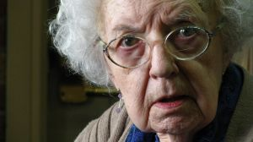
Everybody and their..

Slide 39
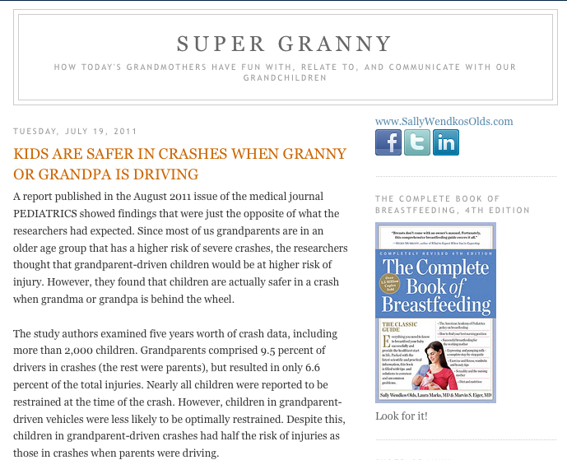
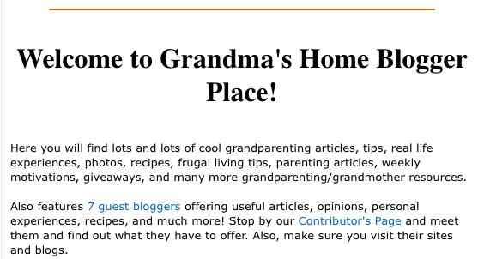
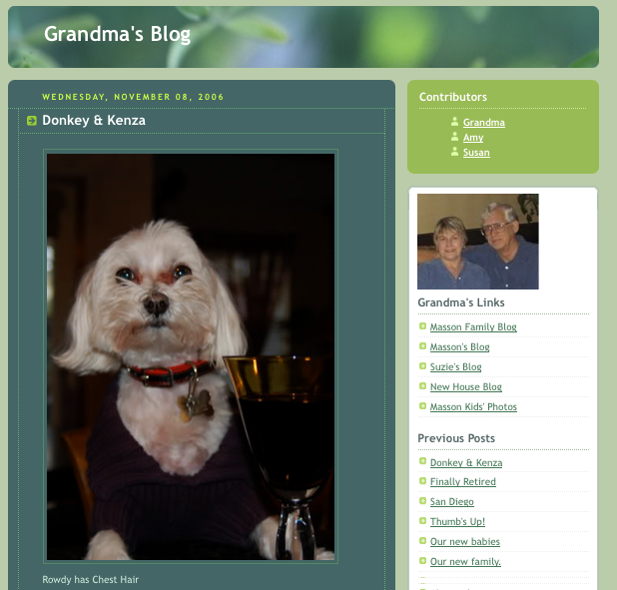


Slide 40
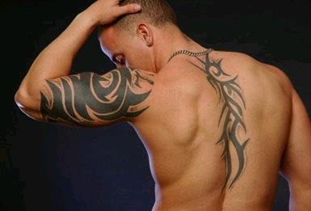
It’s a Tribal thing..

Slide 41

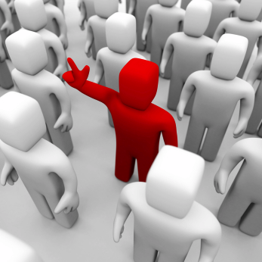
How..

Slide 42
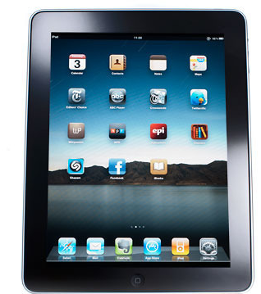
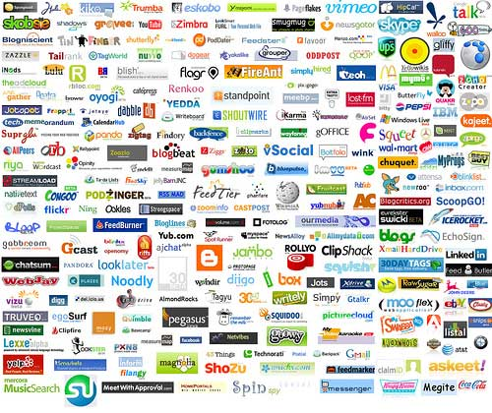
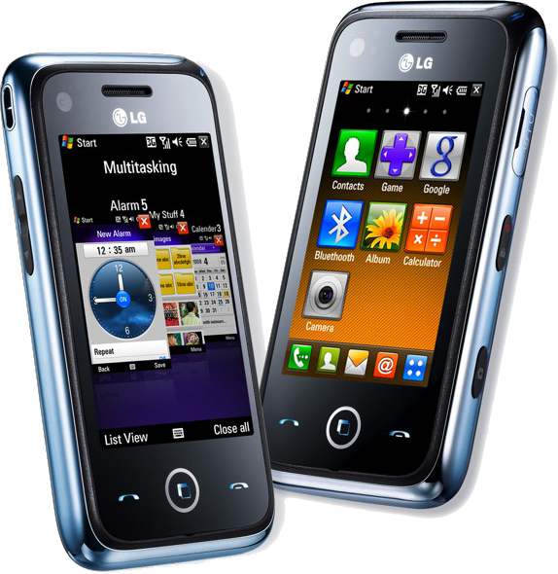
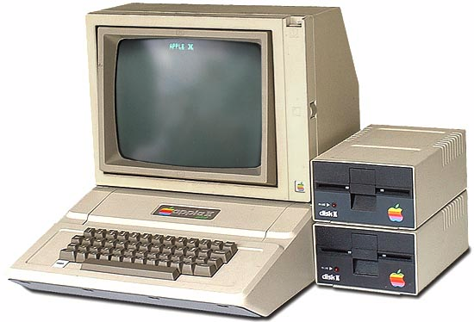
Destination to Distribution..

Slide 43

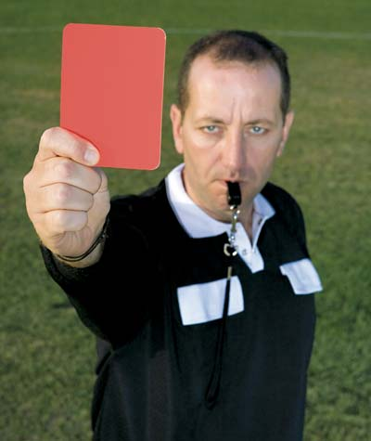
You are not the King
Involve
Dialog

Slide 44




Create a reason for…

Slide 45
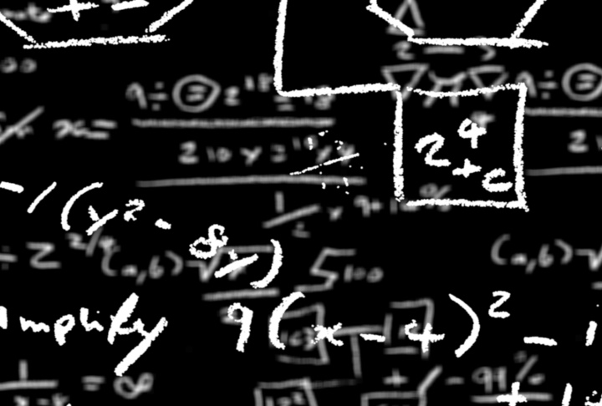
Analytic
Metrics
Intelligence
Conversion
ROI
Reporting
Data that is driven by Dialog and Contextual Content within a Community

Slide 46
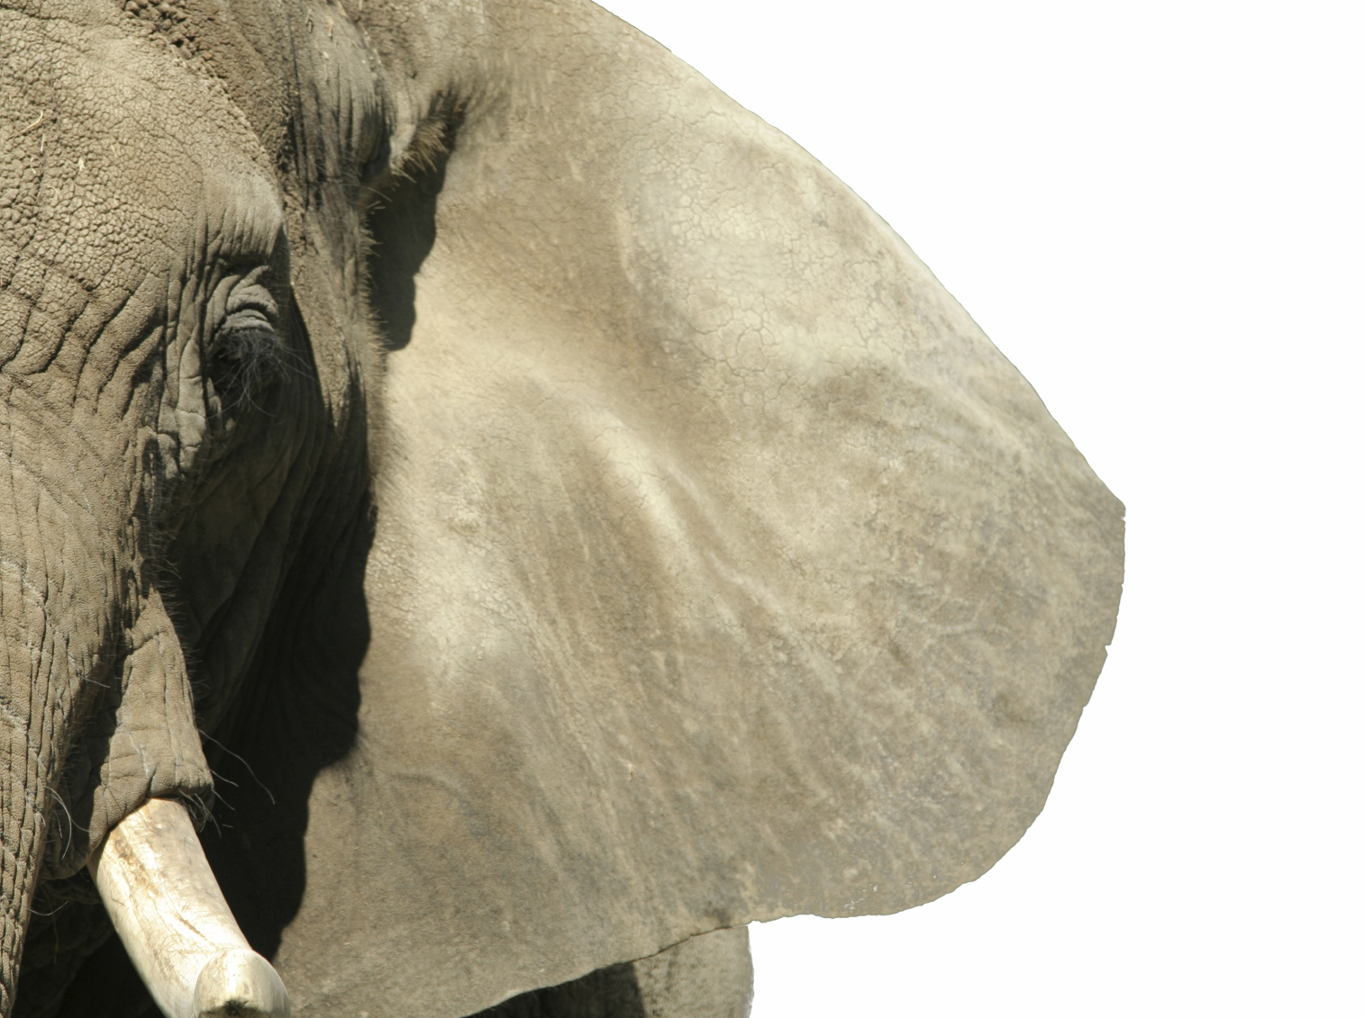
Social Media R.O.I.
ROI = (Profit – Investment)/Investment

Slide 47
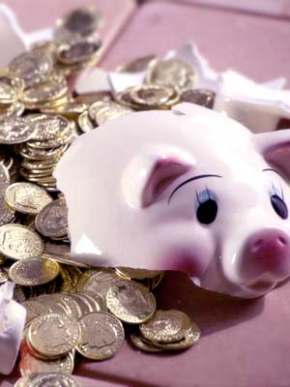
Mindjumpers community management / PR – The cost
X amount of DKK for staff cost
X amount for technical cost
Other: rent, equipment, subscriptions etc.

Slide 48


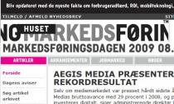




The Profit
PR & Marketing
From “did you mean mind dumpers?” to 1.1 million search results
+200 referral links to our blog (Alexa.com)
+3.800 followers on Twitter
+1.700 Fans on Facebook

Slide 49
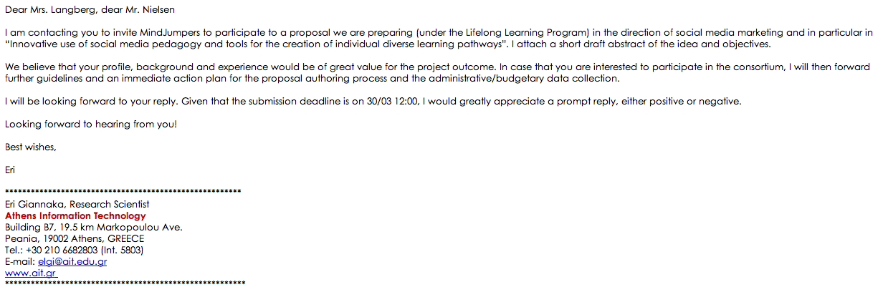
The Profit
Revenue
Using our community initiatives as validation towards new bizz
6 months later
A European project is signed off on DKK 500.000

Slide 50
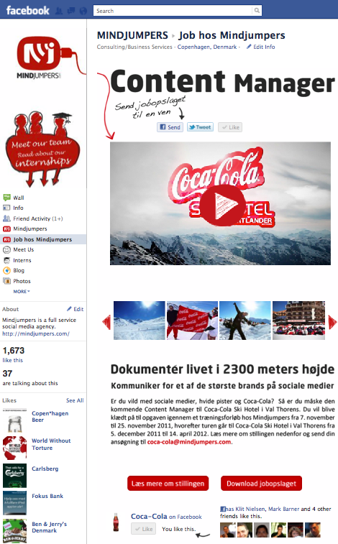


The Profit
Revenue

Slide 51
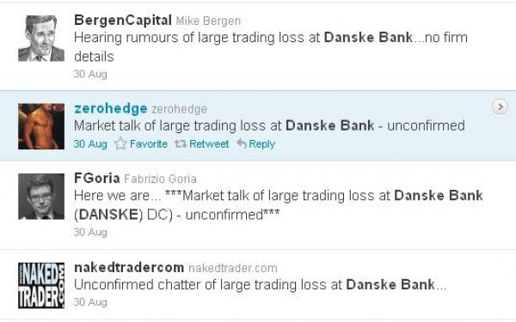
The Influencer

Slide 52

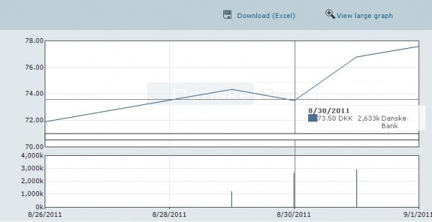

Slide 53
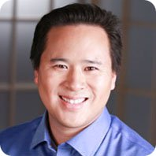

Building a Scalable Social Business Program
Jeremiah Owyang

Slide 54



Facebook.com/Mindjumpers
@Mindjumpers
Mindjumpers.com/blog
Mindjumpers
Just Write on our wall

Slide 55
Lene Dahlquist
Communication & public affairs manager, Ford Denmark

Slide 56
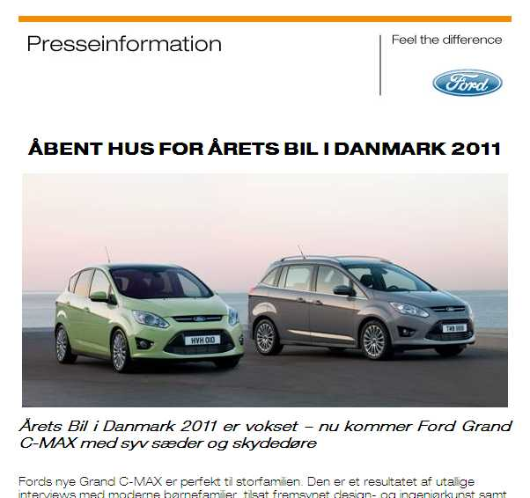
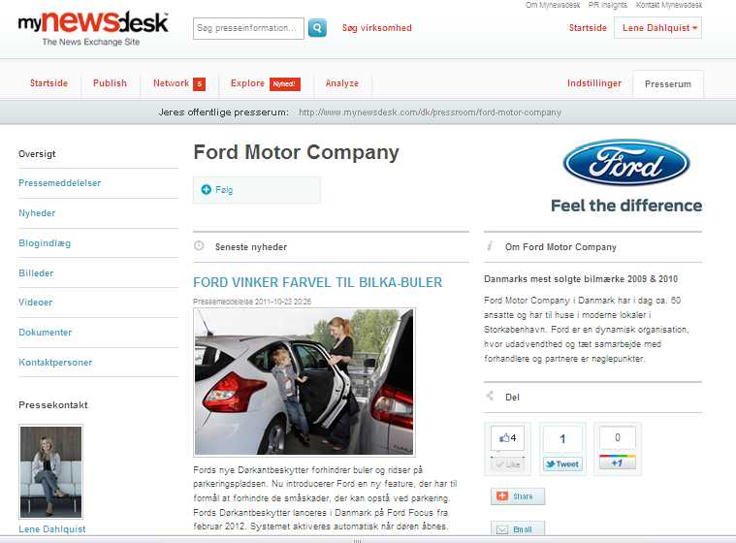
Fra traditionel PR til inkorporeret Search, Social og Network

Slide 57
Tidligere presseinformation via mail
Page 57
oktober 25, 2011

Slide 58
Fords nyhedsstrøm - før
God dækning i motormagasinerne/aviser
Udsendelse af presseinformationer og nyheder.
  Udsendelse af nyheder via mailingslister – ajourføring af lister
  Vedhæftning af fotos – udfordring ved Hi-Res fotos
  Udsending via andre eksterne bureauer – ikke integreret i Fords univers
  Ressourcekrævende – ajourføring, vedligeholdelse og opfølgning
  Ford.dk – vedligeholdelse og opdatering af hjemmeside
Page 58
oktober 25, 2011

Slide 59
Hvorfor Mynewsdesk?
Gennemtænkt løsning med muligheder for udvikling
  Enkelt at bruge
  SEO optimering
  Integreret i Fords univers
  Udvalg af muligheder, foto, video, netværk, invitationer, analyse
  God back-up funktion
  God kommunikation omkring forbedringer, fif og tricks

Slide 60
Ford på Mynewsdesk, opstart maj 2011
Page 60
oktober 25, 2011

Slide 61
Ford & medierne
Udvidelse af medielandskab fra Motor/dagblade til specialmagasiner, bloggere, netværk, livsstilsmagasiner, Facebook, nyhedsmedier.
Revurder medielister. Er dit materiale interessant, udbreder medierne dit budskab.
Klar, parat, start
  Information let tilgængelig, hurtigst muligt – ingen password!
  Samlet informationspakke - ekstra information, fotos, links
  Ingen spam – interessenter er mere værd
  Tilgængelighed - flere indgange; Mynewsdesk mail, web, Ford.dk, Facebook
Page 61
oktober 25, 2011

Slide 62
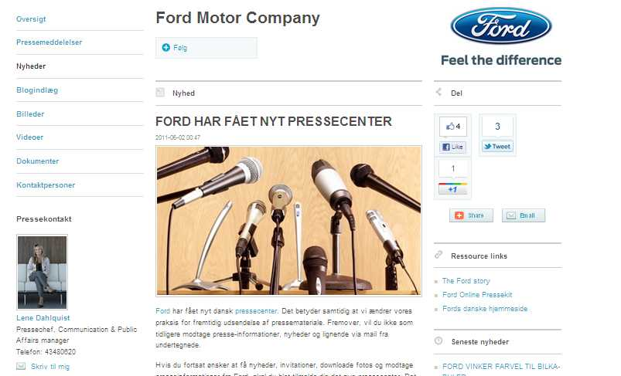
Nyhed om Ford pressecenter
Page 62
oktober 25, 2011

Slide 63
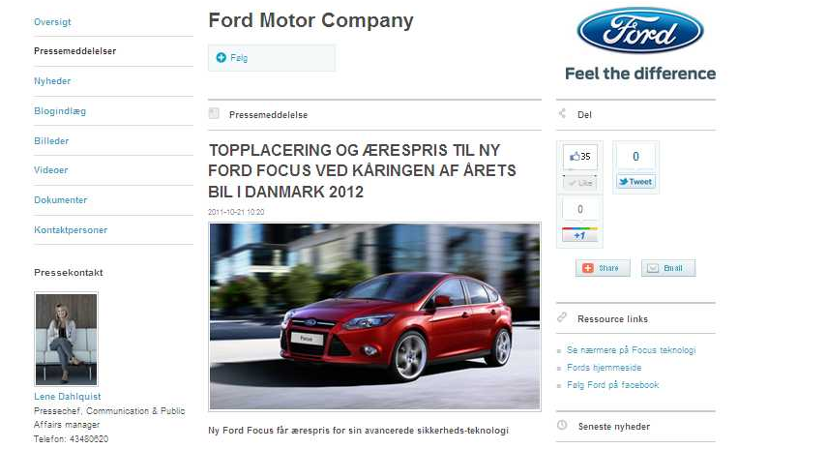
Eksempel på nyhed på Mynewsdesk
Page 63
oktober 25, 2011

Slide 64

Ford livsstilsnyhed på Mynewsdesk
Page 64
oktober 25, 2011

Slide 65

Analyse – what works?
Page 65
oktober 25, 2011

Slide 66

Analyse – fokus på fotos
Page 66
oktober 25, 2011

Slide 67

Integrering med Fords hjemmeside
Page 67
oktober 25, 2011

Slide 68

Integrering med Ford Facebook
Page 68
oktober 25, 2011

Slide 69

Presserum på Ford Facebook
Page 69
oktober 25, 2011

Slide 70
Fords nyhedsstrøm - Mynewsdesk
Forbedret dækning i motormagasiner/aviser
Kontakt til nye medier og kanaler
Udsendelse af presseinformationer og nyheder.
  MyNewsDesk er et let og effektivt stykke værktøj.
  Udsending via MyNewsDesk – alt materiale samlet i én mail
  Kontakt til nye medier, tv, nyheder, games, tænk, kvindemedier, bloggere og andre interessenter
  Netværksfunktion og invitationsmulighed
  Besparelse i tid og ressourcer. Fotos er tilgængelige i Hi-Res.
Page 70
oktober 25, 2011

Slide 71
Fords nyhedsstrøm - Mynewsdesk
Learnings
  Fri for opdatering af in-house databaser
  ingen spam af journalister
  God integrering i Fords andre universer – hjemmesid, Facebook
  God analyse funktion – klogere på hvad der virker, fokus på fotos og SEO
  Afsmitning på hjemmeside – stigende besøgstal
  DET TAGER ALTSÅ LÆNGERE TID!
  Stadig en besparelse hos Ford i tid og ressourcer – ex. Ingen foto-opfølgning
Page 71
oktober 25, 2011

Slide 72
… hos Ford er det kun begyndelsen - bare vent og se!
Notes:
72

Slide 73


Digital trends for PR & Marketing
Kristian Djurhuus,
Industry Manager,
Notes:
Clearly if everything accelerated the universe would be in peril (Force = Mass times Acceleration)
But actually technology is leading to accelerating change in consumer and business behaviour and its only going to continue
We believe that speed is the forgotten ‘killer app’, will be a competitive advantage to move faster in future
We’re just at the beginning of this transformation
When electricity first became available, big organisations had a ‘head of electricity’
Now electricity powers everything we do and makes us more productive. Digital will be the same but we’re at the start of that transition.
Story: Retail Store visit with CEO, in a minute he spots a dirty carpet needing cleaning, a checkout needs to open, a change in layout that could boost sales. It’s in his DNA. But online, in that same minute, we knew that 750 customers who wanted to buy would be frustrated and leave the site. That’s where we are – traditional business unchanged for generations, the new digital things are so new we don’t know how to judge or manage them well. So its important to get started.

Slide 74

Fast
Addressable
Social
Two-way
Notes:
Media has changed – it’s fragmented og hvis man skal prøve at sætte ord på hvad Internettet har betydet:
FAST – the pace of change is relentless and accelerating. Five years ago YT, FB, Twitter barely begun
ADDRESSABLE – can mass target individuals, bring together interest groups, has scale AND targetting
SOCIAL – people are publishers, it’s “a vomit of opinion” according to Salman Rushdie
TWO WAY – aside from the scale and pace, the internet is fundamentally different because it’s two way – consumers can talk back to business. In the past comms for business was about a few trade journalists and a big ad campaign. Now consumers are saying what the hell they like about the brand to each other, cutting you out of the conversation.
TRANSITION
Denne accellerede udvikling har vi oplevet på første parket I Google?

Slide 75























































3.6 mia
Søgninger på Google
globalt pr dag
>48 timer
Video uploaded på YouTube hvert minut
79%
Danskere bruger nettet dagligt / næsten dagligt
550K
Android telefoner aktiveres hver dag
Notes:
75
Der er I hvert fald ingen tviv om at vi oplever denne digitale revolution på første parket I Google, hvilket de her tal siger lidt om….
Google har 3.6 mia søgninger om dagen eller over 100 mia om måneden
Hvert minut uploades der over 48 timers video på Youtube, der ses 1000 vis af timer i minuttet
79 % af alle danskere er på nettet hver dag!
Der sælges 550.000 android baserede mobiltelefoner hver dag
Transition – Det er fair at sige at vi står midt en sand digital revolution – og uden at være ekspert på området vil jeg prøve at give mit bud på nogle af de vigtigste trends indenfor nyhedsmedierne

Slide 76


Notes:
Internettet har forandret den måde vi konsumerer nyheder på – I aviser er nyheder præsenteret I kontekst. “Rated” efter vigtighed …
Online nyheder er ofte læst isoleret – man følger et link fra Google, blog. Læser nyheden og forsvinder igen.
Snack vs. rigtigt måltid, impulsivt via mobiltelefonen
“atomic level of consumption” – hvordan bliver det så bygget op igen

Slide 77

Notes:
Mon ikke nyhedsorganisationer finder en måde at severe “nyhedsdiæt” som passer til vores individuelle behov? Nyheder vil blivere mere personificerede.
Morgenen: en two-liner overskrift vs en fuld artikel
Form: Billeder vs. Tekst.
Stedsbaserede: Ferie I Sverige…
Begyndelsen af disse skræddersyede nyheder

Slide 78

Notes:
For eksempel er Flipboard en IPAD APP som kombinerer links delt af dine venner på Facebook og Twitter med dine foretrukne nyhedsemner.
Magasin-agtigt med fotos
Sociale forbindelser som er med til at forme din personlige nyhedspakke

Slide 79

Algorithms will get better at predicting tastes
Notes:
Det er allerede muligt at træne algoritmer til at forudsige ting som du vil kunne lide udfra din hidtidige adfærd..
Med din tilladelse selvfølgelig
Det eksisterer såvidt jeg ved ikke for nyheder endnu – men tag Amazon som eksempel:

Slide 80

Kurer-Sreda
Notes:
Den digitale udvikling vil også gøre det muligt at gå ind I nye genrer og formater : Den lokale russiske avis I Berdsk m. 97K indbyggere ville gerne lave en version af NYT “1 in 8 million”
Reporterne brugte gratis software til at lave deres eget Multimedia show og derefter uploade dem til Youtube og avisen selv.

Slide 81

Adding a social layer
Notes:
Stadig I begyndelsen , men “mest delte” “mest læse” artikler er kendt for de fleste. Hvad hvis de mest delte artikler blev vist ift de cirkler af folk som er mest relevante for dig: Profession, location, livsstil?

Slide 82

Transformation in the way story ideas emerge
Notes:
En sidste ting er den diversitet I nyhedsdækningen som vi allerede ser på et medie som Wikipedia: Indenfor 24 t efter Mumbai terror angrebet var artiklen omkring dette ændret 360 gange af 70 forskellige mennesker – det siger noget om den kraft som den kollektive bevidsthed besidder. Og vi skal ikke langt tilbage I tid fra vi var vidne til dette…

Slide 83

Example: Iran, Rio, Egypt...
Notes:
Her tænker jeg selvfølgelig det opbrud vi har set I flere lande.

Slide 84

Insights
Notes:
Men lad os tage et skridt tilbage ind I Google…..

Slide 85



Real time insights
_{BE GREATER WITH DATA}
Notes:
Insights for search..

Slide 86



“eco friendly”
2005
2006
2007
2008
2009
2010
_{BE GREATER WITH DATA}
Real time insights
Notes:
It’s not just products, look at what people are telling you about characteristics they care about.
At the start of the credit crunch I went to a discussion with some FMCG marketeers about how consumer spend might change
Everyone in the room had a point of view but none had facts
I went to insights for search and showed that on eco-friendly, interest had indeed fallen in 2008 as budgets tightened
BUT interest was still higher than at any time prior to 2007
That would be worth knowing if you were considering product development and positioning, marketing and sales plans.

Slide 87


Slide 88


Google AdWords & PR
The “Obama Muslim” campaign countered incorrect information being disseminated online and offline about the candidate

Slide 89



The physical & digital shelf
Real time insights
_{BE GREATER WITH DATA}
Notes:
Another thing that real time information is changing is the dynamics of selling
The physical shelf has been understood for centuries. Brands spend a lot of time and a lot of money securing the right shelfspace vs competitors
Retailers know that the right planogram (shelf layout) will drive sales and margins
TRANSITION
But how much attention are they paying to the digital shelf?

Slide 90




Consumers make decisions before entering the store
The Zero
Moment of Truth
The First
Moment of Truth
Zero moment of truth
Notes:
P&G defined the First Moment of Truth as the vital seconds when the target shopper stands in front of the packet on the shelf
But now there’s a zero moment – that happens before the store
TRANSITION
How important is it to win the zero moment?

Slide 91

Trends
Notes:
INSIGHT IS USELESS UNLESS YOU USE IT – TO HAVE BETTER IDEAS
THE simplest example we could find of turning insight into ideas is from Converse. This links directly from insights for search into an innovative campaign, where all the tools needed have been around for years but nobody had had the idea.

Slide 92


speaker
voice
camera
sight
touch screen
feel
microphone
hearing
gps chip
localization
Notes:
Modern day swiss army knife: Iconic etc
Its amazing how quickly this technology has developed and has become intrinsic to our daily lives.
We use it for sending emails, as a flashlight in the dark, as a calulator, an alarm clock, scanning barr codes to compare prices as a spirit lvel for putting up shelves...........and also as a phone....alggedly the killer App for this mini ciomputer we have in our hands.
Evernet

Slide 93

1 in 3 searches on Mobile Phones have local intent
Source: mashable.com 2010
Notes:
Mobile: The big revolution in local
2010 – YEAR OF THE MOBILE
2010-2020 – DECADE OF THE MOBILE

Slide 94
Smartphones
Internet
TV
Radio
Antal brugere (Millioner)
Antal år

Slide 95

2011
smartphones sales outpace PC sales
2013
2015 2013
50% of Internet traffic will be from mobiles
32% 38%
of Danish mobile subscribers already have a smartphone
70% 90%
of all sold mobile phones in Denmark are smartphones
Source: IDC, 2011, TeliaSonera, Tele2, Telenor aug 2011, Gartner 2011

Slide 96


Smartphones
Eksempel fra Japan:
I soveværelset
Desktop trafik
TV-tid
Frokostpause
Pendler til arbejde
Mobil trafik
4:00
6:00
8:00
10:00
12:00
14:00
16:00
18:00
20:00
22:00
24:00
2:00
4:00
96
Source: Google INTERNAL
Notes:
96

Slide 97

Location
Notes:
Local: The Internet is local.
People want to search their neighborhood and town just as easily as they search the web. We receive tens of millions of local searches every day, and as more and more people search from their mobile phones that number is only going one way.
Think about what this means for businesses. It used to be a business' physical presence that mattered. Now virtual presence is as important as physical.
Big opportunity in vertical, specialist and local search / information / entertainment.

Slide 98

Location is at the heart of consumer search behavior
Notes:
I googles søgealgoritme arbejder vi hele tiden på at indarbejde så mange relevante faktorer som muligt deriblandt brugerens fysiske placering

Slide 99

60% of consumers are more likely to engage with an ad that is relevant to their location.
Source – TMP/Comscore, JiWire
Notes:
Det at kunne levere målrettet og nyttig marketing baseret på brugerens faktiske placering er et ekstremt lukrativt marked, hvilket de her tal siger lidt om.
60% of local searches result in purchases (TMP/Comscore)
ADD SOURCES

Slide 100


Slide 101

Social
Notes:
Social: Internettet er socialt, det er ikke kun et sted for research men hvor man socialiserer, kommunikerer og deler ting. Hver gang man har fundet en god håndværker eller en god bilig restaurant deler man det oftest på nettet. Omkring 20% af tweets refererer til et produkt eller et brand
The Internet is social. Not just a place for research, it’s a central hub for communicating & socializing, creating & sharing & now accounts for around 16% of worldwide online time- a category that didn’t exist 3 years ago!
The explosion of social networks though is just the Web catching up with life. The first thing you want to do when you hear something interesting or funny or something that has really annoyed you- is to share it with someone. That has always been the case—what's different is that the Web is now the place where all this sharing takes place.
Over 850 million people visit social networking sites.
Facebook recently overtook Google in the U.S in time spent online with 470 million users, half logging on every day.
Twitter has around 74m users but it’s growing at over a 1000% yr on yr & a stat I find most startling is that 20% of Tweets or roughly 83 messages per second (in Feb anyway) contain a reference to a product or brand. And it’s not just Hollywood Celebs, there are now over 42,000 followers for major Insurers on Twitter- how sad is that.
Brand values have to stand the test of time & you have to open a constant & permanent dialogue.
Release control. Let go, permission, listen don’t always get involved.
For online publishers and website masters this means social has to be part of every product experience
We need to continue to make it easy for people to discover information, to create information, and to share information with the different social groups in their lives.

Slide 102

Search is becoming more Social
90%
Of consumers online
trust recommendations from people they know
71%
Say reviews from family members or friends influence purchase decisions
Sources: Econsultancy July 2009,
Harris Interactive June 2010
102
Notes:
People trust the opinions of those they know, and research suggests that the vast majority of online consumers are no different.
Social networking has exploded: In the US, 75% of web users have a profile on a social networking site.
~800 million unique users of social networking (a 32% growth from last year)
Over 230 billion minutes spent on these sites (a 50% growth from last year)
The social web will be part of the fabric of the web. You won’t just go to a social networking site: your social graph will follow you around online and make everything you do better.

Slide 103


Introducing the +1 Button
Available on:
Google search results
Google search ads
3rd party sites
Notes:
Hvad er det så:
Recommendations designed for Google Search!
Recently, we announced the introduction of the +1 button. The +1 Button is a socially inspired endorsement gesture designed to allow users to endorse their favorite stuff, and for their contacts to see these recommendations at the moment they need it most…during a relevant search experience on Google.
Personalized annotations increase CTR on ads and organic search listings
Better Traffic
Search traffic is better qualified when the site has been recommended by a friend or contact
Available On
Google search results
Google search ads
3rd Party sites (coming soon)

Slide 104







Notes:
Hangouts (How you shrare)
The third pillar I talked about was how I share information with other people. And the number one way to share information is in person – human being’s like face to face sharing but it’s difficult right now since you don’t know if people are available to chat. Now with hangouts you can see that other people are hanging out and research shows that you’re more likely to join a hangout if you see that two of your friends are already hanging out – because you think they’re talking about you and if you join they can’t talk about you any longer.
And with one click of a button you can join the hangout. No software to download. You go into a green room to make sure you look so good. Then you can click join. Now my fashion friends know that I’m hanging out and they can join the hangout too to talk to me at any time.
There are some great features within hangouts that you can use, you can watch a youtube video or movie together as if you’re in the same living room watching tv together. You can push a button to talk over video or you can chat while watching the video together. You can also chat in the sidebar on the left “Love this show!”
We are amazed with what people are doing with hangouts. I’ll give you 3 examples:
Example #1 US politician, Newt Gingrich wanted to talk to his constituents and he starts hangouts regularly and allows anyone to join since he can make it public. You could imagine hosting focus groups with clients over hangouts for businesses.
A musician called Daria Musk live demos her new songs over hangouts.
Learn to cook over Google+ Hangouts with Lee Allison!

Slide 105

“Ultimately, video is where search was in 1999: a major part of the online ecosystem is still looking for a business model. But history repeats itself and without a doubt video streams will be monetized just as search queries were.
-TechCrunch
Notes:
105

Slide 106


Slide 107
Den journalistiske virkelighed
Tips & tricks til at bryde igennem barriererne
Mads Vad Kristensen
Digital direktør
Berlingske Media
Oktober 2011

Slide 108

Lidt indledende bemærkninger

Slide 109

Det handler om at komme på blokken og videre ud

Slide 110

ikke blive glemt i malstrømmen………

Slide 111

og få budskabet helt ud til den enkelte kunde.

Slide 112

Medier er stadig bedst til at skabe orden ud af kaos

Slide 113

Sådan ser rigtig meget PR ud i dag

Slide 114

Irrelevant og kedeligt

Slide 115

Hvordan ser den perfekte verden ud?

Slide 116

1. Skil jer ud – virkelig ud

Slide 117

2. Hav altid kunderne in mente

Slide 118

3. Gør det nemt at være journalist

Slide 119

4. Glem ”One Size Fits All”

Slide 120

5. Skuf ikke! Aldrig.

Slide 121
Tak for opmærksomheden!
http://berlingskemedia.dk
@vadnu
http://vadnu.com

