Slide 1
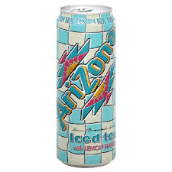
Nu i Burk!
Arizona Iced Tea Lemon
Art.nr: 10893
Storlek: 24x340ml
EAN: 7350076810052
Pris: 235,2kr/krt (9,80kr/st)
Arizona Iced Tea Raspberry
Art.nr: 10895
Storlek: 24x340ml
EAN: 7350076810045
Pris: 235,2kr/krt (9,80kr/st)

