Slide 1
HILL+KNOWLTON STRATEGIES
Nå ut til flere med engasjerende innhold

Slide 2
1. “Content Marketing” 2. The model
© Hill + Knowlton Strategies 2014

Slide 3
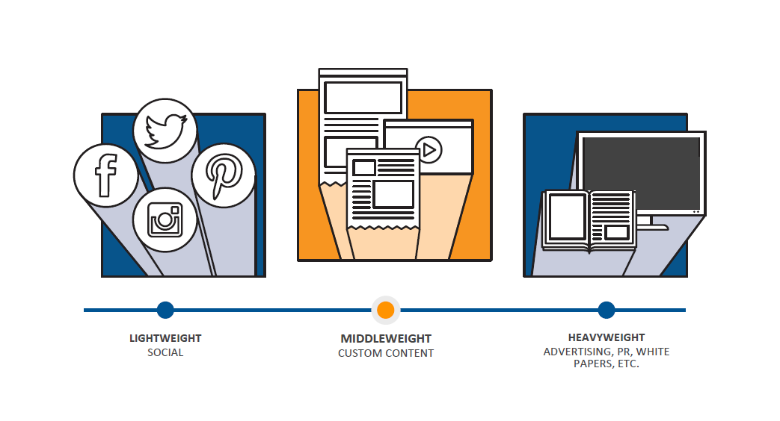

Slide 4
STORYTELLING: An ancient craft

Slide 6
PUTTING STORYTELLING AT THE CENTER OF COMMUNICATIONS

Slide 7
PUBLISHING
CONTENT
OWNED
EARNED
STORY ARCS
(Messaging)
H+K Storytelling Model
CREATIVE PLATFORM
(Campaign/Cause)
CENTRAL NARRATIVE
(Purpose)
SHARED
PAID

Slide 8
QUESTIONS?

