Slide 1

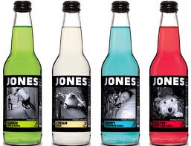
Jones Soda
Jones Orange & Cream Soda Jones Strawberry & Lime Soda
Art.nr: 10879 Art.nr: 10881*
EAN: 5019547000478 EAN: 5019547000034
Jones Green Apple Soda Jones Blue Bubblegum Soda
Art.nr: 10883* Art.nr: 10885
EAN: 5019547000010 EAN: 5019547000027
PRIS: 320kr/krt (13,33kr/st)
STORLEK: 24X330ml
* Innehåller azofärgämnen.

