Slide 1

The SOCIAL JOURNALIST
Presentation at Nordic Media Days 2011 by @charlotteulvros, @jonobean, @cjacobsson
Notes:
Great to be hear, joining me is Charlote Ulvuros – Carl Jacobsson
Channel One anecdote – We are hear to revolutionise the media industry
Mynewsdesk is not hear to revolutionise the media industry – we are simply hear to make more effective the exchange of information between you (the media) and your sources, companies and organisation
Before we start quick survey
-Who thinks here social media has improved the news gathering process
-Who thinks here that social media has confused the news gathering process
- Who here today would describe themselves as a social journalist
This is a quick clip

Slide 2

http://www.youtube.com/watch?v=Jc8TQppzORE&feature=youtu.be&hd=1

Slide 3
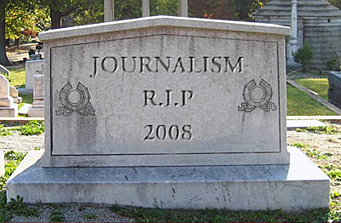
The concept of Social news
Notes:
When I think of the concept of social news I think about Jeff Jarvis
great book ”What would Google Do” – From Content Economy, to link Economy to Network Economy.
Around 2008 images like this started to appear with ceratain commentators predicting the end of journalism
Its true globally that official editorial staffs have shrunk but I would say that the social web offers the most exciting opportunities to be jounalism.
Mynewsdesk is the name of our company but I want you to think about your newsdesk. How big is it.
How many have a newsdesk of more than 10 people.
How many here have a newsdesk of more than 50 people
How many people have a newsdesk of more than 100 people.
However to be successful as a social jounlaist or social news organisation there needs to be a change of mindset.
Often do workshops with communicators and its the same case for the media
-Confidence - in the value that we deliver – not just see social media or online as a threat
-Control – need loosen the control that we have had and accept we are now part of the news, we are not making or dictating the news
- Faith – We need to put faith in the crowd or network that surrounds our content or online persona. Our stories will only be as strong as the network that surrounds them

Slide 4
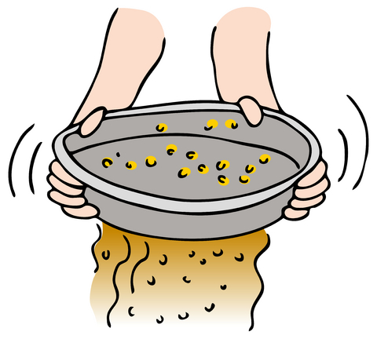
Sources vs. stories
Notes:
-We must not loose sight of our talents
-The social web merely provide the sources…what the social jounalist can do is provide the stories
-The story doesn’t start with us anymore – it starts in the crowd – we put context on that noise – and we throw it out to the crowd again
- Journalism has never been more important than it is today – our abilities to put context to multiple sources will only increase as the social web develops
-However our stories as ever will only be as strong as our sources and the pool of sources we have the ability to draw from is increasing daily.
-- What are you doing to build ypou network

Slide 5
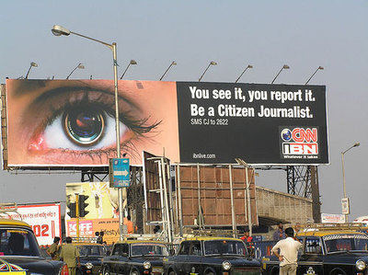
Anyone can be a journalist…can they?
Notes:
Lots has been written and spoken about citizen journalism and the question to be asked is can anyone be a journalist…I don’t think so.
But…anyone can be a source or a breaking news reporter
This came home to me during the (Japanese Tsunami)
-The news broke to me over Twiiter but I was directed immeadiately to a major media outlet
- What I was looking for was an organisation that I trusted that could put context on this explosion of noise on the social web
- As news organisations develop their networks on the social web, more and more commenatary and source material will be from those networks but the media on the social web that will thrive will be 1) the organisations that have those networks in place and 2) The ones that have the processess and journalistic talents to quickly put context and deeper analysis on all of the sources available on the web.

Slide 6
Some sources more important than others
Notes:
Recent piece of research done by Brunswick Reseach regarding news gathering trends using social media
Global research piece with over 1000 news organisations surveyed across US, UK , mainland europé
-Straw Poll
Twitter came out top across all markets – thats not strange
Most significant is that Google cam out down the bottom
What is value
Not just information
Engagement / currently you cannot engage via Google

Slide 7
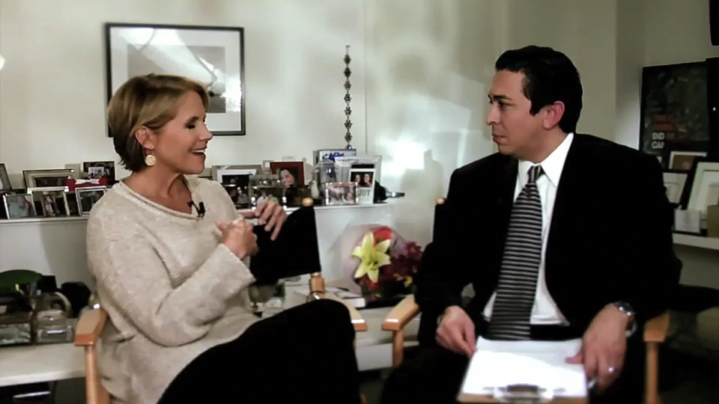
The Social journalist
Notes:
@katiecouric – webshow
Using the social web to work for you takes time – but will also give you great results. Not only will you be able to interact with you audience. Your stories will continue to develop as why social? – in med dump bilder
It used to be that when the story went live, that was the end. Now it’s the middle. The audience can comment, share, add or even change information.
The role of the social journalist is to “check out,” not just to “spread out” information.
Find sources
Spread your stories
Create dialogue
Build your brand
Be relevant
And you need to…

Slide 8
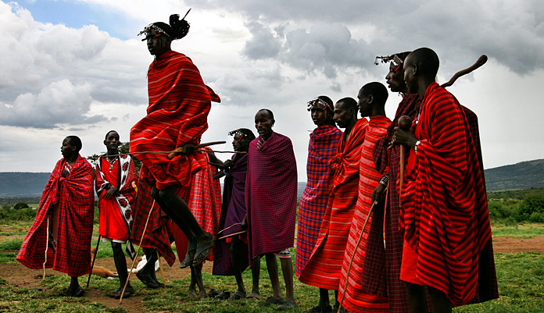
To succeed you need to build your tribe
Notes:
Tidigare broadcasting – the chages now – now
Beacuse your network have your stories, and they sharethem with you. Beacuse thet are your sorces!!!! They filter your stuff
To get the story first, you need to be in tune with existing and potential sources.
Ask yourself are you engaging with your readers, liseners, viewers?
You need to build your tribe before you need them
And who is your tribe – colleugues, friends, and also…

Slide 9


Notes:
Yes companies and organizations.
You need to build a network with the so much dreaded PR-communicator.
You have a need – you need a story – and they need to get one out = dependable relationship
So how do you do it?

Slide 10
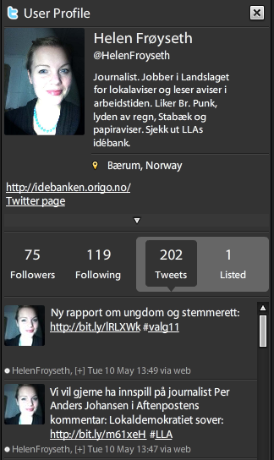
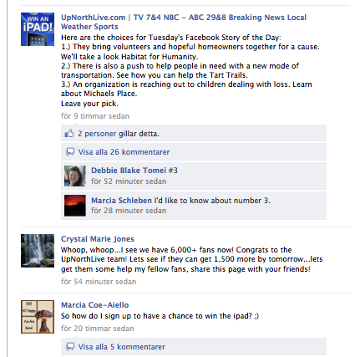
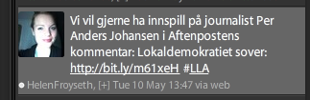
For tribal success – you need to engage!
Listen
Personable
Give to get
Invite people to converse
Collaborate/crowdsource
Story never ends
Share behind the scene
Ask your audience:
”Here’s what we know and what we don’t know. What do you know?”
Notes:
Listen
Focus on storytelling. A good story is a good story on Facebook.
2. Use the wisdom of the crowd in your reporting. It works.
3. Ask questions and invite people to join the conversation.
4. Share the behind-the-scenes process of your reporting (judiciously).
Ask for input on stories and collaboration at all stages
Story never starts, never ends – tap into your sources
Opens up news: transparent
A close relationship will give you an exlusive
Itäs ok to be opena nd ask q’s – you should colloborate
New social news – how do you take advanateg of this on social web with all sourcs . How do you get story before Twitter?

Slide 11
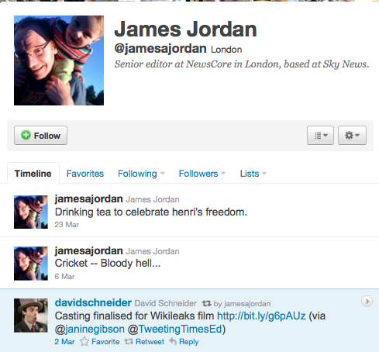
”Creating your own persona in the social web improves your and your organization’s newsgathering abilities. ”
James Jordan, senior news editor Newscore
Notes:
You also need to build a social persona and piut yourself out there.
This is true wehaterher you are a senior edito like James or a new journo.
Where? Linked in? Mynewsdesk, News Facebok pages etc. etc. It is onlt get the best tips - !

Slide 12
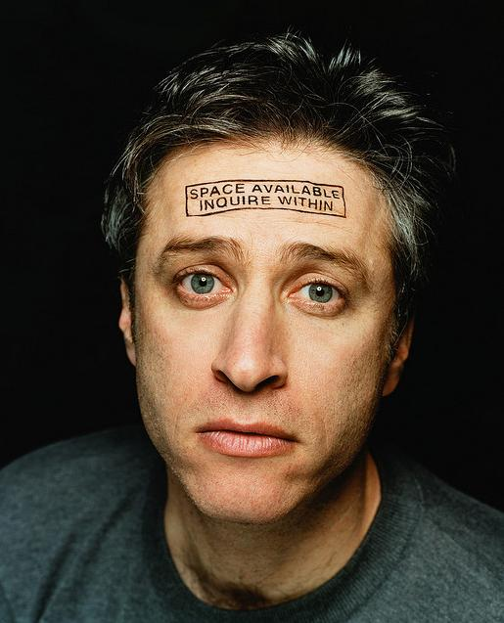
Your social persona
^{YOUR}
  Position
  Past work history
  Beat/ area of coverage
  Earlier work
  How to contact you
  Something personable
Photo courtesy of anonymityact1 via Flickr
Notes:
Need to be appraocheable – people need to like you. Your tribe is your friends. Who wants to be friend with someone without a person. But it’s up to you to decide how much friends you should be.

Slide 13
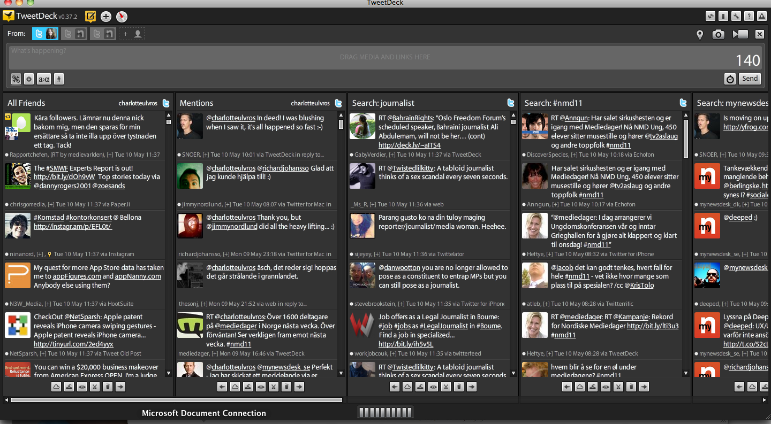
SOME Tips: how to find and filter social sources
Notes:
Story – JB
How Journalists Gather and Report the News Has Changed
Even excluding the dramatic nature of Hernandez’s video find, journalists are using social media to discover new stories and uncover sources.
When Anne McNamara, reporter for WGME in Portland, Maine, was reporting on local illegal dumping, she turned to her social media contacts for help and they provided sources and contacts for the story.
McNamara also finds that while phone calls often go unreturned, when she contacts someone on Facebook, they get back to her within 20 minutes… critical for impending deadlines.
McNamara also reports that Twitter and Facebook often help “localize” international stories. Using these popular social media platforms, she was able to find local people with ties to Japan who were waiting to hear from loved ones after the earthquake and tsunami hit. She only needed to post it to the Channel 13 Facebook page to elicit responses.
Hernandez suggests using Twitter for getting sources right away, and even tapping Foursquare as a way of finding eyewitnesses. If you find a source on Twitter, he says, they’re more likely to talk with you. But “just because they’re tweeting it doesn’t mean it’s real,” he warns.
When reporting a story, she often turns to memorial pages, like the type found on Facebook and MySpace. It’s an effective way of getting information on both the victims and the (alleged) perpetrators.
WRAL uses Twitter to tweet live from trials, even when cameras are not allowed in the courtroom.

Slide 14

SOME Tips: how to find social sources
Turn to your tribe
Ask questions/post status on Facebook
Use location-based services to find eye witnesses
Memorial pages, on Facebook and MySpace
Search Youtube for citizen-video
Twitter and Facebook “localize” international stories
Follow trending local topics on Twitter
Find sources directly by monitor lists of interesst – not just #-tags.
Notes:
You need to invite up to dance! Tirn to your crowrd beavsue their netowrk can help you.
Ask questions/post status updates on Facebook. Faster answers than phone. Critical for deadlines.
Use Foursquare or other location-based services to find eye witnesses or opinions from the crowd.
Use location-based services to find eye witnesses
Turn to memorial pages, on Facebook and MySpace
Search Youtube for uploaded video on ”your” subject.
Turn to your social media contacts (tribe) for help
Twitter and Facebook often help “localize” international stories.
Follow trending and local topics on Twitter
Find sources directly by monitor lists of interesst – not just #-tags.
Search Youtube for uploaded video on ”your” subject.
- effective way of getting information on the victims and the (alleged) perpetrators.

Slide 15
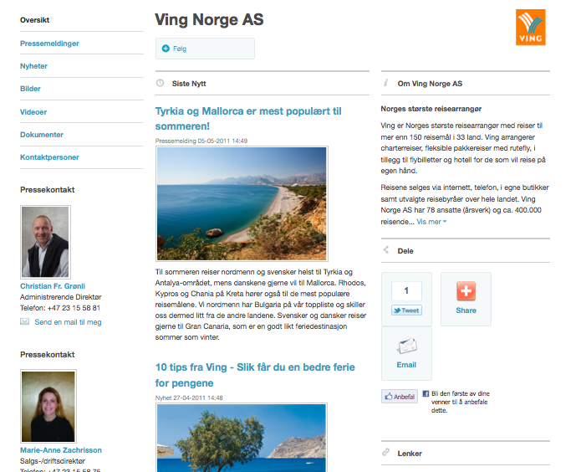
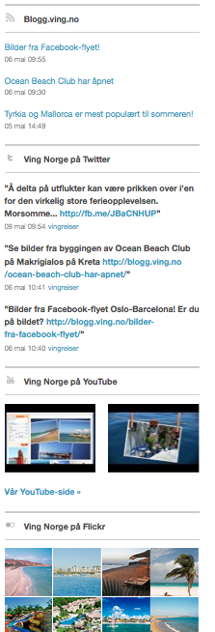
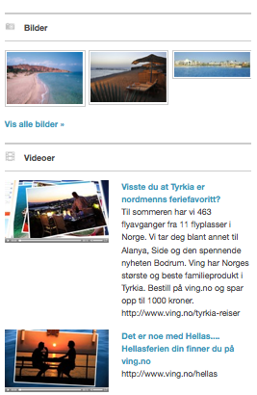
social media newsrooms
Notes:
Comapany generated news.
Social meda newsroom are growing inimportance on the social web- even the communicators are oalso opening up haviung people commenting on their releases etc-
Their side and their conversations side – see whole pictuer of company
Hih res photos

Slide 16
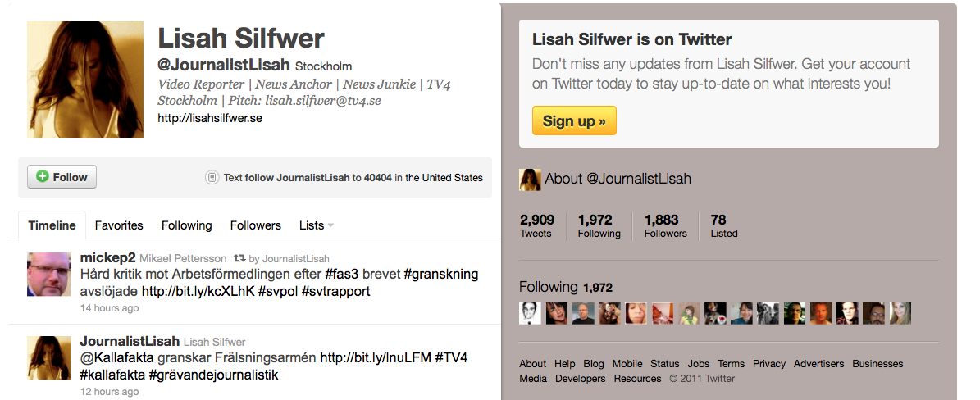
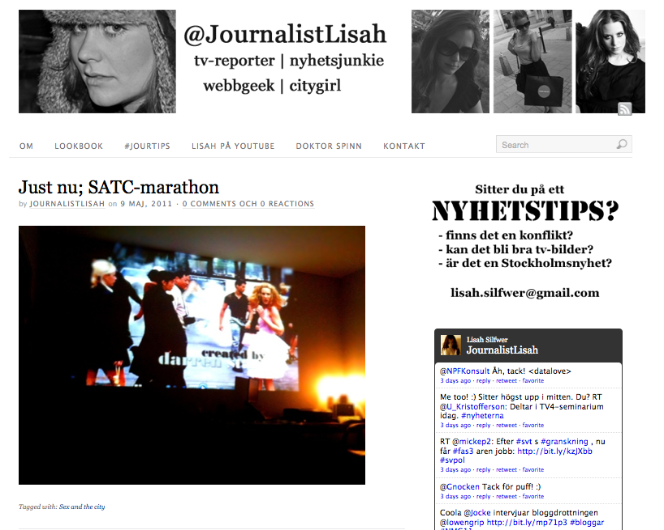
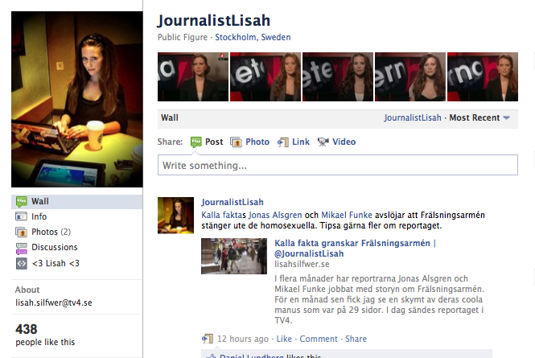
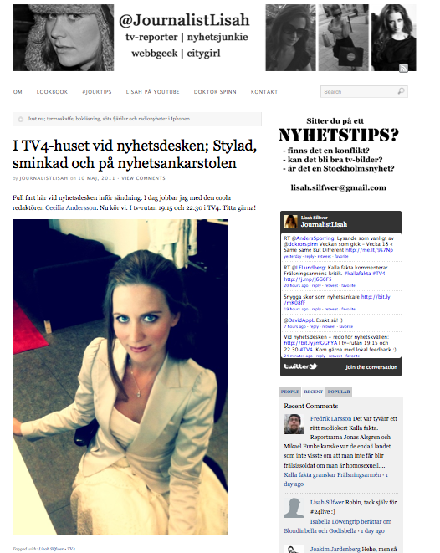
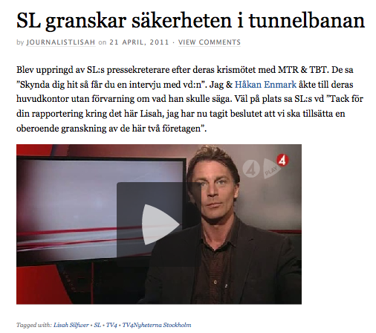
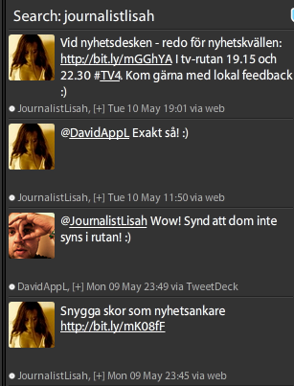
This is how YOU do it for real - persona
Notes:
Exist and create relations on different platforms –
Silfwer -
Twitter – almost 1900 followers and following about the same number. Short, quick, finding sources, talking to audience
Facebookpage -
And a blog – where she’s republish and share stories, feed her twitter and are occassionally more personal. And, of couse, ask for story ideas.

Slide 17




This is mynewsdesk
Mynewsdesk Norway opened in Oslo - spring of 2010
A part of Norwegian media group NHST since 2008
Also offices in Stockholm, Gothenberg, Malmo, Copenhagen, Helsinki, London and Singapore
1 million visitors per month
Over 23,000 sources distributed over 25, 000 content items per month
3,600 social media newsrooms hosted by Mynewsdesk
Notes:
We’ll come back to building your network in a minute. But first a brief presentation of us. Mynewsdesk, founded in Sweden 8 years ago, came to Norway in the spring of last year – with the aim to provide a news source service to journalists and bloggers. With Mynewsdesk a journalist can effectively create their own network of companies and build relations with representatives. It’s easy to create personalized news alerts and take control of the flood of information on the web. We’ve been a part of media group NHST since 2008 and (change slide)

