Slide 1
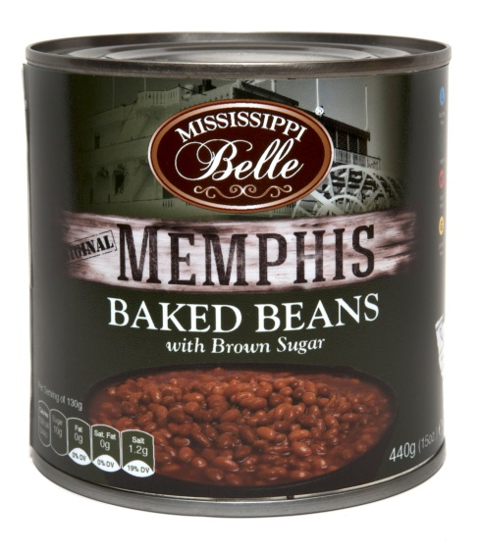
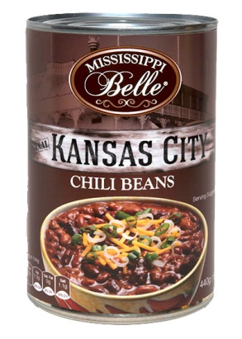
Nyhet-Mississippi BelleBönor
MB Vegetarian Chili Beans
art.nr: 10986
Storlek: 24x425g
EAN: 613668024907
Pris: 329 kr/krt (13,7kr/st)
MB Baked Beans with Brown Sugar
art.nr: 10985
Storlek: 12x425g
EAN: 613668024822
Pris: 249 kr/krt (20,75kr/st)

