Slide 1
How to get your stories out
@pingman

Slide 2
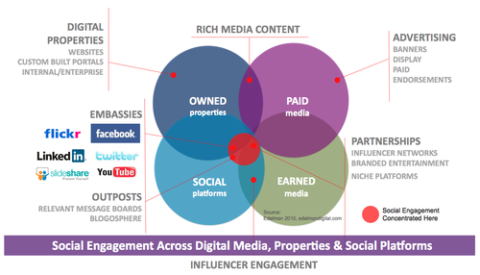
Content - Owned, Paid and Earned
Notes:
Explain the difference

Slide 3
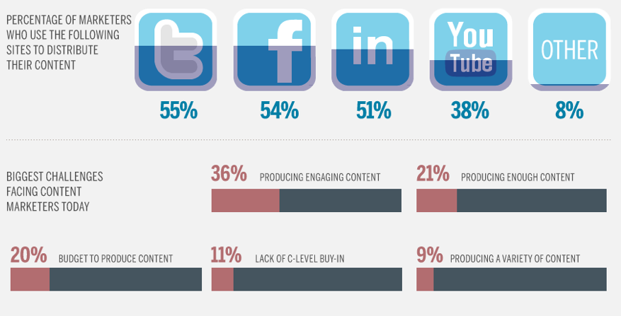
The Platforms and The Challenges
Source: www.market0.com, Junta42, Content marketing Institute and Marketing profs

Slide 4
Your brand could approach storytelling step-by-step – use the ecosystem well
Facebook
Youtube
Newsroom
Our ”Contenthub”
Notes:
Innan du blir social måste du veta vad du ska säga och varför Vår content hub: Content marketing! Detta kan tyckas självklart men är det inte! – sedan kanal Innehåll finns överallt.
Content key! Kan vara text, bild, film

Slide 5



Consistent and syncronized Storytelling on multiple channels will improve efficiency
ASK and REPLY to FAQ
Newsroom: Brand X
10 MILLION PEOPLE
50 MILLION PEOPLE
PUBLISH BLOG
490 MILLION PEOPLE
50 MILLION PEOPLE
600 MILLION PEOPLE
200 MILLION PEOPLE
Notes:
Push content to your existing contacts / influencers (e-mail)
Draw new contacts / influencers through effective SEO
Update your own newsroom on you website with our hosted newsroom
Publish to your own wordpress blogg
Publish and reach your 600m + Facebook users
Publish and reach 200m + Twitter users
Publish video and reach 490m + Youtube users
Publish presentations and reach 50m + Slideshare users
Publish photo’s and reach your portion of the 50m + Flickr users

Slide 6
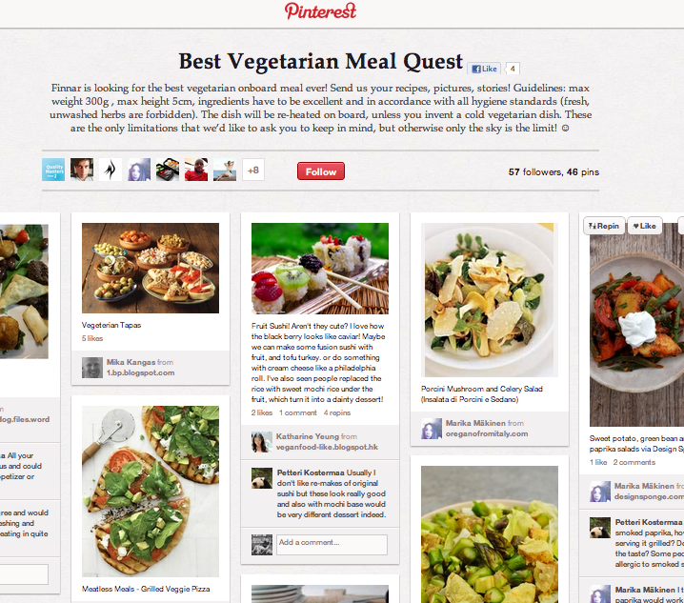
4 reasons why you should consider blogging
Blogging improves your storytelling AND communication skills
Sharing could mean offering something valuable to someone
Blogging helps you build corporate and personal credibility – thought leadership
Introduces you to interaction
See the FinnAir case:

Slide 7
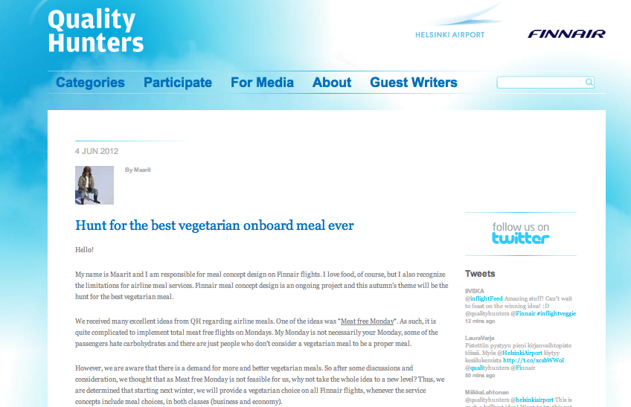

Slide 8
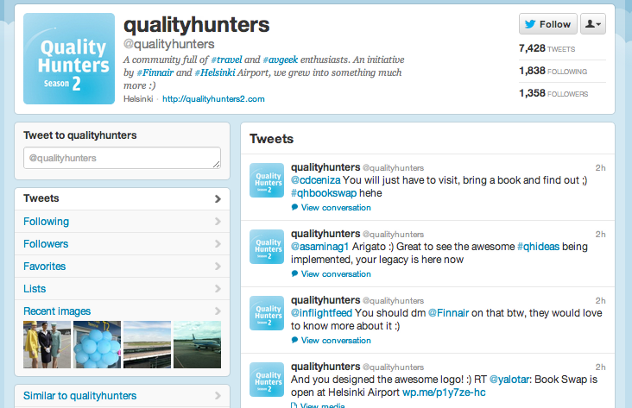

Slide 9
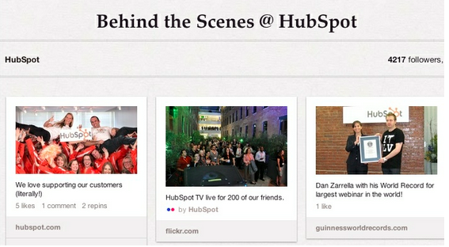
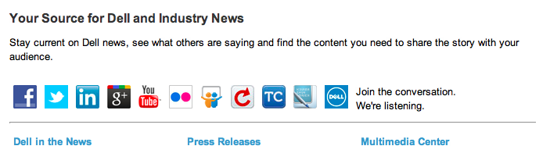
Involve the whole team to Communicate a good story

Slide 10
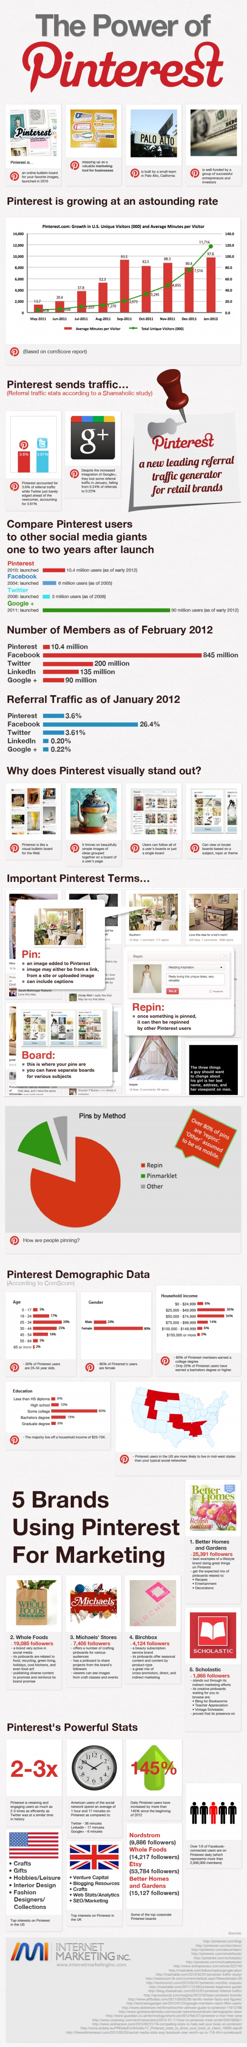
Pinterest moving fast
>still ”only” 10 million users but very high referral levels

Slide 11
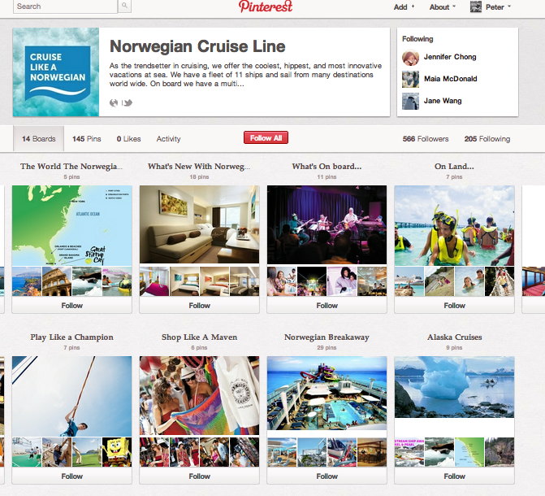

Slide 12
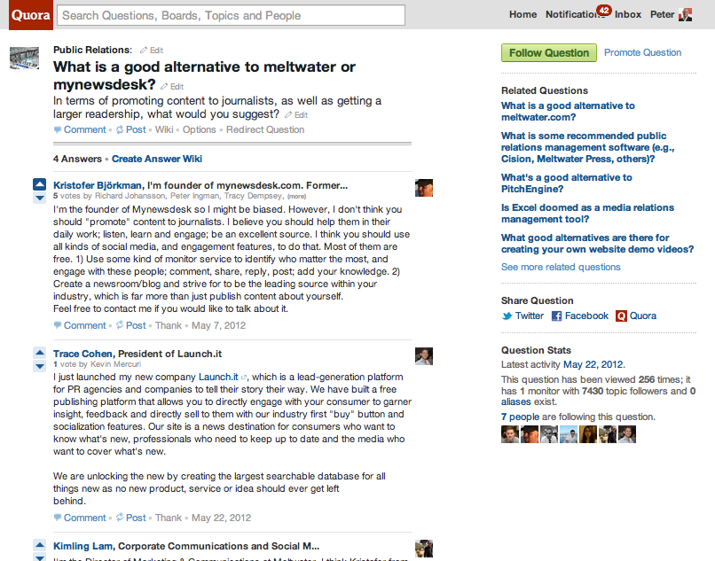
quora
Ask relevant questions and reply

Slide 13
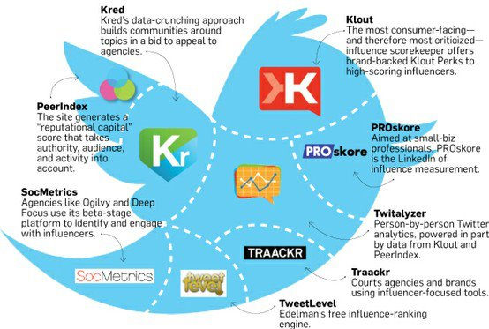
Who will relay a good story
Several interesting influencer index tools available”

Slide 14
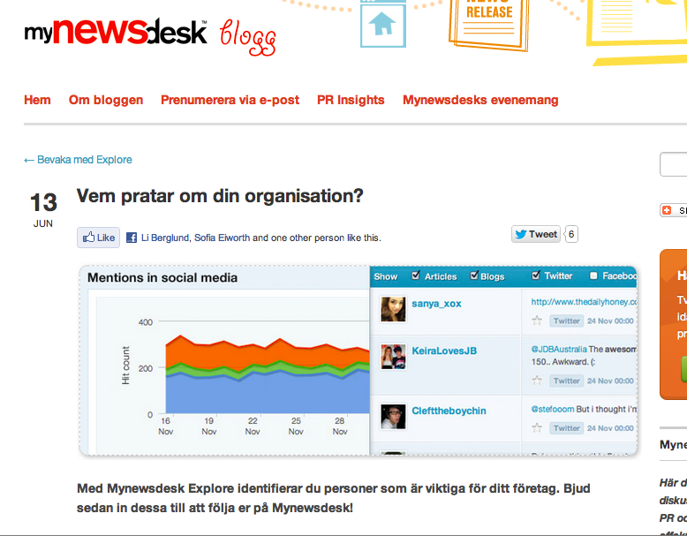
Your own corporate blog

Slide 15

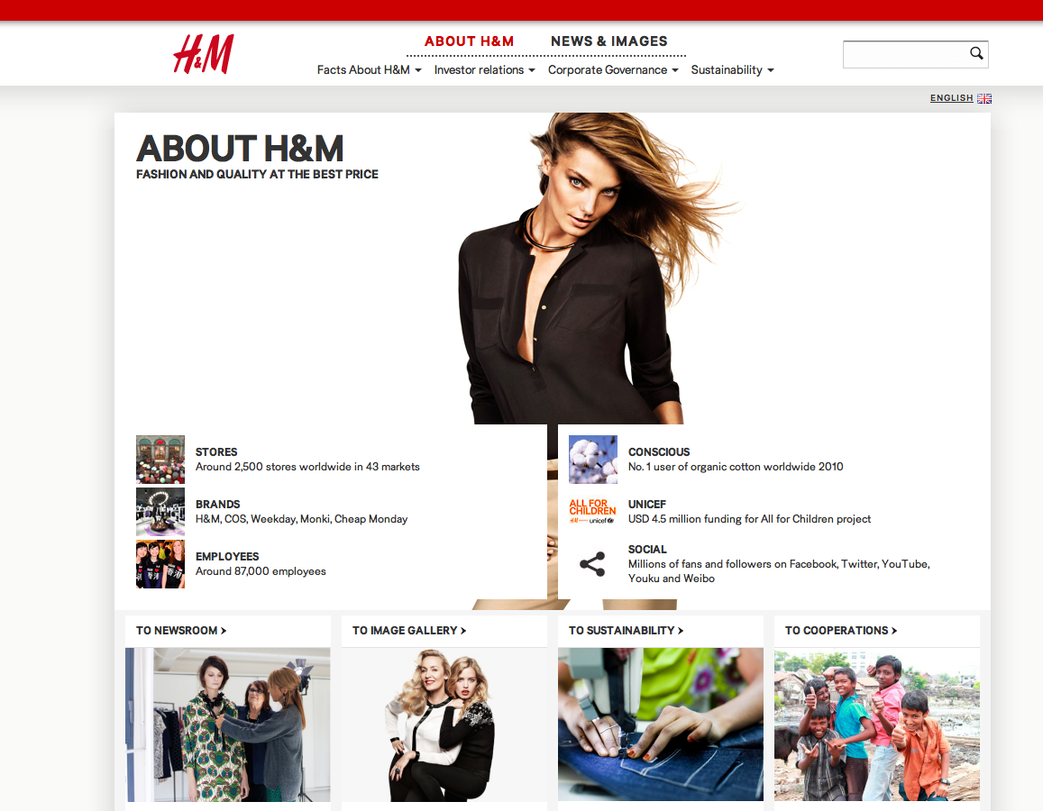

Slide 17
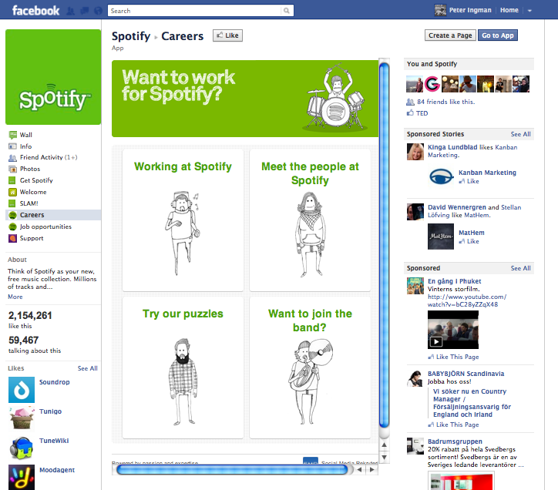

Slide 18
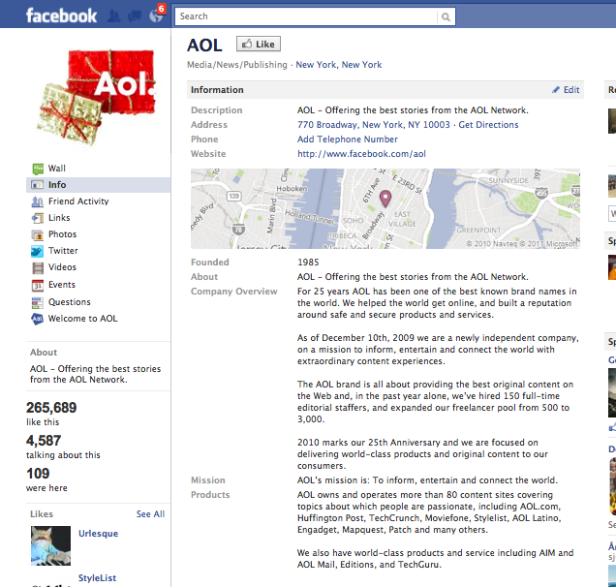

Slide 19
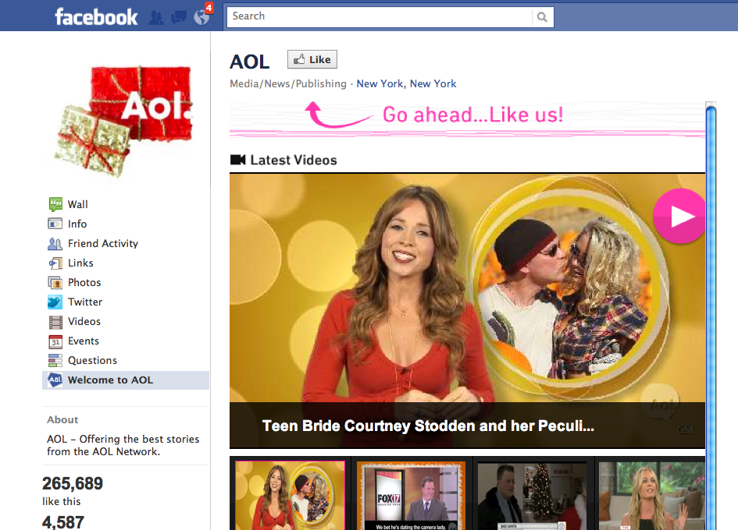

Slide 20
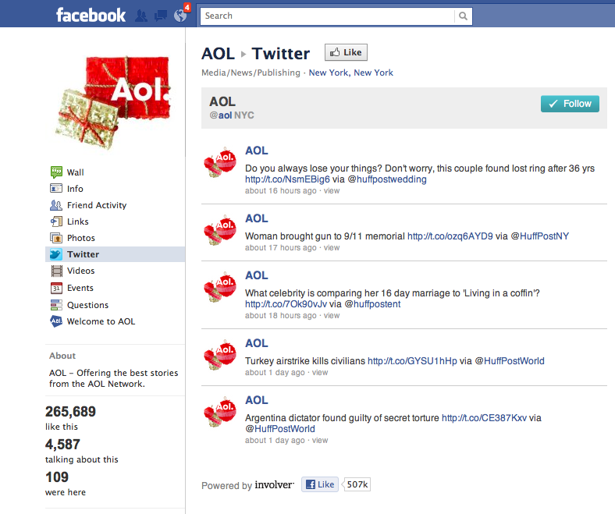

Slide 21
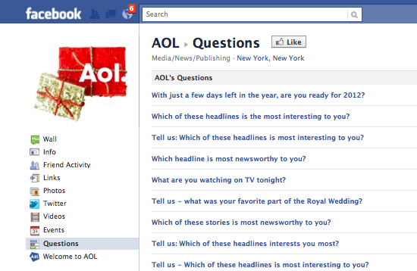

Slide 22
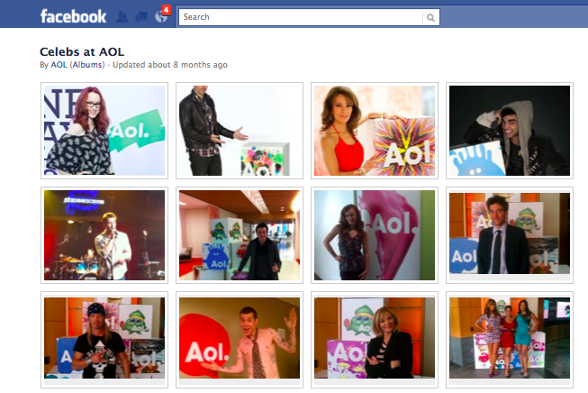

Slide 23
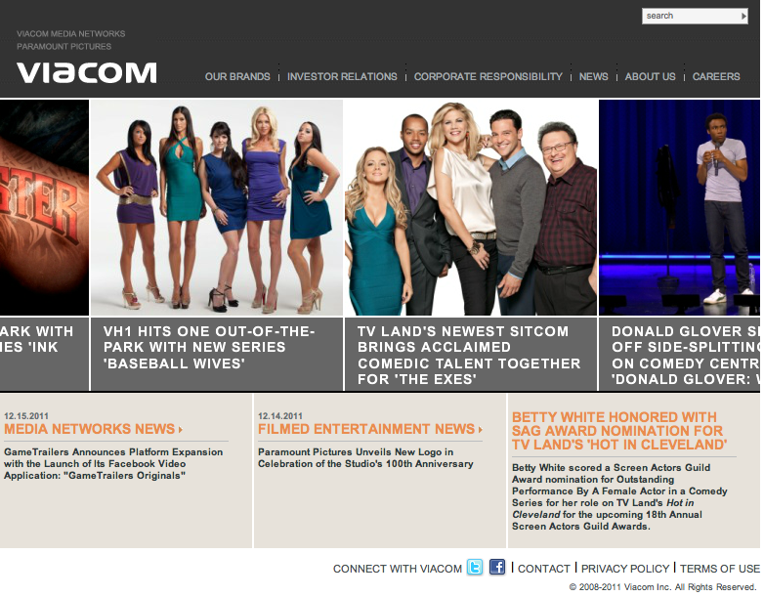

Slide 24
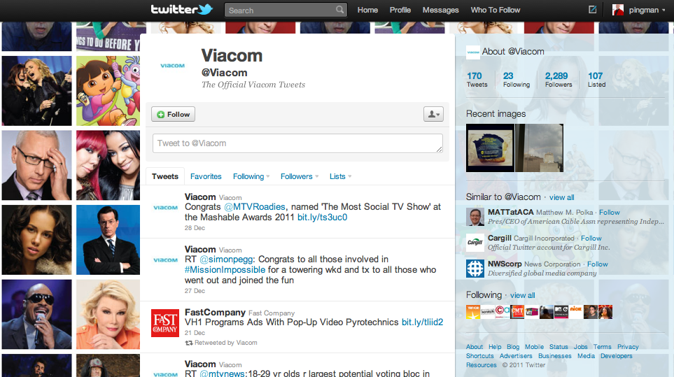
Twitter

Slide 25
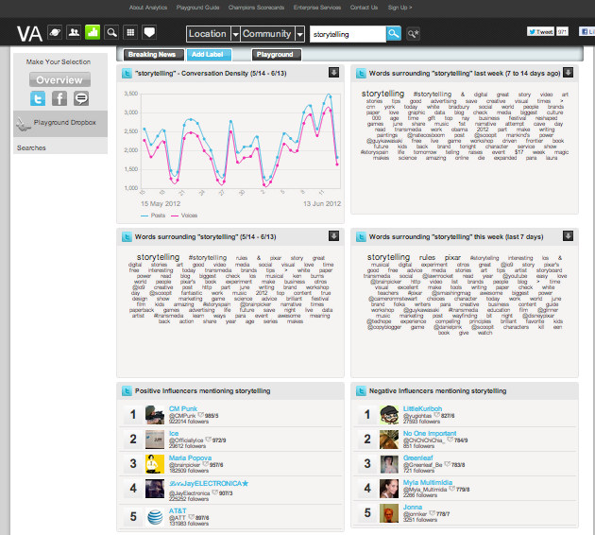
Analyze before and after publishing
See PeopleBrowsr

Slide 26
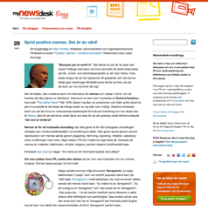
The twitter aproach - example
How?
1 Corporate account and x Personal account
1 tweet ”outgoing” a week enough
Responses always, within 60 minutes
KPI – Key Performance Indicators
Number of mentions/comments/tweets
Sentiment
Amplification (republished links/inlinks and shares)
Number of acquired followers.

Slide 27
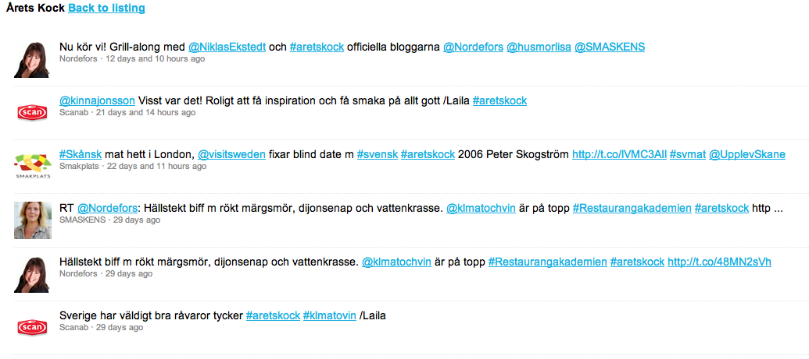
Hashtag #”storytelling”
A hashtag is open and profoundly democratic. People gather around a hashtag. They salute it and spread it or ignore it and let it wither. By Jeff Jarvis
#blamethemuslims, with Norwegian origin

Slide 28
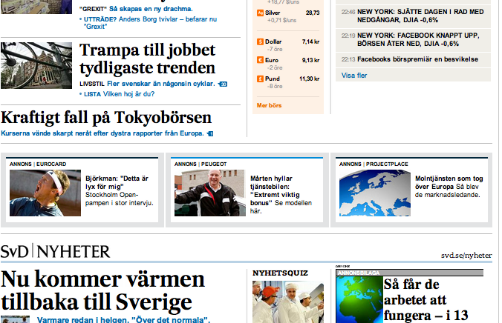
Microsites in editorial context

Slide 29

Storytelling (content) outsourced to professionals

Slide 30
Resources
Content
  JeffBullas.com
  Mashable.com
  Ragan.com
http://www.slideshare.net/Altimeter/the-rise-of-digital-influence
Tools
  Manage your Events – www.eventbrite.com
  Do your own Surveys – www.surveymonkey.com
  Stats Webusage – www.alexa.com
  Manage your projects – www.projectplace.com
  Making your own animated video – www.xtranormal.com
  Easy screencasting – www.telestream.net (Screenflow)
More valuable tools if you follow Adam: http://www.paratuscommunications.com/index.php/tag/platform-five/
Sites & Networks
  New cool Search site – www.duckduckgo.com
  Pioneering newsaggregator – www.squidoo.com
  Microblogging – www.tumblr.com
  Curation – www.scoop.it

Slide 31
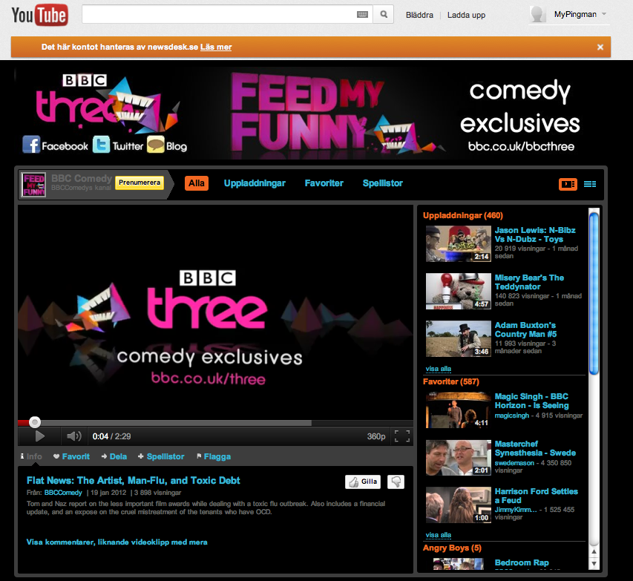

Slide 32
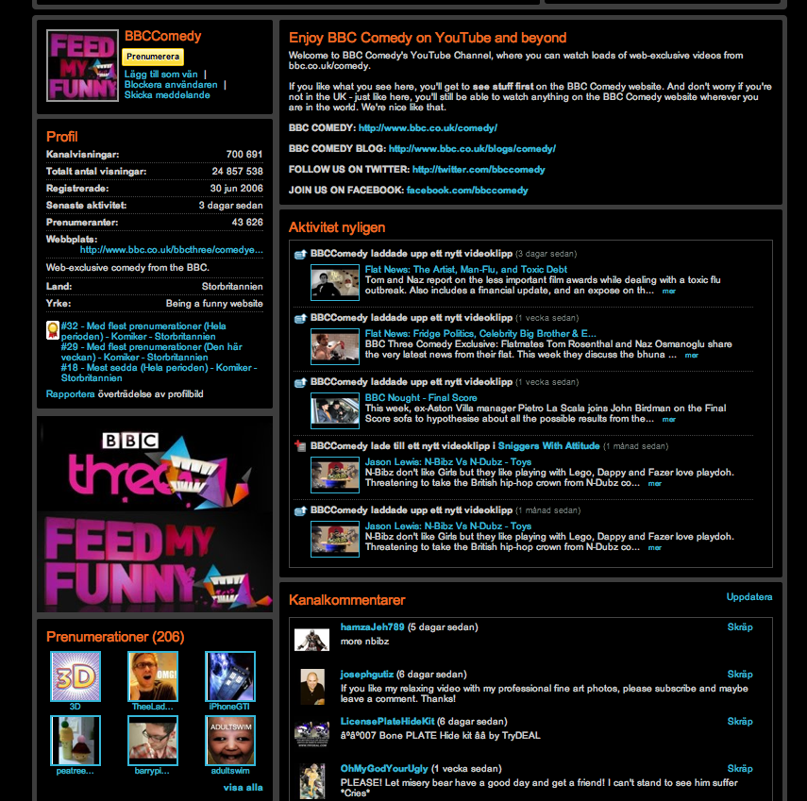

Slide 33
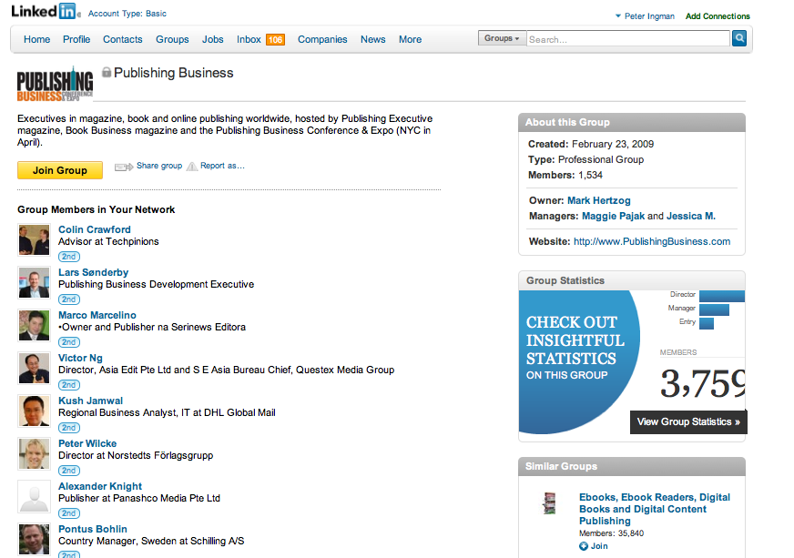

Slide 34
Summary
“The responsibility is yours to create a dedicated tribe that supports, shares, and responds to your professional and personal interaction in both the statussphere (influencers) and throughout the predefined channels we’ve established to steer experiences. It’s the only way to build a valuable and portable community around you and what you represent.”

Slide 35
